Slide 1
Exploring Extreme Programming in Context: An Industrial Case Study
Ziyu Zhang
Notes:
Hey everyone, I am Ronian. Today, I am going to present a paper named “Exploring Extreme Programming in Context: An Industrial Case Study”.

Slide 2
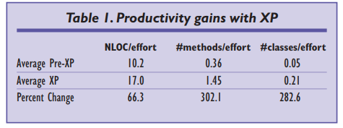
Backgroud -- extreme programming
for rapid development of web-based applicatins
aims to increase a software organization’s responsiveness while decreasing development overhead
works bestfor small teams of 5 to 15 developers
concentrates on producing executable code and automated test drivers
replaces paperbased documentation with face-to-face communication
Notes:
First, some basics about extreme programming:
1. xp is for rapid development of web-based applicatins
2. xp aims to increase a software organization’s responsiveness while decreasing development overhead
3. xp works bestfor small teams of 5 to 15 developers
4. xp concentrates on producing executable code and automated test drivers
5. xpreplaces paperbased documentation with face-to-face communication
Table 1 shows productivity gains between 66.3 percent and 302.1 percent based on hard metrics.

Slide 3
Backgroud -- 12 xp related practices (1)
Customer Satisfaction
  On-site customer.
    When issues arise, programmers can get customer input immediately rather than speculate on customer preferences
  Small releases.
    deal with changing requirements and reduces the impact of planning errors
Notes:
XP proposes a set of software development practices to increase productivity while maintaining quality. the 12 practices according to three key areas: customer satisfaction, software quality, and development process organization.
To raise Customer Satisfaction, xp tries to “get the requirements right” before the software is designed, and uses short cycles reduce customer risk.

Slide 4
Backgroud -- 12 xp related practices (2)
Software Quality
  Metaphor.
    a coherent view of the system
  Testing.
    programmers write unit tests before they write actual code
  Simple design.
    focus on solving today’s problems rather than future changes
  Refactoring
    ensures the existing structure is the simplest to run all the tests
  Pair programming.
    two people working at one machine, switches roles frequently
Notes:
Metaphor represents a coherent view of the system that makes sense to both the business and technical sides and represents “what we are trying to do.”
Tests verify that the program does what it is supposed to do.
Keeping the software design as simple as possible improves a team’s ability to work productively
it is nessary to change the code’s structure to improve its understandability and maintainability
Using Pair programming, it takes only approximately 15 percent more effort , but increases both software quality and programmers’ job satisfaction.

Slide 5
Backgroud -- 12 xp related practices (3)
Project Management
  The planning game.
    balance customer interests with the expertise of the development team
  Sustainable development.
    keep product quality
  Collective ownership.
    team members collectively own the code base
  Coding standards.
    improves consistency among team members
  Continuous integration.
    at least once a day
Notes:
The team estimates task effort, while the customer picks the tasks for the next iteration.
Work under reasonable amount of time to keep product quality
Anyone who can add value to any portion of the code at any time.
A coding standard makes the code easier to understand and
improves consistency among team members.
dedicate a machine, letting pair programmers take turns integrating and testing their code

Slide 6
Case Study -- Sabre Airline Solutions
two releases of the same product
  One release was completed just prior to the team’s adoption of the XP methodology (traditional, waterfall-based software process).
  The other was completed after approximately two years of XP use.
Comparison
  50% increase in productivity
  65% improvement in pre-release quality
  35% improvement in post-release quality
Notes:
In this case study, the author compared two releases of the same product.
One release was completed just prior to the team’s adoption of the XP methodology (traditional, waterfall-based software process). The other was completed after approximately two years of XP use.

Slide 7
Case Study -- Goals
examined five null hypotheses regarding XP’s effectiveness:
H1: pre-release quality (as measured by defects found before product release)
H2: post-release quality (as measured by defects found by the customer after release)
H3: programmer productivity (as measured by both user stories and lines of code per person-month)
H4: customer satisfaction (measured via interview and customer feedback)
H5: team morale (assessed via a survey)
Notes:
The goal of the case study is to examined five null hypotheses regarding XP’s effectiveness:
H1: pre-release quality (as measured by defects found before product release)
H2: post-release quality (as measured by defects found by the customer after release)
H3: programmer productivity (as measured by both user stories and lines of code per person-month)
H4: customer satisfaction (measured via interview and customer feedback)
H5: team morale (assessed via a survey)

Slide 8
Case Study -- Evalutation Framework
The XP-EF is composed of three parts: XP Context Factors (XP-cf); XP Adherence Metrics (XP-am); and XP Outcome Measures (XP-om):
Context Factors: team size, project size, criticality, and staff experience.
Adherence Metrics: express concretely and comparatively the extent to which a team utilizes the XP practices.
Outcome Measures: enable one to assess the business-related results (productivity, quality, etc.).
Notes:
context factors can help explain differences in the results of applying the methodology
The researchers were not present for the old release, and the team was not aware that any research would be done on their product or on their documentation. Consequently, some in-process XPEF metrics were not available.
Six of the teams ten fulltime members were interviewed during the new release. The interviews were semi-structured, and each interviewee was asked the same set of questions.

Slide 9
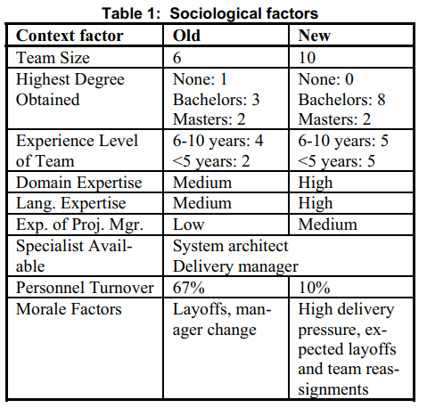
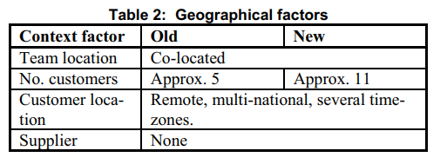
Context factors (1)
Software classification: funded both internally and by customer contribution
Sociological factors: team size 6 -> 10
Geographical: 2 times of users
Notes:
customer suggestions are integrated into the product, we classify this project as commercial software
increased usage of the product as well as the generation of a higher number of requirements.

Slide 10
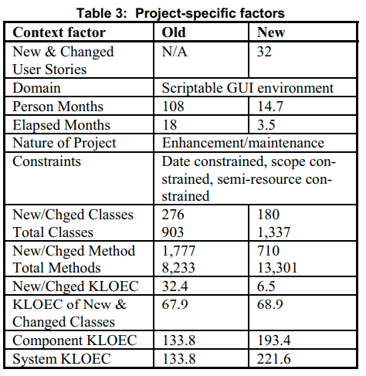
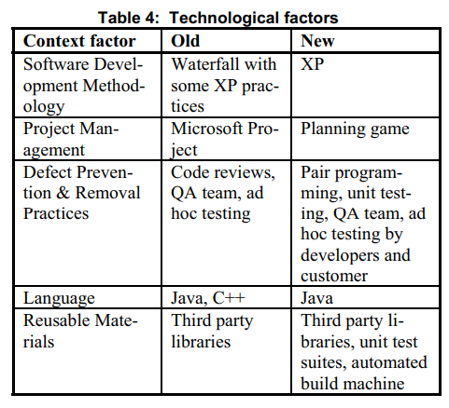
Context factors (2)
Project-specific factors: The size of the new and changed classes are similar
Technological: Microsoft Project -> reorder in Microsoft Excel
Notes:
The size of the new and changed classes are similar for each release, though many
more functions and classes were altered in the old release.
A code review policy was in place during the old release, but it was not strictly enforced. Pair programming took the place of code reviews in the new release.
Customer tests were also integrated into the new release.

Slide 11
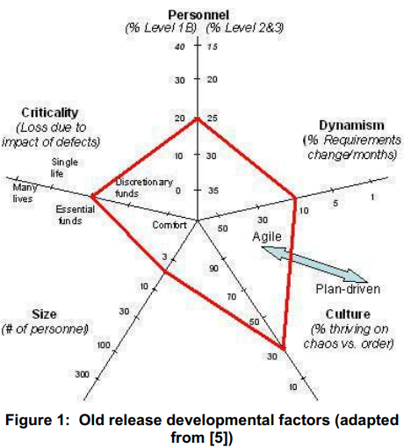
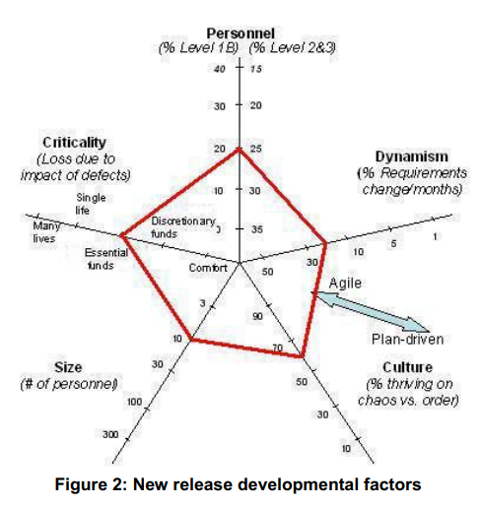
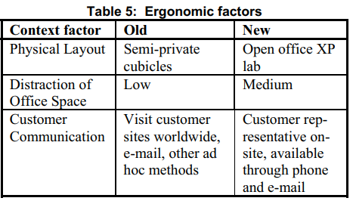
Context factors (3)
Ergonomic: large whiteboard was available, and printouts of iteration plans
      developers frequently visited customer sites -> on-site (1/2 of time)
Developmental: The personnel factor, which pertains to skill level remained same.
Notes:
in the old release the team sat in semi-private cubicles, most of which were
along the same hallway. In the new release, the team sat in an open office environment with furniture and pair programming stations arranged by the developers.
In the old release, the product delivery team and the lead developers were responsible for customer communication.
In the new release, a representative from Sabre’s product marketing department served as the XP customer.

Slide 12
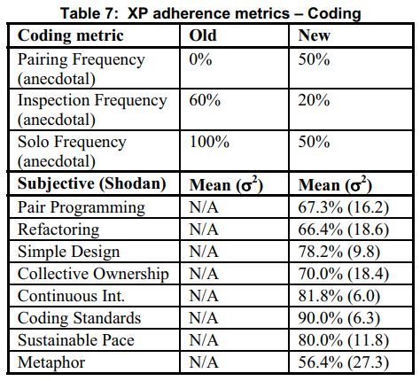
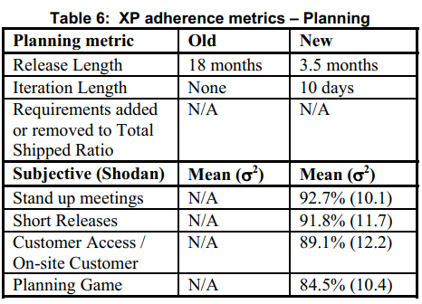
Adherence metrics (1)
These metrics also provide insight into whether a team has adopted XP’s core values.
Planning: inaccurate task schedules -> less anxiety about future tasks
Coding: team paired approximately half the time
Notes:
According to team members, the daily stand-up meetings were a valuable asset for problem resolution and team communication. Team members also stated that the
short iterations were helpful and allowed them to create more accurate estimates.
Almost all interviewees disliked mandated pairing and saw no value in pairing on trivial tasks. However, everyone agreed that it was a valuable process for solving problems and overcoming technical difficulties.

Slide 13
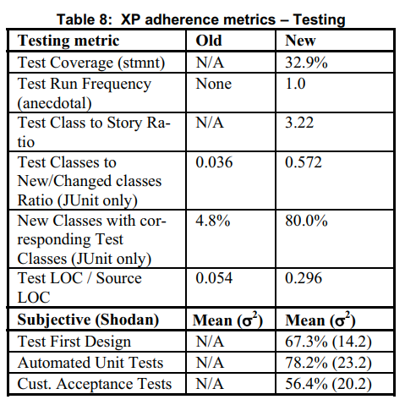
Adherence metrics (2)
Testing: adopt automated unit testing.
Notes:
automated tests were difficult to write for some GUI components because of limitations in available unit testing technology

Slide 14
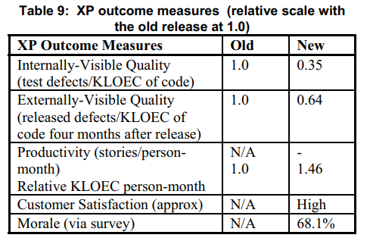
Outcome Measures
internal defects: improved by 65% (pre-release quality)
internal defects: improved by 36% (post-release quality)
Productivity: improved by 46%
Customer satisfaction: more satisfied with the resulting project
Morale: can’t measure
Notes:
18 months of continuous internal testing, while the new release was internally tested for only 3.5 months.
The team’s defect rates were well-below industry averages in both the old and the new releases.

Slide 15
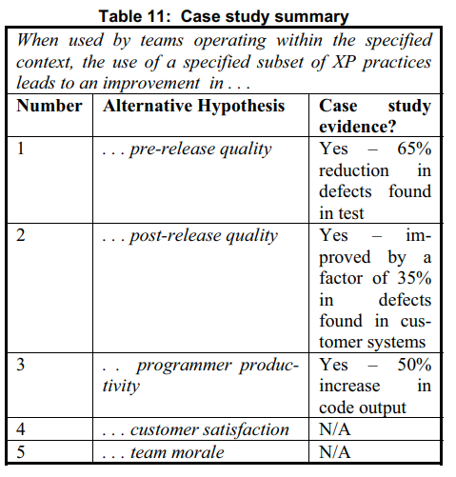
Summary
Result is based on one case study in one particular context, cannot conclusively accept or reject the hypotheses.
Notes:
In summary, the results can be used to build up the weight of evidence about XP: the adoption of XP practices can
improve programmer productivity and can improve product quality.

Slide 16
Strength and Limitations
the case study does not provide any insight into extending the range of applicability of XP beyond small, co-located teams.
reduce internal validity concerns: the same software project with a team comprised largely of the same personnel.
The amount of new and changed LOEC in the new release was approximately one-fifth the size of the old release -> less complex.
the system size increased 65% between the old and new releases, and overall system cyclomatic complexity increased by 20%
Notes:
Here is the strength and limitations of the paper:
The case study only shows the case where xp is applied to small, co-related teams,
However in this way, it also reduces internal validity concerns, as the same software project with a team comprised largely of the same personnel.
Even though the amount of new and changed LOEC in the new release was approximately 1/5 the size of the old release, the system size increased 65% between the old and new releases, and overall system cyclomatic complexity increased by 20%.
Furthermore, the amount of test code written in the new release was not included in effort calculations or total system size. Therefore, productivity and effort results in the new release may be underestimated.

Slide 17
Reference
P. Abrahamsson, "Extreme Programming: First Results from a Controlled Case Study," in 29th EUROMICRO Conference. Belek, Turkey: IEEE, 2003.
K. Beck, Extreme Programming Explained: Embrace Change, Addison Wesley Longman, Reading, Mass., 2000.
F. Maurer and S. Martel, "Extreme programming. Rapid development for Web-based applications," in IEEE Internet Computing, vol. 6, no. 1, pp. 86-90, Jan.-Feb. 2002.
L. Layman, L. Williams and L. Cunningham, "Exploring extreme programming in context: an industrial case study," Agile Development Conference, Salt Lake City, UT, 2004, pp. 32-41.
F. Maurer and S. Martel, “On the Productivity of Extreme Programming: An Industrial Case Study,” draft paper; available at http://sern.ucalgary.ca/~milos/Library.htm (current 11 Dec. 2001).

