Slide 1
1
Design of a Framework to Implement Agility at Organizational Level
Yuan Yao
Notes:
Hey, everyone. My topic today is design of a framework to implement agility at organizational level

Slide 2
2
Contents
Introduction
Background
Existing framework
  Scrum, FDD, DSDM
Analysis
Summary
Notes:
This presentation contains five parts. We first introduce motivation of this paper. We start backboard with comparison between agile approach with traditional waterfall approach. Then we will look agile approach in some perspectives we want to focus on. Then we will exam these perspectives in current frameworks and how can they scale to organizational level. At last we will have a summary of what properties should Organizational Level agile framework has.

Slide 3
3
Introduction
    How should origination adopt agile way of software development?
Notes:
The paper wants to exam what a good organization’s agile framework should be and give a design. Paper’s approach is analyzing existing product framework and consider extra organizational elements on them.

Slide 4
4
Background
  Compare waterfall VS. agile delivery
    people perspective
    process perspective
    customer perspective
Notes:
We know agile is better than waterfall approach. We want to highlight fundamental differences between the two approaches. We will look at People perspective
process perspective and customer perspective.
Underlying Agile Principle:
1 People are trusted to do the right things, at the right time, and in the right way
Thus we need less management in agile approach and developers are more focus on product
2 In an Agile project, quality is not tested in, it is designed in
Iterate on product. Instead of design a perfect product at beginning. Agile focus on takes small steps
3 Things that do not deliver value to the customer probably need not exist
More customer interaction. Requirements and plans are allowed to evolve dynamically

Slide 5
5
Exploring organization agile framework
  Start with existing framework
  Scrum
  FDD
  DSDM
Notes:
We have talks about some perspective we want to focus on. Previously we just talk agile as a big idea. There is many existing methodologies and we want to exam if they can scale to organization level. We want to analyze how they contribute towards running a project the agile way and why they do not directly scale up to an organizational level

Slide 6
6
4 Dimensional Analysis Tool(4DT)
  Focus on
  Method scope
  Agility characterization
  Characterization of agile values
  Software process characterization
Notes:
we use 4DT to examine agile methods to measure agility (degree of agility) of frameworks and identify the additional elements necessary to help implement these frameworks at Organizational level.

Slide 7
7
Agile Manifesto values
  Individuals and interactions over processes and tools
  Working software over comprehensive documentation
  Customer collaboration over contract negotiation
  Responding to change over following a plan
Notes:
Paper points out Agile values is not same for all business. It is important for organization to follow agile values to gain benefit from agile methodology, but they should interpret these values in their own business contexts.

Slide 8
8
Challenges in Scaling Existing Agile Frameworks
  Customer-Related Challenges
  Requirements Related Challenges
  Team Related Challenges
  Model Challenges
Notes:
Paper address some possible challenges in scaling agile frameworks. These challenge also relate to Agile Principles we mentioned in background. We will also exam from people, process and people’s perspective

Slide 9
9
  Customer-Related Challenges
    Customer’s insufficient knowledge of the requirements due to the complexity and size of the system
    not available or not willing to commit to the project
  Requirements Related Challenges
    Frequently changed requirements
    business will not coordinate with developers
  Team Related Challenges
    face to face interaction is difficult
  Model Challenges
    team size, leadership approach, reward mechanism, engineering approach
Notes:
business will not coordinate with developers: Impose more requirements on developments
Team Related Challenge: as we scaling up. Face to face integrations are difficult
Model Challenges how to set up models. More detailed on this challenge in next slide

Slide 10
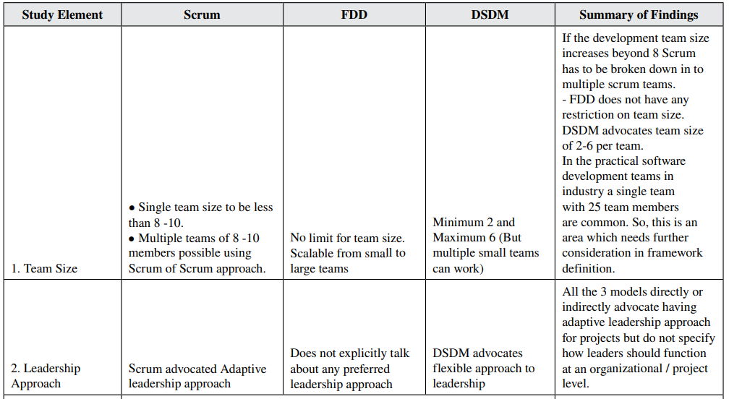
Model challenage
10
Notes:
Detailed model challenge by comparing three models.
Three model has different requirement for team sizes.
Does not how leader function at organizational level

Slide 11
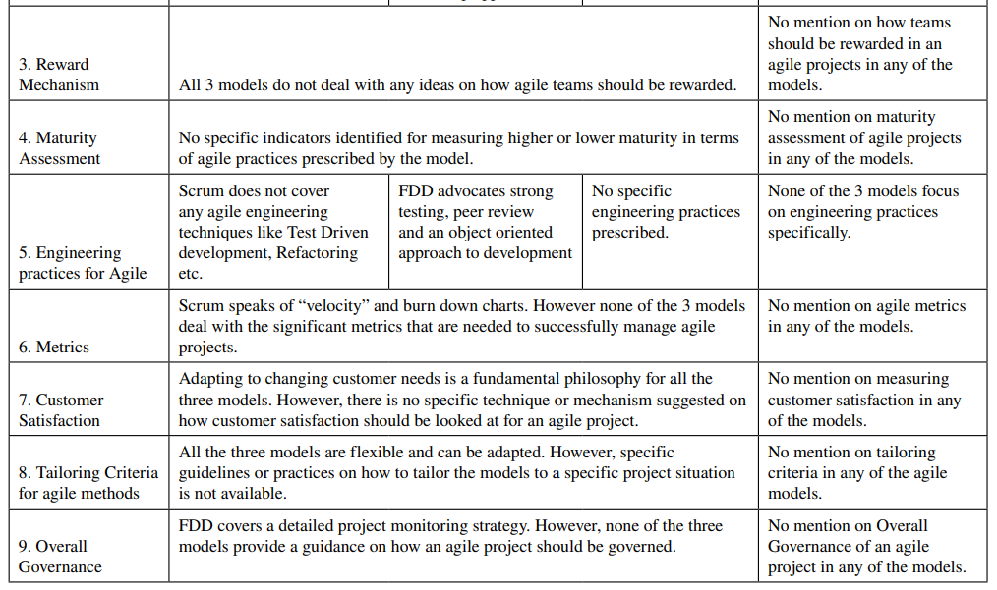
11
Notes:
No mention on how teams should be rewarded in an agile projects
No mention on agile metrics
No mention on measuring customer satisfaction
These are important in organizational levels, but existing framework does not include it

Slide 12
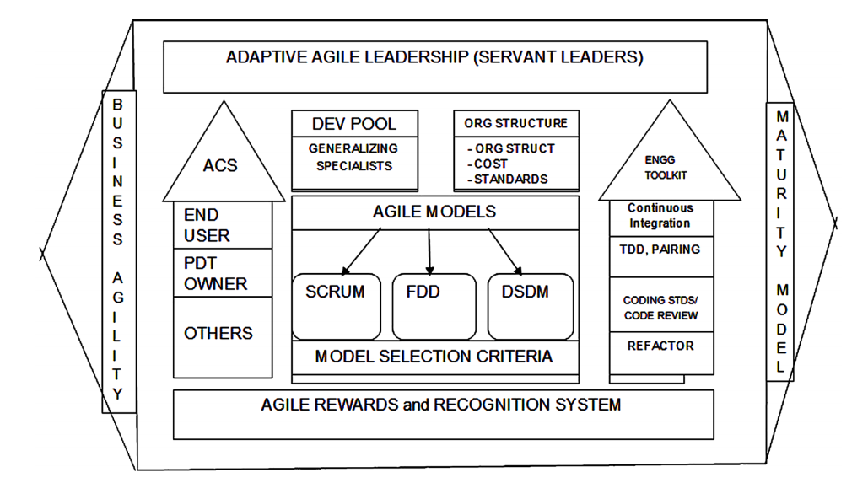
12
Design Building Block
  Agile Models + Model selection criteria
  Agile Rewards and Recognition System
  Business Culture
  Adaptive Agile Leadership
  Agile Customer Satisfaction
  Governance
  Development Pool
  Engineering Took Kit
  Maturity Model
Notes:
From challenges and finds on existing framework, paper lists some Design Building Block and what problems should be considered in block

Slide 13
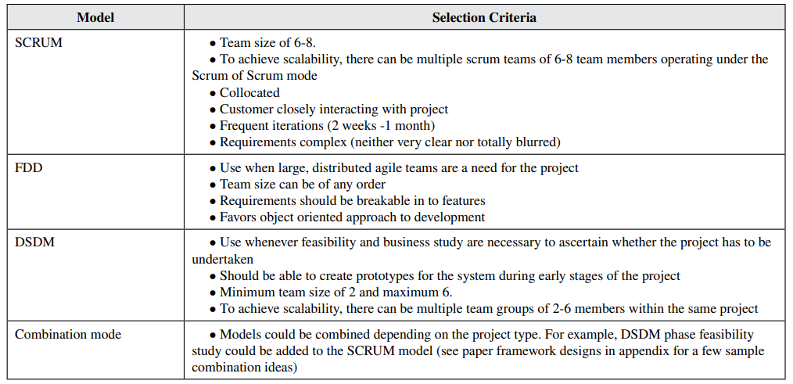
13
Agile Models + Model Selection Criteria
Notes:
Explain how does each block contribute to organizational agile. First is model selection.
Framework can select different agile model for each team according team size
Choose the best fit one or even we can combine models

Slide 14
14
Agile Rewards and Recognition System
Peer Review: Each team member rates himself and others in the team objectively
Team rating: A portion of weightage is given for overall team instead of individual heroism
Product produced
Overall adherence to agile process
Leadership qualities
Customer rating
Notes:
Give some ideas how agile system can design Reward system

Slide 15
15
Business Agility
Agility is a business strategy that helps survive changing market demands
Notes:
Simple Business Agility
Respond to changes

Slide 16
16
Adaptive Agile Leadership
Agile Leaders characteristics：
Flexible
Responsive to change
Willing to learn and adopt new ways
Lead effectively to survive successfully in the modern, complex, ever changing business environment
Example: Servant Leadership Approach
Notes:
How to design Adaptive Agile Leadership
servant first leader is supposed to serve others
Because of those characteristics, leader should able to help others on their problem

Slide 17
17
Agile Customer Satisfaction
Require more dynamic and involve getting direct feedback
“Barely sufficient”
Easy to collect and/or coalesce
Focused around delivering customer value
Measure in different level:
  Direct end user, Product Owner, Relevant stakeholders involved in the project
Notes:
Take minimum time on customer Satisfaction and focus iterate on product

Slide 18
18
Agile Organization Structure
Agile Metrics
Inspired by army of ants
coordination is promoted over control
No bottleneck of decision
make sure people are well trained
people allow to act without having to ask permission first
easy to collect
measures business outcomes over activity
encourages whole team results over individual results
Notes:
Organization aims to increase efficiency
Metrics are similar to customer satfisaction not be an impediment to the team’s work

Slide 19
19
Development Pool
Engineering Tool Kit
generalizing specialists supply to various projects
Developers should able to return to pool and reassigned to another agile project
Pool should have less bench and more active project
no prescribed specific engineering techniques
expandable engineering toolkit
Notes:
Development Pool is similar to thread pool, everyone should be will trained and have similar ability. Pool size should be proper in order to achieve high efficiency.

Slide 20
20
Summary
Advantages:
free to add new agile models and each time size is variable
Scalable to new technologies and new teams
Each organization can tailor model to suit its business context

Slide 21
21
Comments
This paper address good points on challenge to scaling current agile framework to organization level.
Too ideal in some blocks in development pool design
Does not address much on Customer-Related Challenges
Notes:
development pool require developers to move across teams. It seems to ideal that all developers have same set and level of skills. Bring to much overhead.
Agile Customer Satisfaction does not solve Customer-Related Challenges. Customer’s insufficient knowledge can give wrong feedback and bring unnecessary changes to project. It may need a design that minimalize customer’s impact on agile

Slide 22
22
Thank You
Notes:
Take minimum time on customer Satisfaction and focus iterate on product

