Slide 1

Agile For Large Scale Projects
-– A Hybrid Approach
CS 2310 Seminar
Weizheng Xu
Notes:
Hello everyone, my topic is Agile For Large Scale Projects -– A Hybrid Approach

Slide 2
Contents
Background
  Scrum
  RUP
Comparison between Scrum and RUP
Hybrid Approach
Discussion and Conclusion
Reference
Notes:
I split this presentation into five parts, background, comparison between scrum and RUP, hybrid approach, discussion and conclusion.

Slide 3
What is Scrum?
A subset of Agile.
A lightweight process framework for agile development, and the most widely-used one.
It is used to manage complex software development, using iterative and incremental practices.
Scrum processes enable organizations to adjust smoothly to rapidly-changing requirements, and produce a product that meets evolving business goals.
It is always not considered successful in the large organization, instead, it is recommended process in small to medium scale organizations.
Notes:
First, let us talk about the definition and characterization of Scrum.
---A “process framework” is a particular set of practices that must be followed in order for a process to be consistent with the framework. (For example, the Scrum process framework requires the use of development cycles called Sprints, the XP framework requires pair programming, and so forth.)
---“Lightweight” means that the overhead of the process is kept as small as possible, to maximize the amount of productive time available for getting useful work done.

Slide 4
Why Scrum?
The methodology itself has clearly defined rules, roles and work processes.
The projects are divided and realized in iterations called “Sprints”.
It puts an emphasis on communication.
At the end of every Sprint there is an assessment whether the product is acceptable and has met the expectations of the client.
Notes:
There are a few main points and benefits which separate Scrum from other methodologies

Slide 5
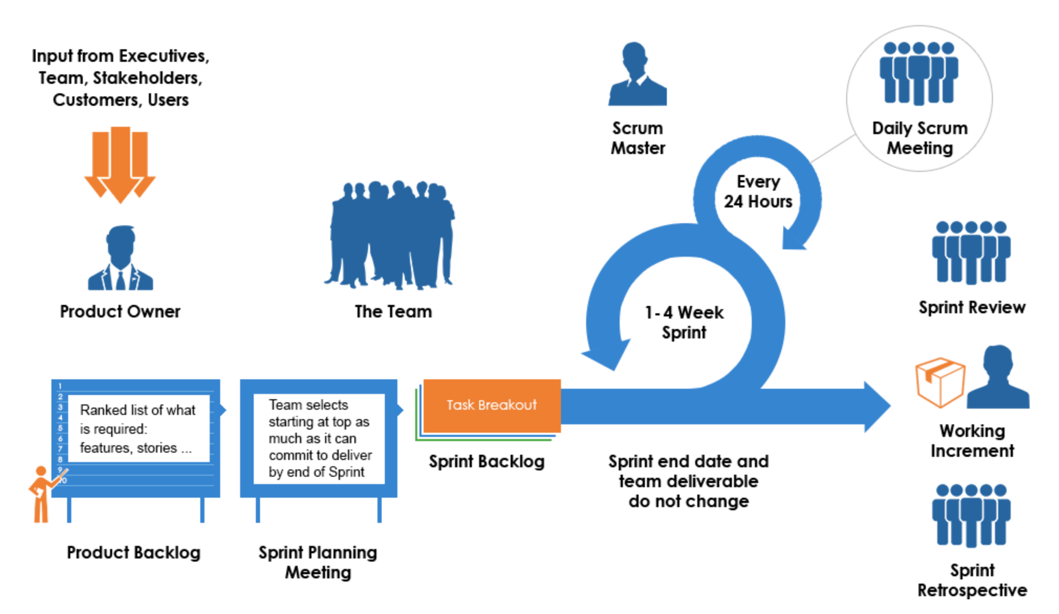
Architecture of Scrum Process
Notes:
Then there is the popular architecture graph of scrum process. A “Product Owner” creates a prioritized list called a “Product Backlog”. During ”Sprint Planning”, the team pulls a small chunk from the top of that list, a sprint backlog, and decides how to implement those pieces. The team has a certain amount of time – a “Sprint” (usually two to four weeks) to complete its work, but it meets each day to assess its progress (daily Scrum) Along the way, the “Scrum Master” keeps the team focused on its goal. At the end of the Sprint, the work should be potentially shippable, ready to hand to a customer, put on a store shelf, or show to a stakeholder. The Sprint ends with a “Sprint Review” and “Retrospective”. As the next Sprint begins, the team chooses another chunk of the Product Backlog and begins working again.

Slide 6
What is RUP?
Stands for Rational Unified Process Framework.
Needs to be configured/tailored.
Contains phases, iterations and workflows.
It is a guide to effectively use the Unified Modeling Language.
Its goal is to delivery a high quality product that the customer actually wants.
Notes:
In this slide, I will introduce the RUP. Before we talked about rational unified process, let me introduce the unified process at first.
The Unified Process is a iterative and incremental software development process framework for building object-oriented system.
For RUP, it is a refinement of the unified process. The goal is to ensure the production of high quality software that meets the needs of its end-users, within a predictable schedule and budget.

Slide 7
The RUP Best Practices
The RUP captures many of modern software development's best practices in a form suitable for a wide range of projects and organizations:
Develop software iteratively.
Manage requirements.
Use component-based architectures.
Visually model software.
Continuously verify software quality.
Control changes to software.
Notes:
The Rational Unified Process is structured around six fundamental best practices, which are so-named due to their common use throughout the industry

Slide 8
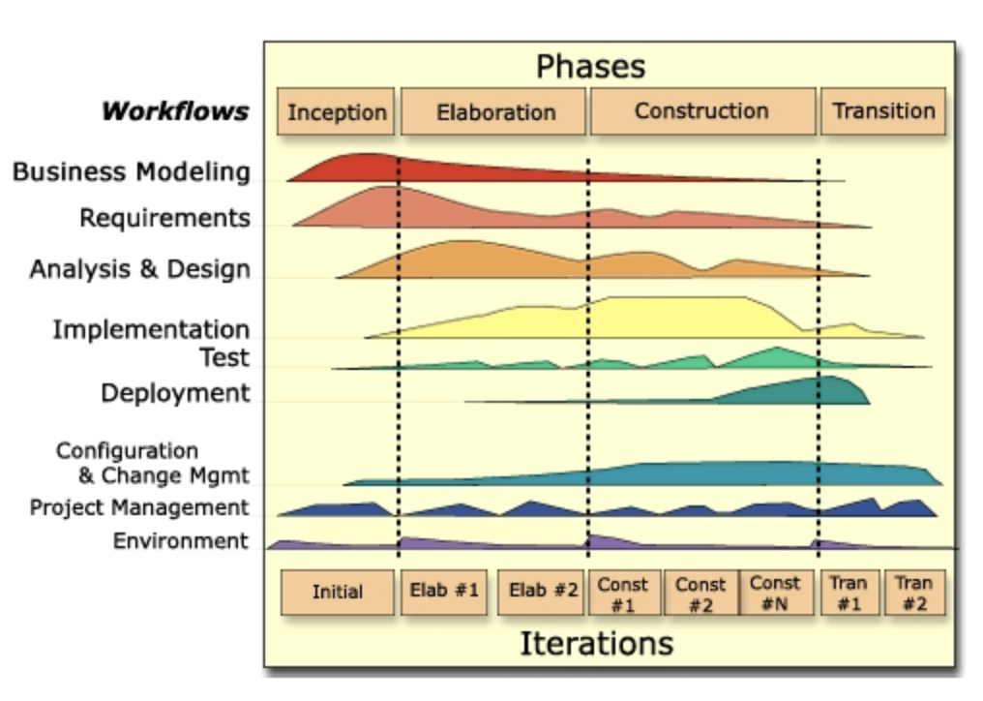
Architecture of RUP Process
Notes:
The RUP model is represented in two dimensions, x-axis and y-axis as shown in Figure. The x-axis is the time and it shows how the process is moving forward through 4 phases.
The y-axis contains the 9 disciplines. These disciplines are executed throughout the 4 phases iteratively.

Slide 9
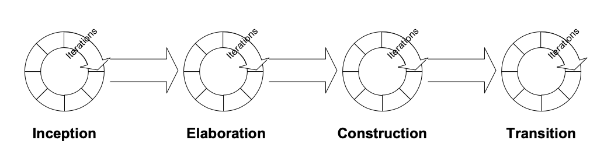
The Four Phases of RUP
Inception
The goal is to obtain buy-in from key stakeholders.
Construction
Elaboration
Objective is to specify requirements in greater detail and define the architecture for the system.
The focus here is to develop the application to the point where it is ready for deployment.
Transition
Delivery the system into production.

Slide 10
Six Engineering Disciplines of RUP
Business Modeling
Analysis and scope formation, vision document
Requirements
Communication and gathering of requirements
Analysis and Design
Formation of design and analyzing the solution
Implementation
Solution implementation
Test
Deployment
Testing, validating the requirements
Production level-deploying the finished software system
Notes:
The RUP’s nine disciplines consist of six engineering discipline and three supporting disciplines. The six disciplines are somewhat similar to waterfall model phases whereas the rest of the three are unique to RUP framework.

Slide 11
Three Supporting Disciplines of RUP
Configuration and Change Management
Document and code versions configuration.
Project Management
Managing customer and team.
Environment
Ensuring RUP implementation awareness in all aspects among project team members.
Managements of changes in solution, requirement and codes.

Slide 12
Compare Scrum & RUP
Scrum
Advantages:
Adaption to changing business changing requirement
More manageable
High customer satisfaction
Light development lifecycle and light documentation
Disadvantages:
(1) Not successful for large scale and complex projects
(2) Document reduction
(3) Not suitable for stable projects
(4) Highly dependent on motivated team members
Complementary！！
RUP
Advantages:
Low risk involve and high percentage of success
Straightforward, well defined and structured
Stability and predictability
Disadvantages:
(1) Lack of ability to adopt change in requirements
(2) Has tendency to carry out an over budget product
(3) Not necessarily meeting the requirement of the customers
Hybrid Approach Proposed
Notes:
Strength and weakness has been analysed in this paper and this slide shows the overview of strength and weaknesses in both methodologies.
We can see that, there is a corresponding relationship between them. They are complementary between each other. So
Based on this, this paper proposed a novel approach to combine them together.

Slide 13
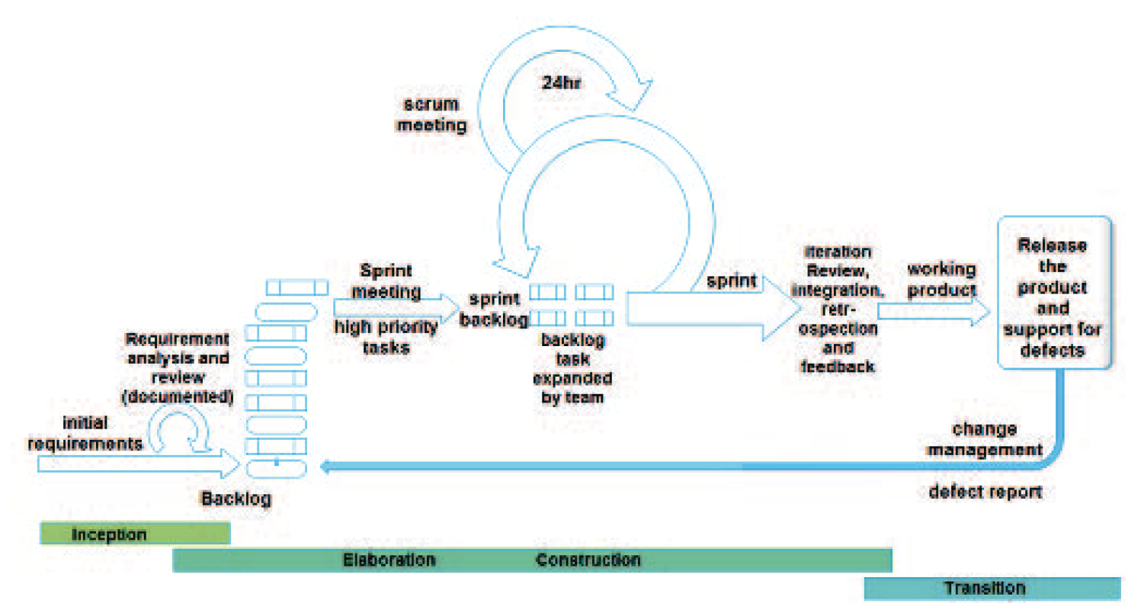
Hybrid Process for a large scale project
Notes:
The Agile method isn’t been successfully implemented on Large scale and complex projects. Agile is coming up as the most popular methodology throughout the organizations according to a survey. With advantage, it comes with certain shortcomings which led to design a hybrid methodology so that Agile can fit into the large scale organizations.
RUP is ideal for Phase management and controlling approach, as each phase ends with a well-defined decision.
Comparatively, Scrum provides the necessary management framework through well-defined ceremonies, roles and
artefacts. In this hybrid approach product backlog is referred as high level SRS (Software Requirement Specification).
Adopting RUP; a basic system architecture design is produced after initial requirement review phase.
Analysing the strength of Agile and RUP, a hybrid model is suggested

Slide 14
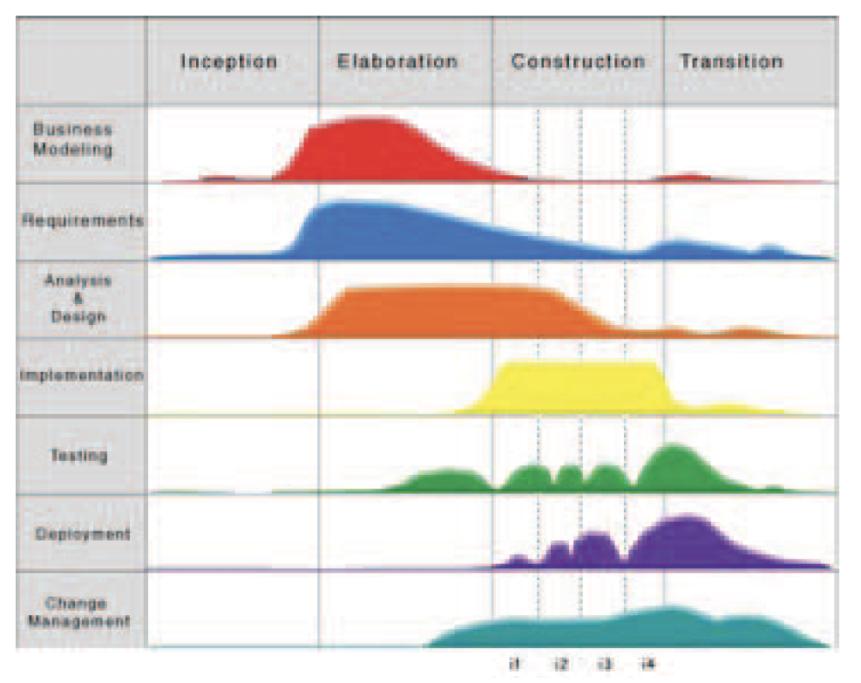
Hybrid Approach
9 disciplines for RUP
7 disciplines for hybrid
Reduced project management and environment
Notes:
In proposed hybrid approach, nine RUP disciplines have been reduced to 7 disciplines after considering suitable mapping
with scrum artefacts. The disciplines utilization in each phase may be different for iterations. The above figure (right) distributes phases on probability of peak utilization of these disciplines.

Slide 15
What can be solved by Hybrid Approach?
Changes in requirements.
Not able to meet deadlines.
Quality.
Distributed software development.
Notes:
Business rule Changes in requirement are redefined in iterations as module development progresses.
User changes are accommodated in long term maintenance period as agile methodology says. Agreement Documentation, deadlines, schedule and budgeting can’t be ignored but can be controlled by applying both methodologies.
High quality assurance of software is somehow compromised for agility but Iterative and incremental combined
development still produced high quality software.

Slide 16
Own Critiques about this Paper
The author does not mention any organizations implementing this approach, so challenges or issues on implementing this approach are not discussed.
It would be better to give some case studies where projects with longer duration as well as for large-scale projects to validate this framework.
It is good that it takes advantage of the strengths and compresses weakness of different frameworks to find a comparatively optimal approach.
Notes:
Here are some my own opinions on this paper.

Slide 17
Conclusion
Scrum is recommended in small to medium scale organizations. The goal of hybrid approach is to suggest a software development model for large scale project that should meet both deadlines and customer needs.
Core idea of hybrid approach, combine the strength of two methods (Scrum and RUP) while suppressing their weaknesses.
It gives freedom of tailoring mentioned artefacts and roles according to project need.
Notes:
Both scrum and RUP have advantages and disadvantages, this paper proposed a hybrid approach to combine them together.

Slide 18
Reference
[1] M. Tanveer, “Agile For Large Scale Projects – A Hybrid Approach,” in National Software Engineering Conference (NSEC 2015). IEEE, 2015.
[2] P. Kruchten, “The Rational Unified Process--An Introduction,” chapter Jan, 2000.
[3] P. Kruchten. The Rational Unified Process: An Introduction The Rational Unified Process. USA: Addison-Wesley Professional, Pearson Education Inc., 1999.
[4] Rational, The Software Development Company, “Rational Unified Process Best Practices for Software Development Teams,” Rational Software White Paper, 2001.

Slide 19
Question?
Notes:
If you have any questions, please feel free to send me an email.

Slide 20
Thank you!

