Slide 1
Requirements Engineering in Agile Software
Zhongxuan Song
Presentation Video:
https://www.youtube.com/watch?v=JORFBJwrh98

Slide 2
Motivation
- Why I start to think about requirement engineering
How do you feel to be asked to implement a requirement like this:
“The theme color of the software should match whenever the user change his phone case.”
This is absolutely a non-feasible requirement
So, I start to think about how can the manager to ask reasonable requirement.
Notes:
I read a news in 2018, that the manager ask the developer to implement the requirement mentioned in the slide.

Slide 3
Content
What is Requirement Engineering (RE)
  Why it important
What is Agile
Conventional VS Agile
Why Agile important in RE
How to use Agile in Requirement Engineering
Criticism
Notes:
Today, I want to talk about these topics to introduce the concept of Agile in RE

Slide 4
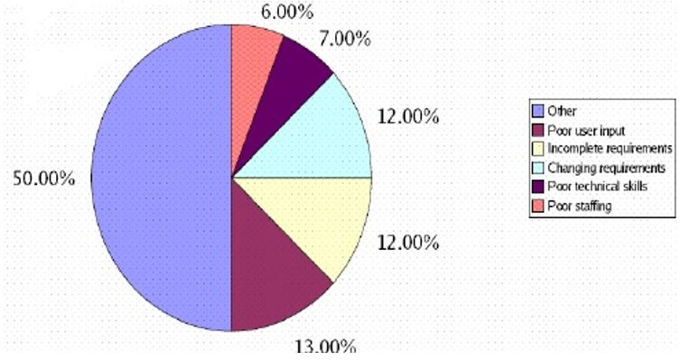
What is Requirement Engineering (RE)
RE is concerned with discovering, analyzing, specifying, and documenting the requirements of the system.
Why RE important?
  The problems in RE is the most expensive to remove
  Around 37% of the problems occurred in the development of challenging systems are related to the requirements phases
Notes:
RE- what we want the system to be?
What customer want the system to be?

Slide 5
What is Agile
Agile means being able to “Deliver quickly. Change quickly. Change often”
Working software is delivered frequently
Working software is the principal measure of progress.
Customer satisfaction by rapid, continuous delivery of useful software.
Even late changes in requirements are welcomed.

Slide 6
Conventional VS Agile
Conventional | Agile
Gaither all requirements at the beginning | More requirement will be added in the development process
Infeasible requirement cannot change | Changes in requirement are welcomed
Project manager in charge of requirements | All the team members come up with the requirements

Slide 7
Why Agile Important in RE
Flexibility - Infeasible requirement can be changed later.
Accuracy - Produce the software that stakeholder wants.
Iteratively - Add or remove features at any phase.
Efficiently - Stay on time and budget.
Notes:
Customer will change their mind, something they want few months ago might not be what they now.

Slide 8
Techniques for Requirement Elicitation in AD
Interviews:
Good for getting an overall understanding of what stakeholders do and how they might interact with the system.
  Closed Interviews: Predefined question let the stakeholder to answer.
  Opened Interviews: No predefined question agenda and a range of issues are explored with stakeholders.
Notes:
interview is the techniques involve customer (stakeholder), one of the main principle of Agile Development.

Slide 9
Techniques for Requirement Elicitation in AD
2. Brainstorming:
Generating new, useful ideal, and promoting creative thinking.
Elicit new features for the application.
The project manager play important role.
Everyone get a chance to express what their thoughts.
All the topics will be evaluated by the team and discuss the connections and dependencies of the taks.
Notes:
Brainstorming is the techniques involve Team, one of the main principle of Agile Development.

Slide 10
Techniques for Requirement Elicitation in AD
3. Use Case Analysis:
A scenario based technique used in UML-based development which identifies the actors involved in an interaction and describes the interaction itself.
Telling out the story of the requirement.

Slide 11
Techniques for Requirement Analysis in AD
Modeling
The pen board will divided into three section:
models to be implemented
models under implementation
models completed.
This layout will provide a visual representation of the project status .

Slide 12
Techniques for Requirement Analysis in AD
2. Prioritization:
Each task should have a priority assigned by the team.
Team must distinguish “must have” requirement from “nice to have” requirement.
The most essential requirement should have the highest priority.
The dependency task need to be don prior than the task which depend on it.

Slide 13
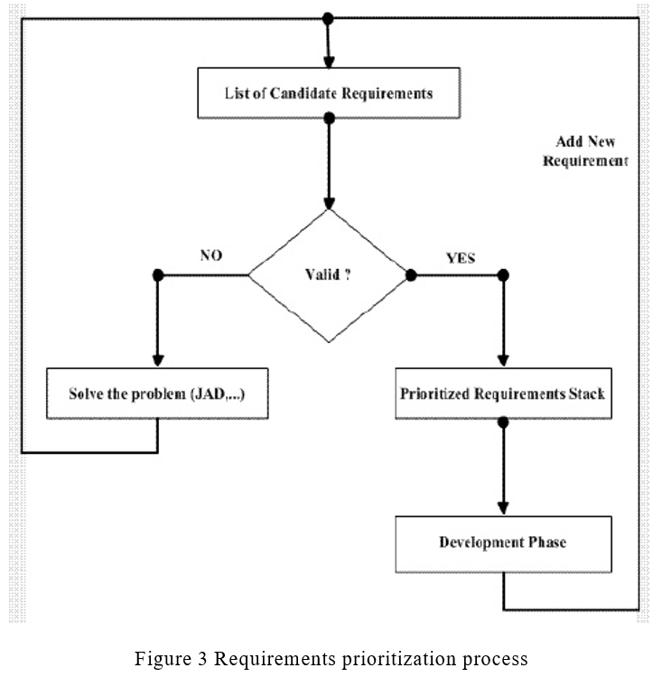
So far
Notes:
This is what we will do in the validation phase.

Slide 14
Requirement Documentation in AD
Agile focus on minimize documentation
The features and the requirements are recorded on storyboards, index cards, and paper prototypes like use cases and data flow diagrams.
The documentation is to be used to communicate the requirement between agile team and stakeholders.

Slide 15
Requirement Validation in AD
The purpose of the Requirement Validation is to make sure the requirement is defined the system which customer wants.
The requirements validation checks the consistency, completeness and realism of requirements.

Slide 16
Requirement Management in AD
Easy to make changes
Easy to access by all the team members
Be able to store the requirements, priority, time, and progress

Slide 17
Guidelines for Agile RE
Customer Involvement: Stakeholder identified the key idea of the project
Frequent Releases: Delivering useable project to the customers frequently.
Requirement Elicitation Language: Use English to describe the language instead of code.
No early documentation: Any early documentation can become irrelevant.
Requirement Splitting: Splitting complex requirement into smaller pieces.

Slide 18
Drawbacks of Agile RE
Require high individual skill
Some software need fixed design to meet certain non-functional features.
Ex. Bank software, security is the top priority.

Slide 19
Criticism
The paper did mention that Agile work better for the small to medium size team, but it did not explain why it is not good for big team.
Ans: Because the big team is harder to keep on the same page.
The paper did not brought up the concept of velocity, but from the supporting material, it give the idea of velocity.
Ans: The velocity is an essential factor to calculate the time and the cost of the project.

Slide 20
Questions?
If you have any question, please send an email to zhs61@pitt.edu

Slide 21
References
https://zhuanlan.zhihu.com/p/41305243
Andrea De Lucia and Abdallah Qusef Dipartimento di Matematica e Informatica, University of Salerno Via Ponte don Melillo, 84084 Fisciano (SA), Italy
A.Polini, “Software Requirements,” http://www1.isti.cnr.it/~polini/lucidiSE/Requirements1.pdf , February, 2010.
T. Poppendieck and M. Poppendieck, “Lean Software Development: An Agile Toolkit for Software Development Managers,” Addison-Wesley, 2003.
S. Bose, M. Kurhekar, J. Ghoshal, “Agile Methodology in Requirements Engineering,” SETLabs Briefings Online. http://www.infosys.com/research/publica-tions/agile-

