Slide 1
Code Level Reusable Software Components
Lingrui Ouyang
Notes:
Hello everyone, my name is Lingrui Ouyang, and today I am going to introduce the code level reusable software components for you.

Slide 2

Background: Reuse advantages and failures
Advantages
  Higher quality products
  Less development time
  Higher scheduling accuracy
Failures
  Organizational impediments
  Economic impediments
  Administrative impediments
Notes:
Before we go to the main topic, let us know some background knowledge first. As the saying goes, "no pain, no gain," and the reuse of software is no exception. With all the costs and prerequisites of software engineering, software reuse may seem like more effort than it is worth or may not. So first we are going to talk about the advantages and failures of software reuse.
Advantages:
Higher quality products are produced due to repeated use and test, and intentional design for robustness and reuse.
Less development time, and therefore cost, is necessary because there is a repository of software assets with which to start.
Higher scheduling accuracy is possible due to reuse of process materials along with a better understanding of the product domain.
Failures:
As the number of developers and projects employing reusable assets increases, it becomes hard to structure an organization to provide effective feedback loops between these constituencies.
Many organizations find it hard to institute appropriate taxation or chargeback schemes to fund their reuse groups.
Although it's common to scavenge small classes or functions opportunistically from existing programs, developers often find it hard to locate suitable reusable assets outside of their immediate workgroups.

Slide 3
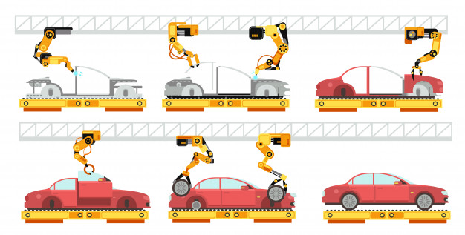
What is a “Reusable Software Component?”
Analogy: Car assembly line
Definition: Software reuse is the use of engineering knowledge or artifacts from existing software components to build a new system. And a component is a object in the graphical representation of application and that can interact with user
Examples: Familiar push buttons, text fields list boxes, scrollbars, dialogs . everything visible in Java interface
Notes:
Firstly I am going to talking about the definition of “software reuse”. We can take care assembly line as an analogy. All the typical part in your car can be replaced by a component made from one of many different competing manufacturers. The idea is that standard interfaces allow for interchangeable, reusable components. But this definition of reuse does not meet our definition because it is not concerned with reusable software components incorporated into client programs. The true definition of software reuse is: foftware reuse is the use of engineering knowledge or artifacts from existing software components to build a new system. And a component is a object in the graphical representation of application and that can interact with user. Some simple examples of this are familiar push buttons, text fields list boxes, scrollbars, dialogs . everything visible in Java interface.

Slide 4


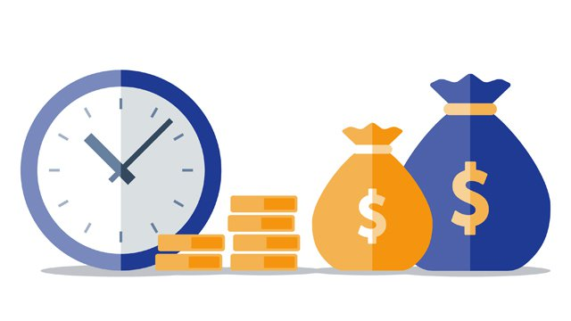
Why Software Reuse?
Increased quality
High reliability
Long-term decreased costs
Notes:
Reusable software components are designed to apply the power and benefit of reusable, interchangeable parts from other industries to the field of software construction. Software reuse provides a basis for dramatic improvements in increased quality and reliability and in long-term decreased costs for software development and maintenance.

Slide 5
Why a component can be reused?
Use the component in its original from in multiple systems
  Code samples are copied and pasted among systems
Extend component functionality as needed for individual systems
  Embed or modify the code to a new method
Restrict component functionality as needed for independent systems
  Reuse the binaries distributed on local or remote systems without distributing them
Notes:
There are so many ways to reuse the component in software. But the three major ways to reuse software, the first way is you can use the component in its original from in multiple systems, the second ways is you can extend component functionality as needed for individual systems, and the last way is you can restrict component functionality as needed for independent systems. In brief the first way involves the technique for writing reusable software components and identifying those components, the second way involves the covering of the steps required for extending reusable software components; finally the last way addresses testing and deploying your extensions and wrappers for reusable software components. In the first way code samples are copied and pasted among systems. In the second way you have a string parsing routine that your coworkers find useful. You email that code to them and they perhaps embed or modify it to a new method. Recipes are an extension of code samples by which a way to reproduce some behavior is described in terms of consuming an existing component. In the last way you can reuse the binaries distributed on local or remote systems without distributing them with each product.

Slide 6
Approaches Supporting Software Reuse
Application Frameworks
Design Patterns
Legacy system wrapping
Program generators
Program libraries
Service-oriented systems
Application product lines
Component-based Development
Aspect-oriented software development
COTS (Commercial-O-The-Shelf) integration
Configurable vertical applications
Notes:
Application Frameworks: Collections of concrete and abstract classes that can be adapted and extended to create application systems.
Application Product Lines: Application product lines, or Application development, refers to methods, tools and techniques for creating a collection of similar product line systems from a shared set of software assets using a common.
Aspect-Oriented Software Development: Aspect-oriented software development (AOSD) is an emerging software development technology that seeks new modularizations of software systems in order to isolate secondary or supporting functions from the main program's business logic.
Component-Based Development: Systems are developed by integrating components (collections of classes) that conform to component-model standards.
Configurable Vertical Applications: Configurable vertical application is a generic system that is designed so that it can be configured to the needs of specific system customers.
COTS Integration: By integrating existing application systems System is developed.
Design Patterns: A design pattern is a recurring solution for repeatable problem in software design.
Legacy System Wrapping: By wrapping a set of defining interfaces by legacy systems provides access to interfaces.
Program Generators: Program Generator is a program that enables an individual to easily create a program of their own with less effort and programming knowledge.
Program Libraries: Function and class libraries implementing commonly used abstractions are available for reuse.
Service-Oriented Systems: SOA is a set of methodologies and principles for developing and designing software in the form of component.

Slide 7
The Topic Levels of Code Level Component
Level 1: Documentation
Level 3: Intellectual Property Issues
Level 5: Packaging
Level 7: Standards compliance
Level 9: Verification and Testing
Level 2: Extensibility
Level 4: Modularity
Level 6: Portability
Level 8: Support
Notes:
There are several technical issues that currently keep reusable software from becoming a reality. One of the techniques is designing code level reusable components. In this approach the technical issue is the lack of formal specifications for components. A programmer cannot be expected to reuse an existing part unless its functionality is crystal-clear. A component will only be reused if its behavior is completely and unambiguously specified in a form understandable by potential programmers. A component is evaluated across topic levels, each of the level which provides guidance about what one can expect at each reuse level.
Level 1: Limited reusability; the software is not recommended for reuse.
Level 2: Initial reusability; software reuse is not practical.
Level 3: Basic reusability; the software might be reusable by skilled users at substantial effort, cost and risk.
Level 4: Reuse is possible; the software might be reused by most users with some effort, cost, and risk.
Level 5: Reuse is practical; the software could be reused by most users with reasonable cost and risk.
Level 6: Software is reusable; the software can be reused by most users, although there may be some cost and risk.
Level 7: Software is highly reusable; the software can be reused by most users with minimum cost and risk.
Level 8: Demonstrated local reusability; the software has been reused by multiple users.
Level 9: Proven extensive reusability; the software is being reused by many classes of users over a wide range of systems.

Slide 8

How to build Code Level Reusable Components
Class libraries
Function libraries
Design patterns
Framework Classes
Notes:
The following ways to build code level reusable components
Class libraries: Class libraries are the object-oriented version of function libraries. Classes provide better abstraction mechanisms, better ability and adaptability than functions do.
Function libraries: Functions are the most common form of reusable components. For many programming languages, standard libraries have been, for example, for input/output or mathematical functions.
Design patterns: The purpose of design patterns is to capture software design know-how and make it reusable. To save time and effort, it would be ideal if there was a repository which captured such common problem domains and proven solutions.
Framework Classes: Frameworks are flexible collections of abstract and concrete classes designed to be extended and for reuse. Components of class libraries can serve as discrete, stand-alone, context-independent parts of a solution to a large range of applications.

Slide 9
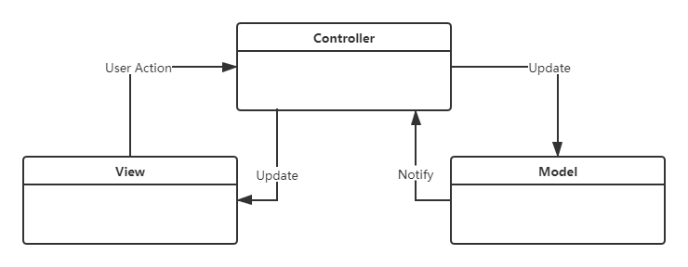
Design patterns : Model/View/Controller (MVC)
Notes:
Here is an example of design patterns: Model/View/Controller (MVC) architecture. MVC is enforces the separation between the input, processing, and output of an application. To this end, an application is divided into three core components: the model, the view, and the controller. Each of these components handles a different set of tasks.

Slide 10
Conclusion and future work
Pros
  Save time
  Save money
  Increase the reliability of resulting products
Cons
  Attempt to reuse software that is not easily reusable can have the reverse effect
Future work
  Digging deeper in using frameworks, the developers can devote more time in developing the software requirement, not in preparing the environment and tools of application development

Slide 11
Evaluation on this paper
Advantages
  Many clear examples about the definition of software reuse and how the reusable components work
  Transparent definition of how we evaluate the reusability of a software
  Good analysis about the pros and cons of each approach to build reusable software
Disadvantages
  Should use some graphs to illustrate the architecture of Framework Classes just like the Design patterns part
  Should further explain the three major ways to reuse software, like how people extend the functions of components.

Slide 12
References
[1] B.JALENDER, A.GOVARDHAN, and P.PREMCHAND. DESIGNING CODE LEVELREUSABLE SOFTWARECOMPONENTS, International Journal of Software Engineering & Applications (IJSEA), Vol.3, No.1, January 2012, https://www.academia.edu/35151812/DESIGNING_CODE_LEVEL_REUSABLE_SOFTWARE_COMPONENTS
[2] B.JALENDER, A.GOVARDHAN, and P.PREMCHAND. A PRAGMATIC APPROACH TO SOFTWARE REUSE, Journal of Theoretical and Applied Information Technology, https://www.researchgate.net/publication/266287893_A_pragmatic_approach_to_software_reuse

Slide 13
Thanks for watching!

