Slide 1
Parkinson’s Detection Application
Milestone 2
-Pratik Musale

Slide 2
Motivation
There are about 60,000 Americans with Parkinson’s Disease. And nearly 10 million worldwide. [1]
This disease requires a constant monitoring which can be done either with a smartphone or smartwatch. [2]
For a prototype I am considering only a smartphone use case.

Slide 3
Idea
Created an Application which uses the motion sensor’s in Android Smartphone to Detect Motion.
This, motion will be monitored continuously and sent to a local server as the Parkinson’s disease attack is very time sensitive and appropriate action needs to be taken

Slide 4

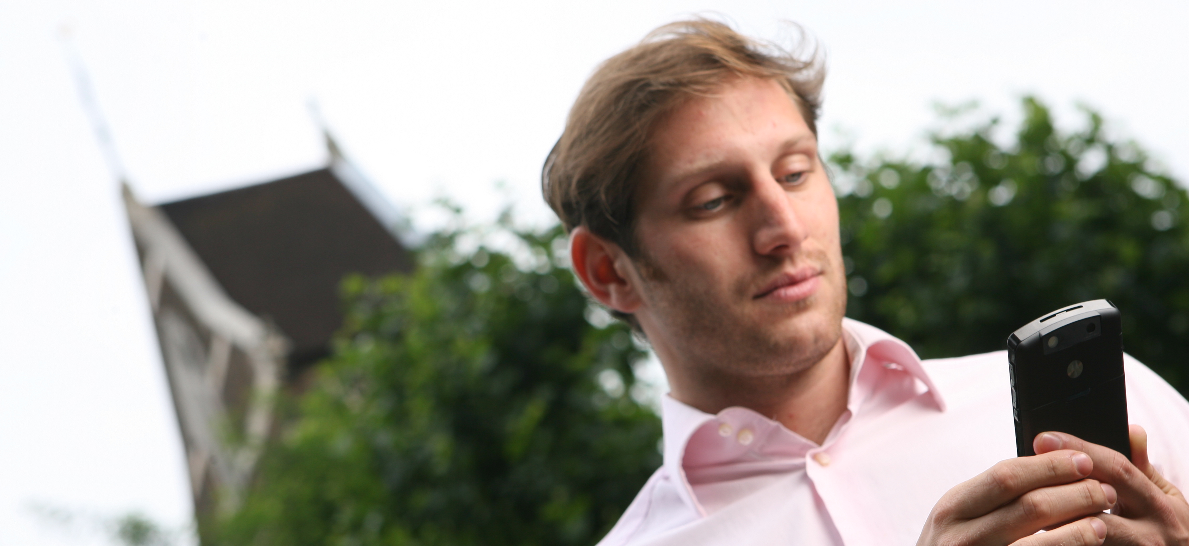
Application Scenario
Parkinson’s user is using the mobile phone continuously and the motion sensor on the phone is used to record the sensor values
A server, or a cloud server will be used to get the values of the sensor and compute on them and decide if there is an abrupt change in the sensor values. If yes, the user will be alerted. Before a major attack.
This Photo by Unknown Author is licensed under CC BY-NC
This Photo by Unknown Author is licensed under CC BY-ND

Slide 5
Current Progress
Initial Design required and mentioned in Milestone 1 is all completed.
Found some additional requirements:
  User/ Organizational Sign.
Planning to finish this before the final project.

Slide 6
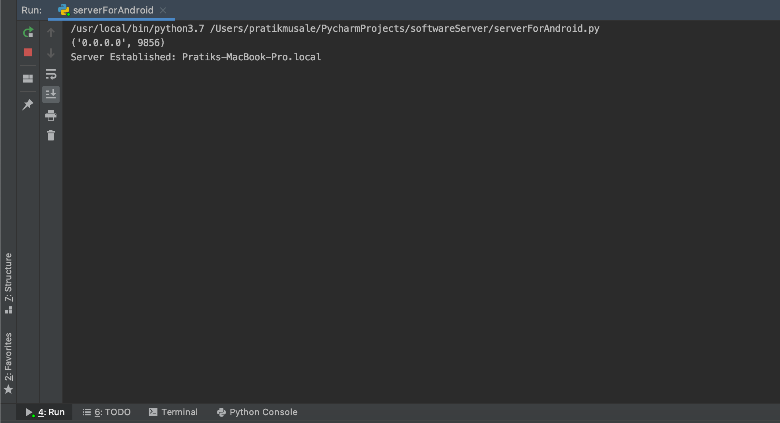
Implementation
Created a python server which runs on the current Network, with the help of port forwarding. (Testing is done on my current Home Network)

Slide 7
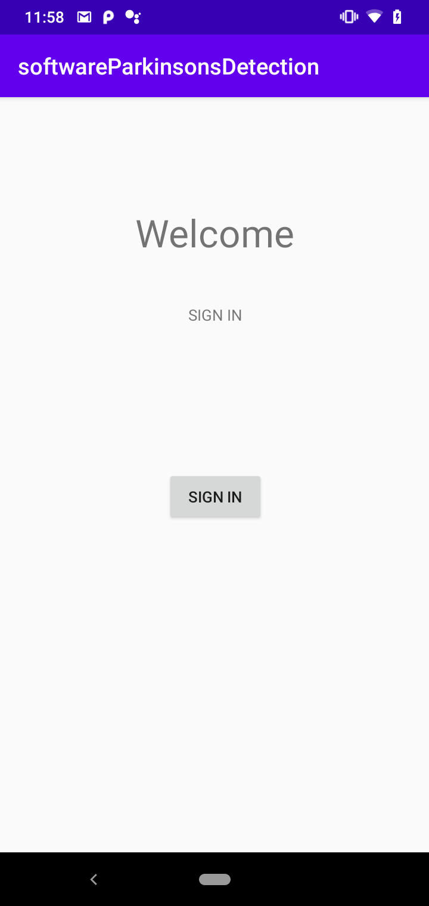
Implementation
Created an Android Application with a basic button user Interface.
Right now the implementation has a hardcoded User.
There is no database connected for authenticating the user.

Slide 8
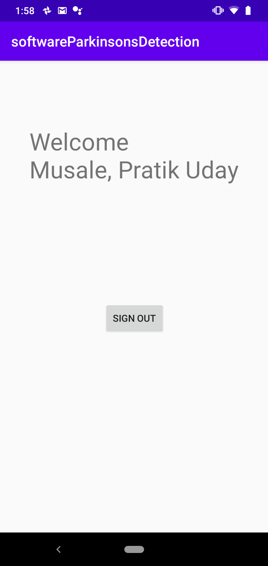
Implementation
After clicking the Sign In button the user’s name will be displayed.
The sensor starts recording the values and pass it to the Python server for detection.
Right Now the User’s name is hardcoded as well.

Slide 9
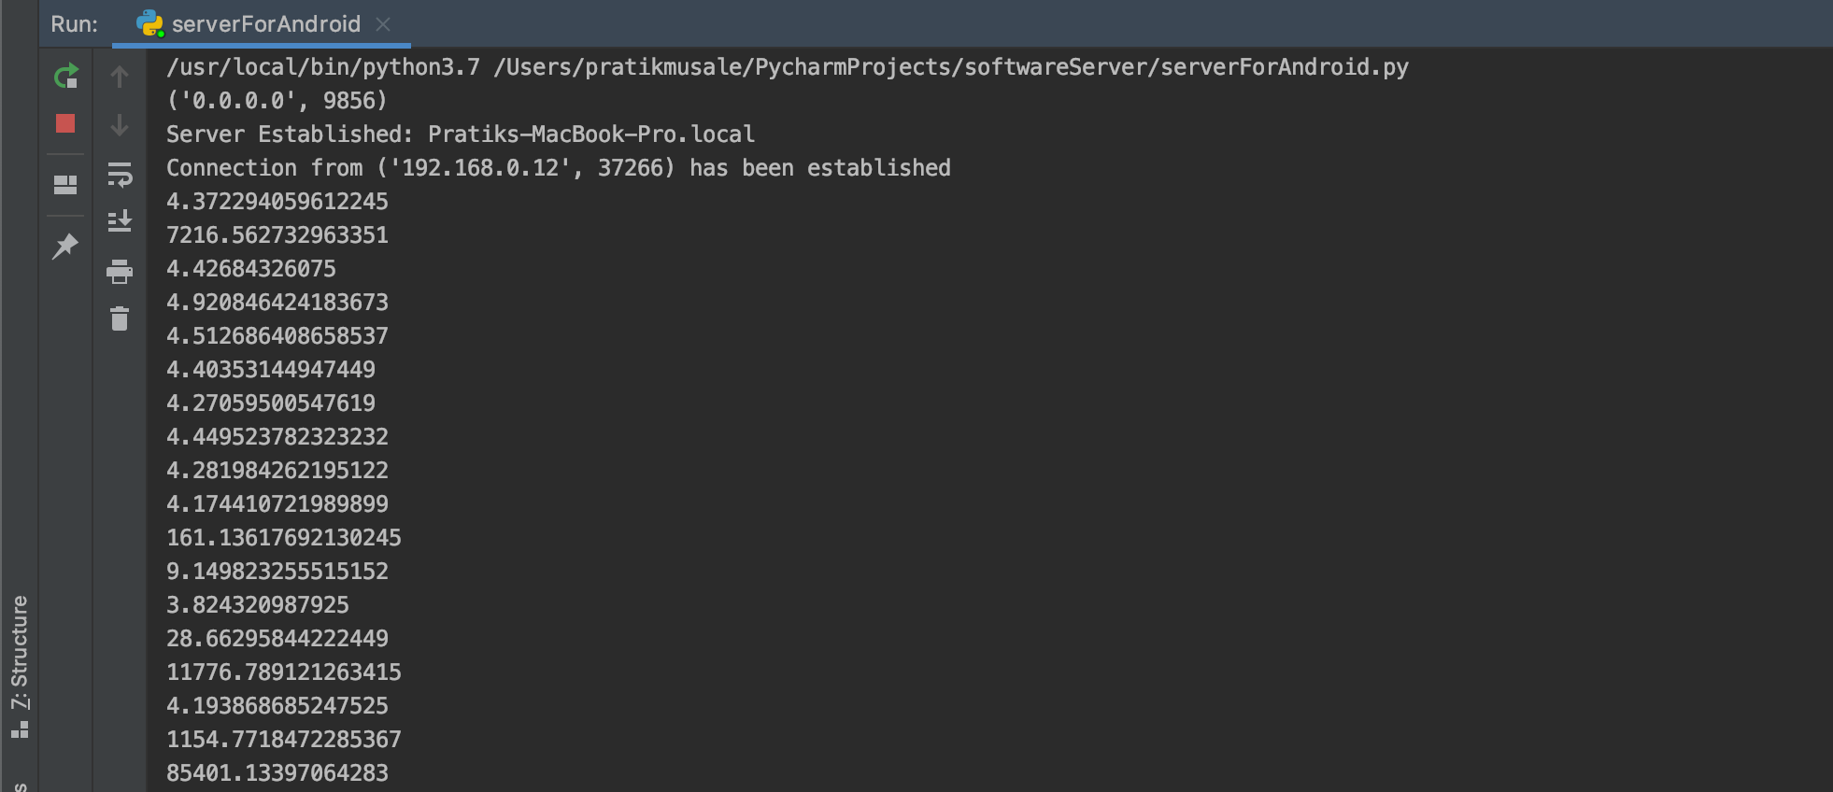
Implementation
Python server receives the data and sends a message of detection to Android Client

Slide 10
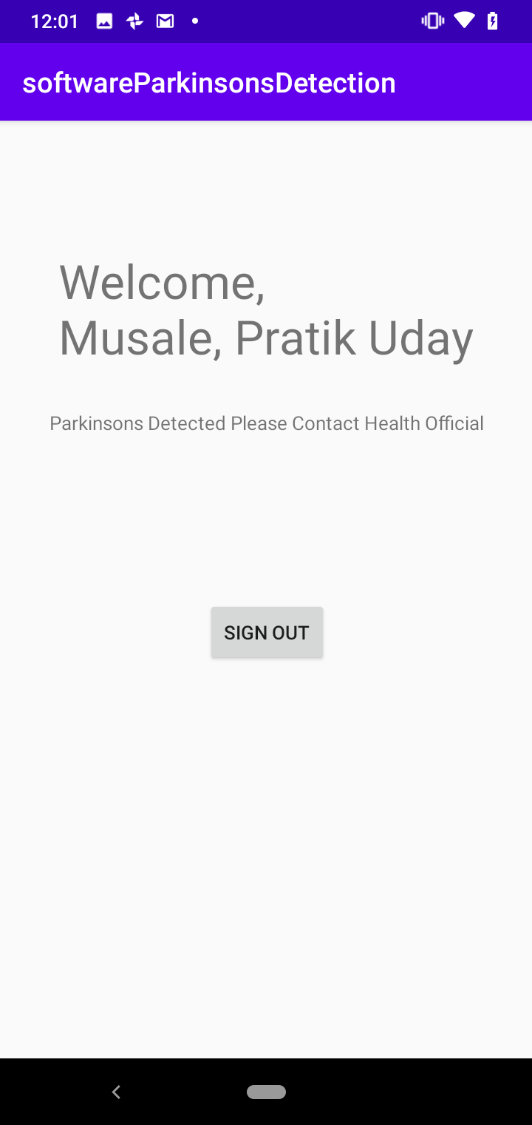
Implementation
The user gets notified and now he/she can contact health official.

Slide 11
Future Work
Need a User Sign In process:
  Tentative Plan: To use school’s login Process. Started working on it. With the proper cloud database, anyone within the organization can utilize this application.
Artificial Intelligence can be implemented if we get an actual user study data. This can help us determine if the user is going to get an attack or not.
New devices like smartwatches need to be user. As of now I don’t own any. But it will be interesting to watch if there are any changes.

Slide 12
Code
I’ll be uploading the code to GitHub after the sign in process requirement is completed.

Slide 13
Refrences
[1] Link: https://www.parkinson.org/Understanding-Parkinsons/Statistics
[2] Link: https://parkinsonsnewstoday.com/2019/10/04/wearable-sensors-offer-way-of-ably-monitoring-day-to-day-movement-in-parkinsons-patients-study-says/

