Slide 1
Milestone 1
-Pratik Musale

Slide 2
Description
Goal:
  Creating an android application that continuously monitors a patient for Parkinson's attack or symptoms.
Method:
  The application will take the use of inbuilt sensor for motion in the android phone.
  The data analysis will be done on the webserver using python. (This is a tentative plan on where the analysis will be done and what language will be used)

Slide 3
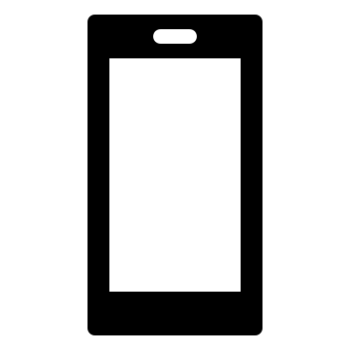
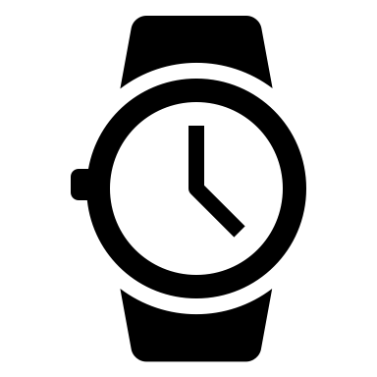
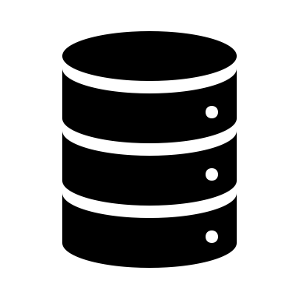

3. Sending the message if person has Parkinson's disease or not
4. Displaying it to User
1. Sending Raw Sensor Data: Accelerometer, Gyroscope
2. Saving Data on Cloud Server and Running the script: Data filtering and Data Analysis

Slide 4
Device Information
Device: Nokia 4.2
  OS: Android
  Sensor: Accelerometer and Gyroscope
Device: WebServer on Mac
  OS: Apache with Python3 for running Scripts (Tentative Plan)

