Slide 1

Understanding Personal Productivity
-Pratik Musale

Slide 2
Context Definition
Context is "a frame that surrounds the event and provides resources for its appropriate interpretation". [1]
Context has been used in many of the recommendation systems. Like Google checking your location (Location being context) recommends places, restaurants near you.

Slide 3
Use of Context in ERP System (Background)
Inka.et.al [2] introduced context in implementation of ERP systems for the industry.
Motivation: To make company Business Process more efficient with the help of using context.
Process:
Conducting Interview,
Design Model,
Information Flow

Slide 4
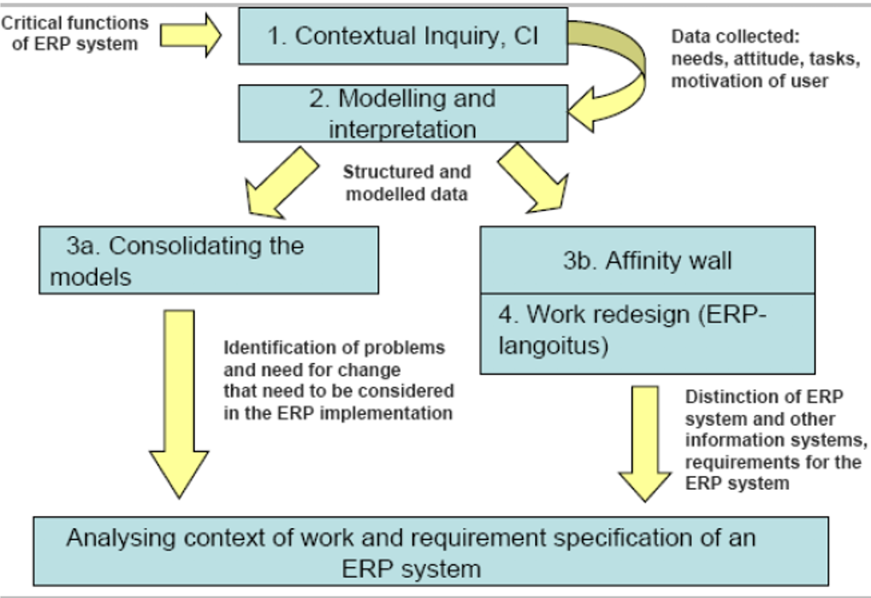
Use of Context in ERP System (Background)
Results: The use of context, helped the industry to setup a model, which helped them realize the potential improvements, as exchange of data could be easily contextualized.
Conclusion: The interview required to contextualize a process in the industry needs to be done in the requirement/procurement phase.
Furthermore, the model should be general, as just interviewing one person can lead to a personalized environment.
Figure 1: Phases of Contextual Methods Applied [2]

Slide 5

Understanding Personal Productivity: Motivation
Motivation:
  Self knowledge plays a vital role in personal productivity as it helps users to reflect upon.
  Existing work measure activities that are simple to monitor, just like seeing what percentage usage of device is used by users to determine its distraction level.
  Furthermore, there is very little work done to understand productivity effecting both work and non-work context and the relationship between them.

Slide 6

Understanding Personal Productivity: Setup/Experiment
Diary Study:
  A diary study was conducted to record the events and experiences in of users.
  Duration: 2 weeks, Place: South Korea
  Platform: Android
Participants:
  All were working at least 30 hours per week.
  Not an undergraduate student and not a participant in any other data study
  24 participants: 12 male, 12 female
  Age Range: 23 to 46

Slide 7
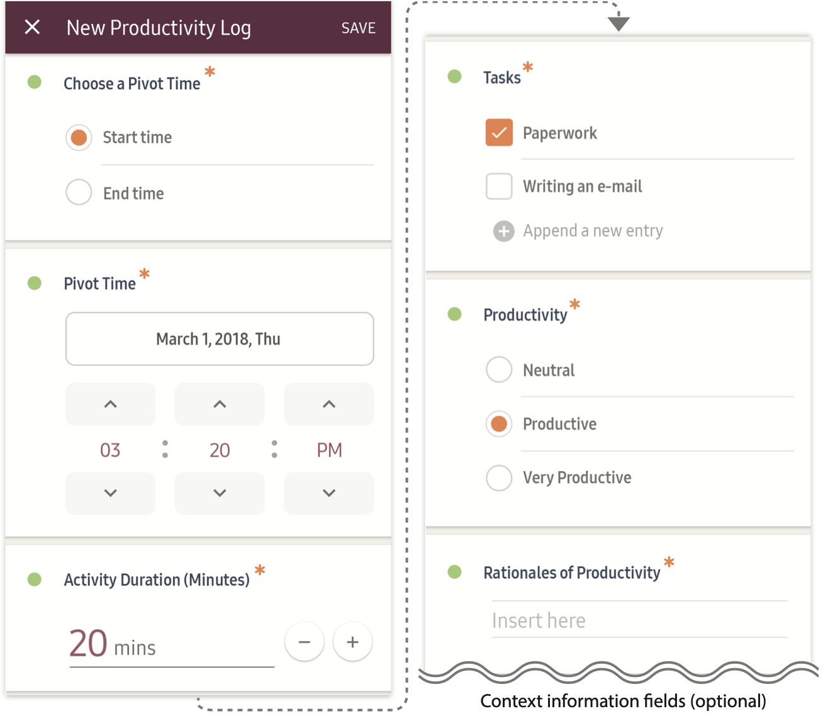
Understanding Personal Productivity: Setup/Experiment
Figure 2: Diary Study Application [3]

Slide 8

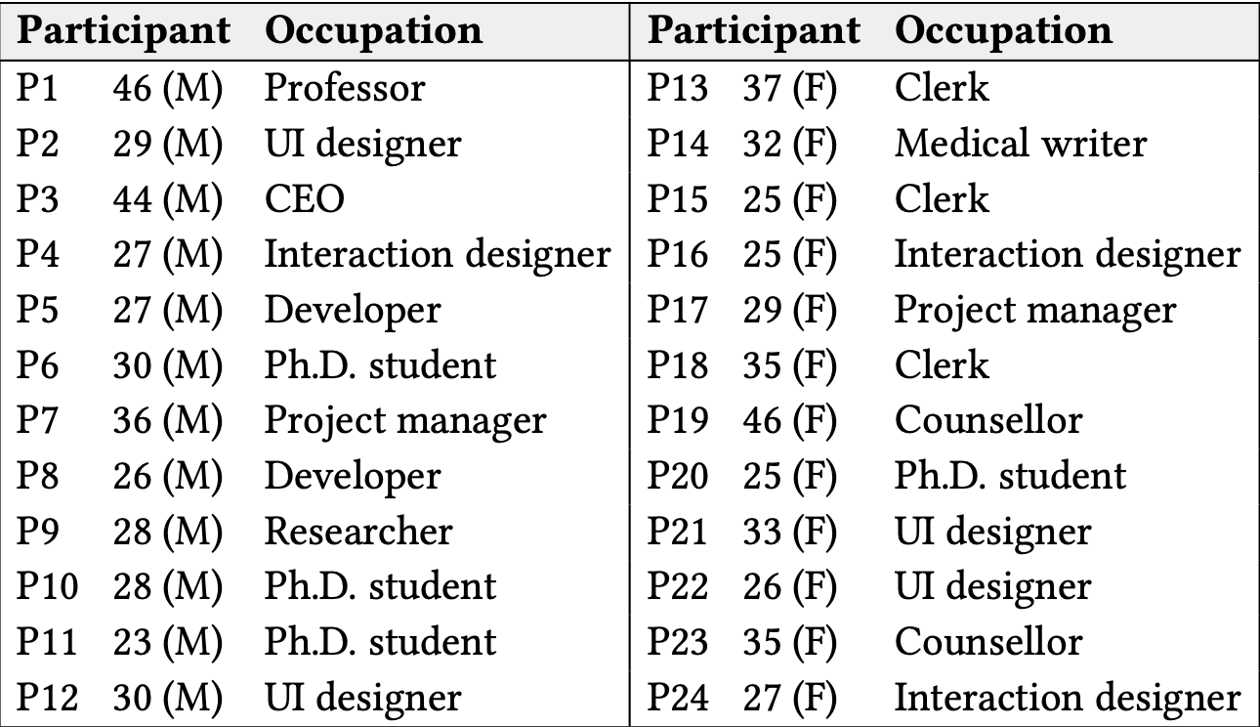
Understanding Personal Productivity: Setup/Experiment
Two applications where developed one named as Productivity Journal and other named as Skip Journal
Table 1:Demographics of the participants [3]

Slide 9

Understanding Personal Productivity: Procedure
2 weeks of study of which 10 mandatory weekdays and 4 voluntary days weekends.
Number of entries wasn’t tied to the study. Thus, the user had a freedom to define his/her own activity, and its impact on his/her own life.
After, 2 weeks of data gathering a semi structured interview was conducted to understand user’s activities and selections of choices in a rational manner.

Slide 10

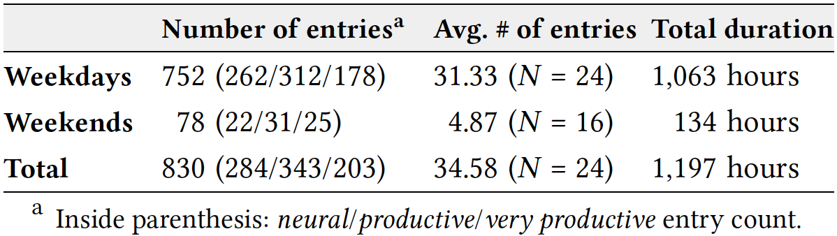
Understanding Personal Productivity: Results
Descriptive Summary of Diaries:
  830 Productive Journal entries were captured by 24 participants.
  The entries constituted 1197 hours of activities.
Table 2: Summary Statistics of the Productivity Journal

Slide 11
Understanding Personal Productivity: Results
Rationales for Productivity Evaluation:
Work Product:
  Concrete Output & Progress
  Conceptual achievement
  Quality and Quantity of the outcome
Time Management:
  Efficiency & intensity
  Punctuality
  Use of Spare time
Worker’s State:
  Attention & Distraction
  Emotional State
  Physical State
Attitude towards work:
  Chores and Mundane Task
  Significance and Rewarding for the task
Impact and Benefit:
  Long-term Career Benefit
  Social and Spiritual Benefit
  Self management and well being
  Monetary Rewards
Compound Task:
  Task switching by interruptions
  Multitasking
  Unexpected Issues

Slide 12
Understanding Personal Productivity: Results
Task Type of Productive Activities:
  Learning: Information is a critical capital for knowledge workers, learning activities covered both the work and non-work contexts.
  Communication: Communication was an essential activity, and authors found in-person communication as more preferred choice compared to email communication. Many of the user considered email as high-level task.
  Personal: These included a range form exercise to shopping medicines to groceries.

Slide 13

Understanding Personal Productivity: Discussion
Productivity as a Multifaceted Concept:
  Existing productivity tools consider whether a certain time spent on task is productive or not.
  Results showed sometimes predisposition to a task (Task is important or not), directly impacted the productivity of the task.
  Sometimes the emotional state of the person impacted the productivity of the task.
  Thus, existing productivity tools need to consider the complex concept of productivity.

Slide 14
Understanding Personal Productivity: Discussion
Diverse Productive Activities in Work Context:
  Existing models considered productivity tracking has considered only computing devices (Desktops, Laptops, Mobiles).
  Face to face meetings, offline learning activities (reading books, research papers).
  People lock their devices in office environment take short walk with colleagues to discuss work related issues.
  Thus, important aspects are still left.

Slide 15
Understanding Personal Productivity: Discussion
Productive Activities in Personal Context:
  Participants were not restricted to only work activities records.
  Assumption was that there would be much more activities work related.
  For example, many personal activities like updating a resume, will help the user for a longterm career.
  Author were able to prove there should be a symbiotic relationship between individual values and organizational productivity.

Slide 16
Understanding Personal Productivity: Discussion
Factors Affecting Productivity:
  Rationales for productivity evaluation were highly entwined within activities.
  Mundane activities are often connected to attention and distraction.
  And low attention was connected to efficiency and intensity leading to low perceived productivity.

Slide 17
Understanding Personal Productivity: Discussion
Opportunities for Tracking Tool Customization:
  There were 183 unique task, but individuals engage on an average 8.8 unique tasks.
  Thus, the current tracking tools should consider the preference, context for tracking user activities.
  As the study involved various facets of context and preference, a semi automatic tracking can be a future were user also gives a feedback.

Slide 18
Understanding Personal Productivity: Discussion
Study Limitations:
  Though the study has covered 11 participants of different occupations. But, its still not diverse enough.
  All these people were form same country South Korea, so the cultural aspects are not considered that enough.
  Many of the activities the user can oversample it as non-productive, but those can be an actual productive activity.

Slide 19
Understanding Personal Productivity: Discussion
Paper Limitation:
  Figure name has spelling mistake.
  The paper didn’t discuss the future, but rather that are some of the trivial understandings of human life.
  The paper only discusses the how a human mind perceives the productivity in the study. It doesn’t show the impact on the human lives once they are made aware of their productive activities.
  Another aspect the paper didn’t discuss was the amount of private information the user has to give in to understand the actual productivity of his/her own.
  The study could have predicted some of the usage by seeing the calendar of the user, instead of a manual entry of every task.

Slide 20

Understanding Personal Productivity: Future work
Future Work Regarding the Health:
  Can we use a similar idea in healthcare to understand personal productivity in staying healthy?
  Can we determine the culture and personalized health practices according to culture, to sustain in a different environment?
  As staying healthy mentally and physically is important task across all age groups. Can we pinout the major aspects for individual improve on?
  The tool developed needs to very much user friendly and automated in all aspects, as a manual entries is not possible for every age group.

Slide 21

Understanding Personal Productivity: Conclusion
In the background paper we saw a simple interview process in the deployment of ERP system considered context design the new system models.
The second paper, showed how personal productivity can be utilized for improvement of the worker. But we can still use this work as benchmark and explore in the realm of healthcare.

Slide 22

Understanding Personal Productivity: References
[1] Wikipedia contributors, “Context (language use) — Wikipedia, the freeencyclopedia,” 2020, [Online; accessed 22-March-2020]. [Online]. Available:https://en.wikipedia.org/w/index.php?title=Context(languageuse)oldid=94150989
[2] I. Vilpola, K. V ̈a ̈an ̈anen-Vainio-Mattila, and T. Salmimaa, “Applyingcontextual design to erp system implementation,” inCHI ’06 ExtendedAbstracts on Human Factors in Computing Systems, ser. CHI EA ’06. NewYork, NY, USA: Association for Computing Machinery, 2006, p. 147–152.[Online]. Available: https://doi.org/10.1145/1125451.1125485
[3] Y.-H. Kim, E. K. Choe, B. Lee, and J. Seo, “Understanding personal productivity: How knowledge workers define, evaluate, and reflect ontheir productivity,” in Proceedings of the 2019 CHI Conference onHuman Factors in Computing Systems, ser. CHI ’19.New York, NY,USA: Association for Computing Machinery, 2019. [Online]. Available:https://doi.org/10.1145/3290605.3300845

