Slide 1

Agile in the Military
Justin Kramer

Slide 2
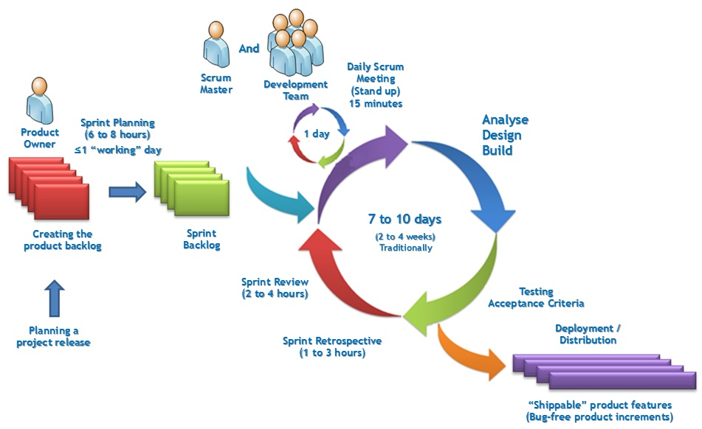
Background: Scrum Vs. Systems Engineering
Scrum
  Backlog generation
  Sprint planning
  Daily standup meetings
Systems Engineering
  Methodical, meticulous
  Detailed engineering process
  Emphasis on complete testing

Slide 3
Background: Scrum Vs. Systems Engineering
Scrum
  Fast, lightweight
  Team-based
  Testing focused
  Widely applicable
Systems Engineering
  Complete testing
  Slow
  Historically verified

Slide 4
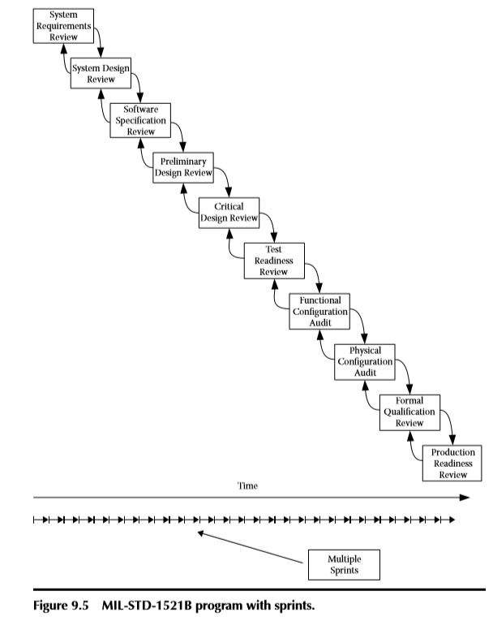
Background: Scrum Uses
Design
Verification
Response to Change
All software products
Maintainability
Review
Table 1: Scrum in Military Review [1]

Slide 5
Background: Conclusions
Systems Engineering to start
  Creating requirements
  Setting up tests
  Building development infrastructure
Scrum for everything else
  Improves workflow
  Creates realistic objectives
  Team-based iterative solutions

Slide 6
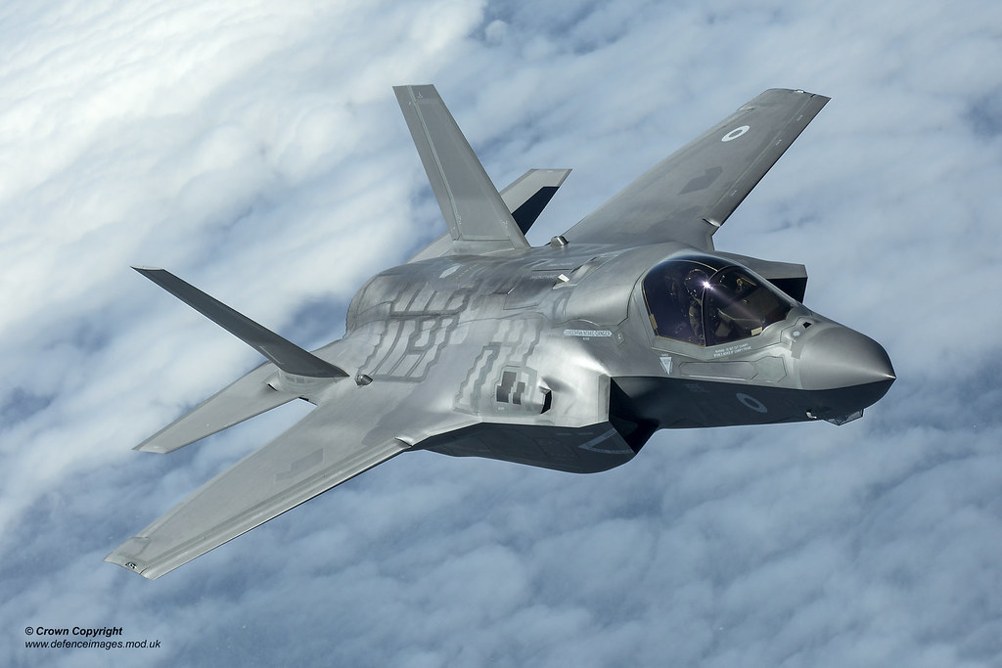
Focus: Italian Army C2 Evolution
Militaries are now software based
  1000 lines of code in F-4A
  5.7 million lines in F-35
Using software production methods
  Agile
  Scrum
Clashes with tradition
  Previous thorough procedures
  Agile is lightweight

Slide 7
Basis: War in Afghanistan
Continually changing requirements
  New forces involved each day
  NATO, Afghan forces, NGOs
Coordination challenges
  Country wide communication
  Constant monitoring
  Language barriers

Slide 8

Lessons: War in Afghanistan
Network Centric Warfare (NCW)
  Introducing software networks
  Tracking and monitoring developments
  Situational awareness
Digitized Service Layer
  Combined with Functional Area Service
  Taking in loads of information
  Translating information into view

Slide 9
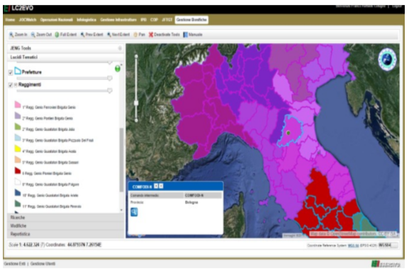
Development: LC2EVO
Land Command and Control – Evolution System
  Software based
  Involves hardware
  Volatile requirements
Time for Agile
  Initially an experiment
  Due to software basis
  Initially 3-week cycles
Table 2: LC2EVO Product [2]

Slide 10
Beginning: Experimentation
First 3-week cycle
  Extremely successful
  Delivered Planned Product
Followed Scrum
  Scrum Master
  Product Owner
  Daily standup
Issues
  Product became too complex

Slide 11
Adjustments: Military Reliability
Military Products
  Extremely high reliability
  Skeptical user community
Adjusting Agile
  Italian Army Agile (ITA)
  Tested in LC2EVO production
  Shared approach
Basis
  Core Services
  Functional Area Services

Slide 12
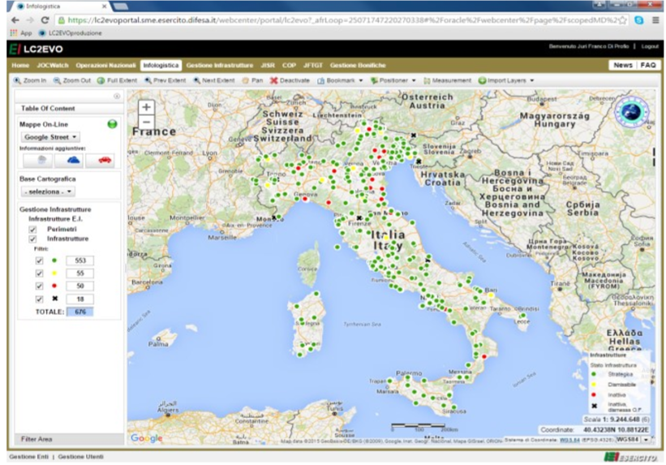
Web Based: LC2EVO
No more client-server architecture
  On the Web
  Widely accessible
Mission Threads
  Separates views
  Share code between mission displays
Common Mapping
  Web based map display
  Similar information dataflow
Table 3: LC2EVO In-Browser [2]

Slide 13
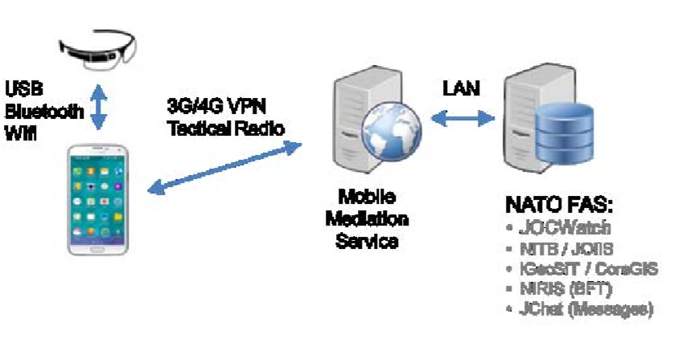
Hardware: Advanced Networking
New Technology
  Google Glass
  4G communication
Relying Information
  Google Glass view information
  Phone location information
Information Processing
  Central software servers
  Displaying live data
Table 4: Hardware Connections in LC2EVO [2]

Slide 14
Growth: Larger Agile Use
Software Intensive Projects (SIP)
  Currently facing issues with Waterfall method
  2014 – SIP Task Force created by NATO
  Improve project performance
Identified 6 key issue points
  Two relate to modernization
  Delivery early and often
  Incremental and iterative testing/development

Slide 15
Modernization: SIP Task Force Issues
Deliver Early and Often
  Previously single delivery at end
  Now multiple deliveries
  Adjusts to changing requirements
Incremental testing/development
  Previously “big bang” development
  Prototyping
  Move through iterations of a product

Slide 16

Procedures: Previous Software Development
CASE tools in place
  Creates documentation
  Very articulated
Focus on documentation
  More effort than actual coding
  Fails at reducing software errors
  Issues based on intrinsic complexity

Slide 17
Unregulated: Agile Concerns
Agile Is Lightweight
  Focuses on results, not documentation
  Lacks detail
  Unregulated environment
Modern Military Agile
  Extremely stringent
  Every single step is monitored
  Evaluating all procedures

Slide 18
Methodology: The 4 Pillars
Needed dedicated rules for Military Agile
Created after LC2EVO success
Brand new environment pillars
  User Community Governance
  Innovative agile training
  Innovative CASE tools
  High Reliability agile doctrine

Slide 19
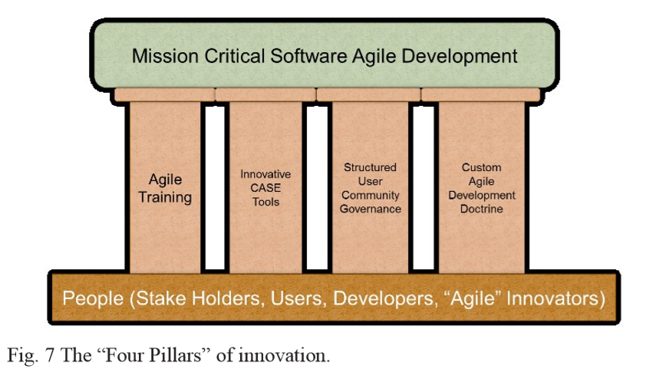
Details: The 4 Pillars
User Community Governance
  Multiple stake-holders
  Ad-hoc social networks for users
  Maintaining needs of users
Innovative agile training
  New training courses
Innovative CASE tools
  Use of natural language stories
High Reliability agile doctrine
  Following documentation
Table 5: The Four Pillars of Military Agile [2]

Slide 20
Results: Agile’s Success
More Than 1,000 Daily Users
Customer Satisfaction Near 100%
Cost Per Code Line Down 50%
LC2EVO Only Took 8 Months
  Proof of Agile’s Success
  Continuous Development

Slide 21
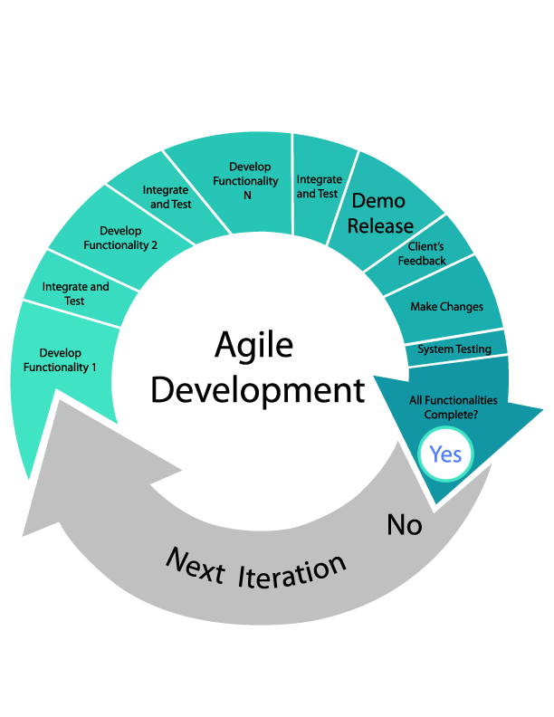
Conclusions: Military Agile
Traditional Software Engineering
  Outdated
  Is being replaced by Agile
Issues Addressed
  Management of User Requirements
  Evolution of User Requirements
Compromise
  Military standards
  Lightweight Agile speed

Slide 22
References
[1] Pries, Kim H., and Jon M. Quigley. Scrum Project Management, CRC Press LLC, 2010. ProQuest Ebook Central, http://ebookcentral.proquest.com/lib/pitt-ebooks/detail.action?docID=589930
[2] Messina, Angelo, and Fiore, Franco. The Italian Army C2 Evolution: From the current SIACCON2 land command & control system to…, International Conference on Military Communications and Information Systems, 2016. PittCat+, https://ieeexplore-ieee-org.pitt.idm.oclc.org/document/7496585

