Slide 1
Scrum Software Maintenance Model: Efficient Software Maintenance in Agile Methodology
Erhu He
Notes:
Hello, everyone. My name is Erhu and the paper for seminar is Scrum Software Maintenance Model.

Slide 2
Contents
Background
  Agile
  Scrum
  Maintenance
Current Approach for Maintenance
Motivation
Scrum Software Maintenance Model
Case Study
Discussion and Conclusion
Notes:
These are contents and talk about agile, scrum and maintenance. I will talk about current approach for maintenance and what’s the problem it has. I will explain the process of maintenance model and also talk about the case study in the paper and the findings from the case study

Slide 3
Background: Agile
Incremental and iterative development
Working Software
Customer Collaboration
Adaptability to change
Various frameworks based on team size, project duration, budget, stability etc.
Scrum, XP, Lean, Kanban, Crystal
Notes:
Agile is an incremental and iterative development model. In agile, we always involve customer and there is a lot of customer collaboration. We get customer feedback at every point by showing the working software to the customer and agile is always adaptable to change working software, encourages change even late in the development cycle. There are various ways of implementing agile through various frameworks based on the team size for a duration, stability of the project cost and so on. Scrum, XP, lean Kanban crystal are the most popular agile methodologies

Slide 4
Background: Scrum
More than 50% projects follow Scrum
Notes:
And in a survey conducted in 2011, it has been proven that more than 50% of the projects follow scrum.
There are three main roles in scrum, product owner, scrum master and the team.
Owner is the owner of the product, and the product owner guides the team throughout the development lifecycle.
Scrum master is a facilitator between the customer and the team.
And the team actually implements the product. And, in every sprint a potentially shippable product is delivered to the customer and they move to the customer to get the feedback and if the product already changes to be incorporated, they'll be pushed together the upcoming sprints

Slide 5
Background: Maintenance
Traditionally industries have different team for development vs. maintenance
  Development: Senior engineers
  Maintenance: Junior engineers
Patching an existing system is always a risk
Legacy system is often a monolith
Difficult to estimate and point size
Difficult to understand somebody else’s code
  Developers are often frustrated and bored
Notes:
Next, Let me give you some background on how traditional industries use to deal with development versus maintenance
So, traditional industries have separate team for maintenance and development.
New development is usually done by senior engineers, and it will be handed out to junior engineers for maintenance
There is a risk when you try to patch an existing system, Because patch a system by make some changes might introduce extra bugs. And these bugs are not tested. It will cause more issues
One of other drawback in traditional maintenance process is that it is difficult to estimate and point size. Generally, Maintenance teams don’t have a specific completion date for maintenance project and only contain tasks to be perform
Lastly, it is also difficult to understand others’ code. Sometimes we should read each line of the code and try to figure out what the code is doing.

Slide 6
Background: Maintenance
Common cases for maintenance
  Bug fixes, security or performance improvement
  New functionalities
  Comply with new laws and policies
60/60 rules of software (Glass, 2001)
  Maintenance 40% to 80% (60 % average) of software cost
  Enhancement roughly 60%
  Error correction 17%
30% of dominant maintenance activity just to understand the system (Glass, 2001)
Notes:
Then, I will talk about why we need software maintenance?
There are some common case for maintenance, bug fixing, security or performance improvement, or just to add new functionalities, or to comply with new laws and policies.
In the article published by glass in 2001, he talks about sixty sixty rule of software maintenance, which basically means that software maintenance accounts for 60% of software cost. And that enhancement is responsible over 60%, and the error correction is about 17%. He also says that 30% of dominant maintenance activity just to understand the system.
And he claims that maintenance is much harder than development.

Slide 7
Current Approach for Maintenance
Maintenance teams start practising agile maintenance
  agile methodologies are widely adopted by software development community and produce high-quality software systems
However, software development and maintenance are different, and we can’t use the same procedure for maintaining the software
  development vs. maintenance
  less documentation vs. up-to-date documentation (Souza, 2005)
  no interruption when development vs. urgent emergency customer involvement during maintenance
Notes:
Currently, Maintenance teams start practising agile maintenance. This is because agile methodologies are widely adopted by software development community and many high-quality software systems are produced with agile methodologies.
However, maintenance team encounters many issues, because we cannot use the same agile procedures for maintaining the software. The first issue is that agile requires less documentation, but maintenance team need up-to-date documentation to understand the system in detail. Second, there is no interruption when development, but customer involvement is frequent during maintenance.

Slide 8
Motivation
Maintenance teams face challenges while working with agile methodologies because maintenance and development are different processes
Agile software development life cycle doesn’t have the specific mechanism for maintenance
Mainly to solve the question:
  how to handle the urgent emergency customer requests during the agile maintenance sprints?
Notes:
Maintenance teams face challenges while working with agile methodologies
In order to bridge the gap that Agile doesn’t include the process of maintenance, the authors start the research about agile methodology, and mainly focus on solving how to handle the emergency customer requests during the agile maintenance sprints.

Slide 9
Scrum Software Maintenance Model
Authors design a scrum software maintenance model to handle urgent emergency customer requests in parallel with regular sprints
Inspiration:
  The finding from Pino (2012): define two different types of sprints – unplanned or unexpected short sprints and planned or regular long sprints
  The finding from Heeager (2015): create a buffer – some extra time that is not allocated to any task and can be used later for unexpected tasks
Notes:
In this paper, authors design a scrum software maintenance model to handle emergency customer requests in parallel with regular sprints.
This model is inspired by two paper. The first paper is published in 2012. The author defined two different types of sprints –short sprints for emergency customer requests and regular sprints for normal maintenance.
Another paper is published in 2015. The author created a buffer for emergency customer requests.

Slide 10
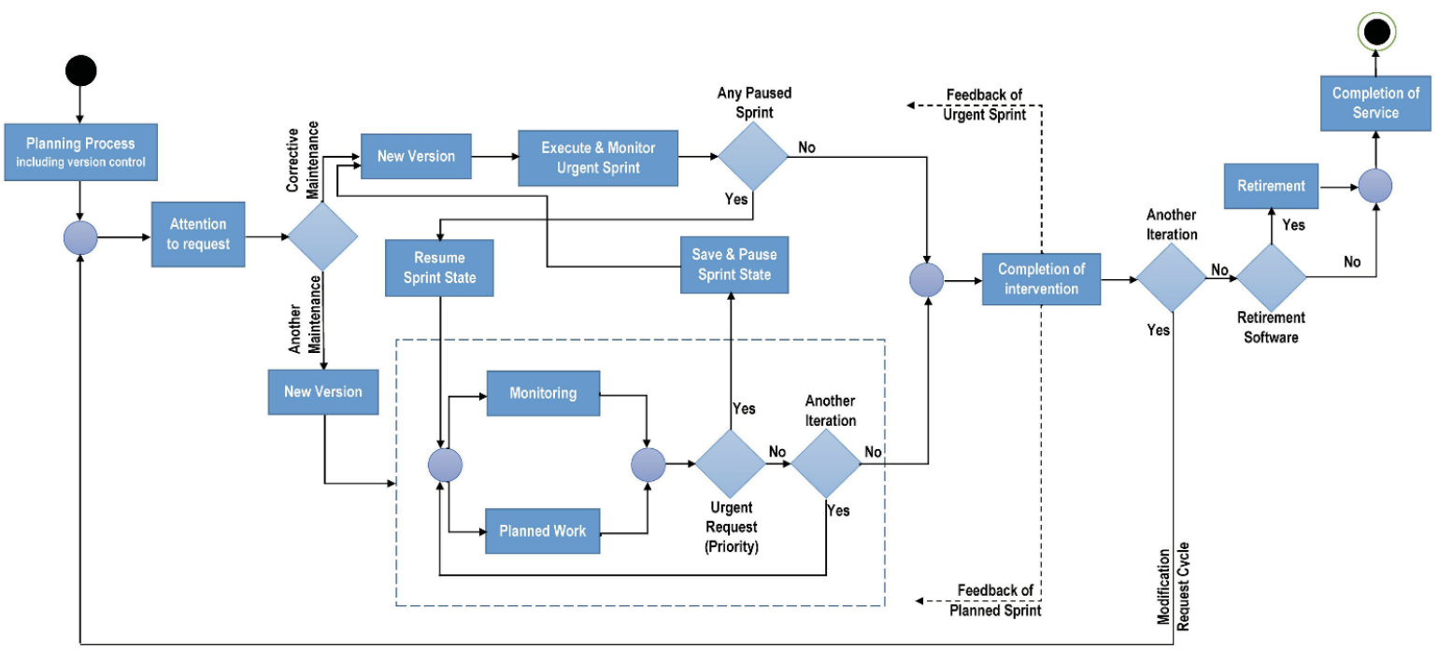
Scrum Software Maintenance Model: Process
Notes:
Now, let me introduce the process of this model.
Scrum Software Maintenance Model starts with the planning process, which contains version control. After planning, special attention is made to check the type of maintenance request.
Corrective maintenance is considered as priority and working is started on it by creating new code branch. Another maintenance requests are planned normally. a special monitoring will be done to check for emergency sprints during their execution. If some emergency request received, current sprint will be stopped, its work is recorded in version control system and the new version is started for the emergency request. After the completion of the emergency request, this model checks for stopped sprint and resume it from the version control.

Slide 11
Scrum Software Maintenance Model: Emphasis
This model introduced a concept of saving sprint state using version control
It emphasizes the following points:
  Planning for the maintenance
  The on-site customer should be present
  Perform each maintenance task in the iteration
  Documentation update after each phase
  Maintenance should be testable
Notes:
Version control is the key point for this model. Beside version control, it also emphasizes the following points:
Planning for the maintenance
The on-site customer should be present
Perform each maintenance task in the iteration
Documentation update after each phase
Maintenance should be testable

Slide 12
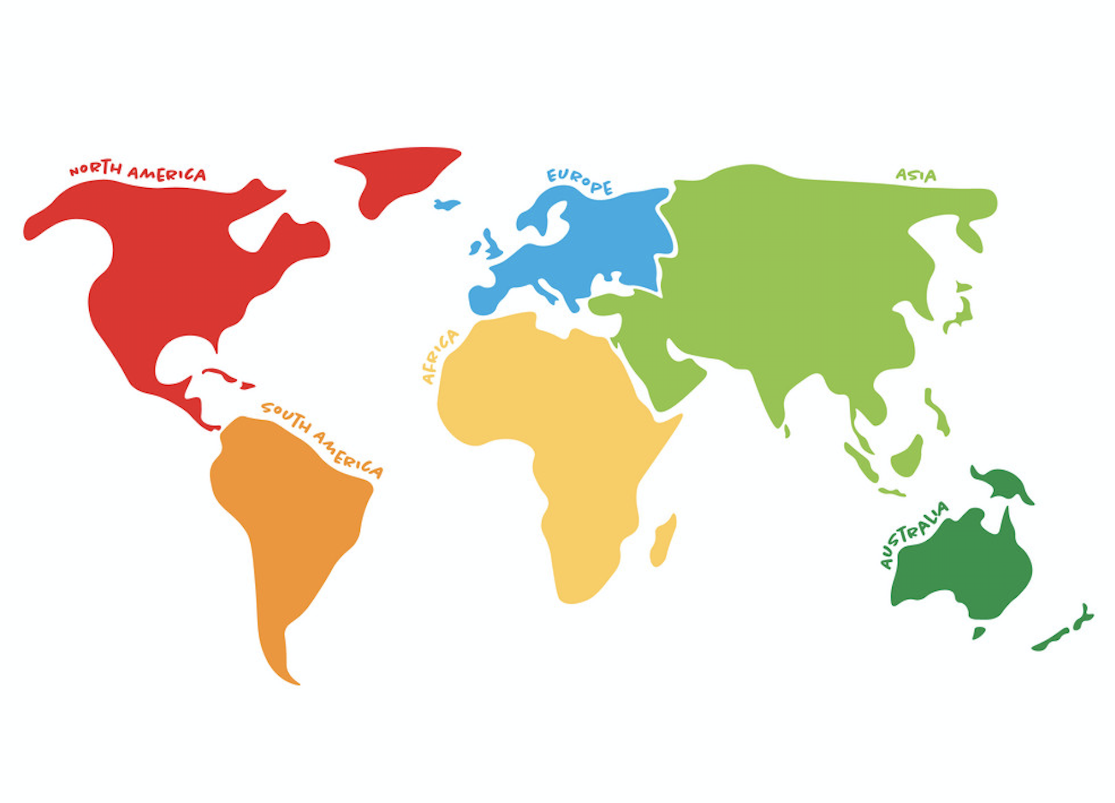
Case Study
A case study for the maintenance of a fitness system:
  Maintenance team is in South Asia
  Customer is in the USA
  Communication is carried out with online communication tools
Notes:
The authors pick a case study for the maintenance of a fitness system This
system has fitness trainers and their clients. trainers are
virtually training their clients using the plans.
The maintenance team is located in South Asia and
customer was in the USA and communication between them is
carried out using communication tools.

Slide 13
Issues during Case Study
Urgent emergency sprints are overriding the current sprints, and sprint goals are not meeting.
Rework required for the sprints that are replaced by urgent emergency sprints because there is no way to save the state of current sprint.
The complete system’s testing naturally impractical, and tracking error is confusing because there is no specific code version for the specific iteration.
Notes:
There are three problems during the case study.
The model doesn’t define the size of sprints, so that sprint goals are always not meeting.
And, We cannot save the state of current sprint, we need to rework the stopped sprint.
Lastly, the test is very difficult, because there is no specific code version for the specific iteration.

Slide 14
Case Study: Analysis
An analysis covered three months of maintenance work and included six planned and four unplanned sprints:
  Conduct interviews with scrum masters, team members and authors
  They also participate in the scrum meetings during which maintenance team discussed and planned the emergency tasks with the client
Notes:
In order to assess the case study, an analysis is done by conducting interviews with scrum master, team members and authors of this paper. These interviewers participate in the scrum meetings during which maintenance team discussed and planned the emergency tasks with the client.
In addition, the analysis covered three months of maintenance work and included six planned and four unplanned sprints. In the start, six sprints were planned
by adding buffers in the sprints. The client requested emergency maintenance four times during the three months’ analysis. Each time client was involved in revising the original sprints plan, and maintenance engineers switched to emergency sprints by saving their work in the separate version using version control system. After completing emergency maintenance, engineers turned back to the leftover sprint; buffers plus approved additional time helped them to meet the time goals. During this process, each iteration was documented in use cases and test cases format.

Slide 15
Benefits using Scrum Software Maintenance
Model
Client satisfaction is increased
Maintenance engineers' morale is improved
Separate version for each sprint makes integration testing easy and enables testers to devise and perform the test cases according to the integration of specific iteration
Simplified minimal documentation in the form of use cases and test cases increase the software system maintainability and testability.
Notes:
The case study shows that the model has the following benefits:
Client satisfaction is increased
Maintenance engineers' morale is improved
Separate version for each sprint makes integration testing easy and enables testers to devise and perform the test cases according to the integration of specific iteration
Simplified minimal documentation in the form of use cases and test cases increase the software system maintainability and testability.

Slide 16
Discussion: Personal Perspective
Positive:
  This model gives us a specific process of maintenance in detail
  It speeds up the process of maintenance, as maintenance engineers can have individual tasks on different versions of a system
  It increases the communication between maintenance team and customers
  It improves code quality

Slide 17
Discussion: Personal Perspective
Negative:
  It's hard to predict the size of unplanned or unexpected sprints
  Version control increases the errors traceability, but it also make the software system difficult to understand
  Only one case study is not sufficient to prove the performance of new model

Slide 18
Conclusion
Maintenance is much harder than development
Industries should pay more attention on maintaining software systems
Scrum Software Maintenance Model works well but still has issues
Authors need to do more and more case studies to prove the performance of their model
In the future, we can focus on defining the size of extra sprint and specific code version

Slide 19
References
ur Rehman, Fateh, et al. "Scrum Software Maintenance Model: Efficient Software Maintenance in Agile Methodology." 2018 21st Saudi Computer Society National Computer Conference (NCC). IEEE, 2018.
Glass, Robert L. "Frequently forgotten fundamental facts about software engineering." IEEE software 3 (2001): 112-110.
de Souza, Sergio Cozzetti B., Nicolas Anquetil, and Káthia M. de Oliveira. "A study of the documentation essential to software maintenance." Proceedings of the 23rd annual international conference on Design of communication: documenting & designing for pervasive information. 2005.
Pino, Francisco J., et al. "A software maintenance methodology for small organizations: Agile_MANTEMA." Journal of Software: Evolution and Process 24.8 (2012): 851-876.
Heeager, Lise Tordrup, and Jeremy Rose. "Optimising agile development practices for the maintenance operation: nine heuristics." Empirical Software Engineering 20.6 (2015): 1762-1784.
Notes:
These are references. The first one is the main paper, others are background papers

Slide 20
Thank you!
Questions?

