Slide 1

Performance Analysis of Microservices Design Patterns
Fangzheng Guo
fag24@pitt.edu

Slide 2
Background
Microservices architecture brings a lightweight, independent, reuse-oriented, and fast service deployment approach that minimizes infrastructural risks.
The performance of its design patterns?
  Query response time
  Hardware usage
  Hosting cost
  Packet loss rate
  …
Notes:
We have already been familiar with the concept of Microservices from Jiaye Zhu’s presentation. Microservices-based solutions are currently gaining momentum because they do not have the disadvantages of traditional monolithic architectures. This approach is at an early stage of its development, and in view of this, it is important to understand the performance of its design patterns.

Slide 3
Design Patterns
API Gateway
Chain of Responsibility
Asynchronous Messaging
Notes:
Until now, a lot of design patterns have been proposed. This paper implemented various applications using the API Gateway, Chain of Responsibility, and Asynchronous Messaging design patterns. Let’s look at API Gateway first.

Slide 4
Experiments
Tester: generates web customer requests
  Multi-threaded structure
Analyzer processes the response time and calculate the mean and confidence interval of the response time.
Notes:
All experiments use the following 3 main components; a tester, an analyzer and web resources implemented in microservices related to the experiment. The tester generates web customer requests that are executed by the microservice environment. All experiments evaluated the response time of an implemented application, i.e., the time it takes to process a request, by subjecting the application to a maximum load. To this effect, the tester was implemented as a multi- threaded structure which generates a predetermined number of threads. Each thread issues 3000 requests back-to-back in an asynchronous manner, and when all the responses to the requests are received, the thread is deleted.
Each thread records the time at which a request is issued and the time at which the response to the request is received in a text file. All the text files generated in the experiment are processed by the analyzer in order to calculate the mean and confidence interval of the response time, also the 95th percentile of the response time. The latter metric is a value of the response time such that only 5% of the sample response times are higher. We note that this is a more meaningful metric in Service Level Agreements (SLAs) than the mean, since it provides a statistical upper bound.

Slide 5
API Gateway
(a)Mean and 95th Percentile of the Response Time vs Number of Threads
Notes:
An API Gateway acts as a single entry point for requests and based on the nature of a request it invokes an appropriate sub-service. The authors implemented an online theater system using this pattern on a 4 core Intel CPU (2.0 GHz) with 16 GB RAM server. The system consists of four services: Movies, Sessions, Tickets and Reservations. From the testing result, we can clearly see that for the tail of the response time distribution, the further away it is from the mean, the longer the tail is. For instance, for a single thread, the average response time is 3.82 ms, whereas the corresponding 95th percentile is 10.48 ms. Similarly, for 100 and 200 threads, we have a mean response time of 399.89 ms and 1295 ms respectively with a corresponding 95th percentiles of 2544.32 ms and 5077.85 ms.
The reason is we submit all the requests from all the threads as soon as possible which creates a huge BACKLOG, then the response time of the requests towards the end of the queue increases quite dramatically.

Slide 6
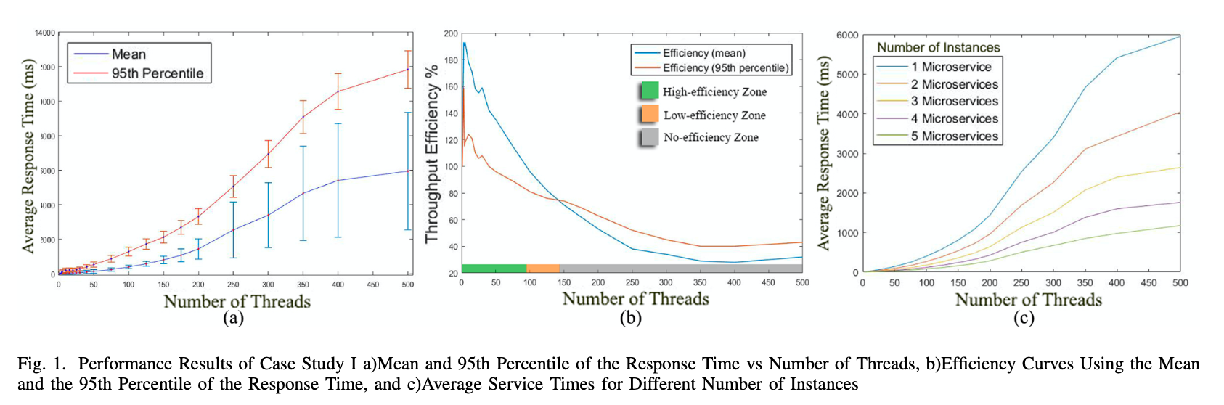
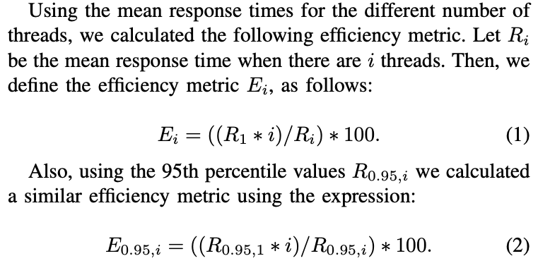
API Gateway
(b) Efficiency Curves Using the Mean
and the 95th Percentile of the
Response Time
Notes:
The efficiency based on the mean response time (Ei) increases from one thread to 18 threads, and then from 19 to 94 threads it continuously decreases until at 94 it becomes equal to E1. The paper identified high-efficiency is achieved for the range of threads from 1 to 94, since the efficiency is over 100%. Low efficiency is achieved from 95 to 141 threads, since the efficiency is between 100% and 75%. In this case, the service time is slightly longer, but it is still acceptable. Finally, for more than 142 threads, the efficiency is less than 75%, and the service is classified as not efficient.
When we use the efficiency plot based on the 95th percentile of the response time. High-efficiency is achieved from 1 to 83 threads, and low-efficiency is achieved from 84 and 141 threads.

Slide 7
API Gateway
c)Average Service Times for Different Number of Instances
Notes:
If we want to decrease the non-efficient zone, we need to use more than one instantiation of the microservice. We can see that microservice architectures offer scalability at a very high level by replicating microservices.

Slide 8
API Gateway Summary
The most ideal architecture for an equally balanced scenario.
Flexible while managing requests from multiple channels.
Facilitates the execution logic of synchronous communications between equally balanced services and provides scale-up artifacts
Notes:
The API Gateway design is typically used as a point of contact layer among other architectures. In fact, a microservices ecosystem without an API Gateway is considered as a bad practice or an anti-pattern.

Slide 9
Chain of Responsibility
A collection of sub-services designed to work together in order to process a request
  Sub-services are linked together sequentially

Slide 10
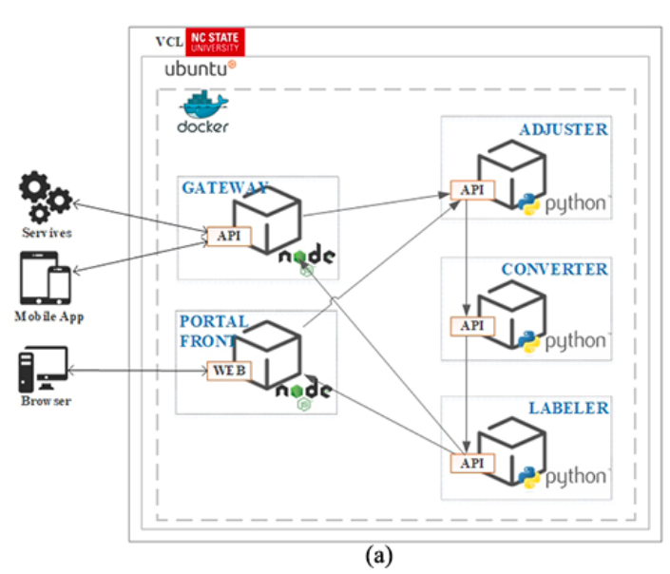
Chain of Responsibility
Notes:
In the experiment, users submit a colored image as an input and request to have it converted to black and white.
Microservices:
Adjuster: checks the size of the submitted image and resizes it if it is bigger than 1920 x 1080.
Converter: converting the image into a grayscale form
Labeler: applies a watermark onto the image

Slide 11
Chain of Responsibility
The CPU and RAM for the composite implementation were obtained experimentally
by varying them until the throughput of the composite implementation
became equal to that of the microservice implementation.
Notes:
The third column labeled “Hosting Diff” gives the percentage by which the hosting cost will increase if we used the composite implementation based on hosting prices from Amazon web services.
We can see that the same application may require different RAM and CPU for different design pattern implementations. Therefore, the design pattern is an important decision that has a direct impact on hosting costs. Table I shows that the cost difference for a different number of users varies between 21.25% and 33.18%.

Slide 12
Chain of Responsibility Summary
Pros: this architecture allows us to scale back-end services independently, with a gain on the hardware usage of around 30% compared to the megaservice equivalent structure.
Cons: excessively long chains may lead to a spaghetti structure.

Slide 13
Asynchronous Messaging
A large volume of data needs to be processed
No immediate response is expected
Notes:
The synchronous communication provided by the REST mechanism is simple and well-known, easy to test, and firewall-friendly. However, it is not ideal for some scenarios because of the blocking of the clients. Asynchronous messaging and event-driven communications can be implemented to propagate changes between microservices.
The asynchronous messaging design pattern is preferred when there is a large volume of data that needs to be processed and also when no immediate response is expected.

Slide 14
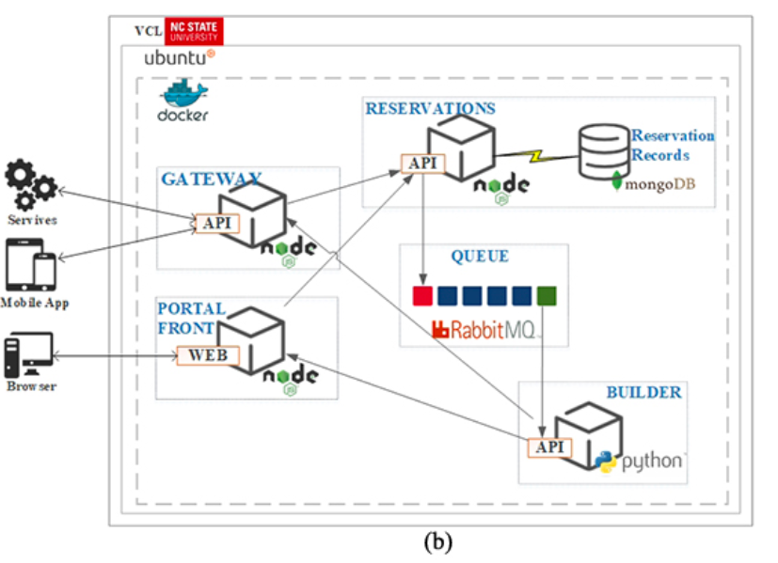
Experiments
A queue in RabbitMQ between Reservation and Builder (FIFO).
Notes:
The case study was implemented using the Asynchronous Messaging design pattern, as shown in Figure 2.b. A queue structure is introduced between the Reservation and the Builder microservices using RabbitMQ since the service time of a request in the Builder is much longer than that in the Reservation.
A queue in RabbitMQ is an ordered collection of messages which are enqueued and consumed in a FIFO manner.
The scenario ends with the transfer of the pdf-formatted ticket to the client. The reason we implemented RabbitMQ instead of any other message broker products is because of it provides the state of the messages (consumed, rejected, acknowledged, etc.) in the ecosystem. Most of the message brokers are stateless and assume that the consumer keeps track of what has been consumed.

Slide 15
Asynchronous Messaging
Useful to transaction-based scenarios involving processes with disparate service times.
No packet loss:
Composite Implementation: 131.073 GB vRAM and ten 4.0 GHz vCPUs
Asynchronous Messaging: 122.288 GB vRAM and six 4 GHz vCPUs
Notes:
The authors found using Asynchronous Messaging is able to let us minimize the packet loss with lower configurations.

Slide 16
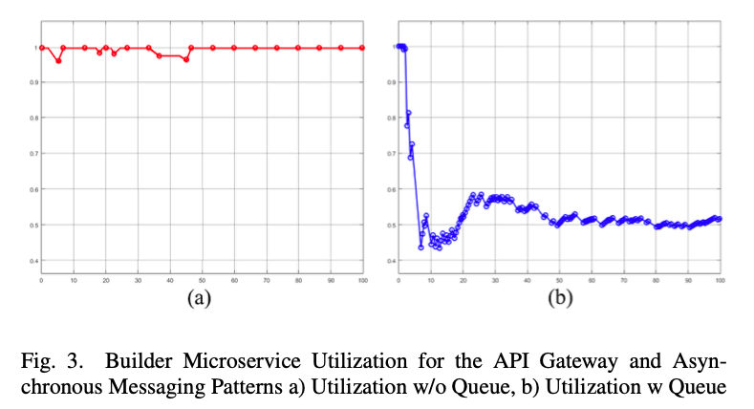
Asynchronous Messaging
Optimal CPU utilization
Notes:
Configuring the egress rate of RabbitMQ via its management plugin appropriately can let us save half of the CPU utilization, in order to avoid unnecessary energy consumption.

Slide 17
Conclusion
Each design pattern performs better in different scenarios.
Complex architectures come with long-term development cycles. However, they will increase productivity and drive down cost.
Still immature, practices of use are critical to their success in future.
Notes:
From this paper, we know that there is no single microservices pattern that is better than the other in general. Developing these microservices architecture and patterns will need more effort, but they worth it. The easiest way to evaluate the success of microservices is to ensure that they meet or exceed monolithic pre-migration performance.
Microservices architectures are still immature. Therefore, best practices of their use are critical to their successful adaptation and incorporation in the future of SOA.

Slide 18
Thank you for watching
Please email me if you have any questions.

