Slide 1
AUTOMATICALLY LOCATE BUGGY FILES IN SOURCE CODE:
USING Information Retrieval AND DEEP LEARNING METHODS
Gerasimos Palaiopanos
Presentation Video

Slide 2
CONTEXT – PROBLEM - SOLUTION
- Context: Software is released or getting maintained. It may have bugs.
- Problem 1: identifying potentially buggy source files?
- Problem 2: Where in the code can we start correcting the bug? Can we formulate a query for a location in the code?
- Problem 3: Experience (feedback) from the developer can help do this automatically?
Notes:
CONTEXT – PROBLEM - SOLUTION
- Context: Software is released or getting maintained.
It may contain buggy files.
A software user (e.g. ECLIPSE user, jEDIT user) provides a bug report.
- Problem 1: How can we relieve the developer from the burden of identifying potentially buggy source files (given a bug report)?
- Problem 2: Thus, where in the code can we start correcting the bug? Can we formulate a query for a location in the code? (query formulation for Software change )
- Problem 3: How to use feedback from the developer to help do this automatically?

Slide 3
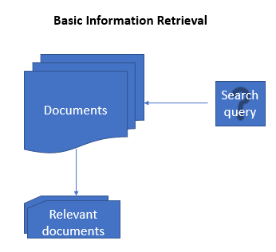
Solution proposed (IBM widely uses it!):
- A new methodology for lexical based static concept location.
- Treat the code as text units (call them ‘documents’ of natural language).
- Take the bug report and create a ‘query for searching’ the location of the code to be fixed.
- The buggy files will present higher relevance to the query.
- So they surface among the others.
Notes:
SOLUTION proposed in these 2 papers:
A new methodology for lexical based static concept location.
That is, treat the code as text units (call them ‘documents’ of natural language).
Then take the bug report, create a ‘query for searching’ the location of the code to be fixed and try to correlate all files with it.
The buggy files will present higher relevance to the query.
This is how they will be automatically distinguished among other files (they surface among the others).
Tool for this: NLP (natural language processing) methods based on similiarity search.

Slide 4
Why is this problem important?
- Guarantee the software quality assurance given:
-> the large volume of code
-> the complexity of code
-> hard to track every software defect BEFORE formal release of the software

Slide 5
Content
What is Change Request, Concept Location, Relevance Feedback (RF), Information Retrieval (IR), IR+RF=IRRF
  Why it is important
NLP method 1: Vector Space model
Experiments
NLP method 2: Long-Short term memory networks combined with Convolutional Neural Networks
Advantages & Disadvantages of methods
Conclusions
Criticism

Slide 6
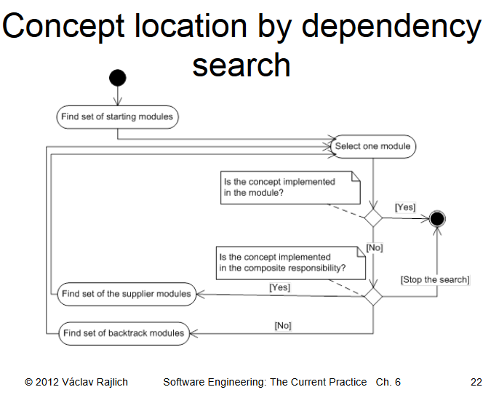
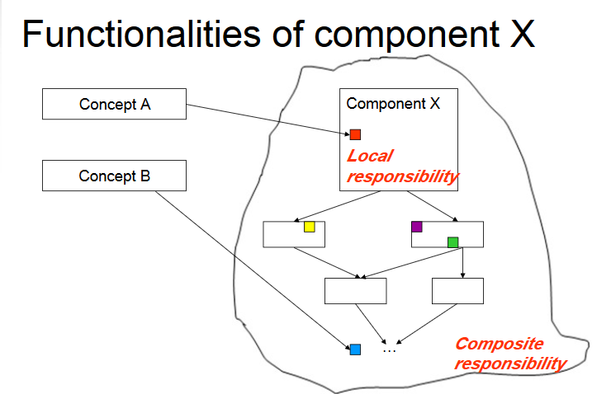
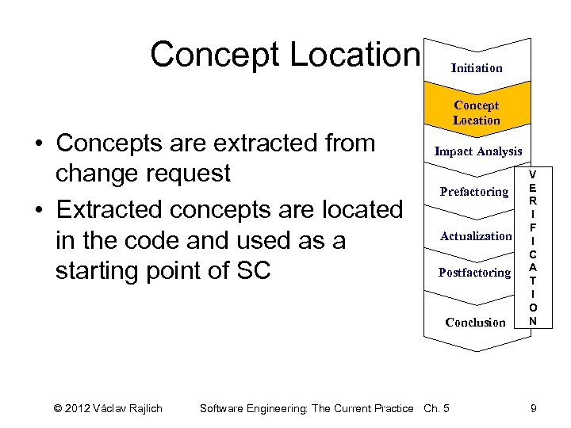
DEFINITIONS:
1. Concept Location
Concept_Location_image-9.jpg
Notes:
DEFINITIONS:
1)Concept Location: activity where the developers browse and search the code to find where a change is to start (SC: Software Change) in response to a modification request during software evolution and maintenance (such as bug report or a new feature request).
Applications: change management , fault localization etc in S. Eng.
It is only intended to provide starting points for more detailed exploration of the code.
Concept location starts with the change request and ends when the developer finds the location in the source code where the first change must be made. Thus they need tools and methodologies to navigate in the code for this.

Slide 7
DEFINITIONS:
- 2. Information Retrieval for concept location
- 3. Relevance Feedback
- Why is it important (e.g. in locating buggy code files) to use apply efficiently concept location?
So:
Use of Relevance Feedback in IR for concept location (e.g. detection of bugs): IR+RF=IRRF
Notes:
DEFINITIONS:
2) Information Retrieval for concept location
How to use Information Retrieval: treat source code as a text corpus and use IR methods to
index the corpus and build a search engine, which allows developers to search the source code
much like they search other sources (e.g., the internet)
The user needs to match a query for a change in the source code to a textual location in the code.
3) Relevance Feedback is a two-part process in which
the developer judges existing results returned by a search and
the IR system uses this information to perform a new search (formulate new queries), returning more relevant information to the user.
Why is it important?
Developers start the process from a change request and they either use the entire change request as a query or they select a set of words from it and use this subset as a query in order to detect the textual location in the code for the code modification.
Extracting a good query from a change request depends on the experience of the developer.
So:
Use of Relevance Feedback for concept location: i.e. to match a query for starting to correct a bug to the suitable location in the source code.

Slide 8
METHOD 1: Locate buggy files with the use of Information Retrieval only
- IR-based concept location (‘index the corpus from software’)
1. Corpus creation
2. INDEXING
3. Query formulation
4. Ranking documents
5. Results examination
Notes:
METHOD 1: Locate buggy files with the use of Information Retrieval Relevance Feedback
- IR-based concept location: Uses an IR method to index the corpus extracted from the software (here: Vector Space Model).
1. Corpus creation: The source code is parsed and documents are extracted from the source code. Each method (or class) will have a corresponding document in the corpus. (Or the code can be split on its identifiers, the stop words may be removed, the keywords may be removed, stemming may be done, comments may be excluded etc.)
2. INDEXING: The corpus is indexed by the IR math method and each document (i.e., each method or class) has a corresponding index (computed with Latent Semantic Indexing, Vector Space Model, traceability link recovery etc.)
3. Query formulation: A developer selects a set of words that describe the concept to be located (= query). The entire change request can be the query.
4. Ranking documents. Similarities between the query and every document from the source code are
computed and the documents are ranked according to this similarity. The similarity measure depends on the
IR method used
5. Results examination. The developer examines the ranked list of source code documents, starting with
those with the highest similarities (to the query). For every source code document examined, a decision is made
whether the document will be changed or not. Decision: ‘End the location search’ or ‘Go back to step 3’ to make a better query using your new knowledge

Slide 9
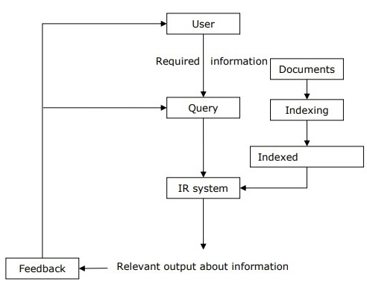
METHOD 1: Locate buggy files using Information Retrieval: ADD RELEVANCE FEEDBACK (IRRF)
- Explicit feedback: users decide the relevance of a document retrieved for a query
- Again the 4 steps are same as before
1. Corpus creation
2. INDEXING
3. Query formulation
4. Ranking documents
5. Results examination: NEW TECHNIQUE here: If developer decides that the document does not change, he/she marks it as relevant or not. After N documents being marked, a new query is created.
Notes:
METHOD 1: Locate buggy files using Information Retrieval: ADD RELEVANCE FEEDBACK (IRRF)
- Explicit feedback is obtained from users by having them ASSESS the relevance of a document retrieved for a query. Users may indicate relevance explicitly using a binary or graded relevance system.
Binary relevance feedback indicates that a document is either relevant or irrelevant for a given query.
Graded relevance feedback indicates the relevance of a document to a query on a scale using numbers.
Assumption in RF which are not true in source code: There are patterns of term distribution (words) in the relevant vs. non-relevant documents: (i) term distribution in relevant documents will be similar; (ii) term distribution in non-relevant documents will be different from that in relevant documents (i.e., similarities between relevant and non-relevant documents are small).
There is no evidence so far that this is true for source code.
This will make the problem more challenging for us!
Again the 5 steps are the same as before
1. Corpus creation
2. INDEXING
3. Query formulation
4. Ranking documents
5. Results examination: NEW TECHNIQUE here: The developer examines the top N documents in the ranked list of results. For every source code document examined, the developer makes a decision on whether the document will be changed in response to the change request or not. If it is changed, then the search succeeded and concept location ends. Else, the user marks the document as relevant or irrelevant. After the N documents are marked a new query is automatically formulated and the methodology resumes at step 4. If several rounds of feedback do not result in reaching the result, then the query may be reformulated manually by the user and resume at step 4.

Slide 10
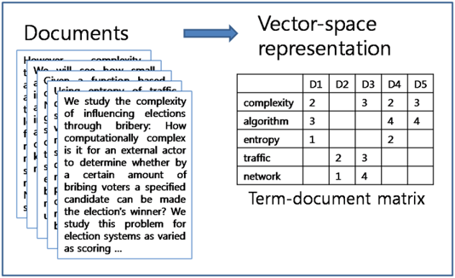
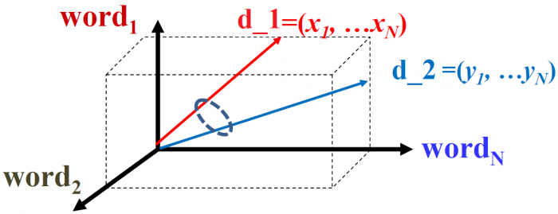
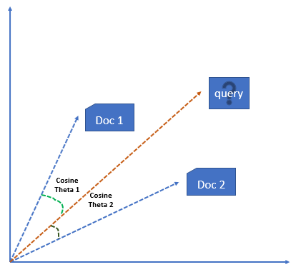
METHOD 1: Locate buggy files using Information Retrieval: ADD RELEVANCE FEEDBACK (IRRF)
- STEP 3: IR indexing with the Vector Space Model. Vector with word frequencies TF-IDF.
Notes:
METHOD 1: Locate buggy files using Information Retrieval: ADD RELEVANCE FEEDBACK (IRRF)
STEP 3: IR indexing with the Vector Space Model. A vector model of a document d is a vector of words weights that span over the number of words in the corpus. The weights for each word are computed based on the term frequency of that word in d and the inverse document frequency (scaled inverse fraction of the documents that contain the word. It checks whether the term is common or rare across all documents in the corpus). The similarity between two documents is computed as the cosine between their corresponding vector models (TF-IDF).

Slide 11

METHOD 1: Locate buggy files using Information Retrieval: ADD RELEVANCE FEEDBACK (IRRF)
- STEP 5: RF with ATTRACT-REPEL model.
Update current Q: query vector of words
-> Add weighted word vectors from the relevant docs (RQ)
-> Discard weighted word vectors from the irrelevant docs (IQ).
Notes:
METHOD 1: Locate buggy files using Information Retrieval: ADD RELEVANCE FEEDBACK (IRRF)
- STEP 5: RF with ATTRACT-REPEL (Rocchio) model: When analyzing the top ranked methods, the user is asked to judge the current method as relevant, irrelevant, or neutral to the current change task.
Given a set of documents DQ encompassed by query Q, let:
RQ: the subset of relevant documents and
IQ: the set of irrelevant documents to the query.
The original query Q can be then updated by adding terms from RQ and discarding terms from IQ. This mechanism is meant to bring the query closer (‘ATTRACT’ IT) to the relevant documents and drive it away (‘REPEL’ IT) from the irrelevant documents in the vector space.

Slide 12
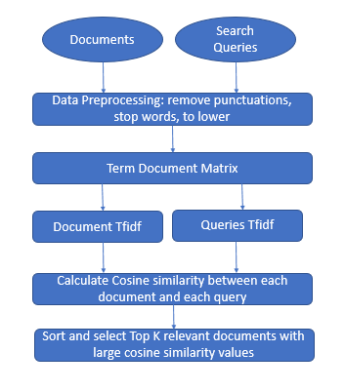
METHOD 1: THE BUG FILES USED FOR THIS CASE STUDY EXPERIMENTS
ECLIPSE
-jEDIT
-Adempiere (all are open source)
- All have rich history of changes
- Millions of code in Java, thousands of methods in each system
- STEP 1: Corpus was created, see image:
Notes:
METHOD 1: EXPERIMENTS
- ECLIPSE, jEDIT, Adempiere (all are open source)
- All have rich history of changes
- They all have online bug tracking systems, where bugs are reported and patches are submitted for review.
Eclipse is an integrated development environment developed in Java. For our case study, we considered version 2.0 of the system, which has approximately 2.5 million lines of code and 7,500 classes.
JEdit is an editor developed for programmers and it comes with a series of plugins which add extra features to its core functionality. It is developed in Java and version 4.2 used in this case study has approximately 300,000 lines of code and 750 classes.
Adempiere is a ‘Commons-based’ peer-production of open source enterprise resource-planning applications. It is developed in Java and it has approximately 330,000 lines of code and 1,900 classes in version 3.1.0, which was used in our case study.

Slide 13
METHOD 1: EXPERIMENTS
- ECLIPSE : open-source bug tracking system BugZilla6 to keep track of bugs in the system
- jEDIT : bug tracking system in http://sourceforge.net/tracker/?group_id=588&atid=300588
- Adempiere : bug tracking system in http://sourceforge.net/tracker/?atid=879334&group_id=176962
Notes:
METHOD 1: EXPERIMENTS
- ECLIPSE, jEDIT, Adempiere (all are open source)
We used the history of a software system, i.e., approved patches of documented bugs, in order to extract real change requests and their corresponding change sets. The bug descriptions are considered to be the change requests.
For each of the systems, we analyzed their online defect tracking systems and manually selected a set of bugs to extract change sets for our case study.
The Eclipse community uses the open-source bug tracking system BugZilla6 to keep track of bugs in the system. Each bug has an associated bug report, which consists of several sections, one of which is the bug description. Sometimes the patches used to fix the bugs are also contained in the bug report, as attachments. They are usually in the form of diff files, containing the lines of code that changed between the version of the software where the bug was reported and the version where the bug was fixed. For our case study, we chose an initial set of 10 bugs reported in version 2.0 of the system, for which the patches were available in their bug reports.
For jEdit7 and Adempiere8, we analyzed the bug tracking systems hosted on the projects’ sourceforge.net website. Both projects have systems that keep track of the patches submitted for known bugs in the source code. In these trackers, each patch has an associated report where the changes implemented in the patch are described in a diff file attached to the report. We selected for each system 10 initial patches for which a good description of the bug fixed by the patch was available, either in the description of the patch or in a separate bug report.
All the patches we selected for jEdit were submitted and their corresponding bugs reported, after version 4.2 of the system was released.
For Adempiere, the patches selected were after the release of version 3.1.0.

Slide 14
METHOD 1: EXPERIMENTS
- Assessment of the experiment: the efficiency measure is the number of source code documents that the user has to investigate before locating the point of change
- Target methods: the java ‘method’ fetched, i.e. the code location which is the index of a vectorized java method, is correctly found to be the buggy one for modification
Notes:
METHOD 1: EXPERIMENTS
- Assessment of the experiment: the efficiency measure is the number of source code documents that the user has to investigate before locating the point of change (resembles like the user selects 1 True Positive from the False Positive the system fetched).
- Target methods: the java ‘method’ fetched, i.e. the code location which is the index of a vectorized java method, is correctly found to be the buggy one for modification

Slide 15
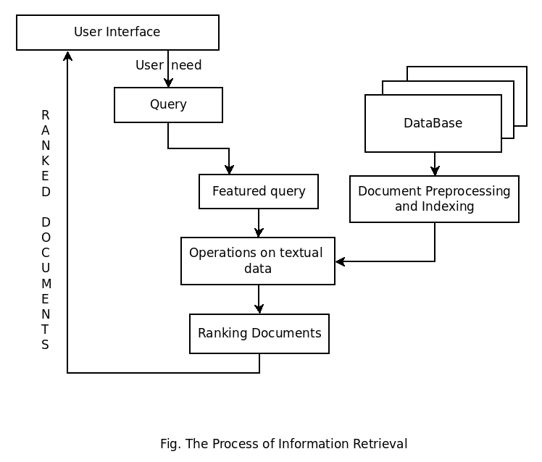
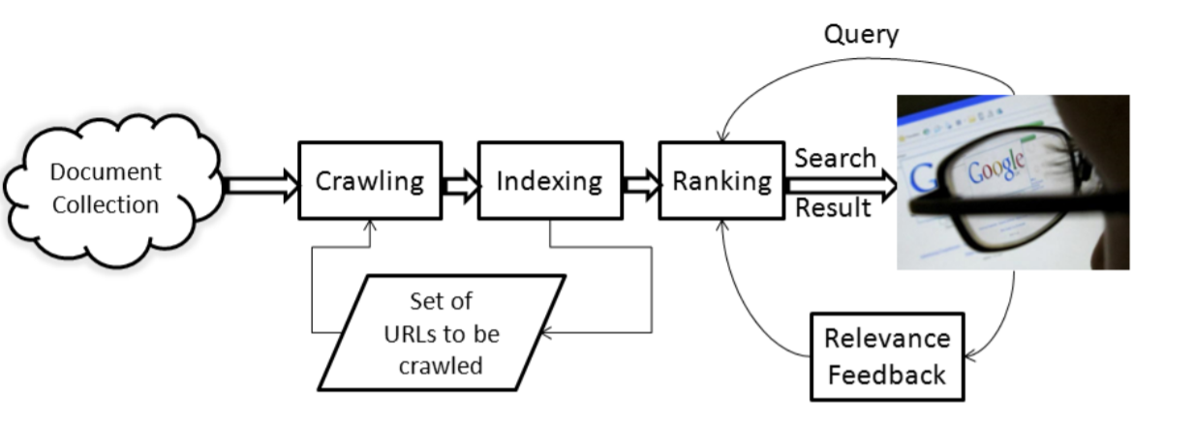
METHOD 1: EXPERIMENTS
- What did the user do here?
Ans.: All steps 1,2,3,4 and then step 5:

Slide 16
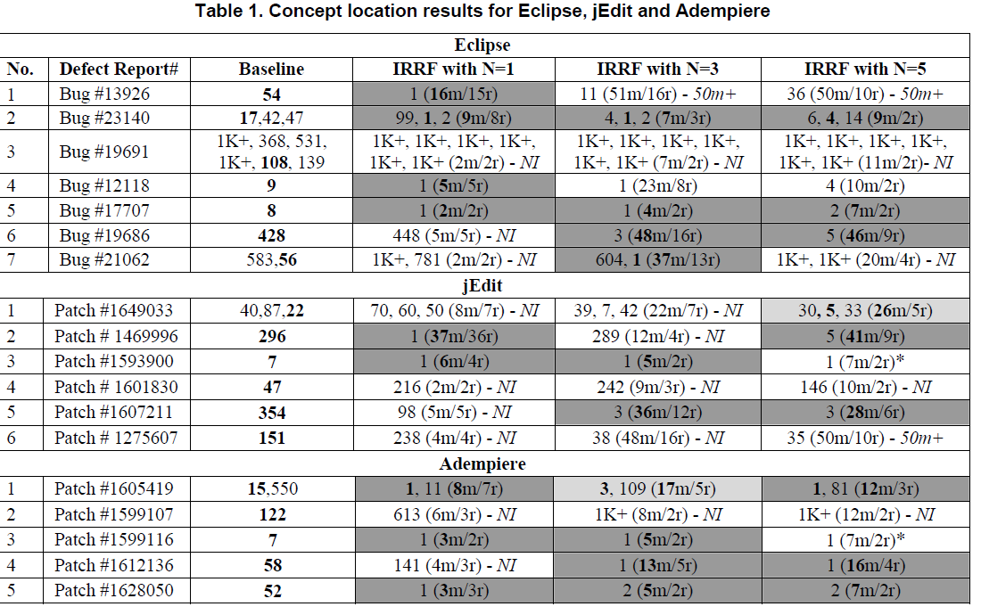
Notes:
EXPERIMENTS TABLE:
1) The Baseline column shows the positions of the target methods (where the change needs to start from, i.e. the correct concept location) in the result list after the initial query.
The best rank in each case where there is more than one target method is marked in bold.
This represents the efficiency measure in the baseline case (i.e., how many methods would the user need to investigate to find the best ranked target).
2) The IRRF columns show the positions of the target methods at the end of the IRRF location process, whether it succeeded or not (the java ‘method’ fetched, i.e. the code location which is the index of a vectorized java method, is correctly found to be the buggy one for modification).
If a target method was not ranked in the top 1,000 results at the end of IRRF, we denote its position as 1K+.
The N in the column header indicates the number of marked methods in each feedback round during IRRF.
Note that only the methods for which relevance was given are counted as one of the N methods ranked in a feedback round (i.e., methods marked neutral are not counted towards the N, yet they count towards the efficiency measure).
The number of methods analyzed by the developer before she/he stopped (i.e., the efficiency measure), either because a target method was found or because IRRF failed (the concept location method was not found) is reported in parenthesis (marked with m). This number includes all the methods marked by the developer in all the rounds of feedback, including also the methods marked as neutral, plus the rank of the target method in the final round.
The number of feedback rounds is also reported in parenthesis (denoted with r), including the (incomplete) round when the target is found.

Slide 17
EXPERIMENTS TABLE:
What is the assessment measure used in this table?
- How many methods the user needs to investigate in order to find the best ranked target.
Notes:
EXPERIMENTS TABLE:
1) The Baseline column shows the positions of the target methods (where the change needs to start from, i.e. the correct concept location) in the result list after the initial query.
The best rank in each case where there is more than one target method is marked in bold.
This represents the efficiency measure in the baseline case (i.e., how many methods would the user need to investigate to find the best ranked target).
2) The IRRF columns show the positions of the target methods at the end of the IRRF location process, whether it succeeded or not (the java ‘method’ fetched, i.e. the code location which is the index of a vectorized java method, is correctly found to be the buggy one for modification).
If a target method was not ranked in the top 1,000 results at the end of IRRF, we denote its position as 1K+.
The N in the column header indicates the number of marked methods in each feedback round during IRRF.
Note that only the methods for which relevance was given are counted as one of the N methods ranked in a feedback round (i.e., methods marked neutral are not counted towards the N, yet they count towards the efficiency measure).
The number of methods analyzed by the developer before she/he stopped (i.e., the efficiency measure), either because a target method was found or because IRRF failed (the concept location method was not found) is reported in parenthesis (marked with m). This number includes all the methods marked by the developer in all the rounds of feedback, including also the methods marked as neutral, plus the rank of the target method in the final round.
The number of feedback rounds is also reported in parenthesis (denoted with r), including the (incomplete) round when the target is found.

Slide 18
EXPERIMENTS TABLE: how many methods would the user need to investigate to find the best ranked target
1) Baseline column: shows the positions of the target methods (where the change needs to start from, i.e. the correct concept location) in the result list after the initial query using only IR method.
- Best rank of a target method: in bold.
2) The IRRF columns show the positions of the target methods at the end of the IRRF location process (the java ‘method’ fetched)
- The N in the column header indicates the number of marked methods in each feedback round during IRRF (relevance was given).
- parenthesis (marked with m): The number of methods analyzed by the developer before she/he stopped
Notes:
EXPERIMENTS TABLE:
1) The Baseline column shows the positions of the target methods (where the change needs to start from, i.e. the correct concept location) in the result list after the initial query.
The best rank in each case where there is more than one target method is marked in bold.
This represents the efficiency measure in the baseline case (i.e., how many methods would the user need to investigate to find the best ranked target).
2) The IRRF columns show the positions of the target methods at the end of the IRRF location process, whether it succeeded or not (the java ‘method’ fetched, i.e. the code location which is the index of a vectorized java method, is correctly found to be the buggy one for modification).
If a target method was not ranked in the top 1,000 results at the end of IRRF, we denote its position as 1K+.
The N in the column header indicates the number of marked methods in each feedback round during IRRF.
Note that only the methods for which relevance was given are counted as one of the N methods ranked in a feedback round (i.e., methods marked neutral are not counted towards the N, yet they count towards the efficiency measure).
The number of methods analyzed by the developer before she/he stopped (i.e., the efficiency measure), either because a target method was found or because IRRF failed (the concept location method was not found) is reported in parenthesis (marked with m). This number includes all the methods marked by the developer in all the rounds of feedback, including also the methods marked as neutral, plus the rank of the target method in the final round.
The number of feedback rounds is also reported in parenthesis (denoted with r), including the (incomplete) round when the target is found.

Slide 19
TABLE EXAMPLE 1: row #2 in Eclipse
- (A, B, C): three are the target methods.
- Baseline IR method ranked the best on position 17 (i.e. needed 17 steps to locate a target).
- IRRF method (ours) with N=3 (4, 1, 2 (7m/3r)) means that a target method (i.e., the 2nd) was ranked #1.
User needed to mark a total of 7 methods first, after 3 rounds.
Notes:
TABLE EXAMPLE 1: row #2 in Eclipse
(A, B, C): three are the target methods.
Baseline (17, 42, 47) means there are three target methods and the best ranked is on position 17.
IRRF with N=3 (4, 1, 2 (7m/3r)) means that one of the target methods (i.e., the 2nd) was ranked #1 on the 3rd round and the user marked a total of 7 methods (‘time consumption’ until the successful hit) to reach it (including the target method in the 3rd round).

Slide 20
TABLE EXAMPLE 1: row #2 in Eclipse
17 steps for ranking (IR method, baseline)
VS
7 steps for ranking (IRRF method, the current one)
SO IRRF is FASTER! It matches faster a user query to the source code text.
Notes:
TABLE EXAMPLE 1: row #2 in Eclipse

Slide 21
CONCLUSIONS OF METHOD 1:
- The data reveals that IRRF brings improvement over the baseline in 13 of the 18 change requests (i.e. at least one cell in the row is dark grey).
- In 3 cases, the improvement is observed for all values of N (i.e., all 3 RF cells are dark grey in these rows).
- RF with N=1 improved in 9 cases,
RF with N=3 improved in 9 cases, and
RF with N=5 improved in 8 cases, not all the same.
- In most cases RF reduces developer effort over the IR-based concept location, in the absence of manual query reformulation.

Slide 22
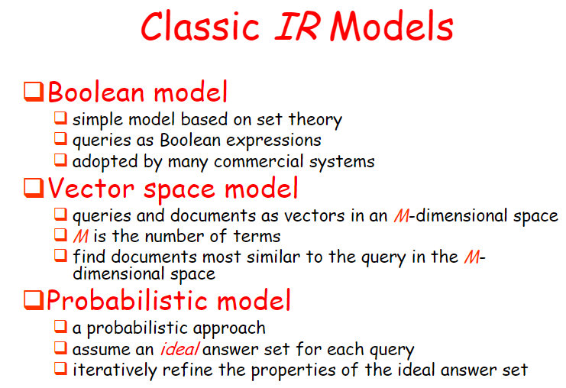
ALTERNATIVES OF METHOD 1:
- Step 3: IR. Also by using:
-> Latent Semantic Indexing
-> Bayes Classifiers
-> Latent Allocation
- Step 5: RF. Also by using:
-> Implicit feedback when the user (developer) evaluates the relevance of a ‘document’ (e.g. a java method, a java class, a piece of code)
-> Blind feedback (pseudo feedback) etc.
- Step 1: Corpus creation. Also by using:
-> Stopword removal
-> Bring all same-root words into the same form (‘Stemming’)
Notes:
ALTERNATIVES OF METHOD 1:
Step 3: IR
- Bayes Classifiers: E.g. a decision tree.
- LDA: Assume all words (of the term vector v) form a multivariate Random Variable which follows a joint probability function (joint PDF) with some parameters.
Try to maximize the L likelihood of the given words (Samples).

Slide 23
CRITICISM (disadvantages) of method 1 (paper 1):
• Other papers remark that one irrelevant word can undo the good caused by lots of good words (so it decreases effectiveness). This is reported as a probable fact in this paper.
• The authors state that the source-code-based corpora they formed finally increase their queries’ length significantly and rapidly. (Long queries are inefficient for a typical IR engine.)
• Paper 1 uses vector similarity techniques, as commonly done for IR: time consuming. Imagine comparing the vector of one bug report to all vectors of the existing buggy files.

Slide 24
CRITICISM (disadvantages) of method 1 (paper 1):
• In 2.3.2 paper section, the weights for the RF metric (ATTRACT-REPEL FROM RELEVANT DOCUMENTS) may result in high precision and recall (i.e. high errors in the RF reranking). A more advanced technique should be used for this (e.g. logit model, Neural Networks).
What they need to do with these parameters: a, beta, chi is to favor irrelevant documents over relevant (to make the ranking more fair and balanced for the concept location). They do not achieve that.

Slide 25
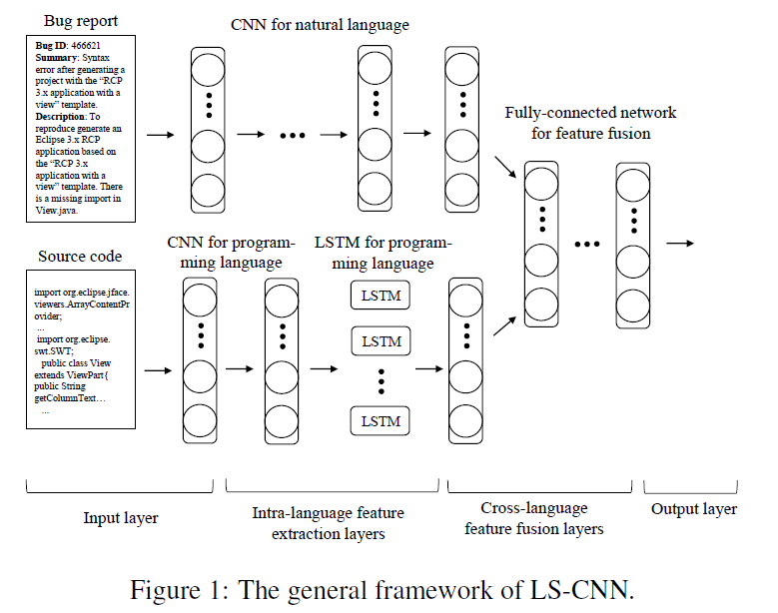
METHOD 2:
Locate buggy files in Software Engineering projects using Deep Neural Networks

Slide 26
METHOD 2: Locate buggy files in Software Engineering projects using Deep Neural Networks
- Paper [2] offers novel method based on Neural Networks: the ‘LS-CNN’ model: LSTM + CNN.
- It uses ‘features’ of the bug-reports (textual features) in order to localize bug in the code.
- It exploits the sequential nature of the source code.

Slide 27
METHOD 2: Locate buggy files in Software Engineering projects using Deep Neural Networks
-It introduces the ‘LS CNN’, a hybrid of a CNN and an LSTM.
-Method: Extract features from the buggy files, unify them in a representation using the LS-CNN, enhance this representation
Notes:
METHOD 2: Locate buggy files in Software Engineering projects using Deep Neural Networks
-It introduces the ‘LS CNN’, a hybrid of a CNN and an LSTM.
-Method: Extract features from the buggy files, unify them in a representation using the LS-CNN, enhance this representation
Feature extraction is a common practice for machine learning with multimedia input (here input is textual form of bugs).
The NN perform fast feature extraction with a number of parameters that can be changed.

Slide 28
METHOD 2: Locate buggy files in Software Engineering projects using Deep Neural Networks
- It then provides a framework in which the NN captures semantics of the soft. engin. project from structural and sequential point of view.
- Novelty:
The program semantics + the correlations between bug reports and source code = EMBEDDED in a vector space

Slide 29
Conclusions
Experiments on widely used software projects show that using sequential features of code ends up in superior locating of bugs!
LSTM is a specific Neural Network that exploits the previous states of the prediction, thus it leverages the memory in bug localization. This is why it fits in this case: sequential features of the current and previous code are exploited for the next part of code.
CNNs exploit the training concept in Machine Learning in the best way in this problem.

Slide 30
CRITICISM (disadvantages) of method 1 (paper 1):
• Other papers remark that one irrelevant word can undo the good caused by lots of good words (so it decreases effectiveness). This is reported as a probable fact in this paper.
• The authors state that the source-code-based corpora they formed finally increase their queries’ length significantly and rapidly. (Long queries are inefficient for a typical IR engine.)
• Paper 1 uses vector similarity techniques, as commonly done for IR: time consuming. Imagine comparing the vector of one bug report to all vectors of the existing buggy files.

Slide 31
CRITICISM (disadvantages) of method 1 (paper 1):
• In 2.3.2 paper section, the weights for the RF metric (ATTRACT-REPEL FROM RELEVANT DOCUMENTS) may result in high precision and recall (i.e. high errors in the RF reranking). A more advanced technique should be used for this (e.g. logit model, Neural Networks).
What they need to do with these parameters: a, beta, chi is to favor irrelevant documents over relevant (to make the ranking more fair and balanced for the concept location). They do not achieve that.

Slide 32
CRITICISM (disadvantages) of method 2:
• Paper 2 bypasses the above problem, but uses CNNs (a Machine Learning tool): It is a classical concept in ML that they are limited in datasets that ‘resemble’ the training sets. E.g. if a very different/strange instance occurs (i.e. an abnormal buggy file), there is a high chance that it will not be recognized.
• Similarly, the training dataset needs to be quite diverse: This requires access to bug reports from various software frameworks. This is not always possible for free.
• It bases its predictions on the sequential info from the code. This is a particular assumption and doesn’t capture the more complex structural information of code files.

Slide 33
OVERVIEW:
• 2 methods that locate bugs
• Goal: match a query for change to the location
• He/She uses a bug report for this.
• Method 1: user’s decision (RF)
• Method 2: trains a NN to make predictions
Notes:
OVERVIEW:
We presented 2 methods that locate buggy files/methods/classes/code in the source code of a software.
The goal was to have the user (developer) match fast a query for change in the code to the textual location of this source code.
He/She uses a bug report for this.
Method 1: achieved that using the user’s decision: RF and then a ranking on the accumulated buggy files.
Method 2: achieved that by training a NN to make predictions

Slide 34
Thank you for your attention!
Questions?
Don’t hesitate to email me your question in gep35@pitt.edu

Slide 35
References
[1] Gay, G., Haiduc, S., Marcus, A., & Menzies, T. On the Use of Relevance Feedback in IR-Based Concept Location, 2009 IEEE International Conference on Software Maintenance
[2] HUO, Xuan; LI, Ming Enhancing the Unified Features to Locate Buggy Files by Exploiting the Sequential Nature of Source Code
International Joint Conference on Artificial Intelligence (IJCAI-2017)
[3] Dit, B., Revelle, M., Gethers, M., & Poshyvanyk, D. (2013). Feature location in source code: a taxonomy and survey. Journal of software: Evolution and Process, 25(1), 53-95.

