Slide 1

An Agile Software Engineering Process Improvement Game
CS2310 Seminar
Yue Dai
yud42@pitt.edu
Notes:
Good afternoon everyone,
Thank you for coming, my name is Yue Dai. Today I am going to present a paper called “An Agile Software Engineering Process Improvement Game”. The paper mainly focus on using serious game approach to enhance experimental learning in agile software engineering education.

Slide 2
Contents
Background
Motivation
System Design
Evaluation
Conclusion and Future works
Notes:
The contents I want to introduce are as following.
Firstly I will go over the background of the paper for better understanding. Then based on current demands I will show the main motive of the paper. In the following part I will go over the system design as well as the evaluation approach they proposed. In the end I will have a conclusion on it and prospect possible future works.

Slide 3
Contents
Background
Motivation
System Design
Evaluation
Conclusion and Future works
Notes:
First Let’s look at the background.

Slide 4
Background
Agile
SCRUM
Serious Gaming
Notes:
The main resource for this paper can be categorized into three parts: Agile software development, SCRUM software development framework, and serious gaming strategy for learning.

Slide 5
Background: Agile
Set of approaches to Software Development
  Evolving requirement and solutions
  Collaborating development teams and users
Principles
  Individuals and Interactions over processes and tools
  Working Software over comprehensive documentation
  Customer Collaboration over contract negotiation
  Responding to Change over following a plan
Characteristics
  Iterative and incremental development methods
  Efficient communication
  Short feedback loop and adaptation cycle
* Figure from online resource
Notes:
Consists of many iterative and incremental development approaches, the Agile software development covers a set of recurrent life-cycle development.
By collaborating development teams and users, Agile targets on evolving requirement and solutions to accomplish quick service delivery as well as adaptive solutions.
The stages of agile software development usually seen as pictures on the right side. The continuously plan, design, develop, test and release stages are driven by effective on-time feedback from user teams. And the stages operate as an iterative way to guarantee the adaptivity as well as quick delivery.
Agile has following key principles as the rule of assessment:
Individuals and Interactions over processes and tools
Working Software over comprehensive documentation
Customer Collaboration over contract negotiation
Responding to Change over following a plan
By following these rules and deploying development stage as shown in the figure, the agile accomplished following characteristics:
Iterative and incremental development, efficient communication between user and multi-task teams, and adaptive development cycle.

Slide 6
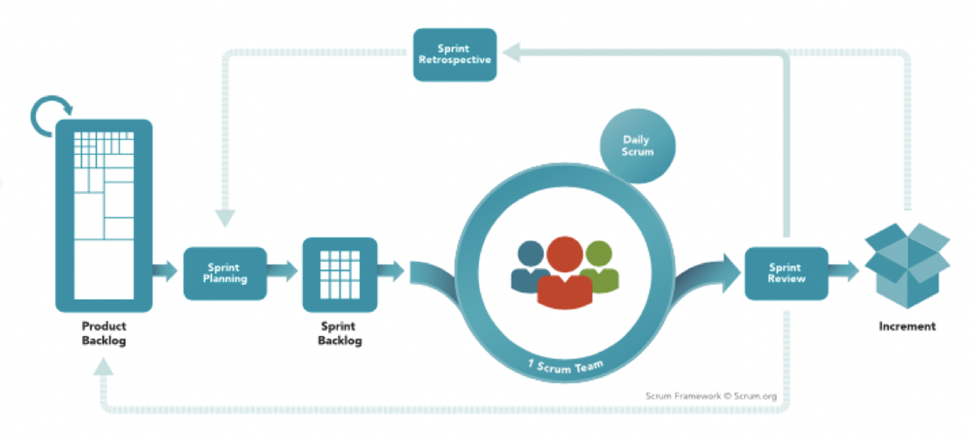
Background: SCRUM
A agile process framework
* Figure from: https://www.scrum.org/resources/what-is-scrum
Notes:
SCRUM is one of the most popular agile based framework for software development. Here’s an overview on SCRUM process.
Note that the backlog here indicates tasks need to be accomplished before specific deadline.
The Product backlog is allocated into sprints, which represent a period of development. And the Sprint Backlog is assigned to scrum development teams by daily scrum meetings. Once the sprint is finished, a review/summary will be provided based on user/market feedback, and those feedback are further leveraged into following sprint developments. The process will be iterative and increment until all product backlog are finished.

Slide 7
Background: Serious Game
Serious game for learning
  Deliver experimental learning
  Utilizing artistic medium of games
Advantage
  Easy deployment
    Virtual environment
  Engaging
  Effective
    Less cost on failure
    Milder forgotten curve
    Stimulate improvement by rewards
Notes:
On the other hand, serious game has been invoked into learning services.
A serious game for learning is defined as Delivering experimental learning by utilizing artistic medium of games.
According to previous works, the serious game for learning takes advantage in:
Easy deployment, since it is less costly to setup virtual environment than build actual classroom and stuff teams.
Additionally, the gaming based learning are more attractive and engaging than traditional learnings.
More overly, these serious game learning methods show great potential in effectiveness. As there is less cost on failing experiences, stimulating with rewards and milder forgotten curve.
Interested by these advantages, the paper proposed a serious gaming based learning for agile development process improvement.

Slide 8
Contents
Background
Motivation
System Design
Evaluation
Conclusion and Future works
Notes:
Now let’s see what is the motivation for them.

Slide 9
Motive
Agile software development learning
Cross-platform computer game
Notes:
The motive can be mainly categorized into two aspects:
Agile software development learning and
Cross-platform computer game

Slide 10
Motive: Agile software development learning
Agile development requires experimental learning
  Dynamic requirement
  Adaptive solutions
  Swift response
  Costly on failures
Traditional learning
  Costly to deploy
    Stuff required
    Fixed time required
  Further costly to refine
    Redeploy when updating
    Actual environment required for effective experiences
Notes:
One motive is the growing demands on agile development
As a process management facing dynamic requirements, the adaptive solutions usually need to be decided in a swift response. More overly, it could be costly in real world scenarios.
As a solution to such experience hungry learning, the traditional learning is one but inefficient solution:
To delivery abundant contents, it is always source costly to deploy traditional learning programs. Not only stuff and classroom required, fixed time and paperwork are also required which lead to less flexibility and accessibility.
Additionally, to update the current learning plan, it is even more lagging due to actual redeployment.

Slide 11
Motive: Agile software development learning
Agile development requires experimental learning
  Dynamic requirement
  Adaptive solutions
  Swift response
  Costly on failures
  Less costly and real educating design required
Traditional learning
  Costly to deploy
    Stuff required
    Fixed time required
  Further costly to refine
    Redeploy when updating
    Actual environment required for effective experiences
  More dynamic interactive learning design required
Notes:
Therefore, the demands lead to two requirements:
Less costly and real educating design required
More dynamic interactive learning design required

Slide 12
Motive: Cross-platform computer game
Current serious games for agile development
  Time required to set up
  Substantial to manage
  Involve the creation of paper works
Current software engineering process games
  On specific platform
  Focus on low-level skills
    Scenarios recognition
    Recalling solutions
Notes:
On the other hand, the current serious game for agile development has following drawbacks, since they are usually real board/card games:
It is time required to set up, as well as following management. Also they involve the creation of paper works.
The current software engineering process games also facing the problems as:
Focusing on low-level skills such as recalling and recoginizing, and built on specific platform using web-based techniques.

Slide 13
Motive: Cross-platform computer game
Current serious games for agile development
  Time required to set up
  Substantial to manage
  Involve the creation of paper works
  Computer game required
Current software engineering process games
  On specific platform
  Focus on low-level skills
    Scenarios recognition
    Recalling solutions
  Process improvement experience required
Notes:
Therefore, it motives:
Computer game on Process improvement experience

Slide 14
Motive
Agile software development learning
  Less costly and real educating design required
  More dynamic interactive learning design required
Cross-platform computer game
  Computer game required
  Process improvement experience required
Notes:
Now, given the demands from above aspects

Slide 15
Motive
Agile software development learning
  Less costly and real educating design required
  More dynamic interactive learning design required
Cross-platform computer game
  Computer game required
  Process improvement experience required
Goal
  Serious computer game
  Allows students to manage virtual software projects using agile software engineering practices
Notes:
The paper shows a goal on a serious computer game such that:
It lllows students to manage virtual software projects using agile software engineering practices

Slide 16
Contents
Background
Motivation
System Design
Evaluation
Conclusion and Future works
Notes:
Now we are moving to actual system design

Slide 17
System Design: Overview
Using SCRUM as basis of gameplay
  3 Projects
  Sprints in projects
  Turns in sprints
  Virtual process management
Cross-platform card game
  Reduce system requirement for mobile
  Emphasis decision making
  Focus on quality of AI
Allow individual experimental learning
Random event behavior
Notes:
The game using SCRUM process given it is the most popular and representative framework in agile.
The game contains 3 projects, each project consists of sprints which will take several turns. And the player need to do virtual process management decision in each turn.
It is designed as a cross platform card game, the reason to use card game is to reduce system requirement on mobile and give more focuses on quality of AI.
And this is a single player game, which brings flexibility for individual experimental learning.
The random event behavior will be generated on each turn to simulate real world dynamics.

Slide 18
System Design: Gamified Work Flow
Project
  PIG contains 3 SCRUM projects as challenges
    1 tutorial challenge
    2 additional challenge
  Project components
    Backstory
    Sprint
  Sprint
    Select tasks from current product backlog list
    Allocate developer into roles (coder, tester, or debugger)
    Allocate activities during daily SCRUM meeting
    Received summary by the end of each sprint
Notes:
Here are the details of the Process Improvement Game (PIG):
It contains 3 SCRUM projects as independent challenges
1 tutorial challenge will be provided as guidance, and 2 additional challenge can be accessed if the tutorial challenged finished.
Each project will have a backstory to bring insights for decision making, and projects will be allocated into sprints.
In each sprint: player need to
Select tasks from current product backlog list
Allocate developer into roles , such as coder, tester, or debugger
Allocate activities during daily SCRUM meeting
They will receive a summary by the end of each sprint as a feedback

Slide 19
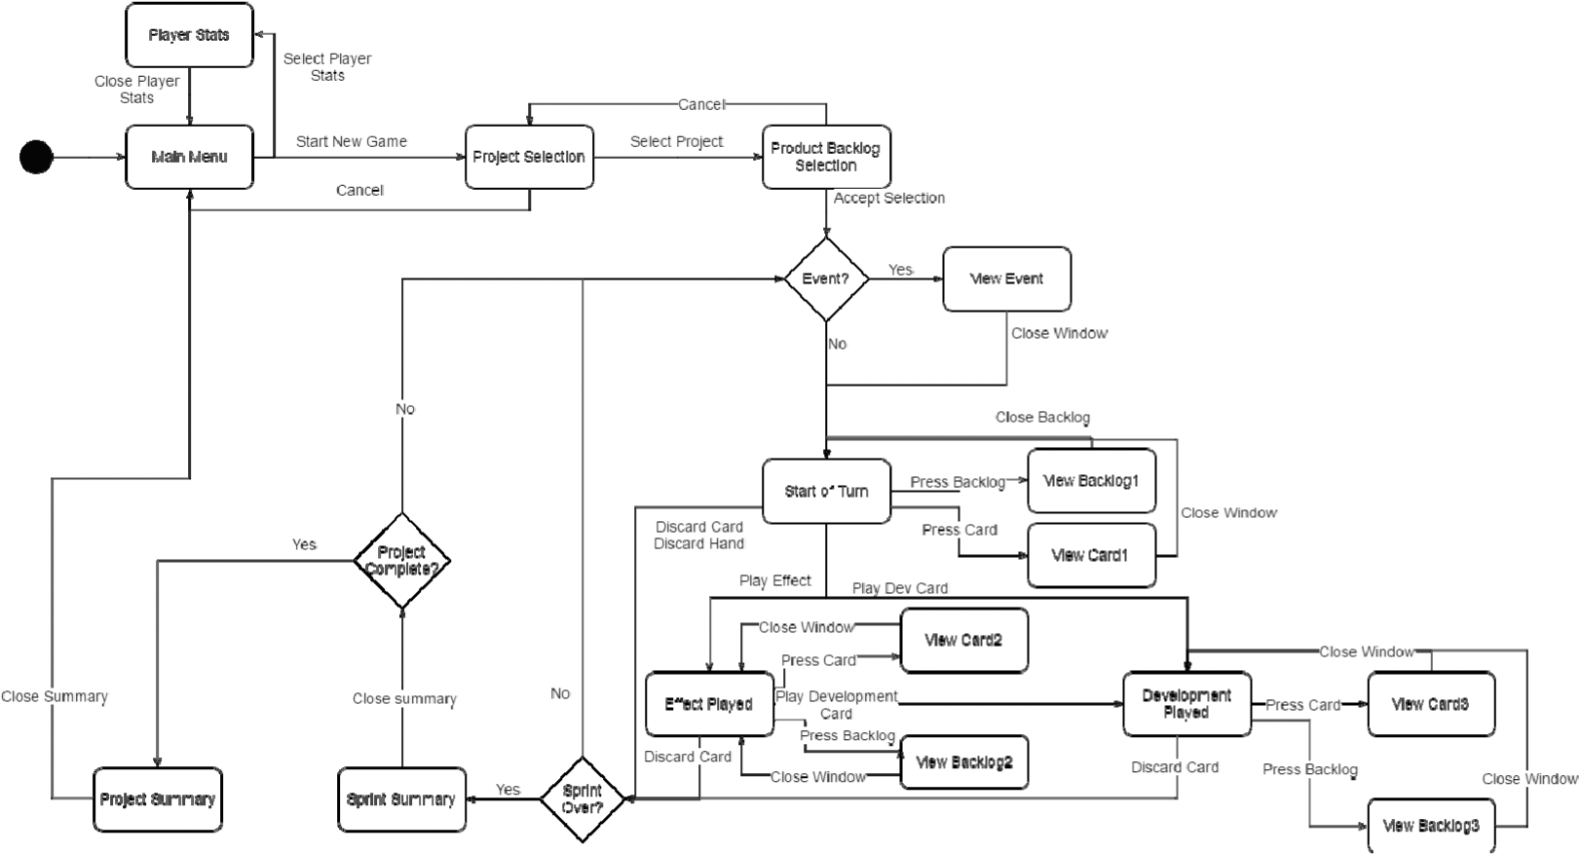
System Design: Game Flow
Notes:
Here’s the game flow diagram

Slide 20
System Design: Game Flow
Main Menu
Notes:
This part the main menu where players can choose challenges and view stats

Slide 21
System Design: Game Flow
One Project
Notes:
This part is a project. Each time when a project is chosen, challenge will begin. In the end, a project summary will be provided as an assessment on the performance.

Slide 22
System Design: Game Flow
One Sprint
Notes:
And here is the sprints. They are within each projects and consist of turns, a summary will be provided once a sprint is finished.
In each turn. Player will see an random event, and making decision based on their development/effect cards. The decision making will be done in each daily SCRUM meeting.

Slide 23
Contents
Background
Motivation
System Design
Evaluation
Conclusion and Future works
Notes:
The paper also proposed several evaluation methods they will use in the future to judge their system.

Slide 24
Evaluation
Usability
  Developer checklist
  User feedback
    Online questionnaire
Learning
  User: Junior level software engineering student
  As assignment
  Online quiz assessment
Notes:
They will evaluated the system on two aspects: Usability, and learning
For usability, it is mainly the software quality. And they plan to have developer testing with checklists, and online feedback from users played the game
For learning. They will do a test on a batch of junior level software engineering students. The game will be delivered as an assignment and an online quiz will be used as learning assessment.

Slide 25
Contents
Background
Motivation
System Design
Evaluation
Conclusion and Future works
Notes:
In the following section I’ll show a few take away from the work.

Slide 26
Conclusion
Using serious game to efficiently deliver experience learning
Gamifying agile process management
Less failure cost and on-time feedback in learning
Decision making
Dynamics involved by random events and AI opponents
Notes:
In conclusion, the PIG proposed an approach that using serious game to effectively deliver experiential learning.
By Gamifying agile process management, they provided less failure cost and on-time feedback experience in learning
Their game focus on decision making and involves dynamics by random events and AI opponents.

Slide 27
Future work
Action-awared random events
Using reinforcement learning to provide dynamically enhanced AI
More complex environment involved
Multiplayer add-ons
Notes:
There are still many works can be explored, however.
Firstly, it would be more reasonable and realistic to implement a previous action awared events instead of purely random.
Secondary, the AI opponents can be furtherly enhanced by reinforcement learning to simulate the “growth of industry”
Additionally, more complex environment, such as multi-projects would be a valuable extension for the work.
In the end, the multiplayer mode could be worthy as well. Since competition and be more engaging and brought more dynamic and meaningful learning environment.

Slide 28
Thanks!
Questions?

Slide 29
References
[1] Maxim, Bruce R., et al. "An agile software engineering process improvement game." 2016 IEEE Frontiers in education Conference (FIE). IEEE, 2016.
[2] Raju, P. K., and Chetan S. Sankar. "Serious games to improve student learning in engineering classes." The ASEE Computers in Education (CoED) Journal 5.2 (2014): 68.
[3] Highsmith, James A., and Jim Highsmith. Agile software development ecosystems. Addison-Wesley Professional, 2002.
[4] Schwaber, Ken, and Mike Beedle. Agile software development with Scrum. Vol. 1. Upper Saddle River: Prentice Hall, 2002.

