Slide 1
A Model Based Path Selection Testing on Mobile Apps using TABU Monitored Hybrid Local Search Optimizations
Main Paper
Akhil Yendluri

Slide 2
Automation Framework for Testing Android Mobiles
Supplementary Paper
Akhil Yendluri

Slide 3

Market
Number of Applications over 2 major platforms (iOS & Android) has crossed 4 billion in total
Number of downloads is over 150 billion for the 2 major platforms.
Total Revenue has exceeded $20 billion

Slide 4
Need for Effective Testing
Productivity
Shift Left Testing – Testing should start early in the development process [2]
Time is Money – More the time spent on Development and testing, more the market share lost
Performance – Effective test cases to cover catch all possible bugs
Continuous testing throughout the development cycle [2]

Slide 5
Need for Another Testing Methodology?
Do not determine the correctness of test case execution
Proficiency required to write Automation test scripts
Not all scenarios can be automated
Changes in development can lead to drastic changes of test scenarios
Maintenance is costly

Slide 6
So what does this paper propose?
Use of mobile application design to decide test cases
Generates Sequence diagram and Data Flow Diagram to decide on test cases
Introduces TABU Search Optimization Methodology for testing
Automated testing and Report Generation

Slide 7
EFFECTS
TABU Search Optimization helps in optimization of the testing criteria
Less Scripting and Maintenance required
Helps saving both time and money
Helps in automatic construction of test scenarios based on sequence and data flow diagrams

Slide 8
Existing Techniques
Automated Test Oracles for Android
Complexity Evaluation of Test Scenarios
Automation Framework for testing Android Apps
Test Cases based on Activity Diagram

Slide 9
Automated Test Oracles
Automates recursive testing thereby reducing time consumption
A detailed documentation of the system is required
Uses image verification to determine success or failure

Slide 10
Complexity Evaluation
Helps in performing test modelling and analysis for various mobile environments
Uses a Model Based Approach and presents analysis of diverse Mobile Environments
This is mainly helpful when deploying the app in multiple environments

Slide 11
Automation Framework for Testing
Gives capability to write script and execute in multiple platforms
It can capture images and compare them
It checks if the output is as expected and decides on whether it is a Success/Failure
Helps in reducing time to test application in multiple environment.

Slide 12
Test Cases based on Activity Diagram
Converts program workflow into an Activity Diagram
Dependency tables are generated from Activity Diagram
Finally dependency graph is created from Dependency table
Cyclomatic complexity is used to find the minimum number of test cases

Slide 13
What is TABU Search Optimization?
Created by Fred W. Glover in 1986
Is a metaheuristic search method for mathematical optimizations
Local search algorithms have the tendency to get stuck in sub-optimal solutions
TABU Search Optimization improvises on Local Searching techniques to find optimal solution
It changes the Searching Algorithms behavior dynamically to get optimal results

Slide 14
Application
Tabu Search Optimization(SO) is applied on Hill climbing algorithm
Hill climbing is an Optimization technique to find the optimal route from start to end
Tabu SO has four types of Memory:
  Recency
  Frequency
  Quality
  Influence

Slide 15
Working
TABU SO uses Steep hill climbing algorithm until it reaches a local optima
After which it takes the smallest non-improving quality in the neighborhood
It then fills its memory with data of what is good quality and bad quality
Although initially it is fast, it gradually becomes slow as it reaches the end

Slide 16
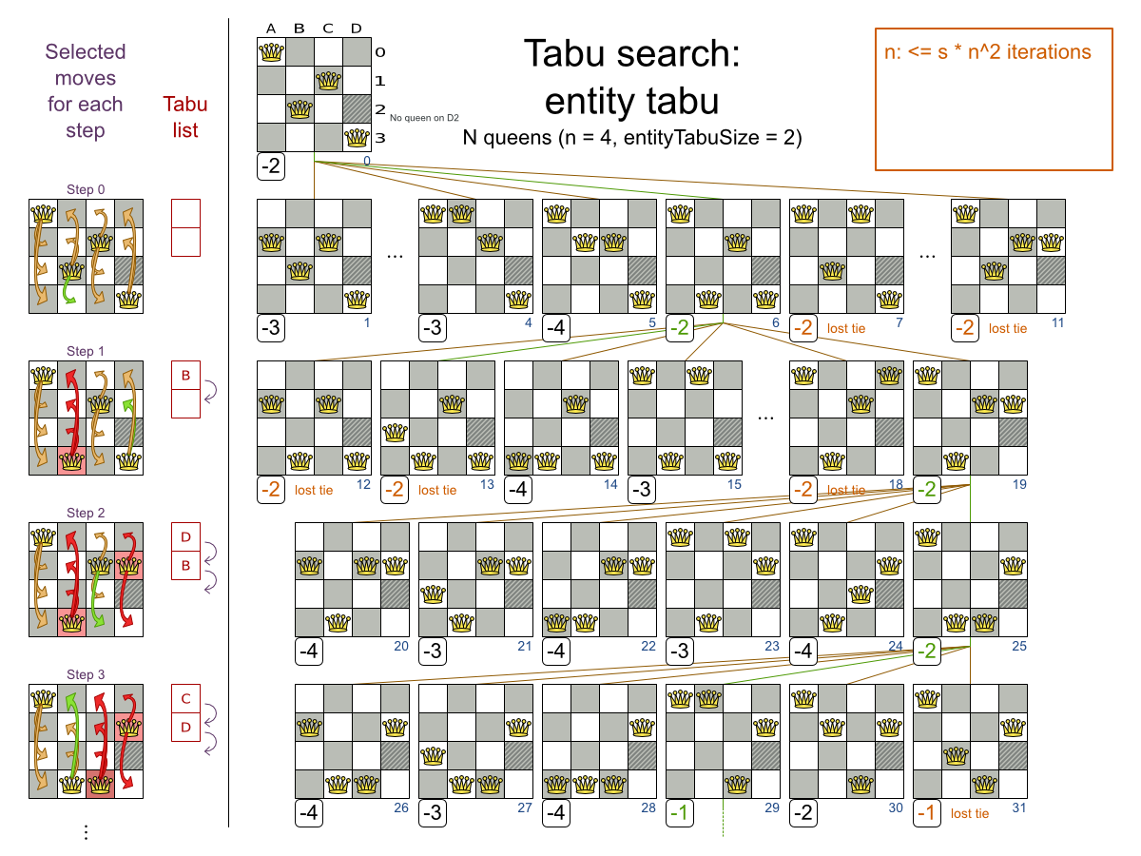

Slide 17
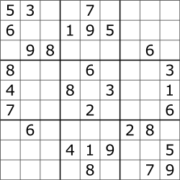
Win A MILLION DOLLARS
$$$

Slide 18
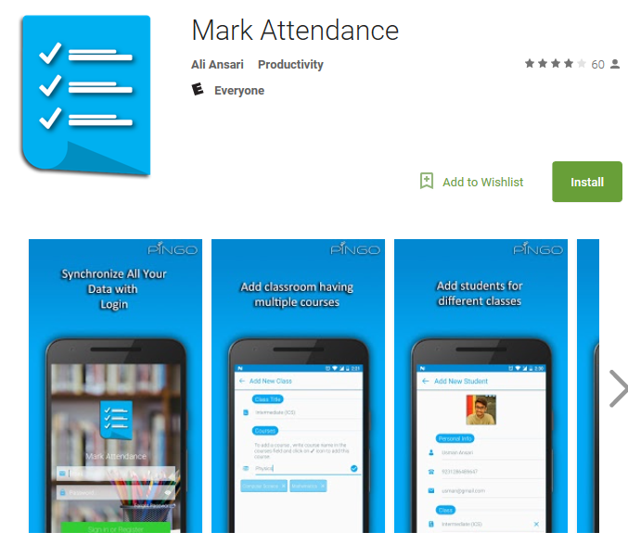
Examples
Student Result Automation System
Student Attendance Management System

Slide 19
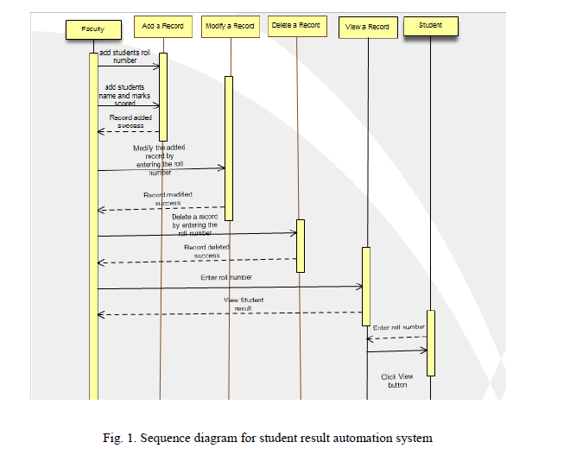

Slide 20
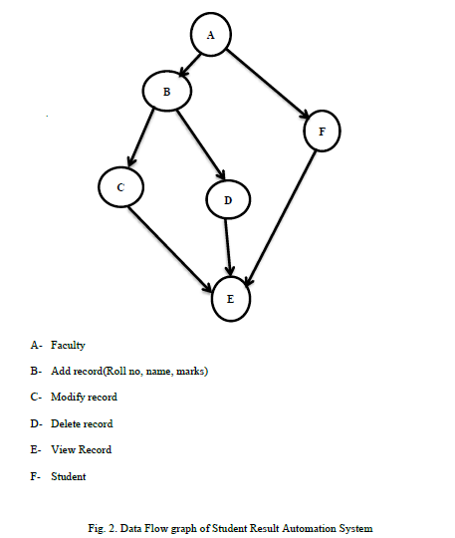

Slide 21
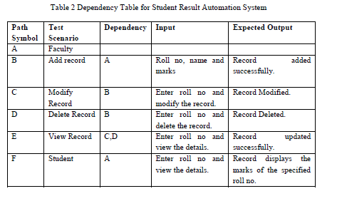

Slide 22
Conclusion
TABU SO is an effective optimization technique which is domain-independent and Technology-independent
Automates test generation process completely
Overcomes traditional drawback of correctness of test scenarios [2] by applying TABU SO
Helps saving time and money
There still are certain scenarios where this can fail as it still is an Algorithm

Slide 23
QUESTIONS ?

Slide 24
References
[1] Source: Statistic Brain Research Institute (Sept 2017) https://www.statista.com/statistics/276623/number-of-apps-available-in-leading-app-stores/
[2] Challenges for testing https://dojo.ministryoftesting.com/lessons/4-key-challenges-of-mobile-testing

