Slide 1
EASYCOMM: A FRAMEWORK AND TOOL TO SOLVE CLIENT
COMMUNICATION PROBLEM IN AGILE DEVELOPMENT
Seminar CS2310 Multimedia Software Engineering
Krithika Ganesh

Slide 2
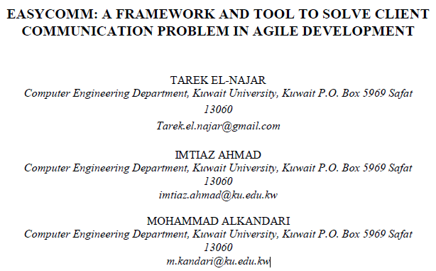
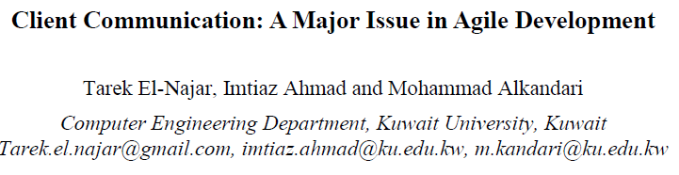
Papers

Slide 3
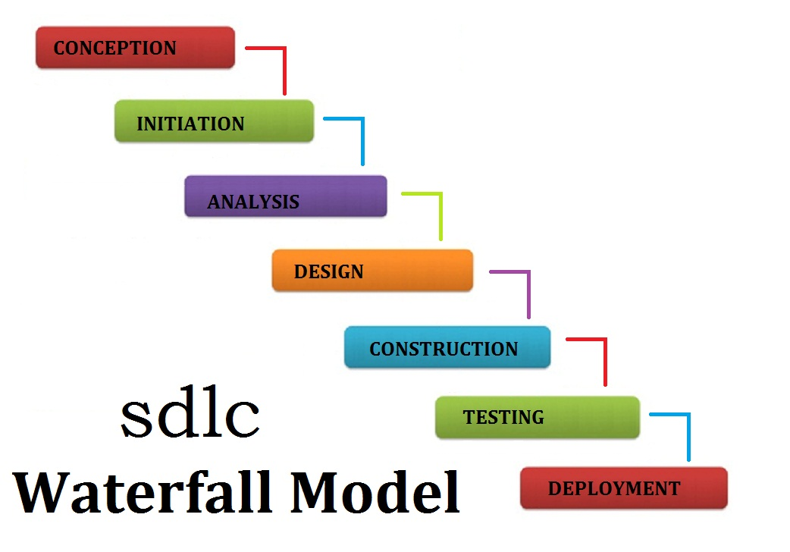
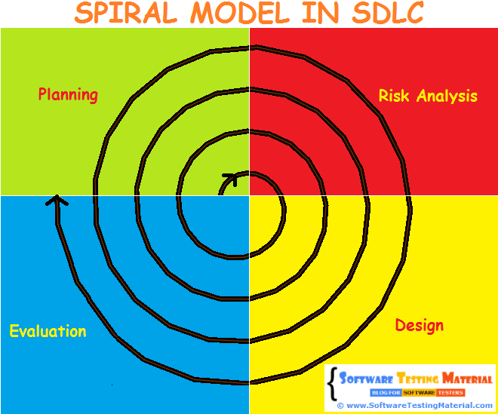
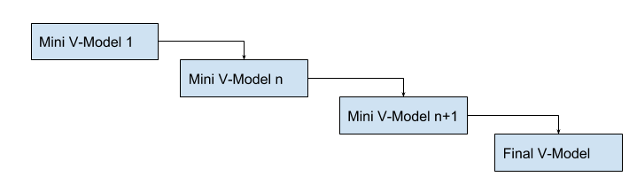
Traditional SDPs
Incremental model

Slide 4
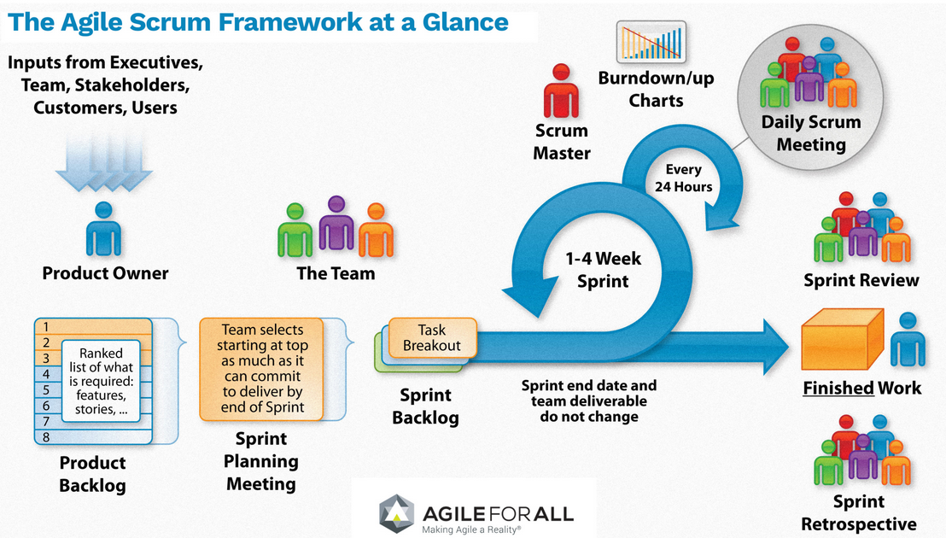
Agile

Slide 5
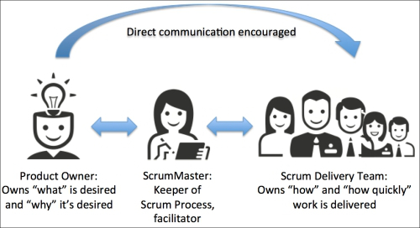
Client Communication Problem
REALITY
EXPECTATION
Availability of client representative
Geographic location difference
Change of user groups responsible for project
Exclusion of some key users
Informal communication

Slide 6

Proposed Solution
Software tool
  Easy to use
  No technical background required
  Covers all project phases
  Less expensive
  Facebook’s looks
  Solves the Client communication problem
WinWin
Winbook

Slide 7
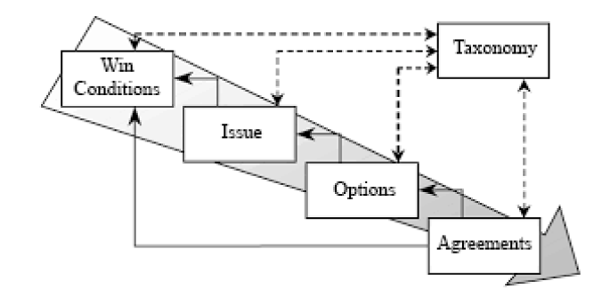


Winwin framework
Framework for capturing and negotiating system requirements
1. Project owner creates a new project and assigns all members to it.
2. User creates project taxonomy and terms which any user can access and read.
3. Users add win conditions (requirements).
4. Users review the added win conditions and start raising issues and concerns they might have on any win condition.
5. Users propose options for the raised issues.
6. Users create agreements on the proposed solutions and vote on them to either pass or fail
users
Project owner
Download link: http://sunset.usc.edu/research/WINWIN/winwinspiral.html

Slide 8

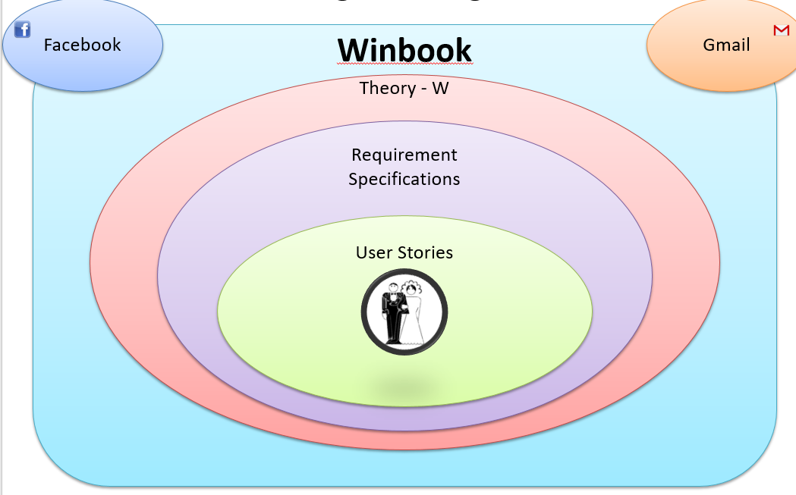



solved the issue of utilizing existing social media framework by integrating the framework's features into a specialized RE tool
a RE tool that can be used by nontechnical users in order to include them in the processes of requirement elicitation and
negotiation.
"Shaper" is responsible of shaping the discussions, take care of overlapping artifacts, shortening wide discussions, rejecting and agreeing on win conditions.
not designed specifically for Agile
Shaper

Slide 9
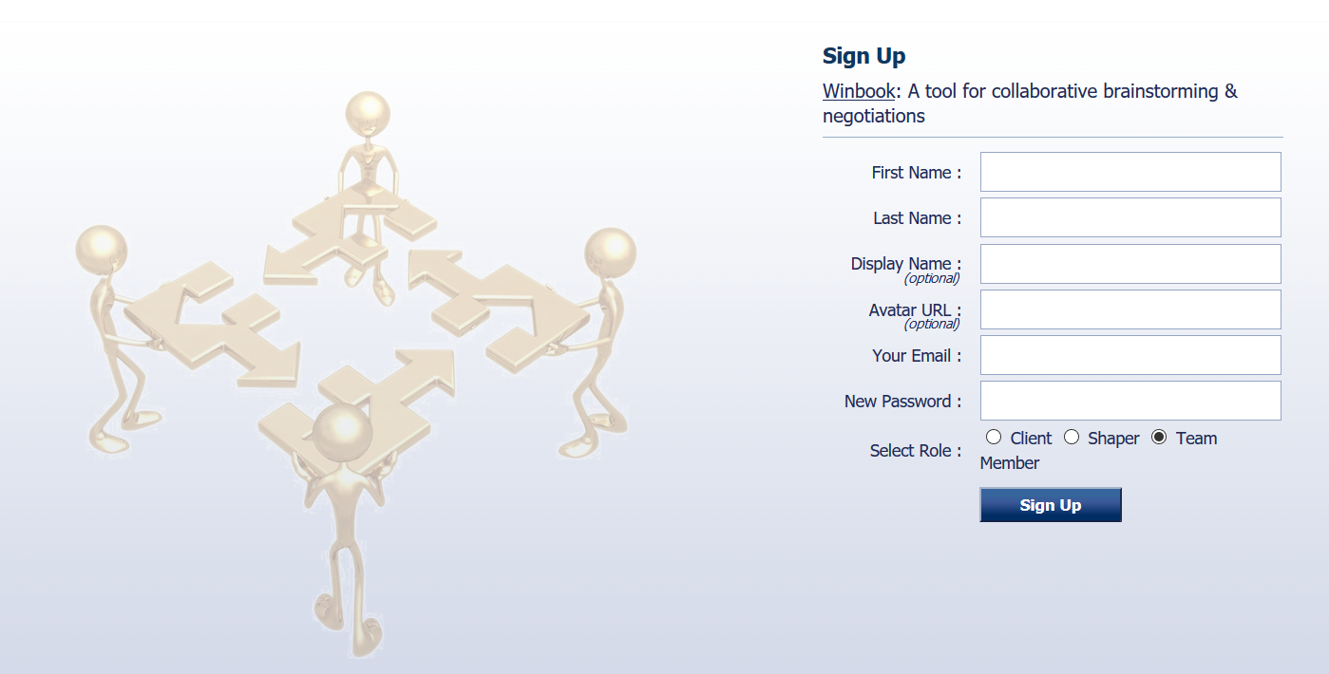

Slide 10
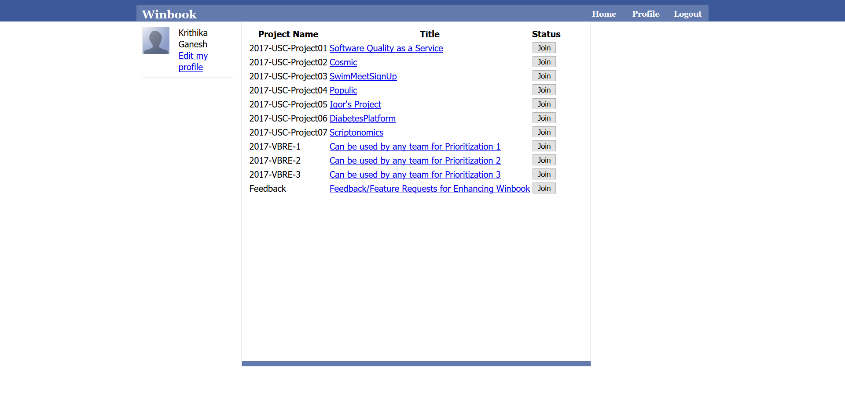

Slide 11
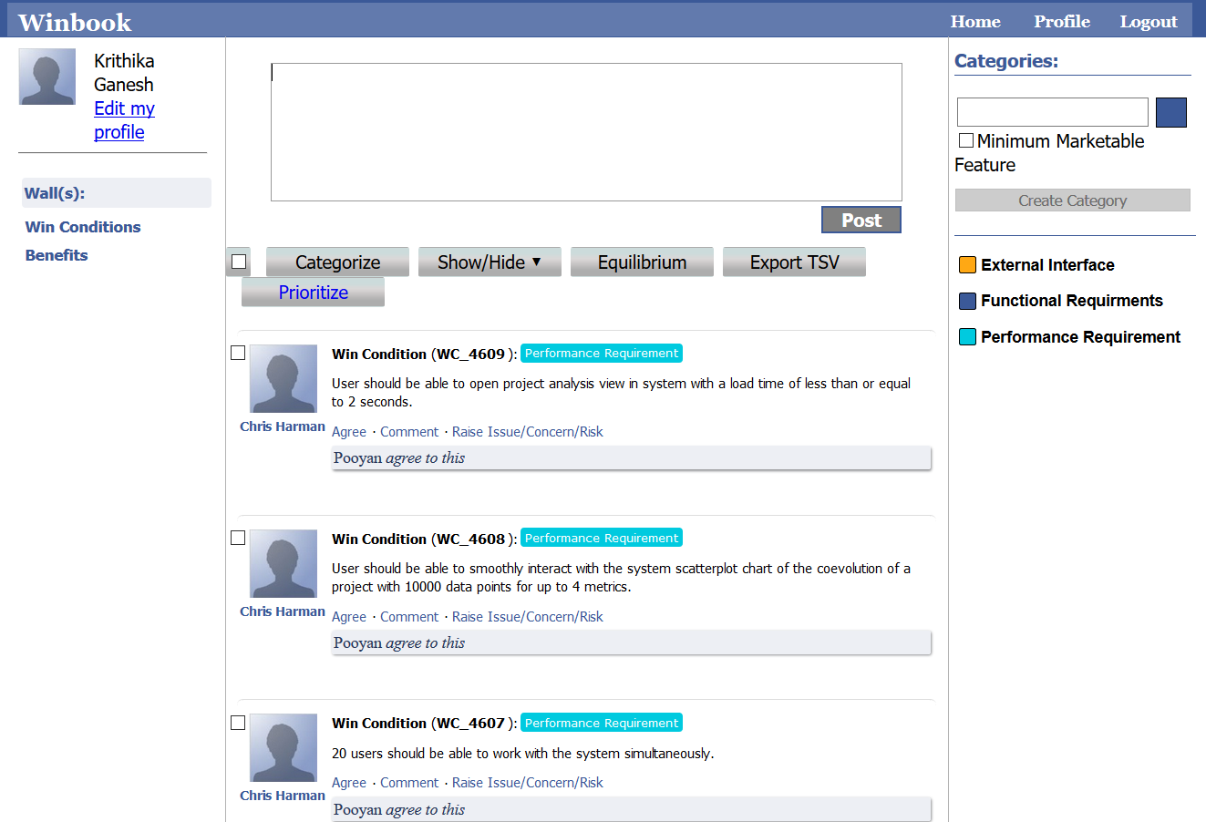

Slide 12

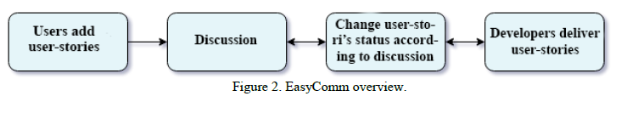
Features
Roles
User stories
Groups
Visual dictionary
Easycomm =
+

Slide 13

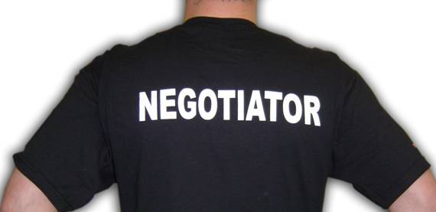


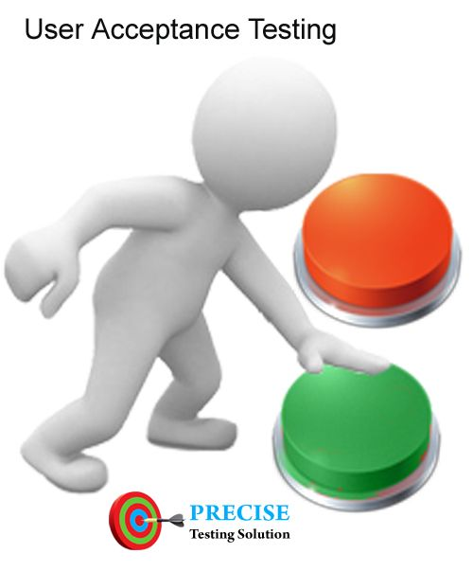

Roles
Customer team roles
Developer team roles
Shaper
Green executive
Technical liaison
Acceptance tester
Technical writer

Slide 14
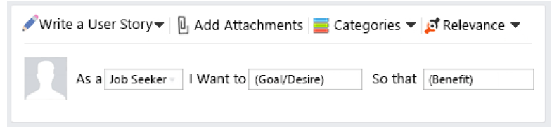
User stories
User role
Goal
Benefit

Slide 15
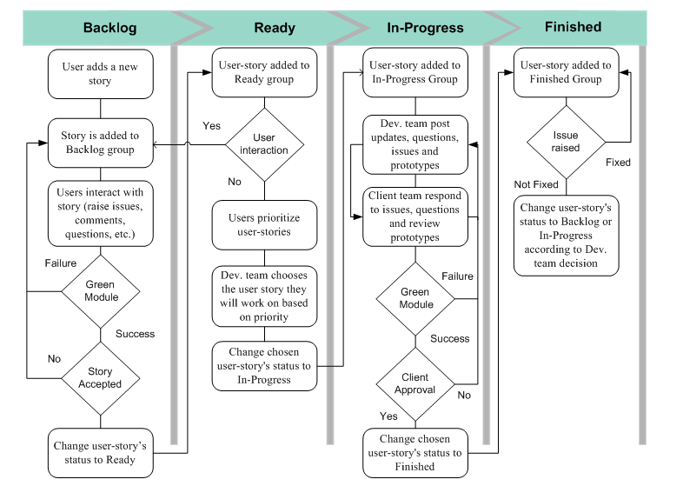
Easycomm Groups

Slide 16
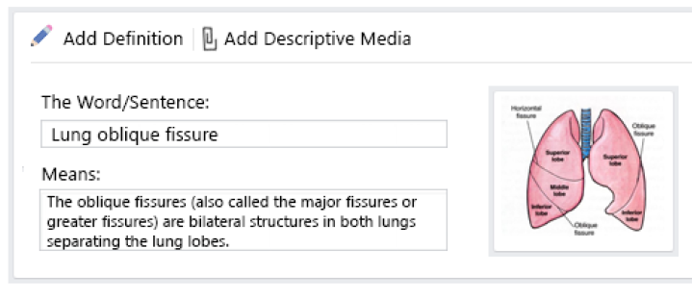
Visual dictionary
Visual dictionary allows descriptive media files to be attached with dictionary entries of business- or development-specific words and definitions that one of the teams may not be aware of, which can provide more information about the entry.

Slide 17
Using Easycomm
STEP 1
STEP 2
Set up new project
Project name
Categories
Project Dictionary
User roles
Development team members
Client’s team members
Adding user stories
can post new user-stories directly in the backlog group
teams can access the backlog group to check all user-stories posts, and can comment, raise issues or provide options on any posted story
assign relevance to each posted comment or issue users must select "Technical" from the relevance menu
tagging allows users to select specific people to get notified, regardless of their role in the system.

Slide 18
Using Easycomm
STEP 3
STEP 4
Managing the ready group
the negotiator starts prioritizing the user-stories according to their importance to the client and relevance to the projectTeam leaders of each development team open the Ready group to select the
user-story they are going to work on with their teams. All chosen stories are moved to the In-Progress group where users can keep up with all progress made on each user-story.
Communication in development phase
The development team can post documents, screenshots, videos or actual executable prototypes or working website-page links and wait for customer feedback.
If the acceptance tester approves the submitted work, then the user-story will be marked as finished and moved to the Finished group
STEP 5
Last Stage
After the delivered user-story has been accepted, it is moved to the finished group where other users can access and check it.
EasyComm will send notifications to all users with Technical Writer roles so they can start writing technical documents for the delivered work.

Slide 19
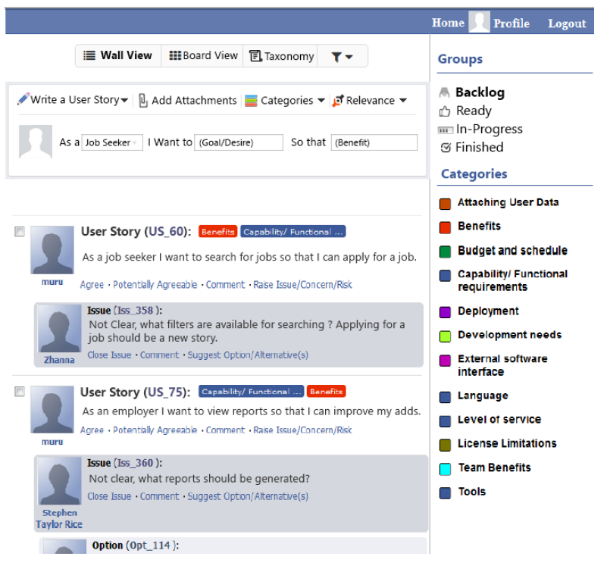

Slide 20
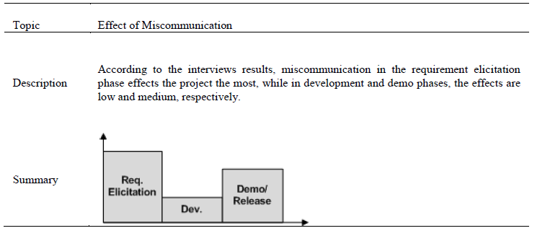
Evaluation 1

Slide 21
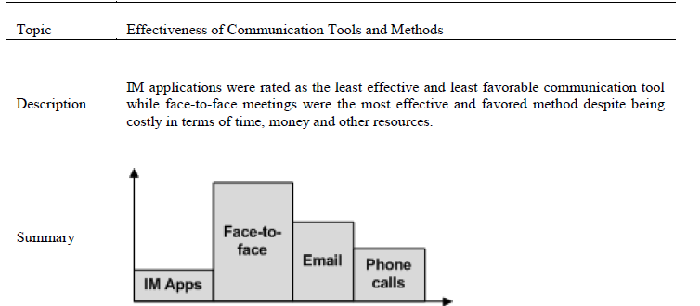
Evaluation 2

Slide 22
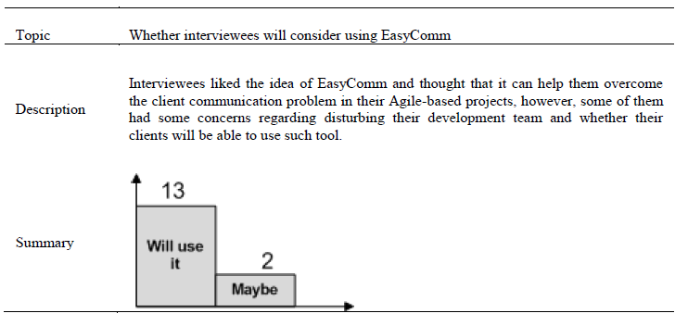
Evaluation 3

Slide 23
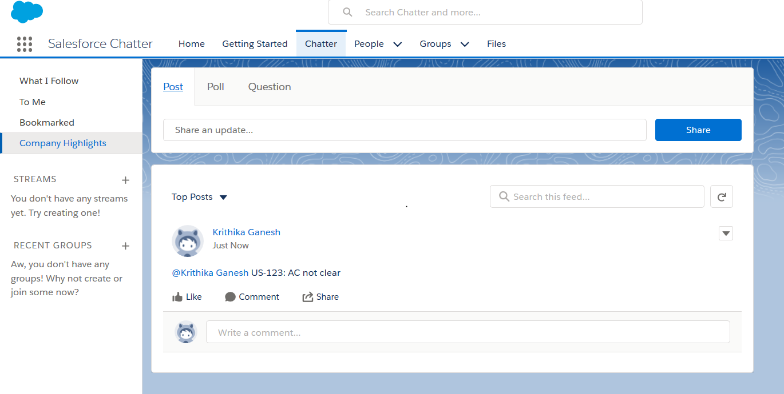
My experience Deloitte: with Salesforce Chatter

Slide 24




My views on solving Client Communication Problem
EVERYDAY
After every sprint
Software tools
Video/audio calls
Documentation when needed
Face to face meetings
BLEND OF

Slide 25
References
Download links to
WINWIN : http://sunset.usc.edu/research/WINWIN/winwinspiral.html
WINBOOK:
http://csse.usc.edu:8888/winbook/
SALESFORCE CHATTER:
https://www.salesforce.com/products/chatter/overview/

