Slide 1
IC card Management System
Card transformation and decomposition
Milestone 2

Slide 2
Idea
Guide IC Card Decomposition/Transformation
  Add new classification of IC cards
    Hybrid
    Organic
    Inorganic
  Use color type
    Isolated components tend to have more responsibilities

Slide 3
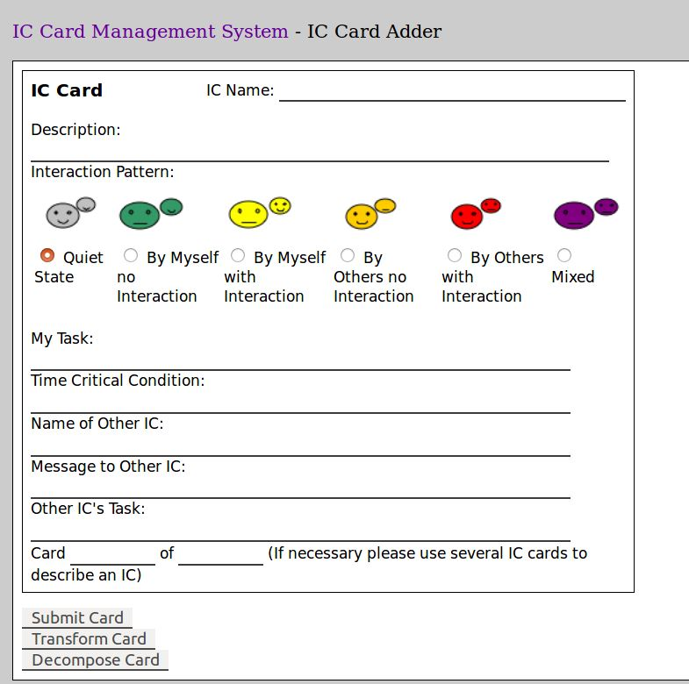
Current implementation

Slide 4
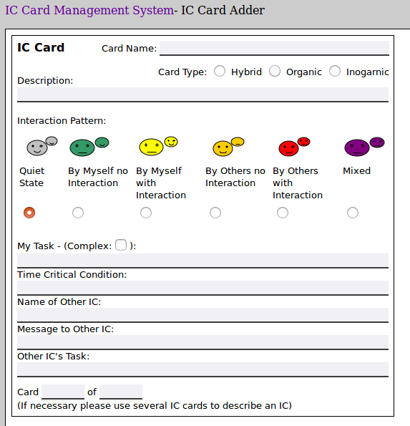
Milestone 2 implementation

Slide 5
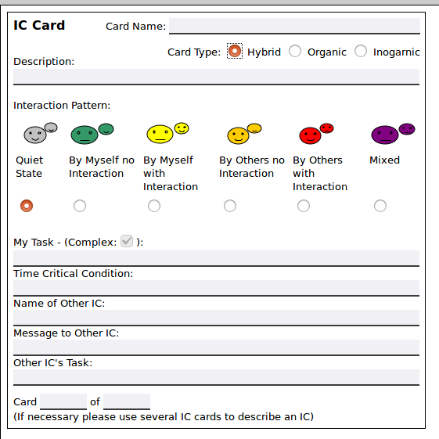
Milestone 2 implementation

Slide 6
Milestone 2 implementation
Hybrid IC cards are always complex since they have organic and inorganic components

Slide 7
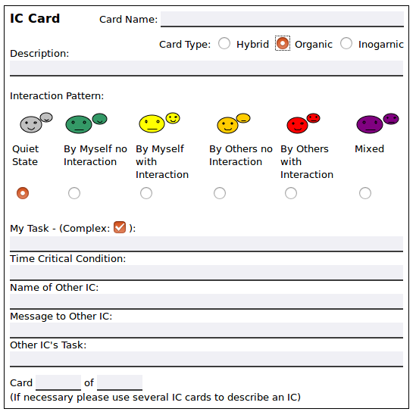
Milestone 2 implementation
Organic and Inorganic IC cards may not be complex tasks

Slide 8
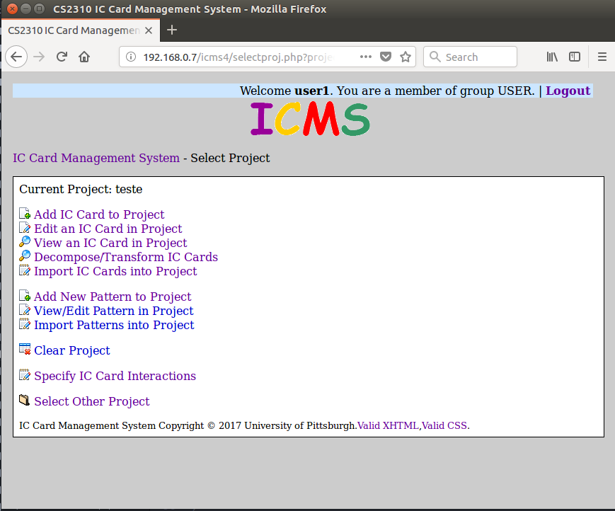
Milestone 2 implementation

Slide 9
Milestone 2 implementation

Slide 10
IC Cards Decomposition/Transformation
How guide IC card Decomposition/Transformation?
  Order existing cards according to the likelihood that they are complex

Slide 11
IC Cards Decomposition/Transformation
How guide IC card Decomposition/Transformation?
  Order existing cards according to the likelihood that they are complex
List 1
List 2
IC card a
IC card b
IC card b
IC card c
IC card c
IC card d
IC card d
IC card a
IC card e
IC card g
IC card f
IC card f
IC card g
IC card e

Slide 12
IC Cards Decomposition/Transformation
How guide IC card Decomposition/Transformation?
  Order existing cards according to the likelihood that they are complex
List 2
Hybrid cards (Inevitably complex components)
Complex (Either Organic or inorganic)
Based on colors
IC card b
IC card c
IC card d
IC card a
IC card g
IC card f
IC card e

Slide 13
IC card color based decomposition guide
Isolated cards tend to be more complex and hiding inner components
Notes:
The organic activity name is not used.
Each condition becomes a new IC card.

Slide 14
IC card color based decomposition guide
Isolated cards tend to be more complex and hiding inner components
Can be a hidden super component. Therefore the system can offer this IC card for further decomposition.
Notes:
The organic activity name is not used.
Each condition becomes a new IC card.

Slide 15
IC card color based decomposition guide
Isolated cards tend to be more complex and hiding inner components
Notes:
The organic activity name is not used.
Each condition becomes a new IC card.

Slide 16
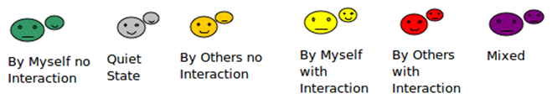
IC card color based decomposition guide
Isolated cards tend to be more complex and hiding inner components
Complexity Likelihood
Notes:
The organic activity name is not used.
Each condition becomes a new IC card.

Slide 17
IC card color based decomposition guide
Therefore the IC card transformation can be guided by the IC card color and Organic/Inorganic types
First cards to be decomposed will be the ones with the highest complexity possible
IC card b
IC card c
IC card d
IC card a
IC card g
IC card f
IC card e
Notes:
The organic activity name is not used.
Each condition becomes a new IC card.

Slide 18
Project source now on GitLab
The project code is now versioned in a Gitlab running at the university servers
Notes:
The organic activity name is not used.
Each condition becomes a new IC card.

Slide 19
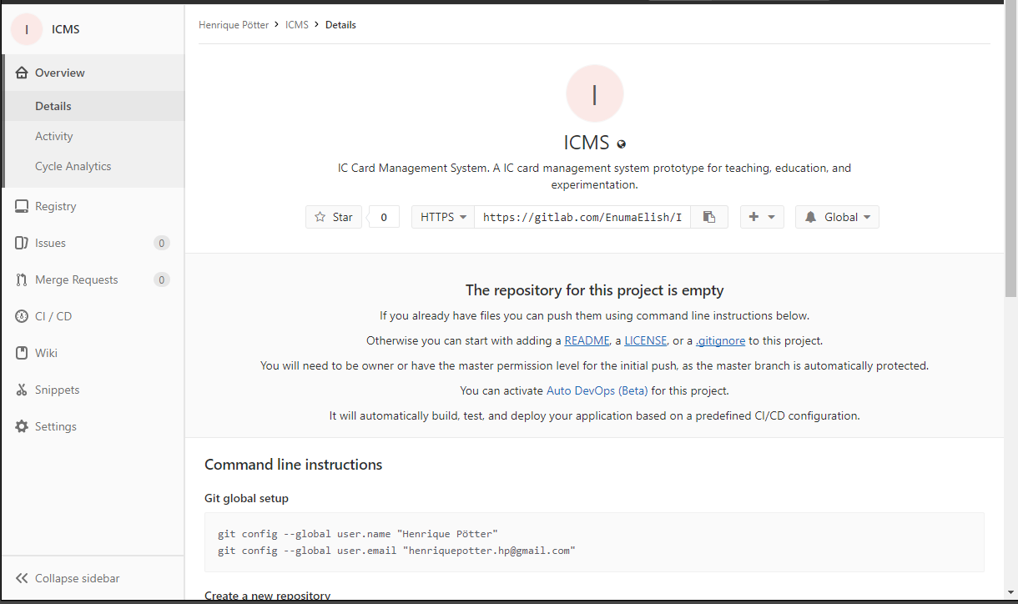
Project source now on GitLab
The project code is now versioned in a Gitlab running at the university servers
Notes:
The organic activity name is not used.
Each condition becomes a new IC card.

Slide 20
Next steps
Finish the ordering (needs Table modification and fix queries)
Decomposition/Transformation interface
Notes:
The organic activity name is not used.
Each condition becomes a new IC card.

