Slide 1

Facial Login App
CS2310 Multimedia Software Engineering
Project - Second Milestone
11/21/2017
Injung Kim

Slide 2
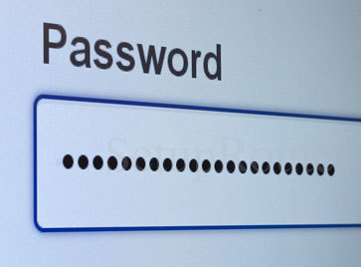
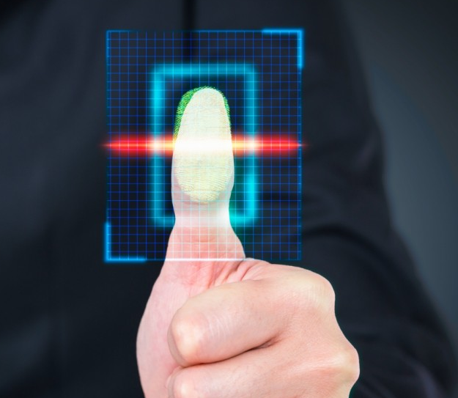
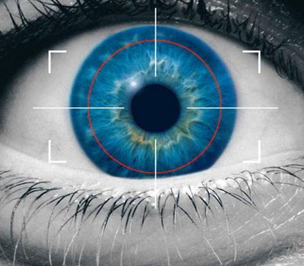
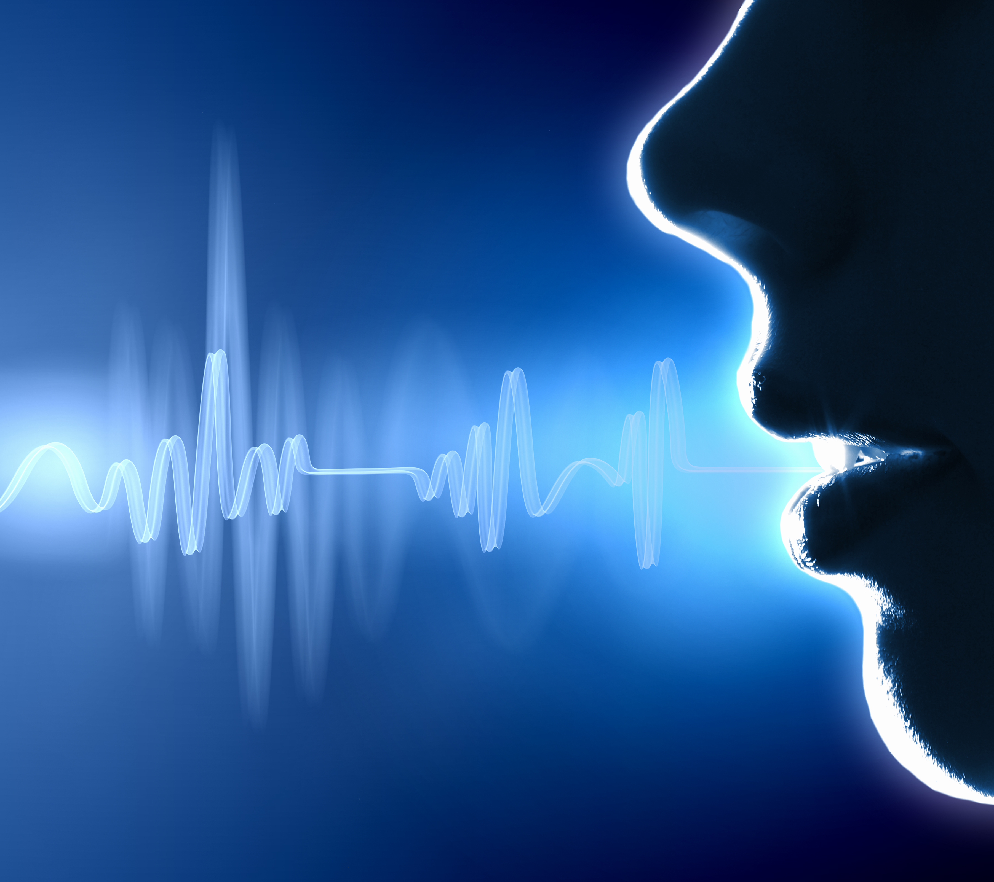
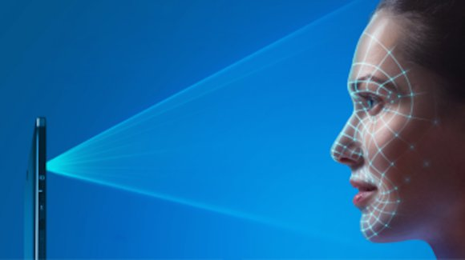
Time to say goodbye, Password
Goodbye, Password
Notes:
Password:
Hard to remember
Easy to crack
Breaches occur
Why Biometric?
identity theft is not possible
pwd remembrance problem doesn’t exist
can’t be predicted or hacked
can’t be shared
Fingerprint
need two-factor authentication
dirt, dryness, injury
Iris scanning
requires an Infrared (IR) camera which isn’t on many phones
poor lighting
Voice
noise
Face
hair, classes, age

Slide 3

Why Intelligent Facial Login?
Better than passwords
Flexible
Easy
No needs to remember
No secret is stored on servers
Identity theft is not possible
Can’t be predicted or hacked
Can’t be shared
Integrate using the language and
platform of your choice
Breadth of offerings to find the right
API for you
No dependency of camera type
or device
Ex) IRIS needs Infrared Camera
iPhone X Face login works on
only their device
No worry for noise or new device
No need to understand AI:
face detection or recognition

Slide 4
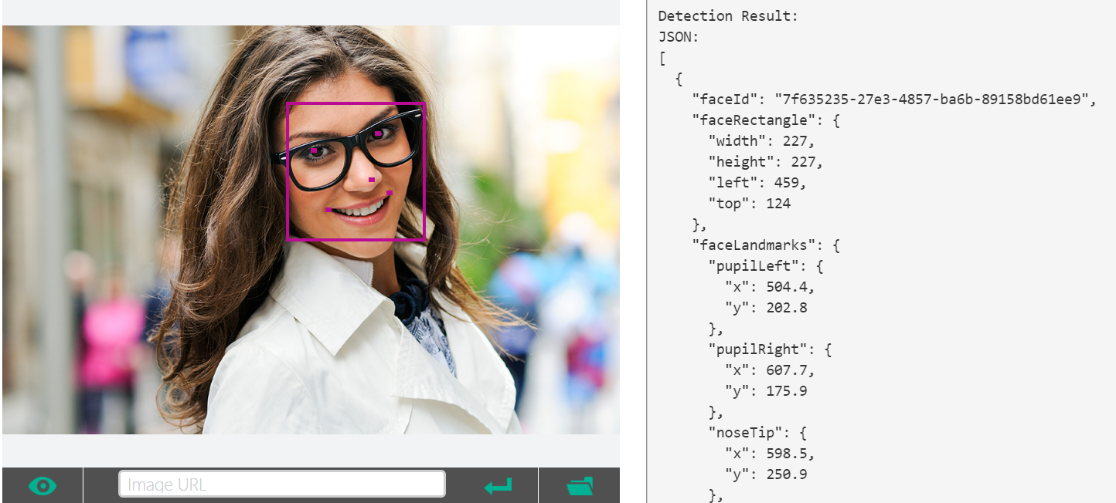
Face Detect
Notes:
Face Detect
Optional parameters for returning faceId, landmarks, and attributes. Attributes include age, gender, smile intensity, facial hair, head pose and glasses. faceId is for other APIs use includingFace - Identify, Face - Verify, and Face - Find Similar.
JPEG, PNG, GIF(the first frame), and BMP are supported. The image file size should be larger than or equal to 1KB but no larger than 4MB.
The detectable face size is between 36x36 to 4096x4096 pixels. The faces out of this range will not be detected.
A maximum of 64 faces could be returned for an image. The returned faces are ranked by face rectangle size in descending order.
Some faces may not be detected for technical challenges, e.g. very large face angles (head-pose) or large occlusion. Frontal and near-frontal faces have the best results.
Attributes (age, gender, headPose, smile, facialHair, glasses and emotion) are still experimental and may not be very accurate. HeadPose's pitch value is a reserved field and will always return 0.
faceId
Unique faceId of the detected face, created by detection API and it will expire in 24 hours after detection call. To return this, it requires "returnFaceId" parameter to be true.
faceRectangle
A rectangle area for the face location on image.
faceLandmarks
An array of 27-point face landmarks pointing to the important positions of face components. To return this, it requires "returnFaceLandmarks" parameter to be true.
faceAttributes
Face Attributes:age: an age number in years.
gender: male or female.
smile: smile intensity, a number between [0,1]
facialHair: consists of lengths of three facial hair areas: moustache, beard and sideburns.
headPose: 3-D roll/yew/pitch angles for face direction. Pitch value is a reserved field and will always return 0.
glasses: glasses type. Possible values are 'noGlasses', 'readingGlasses', 'sunglasses', 'swimmingGoggles'.
emotion: emotions intensity expressed by the face, incluing anger, contempt, disgust, fear, happiness, neutral, sadness and surprise.
"faceId": "7f635235-27e3-4857-ba6b-89158bd61ee9",
"faceRectangle"
"faceLandmarks" 28
"pupilLeft" "pupilRight" "noseTip" "mouthLeft" "mouthRight" "eyebrowLeftOuter" "eyebrowLeftInner" "eyeLeftOuter" "eyeLeftTop" "eyeLeftBottom" "eyeLeftInner"
"eyebrowRightInner" "eyebrowRightOuter" "eyeRightInner" "eyeRightTop"
"eyeRightBottom" "eyeRightOuter" "noseRootLeft" "noseRootRight"
"noseLeftAlarTop" "noseRightAlarTop" "noseLeftAlarOutTip" "noseRightAlarOutTip"
"upperLipTop" "upperLipBottom" "underLipTop": "underLipBottom" }
"faceAttributes"
"age": 23.8,
"gender": "female",
"headPose"
"roll": -16.9,
"yaw": 21.3,
"pitch": 0
"smile": 0.826,
"facialHair"
"moustache": 0,
"beard": 0,
"sideburns": 0
"glasses": "ReadingGlasses",
"emotion"
"anger": 0.103,
"contempt": 0.003,
"disgust": 0.038,
"fear": 0.003,
"happiness": 0.826,
"neutral": 0.006,
"sadness": 0.001,
"surprise": 0.02

Slide 5
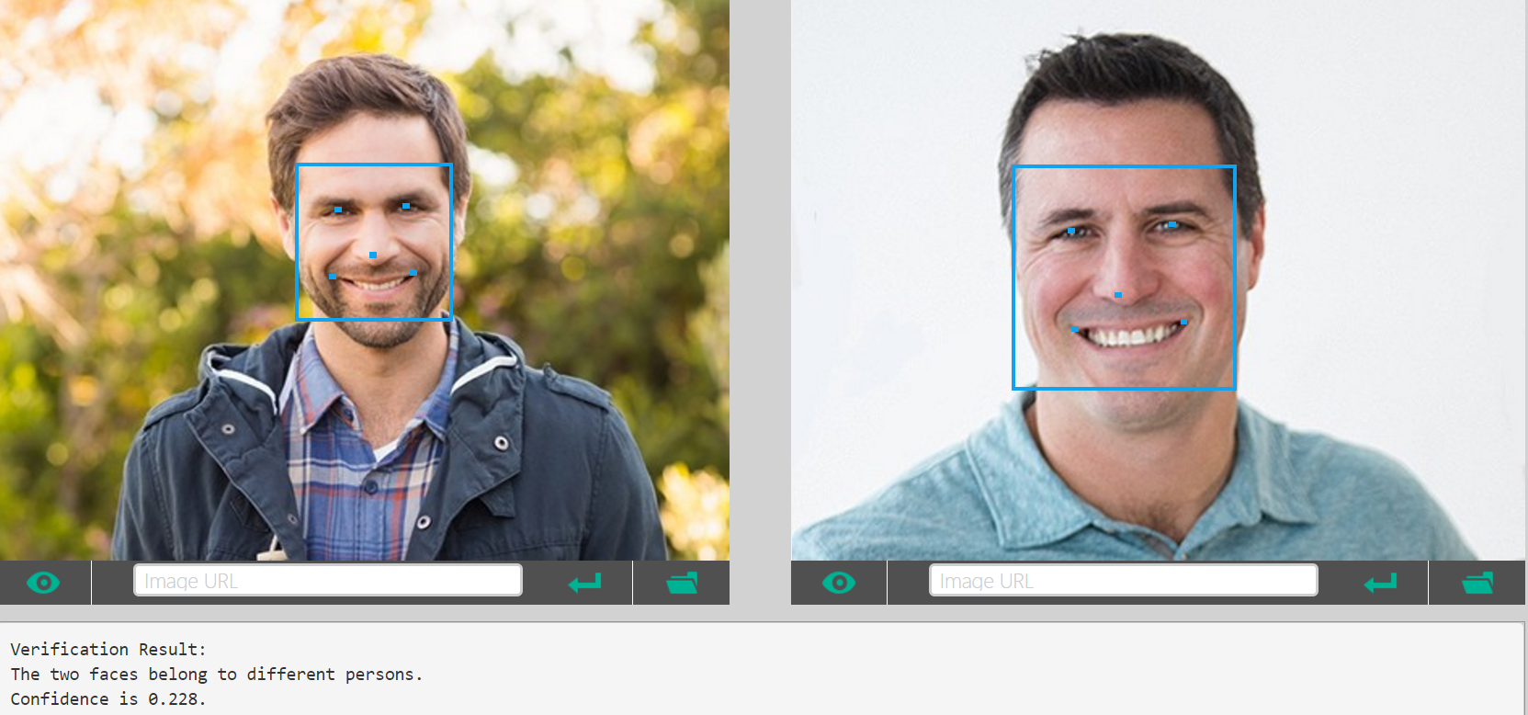
Face Verify
Notes:
Face Verify
This API works well for frontal and near-frontal faces.
For the scenarios that are sensitive to accuracy please make your own judgment.
JSON fields in face to face verification request body:
JSON fields in face to person verification request body:
isIdenticalBooleanTrue if the two faces belong to the same person or the face belongs to the person, otherwise false.confidenceNumberA number indicates the similarity confidence of whether two faces belong to the same person, or whether the face belongs to the person. By default, isIdentical is set to True if similarity confidence is greater than or equal to 0.5. This is useful for advanced users to override "isIdentical" and fine-tune the result on their own data.

Slide 6



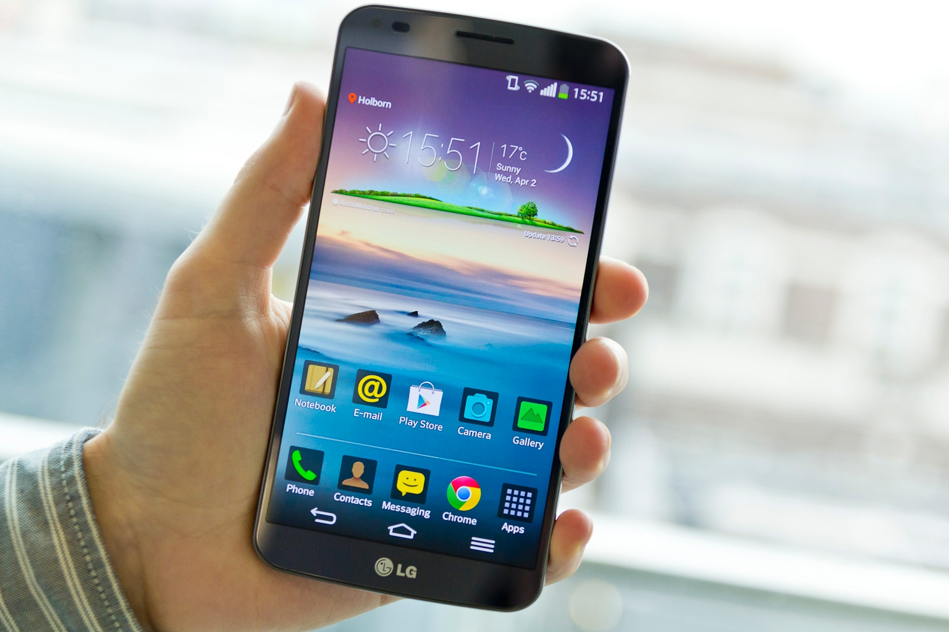

Facial Login App User Scenario
Face Registration
1
2
Facial Login
for Any App
Authentication by using
Microsoft Azure
Vision API
3
Notes:
User scenario
User may register him/her face data into their smartphone
Any app on the smartphone can use the Facial Login System
Facial Login System will authenticate by using Microsoft Azure Vision API
Microsoft Vision API
- Face Detect
: We will use this feature in order to register the user’s face and when they authenticate. More details are below.
Optional parameters for returning faceId, landmarks, and attributes. Attributes include age, gender, smile intensity, facial hair, head pose and glasses. faceId is for other APIs use including Face - Identify, Face - Verify, and Face - Find Similar.
JPEG, PNG, GIF(the first frame), and BMP are supported. The image file size should be larger than or equal to 1KB but no larger than 4MB.
The detectable face size is between 36x36 to 4096x4096 pixels. The faces out of this range will not be detected.
A maximum of 64 faces could be returned for an image. The returned faces are ranked by face rectangle size in descending order.
Some faces may not be detected for technical challenges, e.g. very large face angles (head-pose) or large occlusion. Frontal and near-frontal faces have the best results.
Attributes (age, gender, headPose, smile, facialHair, glasses and emotion) are still experimental and may not be very accurate. HeadPose's pitch value is a reserved field and will always return 0.
faceId
Unique faceId of the detected face, created by detection API and it will expire in 24 hours after detection call. To return this, it requires "returnFaceId" parameter to be true.
faceRectangle
A rectangle area for the face location on image.
faceLandmarks
An array of 27-point face landmarks pointing to the important positions of face components. To return this, it requires "returnFaceLandmarks" parameter to be true.
faceAttributes
Face Attributes:age: an age number in years.
gender: male or female.
smile: smile intensity, a number between [0,1]
facialHair: consists of lengths of three facial hair areas: moustache, beard and sideburns.
headPose: 3-D roll/yew/pitch angles for face direction. Pitch value is a reserved field and will always return 0.
glasses: glasses type. Possible values are 'noGlasses', 'readingGlasses', 'sunglasses', 'swimmingGoggles'.
emotion: emotions intensity expressed by the face, incluing anger, contempt, disgust, fear, happiness, neutral, sadness and surprise.
"faceId": "7f635235-27e3-4857-ba6b-89158bd61ee9",
"faceRectangle"
"faceLandmarks" 28
"pupilLeft" "pupilRight" "noseTip" "mouthLeft" "mouthRight" "eyebrowLeftOuter" "eyebrowLeftInner" "eyeLeftOuter" "eyeLeftTop" "eyeLeftBottom" "eyeLeftInner"
"eyebrowRightInner" "eyebrowRightOuter" "eyeRightInner" "eyeRightTop"
"eyeRightBottom" "eyeRightOuter" "noseRootLeft" "noseRootRight"
"noseLeftAlarTop" "noseRightAlarTop" "noseLeftAlarOutTip" "noseRightAlarOutTip"
"upperLipTop" "upperLipBottom" "underLipTop": "underLipBottom" }
"faceAttributes"
"age": 23.8,
"gender": "female",
"headPose"
"roll": -16.9,
"yaw": 21.3,
"pitch": 0
"smile": 0.826,
"facialHair"
"moustache": 0,
"beard": 0,
"sideburns": 0
"glasses": "ReadingGlasses",
"emotion"
"anger": 0.103,
"contempt": 0.003,
"disgust": 0.038,
"fear": 0.003,
"happiness": 0.826,
"neutral": 0.006,
"sadness": 0.001,
"surprise": 0.02
- Face Verify
: We will use this feature in order to authenticate the user’s current face and stored face image. More details are below.
This API works well for frontal and near-frontal faces.
For the scenarios that are sensitive to accuracy please make your own judgment.
JSON fields in face to face verification request body:
JSON fields in face to person verification request body:
isIdenticalBooleanTrue if the two faces belong to the same person or the face belongs to the person, otherwise false.confidenceNumberA number indicates the similarity confidence of whether two faces belong to the same person, or whether the face belongs to the person. By default, isIdentical is set to True if similarity confidence is greater than or equal to 0.5. This is useful for advanced users to override "isIdentical" and fine-tune the result on their own data.
The face attribute features available are: Age, Gender, Pose, Smile, and Facial Hair along with 27 landmarks for each face in the image.

Slide 7
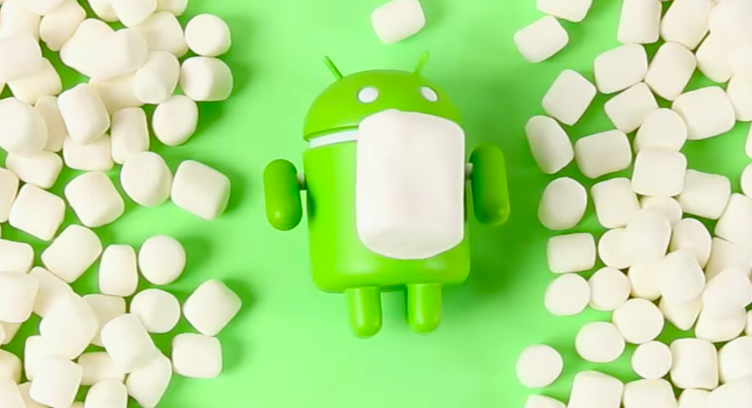



Facial Login App Environment
Android Emulator: Genymotion2.11.0, Virtual Box v5.2.0
Android Studio: 3.0
Android Phone: Asus Z016D
SDK: Android 6.0.1 API23 (Marshmallow)

Slide 8
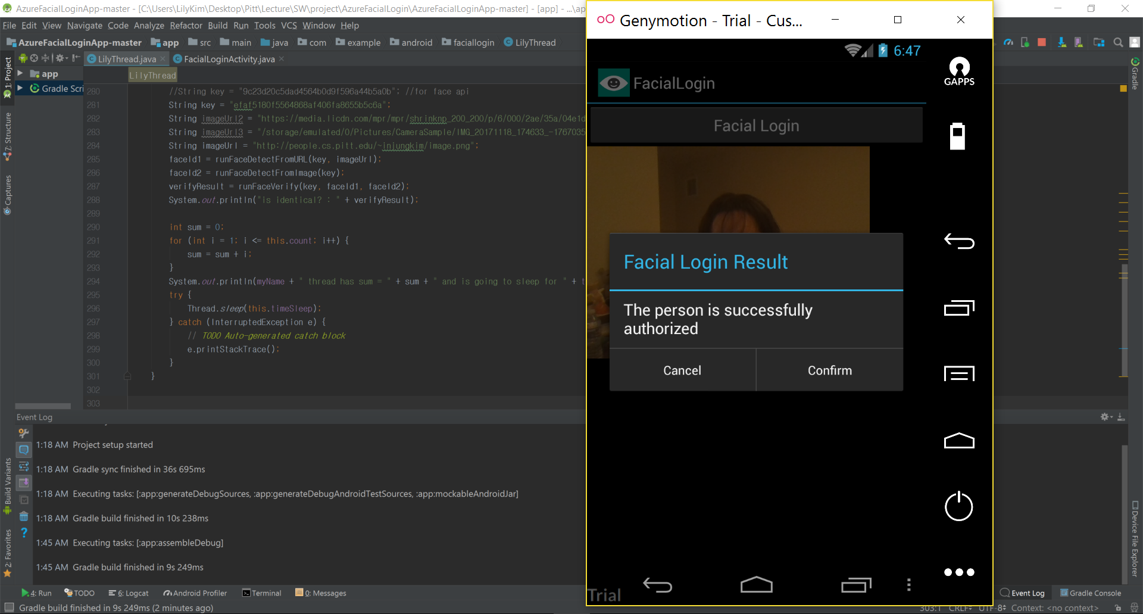
Facial Login App Demo - Success

Slide 9
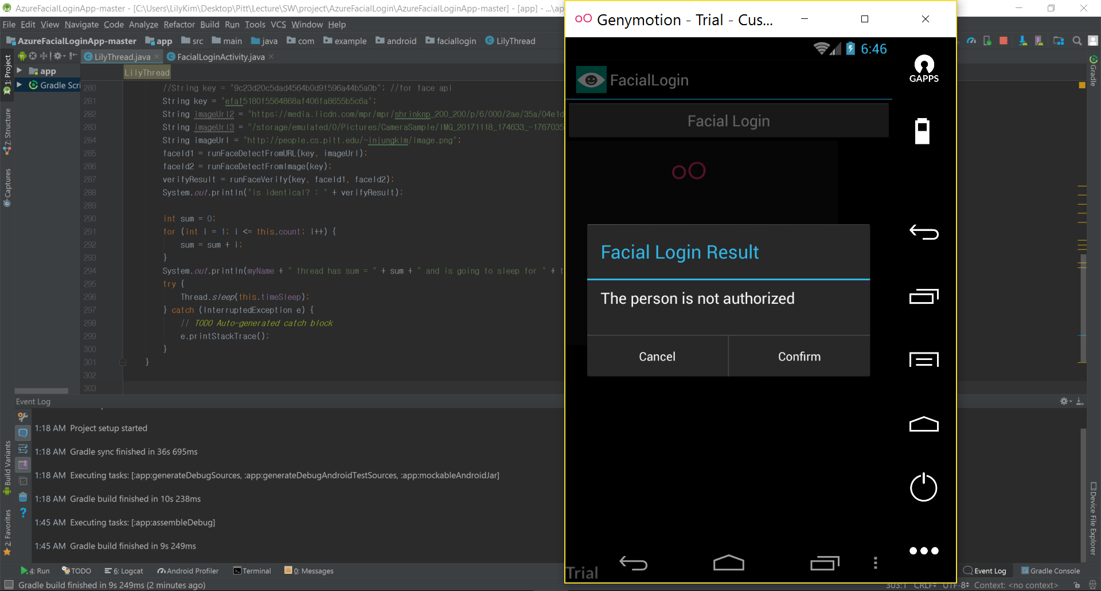
Facial Login App Demo - Fail

Slide 10
Next Steps
Demo
  Registration Face – having problem to access local photo
  Extract Emotion (plan B)
Documentation

Slide 11
Plan B. Who is not happy?
Detect Face & Emotion
  Detect face from the image, then guess emotion and other info
Detect Face from Image
Get Age & Gender Info
Extract Emotion Info
Face API
Emotion API
Azure Portal
Azure Portal
Notes:
Detect Face & Emotion
Detect face from the image, then guess emotion and other info
Face API would detect face from the image
Face API would get age and gender information
Emotion API would get emotion information
score Anger, Contempt, Disgust, Fear, Happiness, Neutral, Sadness, Surprise

Slide 12
Documentation https://docs.microsoft.com/en-us/azure/cognitive-services/ https://azure.microsoft.com/en-us/services/active-directory/
Client SDKs https://github.com/Microsoft/ProjectOxford-ClientSDK https://github.com/felixrieseberg/project-oxford (nodejs) https://github.com/southwood/project-oxford-python https://github.com/microsoftgraph/android-java-connect-rest-sample
Example Code https://github.com/jsturtevant/happy-image-tester-django https://github.com/jsturtevant/happy-mage-tester-nodejs
  References

Slide 13
Backup

Slide 14
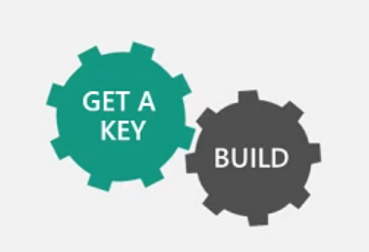

Why Microsoft Azure Cognitive Services?
Easy
Flexibility
Usability
Roll your own with REST APIs
Simple: just a few lines of code
Integrate using the language and
platform of your choice
Breadth of offerings to find the right
API for you
Customers’ case study
Built by experts from Microsoft
Research, Bing, and Azure
Machine Learning
Quality documentation, sample
code, and community support

Slide 15
Case Study

Slide 16

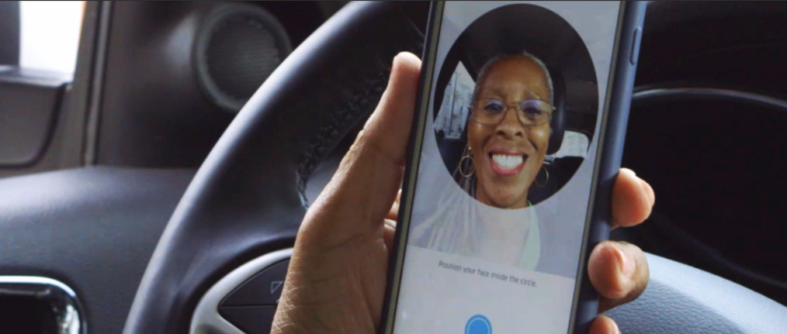
“Thousands of partners sign in to our platform every hour. The response time from the Face API is incredible, enabling us to verify our drivers without slowing them down.”
Uber Product Manager
Dima Kovalev
Vision API
Read Case Study Here

Slide 17


“Conversions related to recommendations account for 15 percent of our sales. The ability to automate recommendations and scale them to 10,000 products has had a big impact on our revenues.”
DutchCrafters Chief Information Officer
Miao Xue
Knowledge API
Read Case Study Here

Slide 18
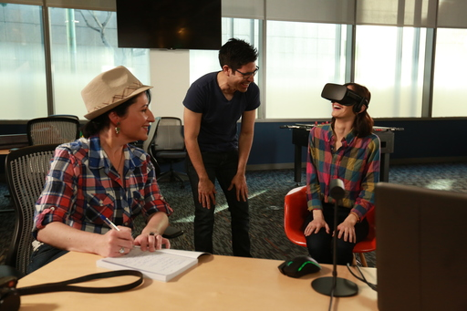

“Using the Custom Speech Service, we were able to cut the word error rate in half without sacrificing any latency. It responds as soon as a person stops speaking, which is incredible.”
Human Interact Owner & Creative Director
Alexander Mejia
Speech API
Read Case Study Here

Slide 19
