Slide 1

Milestone 2
EMOTION DIARY
BENEFITS
Yuhuan Jiang
yuhuan@cs.pitt.edu
Patients will find it easy to report their emotions, because emotion detection is automatic. Uploading emotions can be done conveniently on their iPhones, or via speech on their laptops.
Doctors will find it easier to manage patients because the detection of their critical emotion conditions is automatic.
WHAT IS IT?
Emotion Diary is a platform for patients to easily upload emotion data to psychiatrists.
FEATURE HIGHLIGHTS
For patients:
There are two clients, each has their own advantange:
The iOS client can be used to upload emotions on the go (such as at work, or when the patient is dining).
The web client can be used at home with voice inputs (no key pressing or clicking).
For doctors:
A web client to view patient emotions at a glance through intuitive emotion bar charts.
Get automatic alerts when patients experience non-happy emotions for three times in a row.
SENSORS INVOLVED
The front-facing camera of the laptop and iPhone is used by patients to upload their emotions.
The mic on the laptop is used by the patient to carry out voice commands to control the emotion uploader interface.
SYSTEM COMPONENTS
(See next page.)

Slide 2



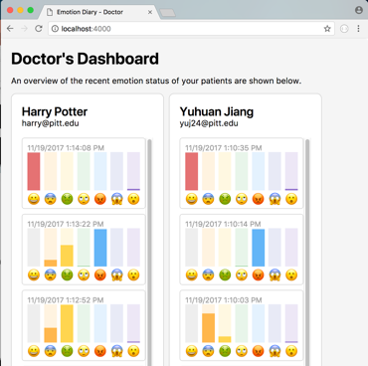
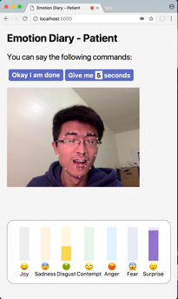
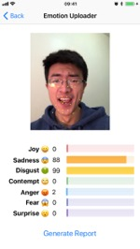
SYSTEM COMPONENTS
(Updated with Actual Screenshots)
Patient
Emotion Datastore
Psychiatrist
MySQL
Uses iPhone on the go;
Uses browser at home.
Sees new emotions;
Sees alerts.
Stores data
Pulls data
Patient Clients
Doctor Client
or
iPhone
Chrome Browser
Chrome Browser

Slide 3
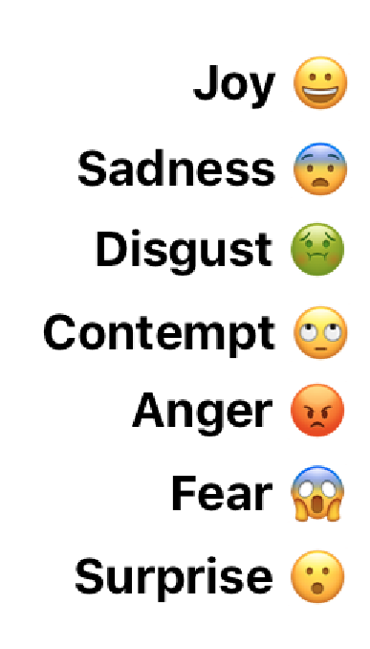
Facial Expression Recognition
Library: Affectiva by Affdex [1]
Recognizes 34 feature points on the human face
  E.g.: Eye brow corners, nose root, mouth corners
Recognizes 7 emotions:
Advantage: can run locally without network
  Computation done at local machine
  Saves cellular data usage when running on iOS
[1] https://www.affectiva.com

Slide 4
Speech Recognition API
A standard API implemented by modern browsers.
A library named Annyang [2] is used to support parameterized commands:
  E.g.: “Give me * seconds”, where * is a number.
Runs in the cloud
  Needs network when to recognize commands
  Not a problem, as the web client is used at home, where Wi-Fi is available.
[2] https://github.com/TalAter/annyang

Slide 5
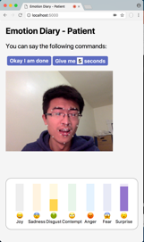


Progress So Far
What Has Been Done? What Are In Progress?
✓
✓
✓
iOS Patient Client
Web Patient Client
Doctor Client
Swift + Affectiva
Node.js + Affectiva + Speech API
Node.js
In Progress
✓
In Progress
MySQL
MySQL
Datastore
Overall Appearance
(BONUS)
Send to Chronobot
(BONUS)
Node.js + MySQL
Based on Colors
PHP

Slide 6
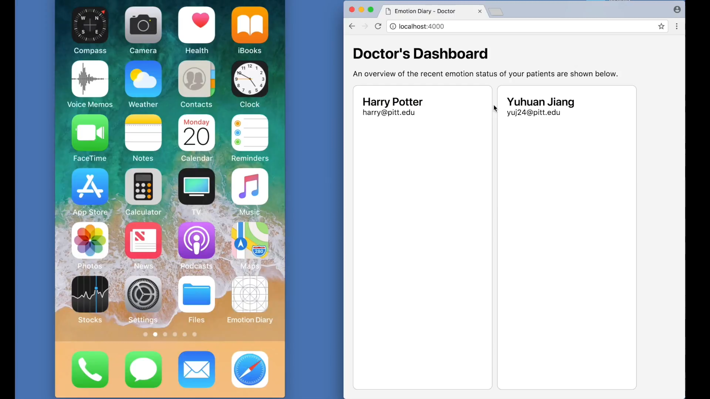
(Length: 4m49s)
Demo Video 1
Scenario 1: Using the iPhone Client on the Go

Slide 7
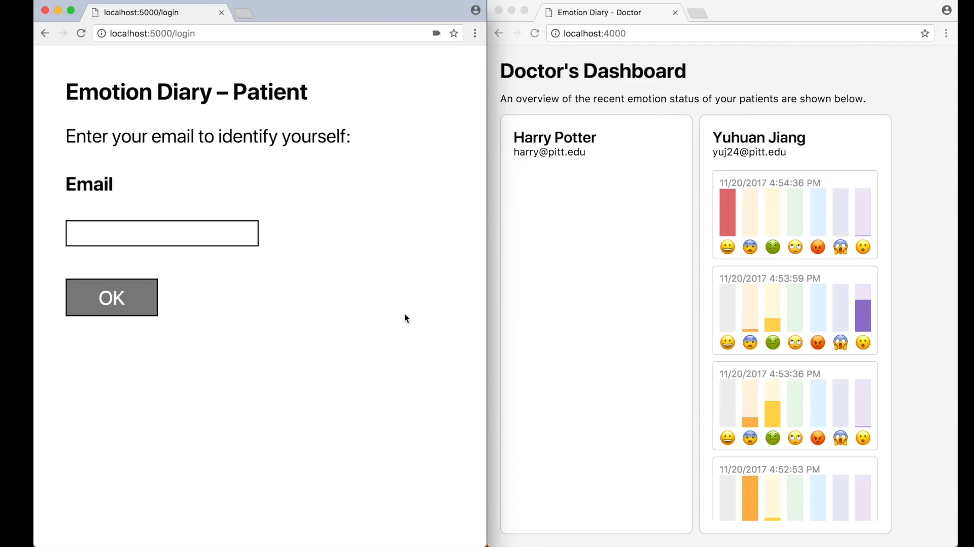
(Length: 4m7s)
Demo Video 2
Scenario 2: Using the Web Client at Home in the Browser

