Slide 1
Hybrid Mobile Applications
Spencer Gray

Slide 2


Motivation-Why Use Them?
Save money
  Most hybrid mobile applications use web based languages/markup
  Web based developers cost less to employ than native developers
Save time
  Write one app and build it for each platform (IOS, Android, Windows, etc)
  No need to retrain developers who already know web based languages

Slide 3






Angular2
Apache
Cordova
HTML5
Sass
Open Sourced, licensed under MIT
Ability to interface with 120 native device features (camera, Bluetooth, etc)
Command Line Interface to build, test, and deploy
  Testing can be done in a web browser, virtual device, or real device

Slide 4
Strengths:
  Free to use
  Easy to learn
  Live Reload (saving in your text editor will propagate changes immediately)
  Good community and documentation
Weaknesses
  Still a few bugs without work arounds
  Allows you to test in a web browser-renders very differently than virtual devices
    People are too tempted to use this option
    Huge difference in styling
  Performance

Slide 5
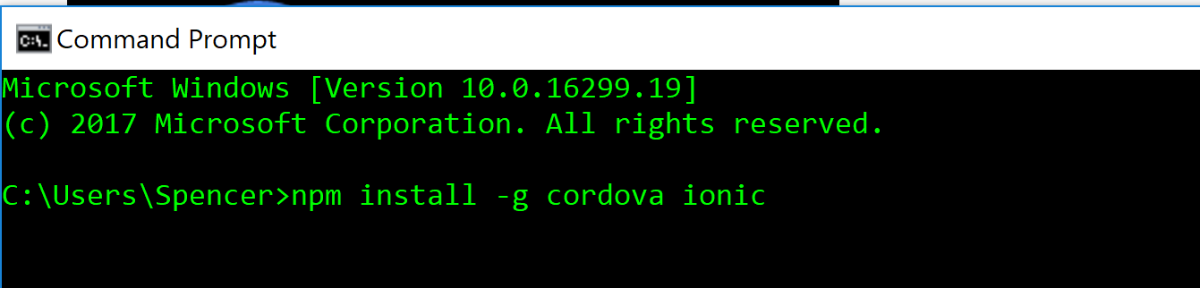
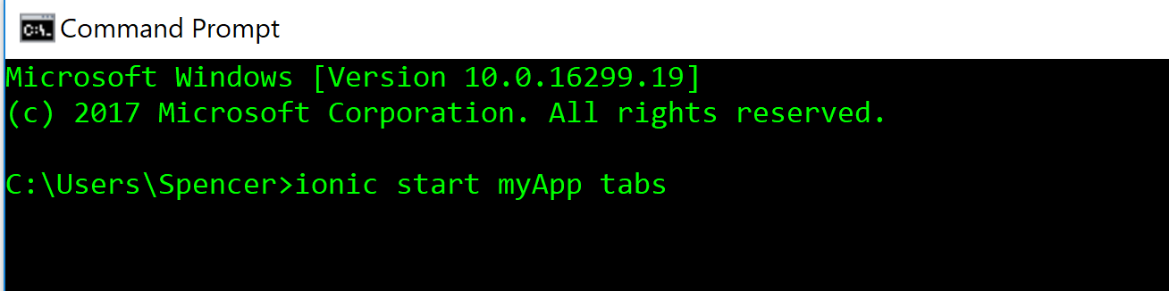
Getting Started
Install Node JS
  https://nodejs.org/en/download/
Download the ionic cordova packing using npm at the command line:
Initialize a project from a template:

Slide 6

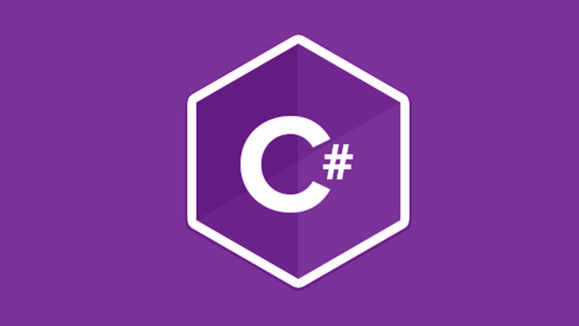
Develop using C#
Open Sourced licensed under MIT
  Only became open source in 2016 when purchased by Microsoft
Ability to use Objective-C, Java, C, and C++ 3rd party libraries

Slide 7

Strengths
  Open sourced and free to use
  Available for free in Visual Studios
  Higher performance than other hybrid frameworks
Weaknesses
  Developers must learn C#
  Xamarin apps take up more memory on devices

Slide 8
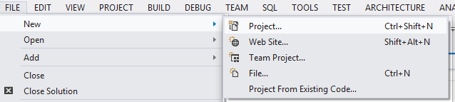
Getting Started
Go to the Xamarin website and download Xamarin with Visual Studios
  If you already have Visual Studios, it will simply add it to your installation
  Visual Studios Community is free
  Link: https://www.xamarin.com/download
Create a new project:
Select a new Xamarian.Forms project
Everything else will happen automatically

