Slide 1
Detecting personality based on interactions with Alexa
Krithika Ganesh
CS2310 Multimedia Software Engineering

Slide 2
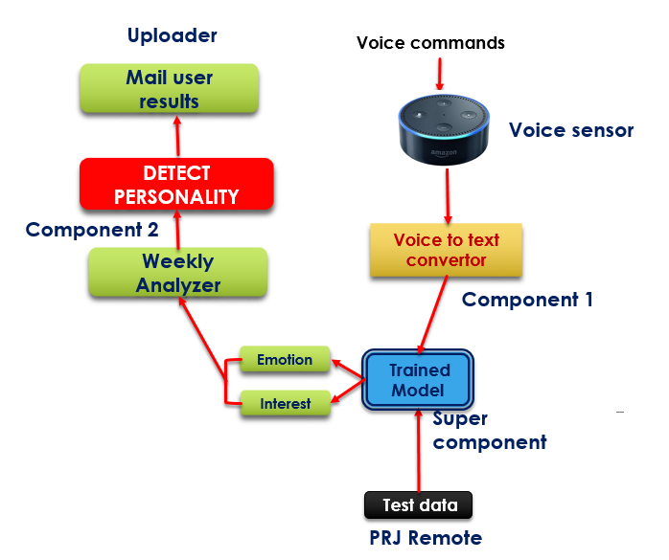
Detecting personality based on interaction with Alexa
Detect personality of the user by passing the user voice commands to a machine learning model which predicts the emotional and interest quotient for each voice command. At the end of the week gives an analysis of the interest and emotional quotient of the user..
Objectives
Predict emotion and interest quotient for each voice command
End of week give an overall analysis of the mood and interest of the person

Slide 3

  Progress
  Architecture
Tasks
Configuring the server (SIS)
Machine learning component
PRJ Remote component
Uploader component(mail results)
Alexa app
SIS server working together with all components
Super component
Component
Machine learning component
Prj Remote component
Flask server
SIS Server
Component
Component
Uploader
component
Voice app

Slide 4
13
  Machine Learning Training Components
Building Model
<Sentence , interest>
<Sentence , emotion>
Data scrubbing
Clean data
Vectorization
Sentence vectors
Embedding layer
Word vectors
LSTM
Predicted vectors
Dense layer
Probability distribution vector
Softmax layer
Max of Probability distribution vector
Categorical Cross entropy loss function
Changes vector to O/P dimension
Predicts emotion
Predicts interest

Slide 5
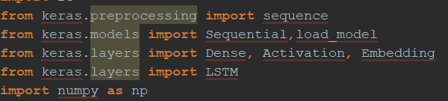


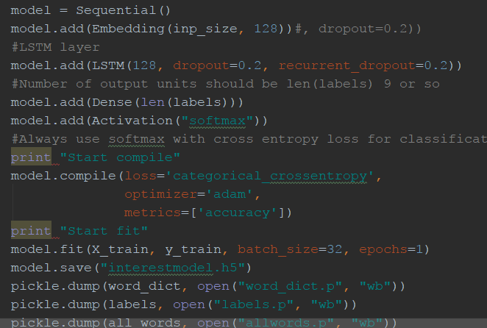
Progress : ML Implementation
Keras is a high-level neural networks API, written in Python and capable of running on top of TensorFlow, CNTK, or Theano.

Slide 6
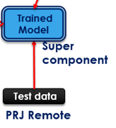
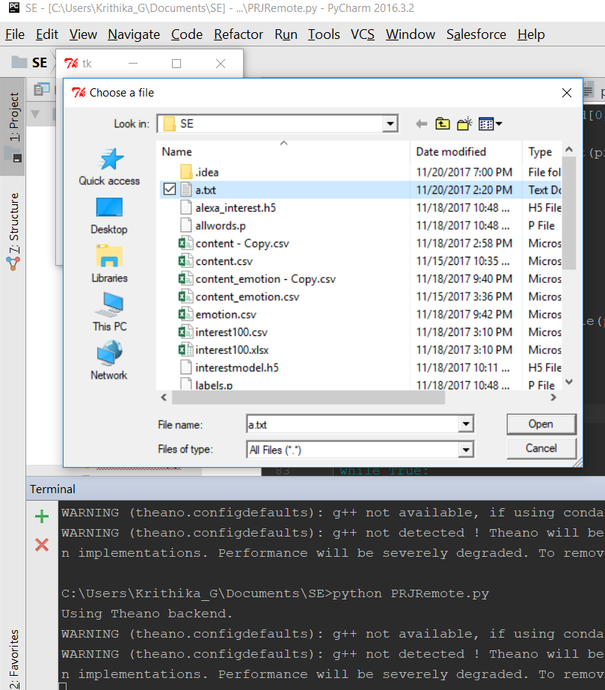

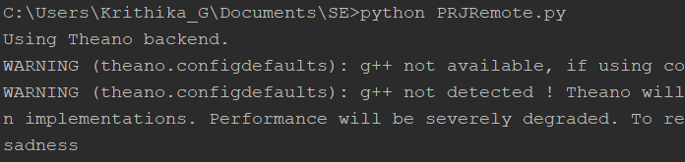

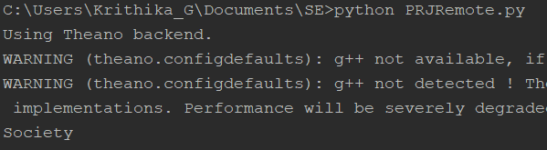
  PRJ REMOTE : TESTING COMPONENT

Slide 7

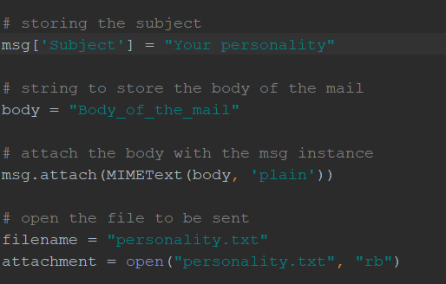

  Uploader : Mailing Results
  Hostname: smtp.gmail.com
  Port: 587

Slide 8
  References
  Training data
  <sentence, emotion> : https://www.crowdflower.com/
  <sentence, interest> : www.dmoz.org/
  Training model
  https://keras.io/
  PRJ Remote
  https://stackoverflow.com/questions/16798937/creating-a-browse-button-with-tkinter
  Uploader
  http://www.geeksforgeeks.org/send-mail-gmail-account-using-python/

