Slide 1
Detecting Room Occupancy with Pi Camera
Milestone 2
Muneeb Alvi

Slide 2
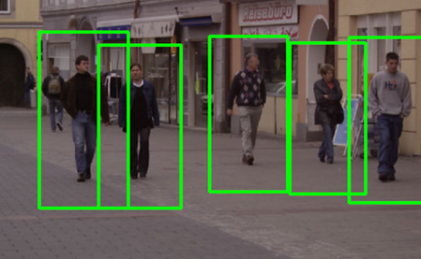
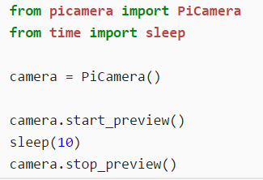
Original Goal
Python
OpenCV
Open Source Computer Vision Library

Slide 3
Current Progress
Able to detect occupancy using difference in images
Don’t say unoccupied for first 10 seconds
Don’t say unoccupied unless 10 seconds pass since occupancy

Slide 4
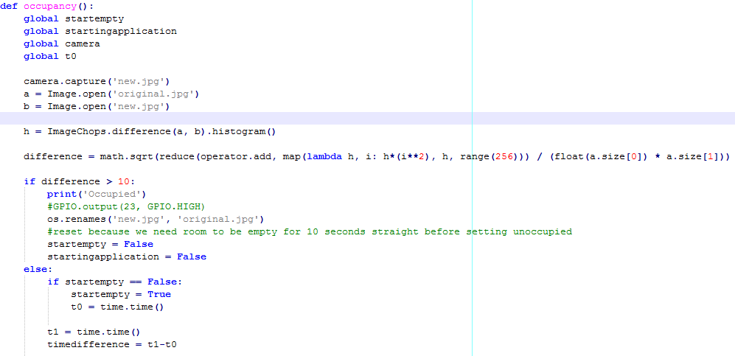

Slide 5
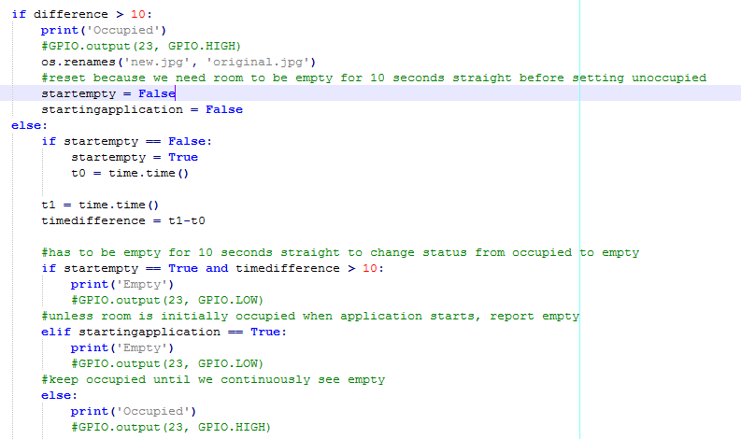

Slide 6
Demo

