Slide 1
Playback control using mind

Slide 2
Mind wave controller
MindWave Mobile safely measures and outputs the EEG power spectrums
Output Spectrums are :
  Alpha
  Beta
  Gamma
  Delta
  Theta
These signals capture present state of mind.

Slide 3
Project model
GUI
Mind Wave Headset
Input Processor
SIS SERVER

Slide 4
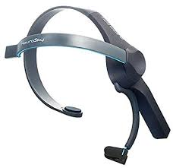
Control flow
Video
Play/
Pause
Processing.java
Raw Data
Mindwave.java
Bluetooth Information
Processed Information

Slide 5
Processing data
Raw Data is categorized into :
  Attention Event
  Meditation Event
  Blink Event
  Poor Signal Event
By assigning a threshold limit given to the Attention Event we can decide if a person is paying attention or not.
This information can be used to play/pause the video.
This method can be ineffective.

Slide 6

Applying ML
Video
Categorize Data
Send Output
Collect Data
Train Data
Raw Data
Mindwave.java
Processed Information

Slide 7
Processing Data
Raw data is continuously collected
This model is then trained to identify the different possible signals
The relationship between the data and the type of signals are established
Using Weka Workbench as tool for applying Machine Learning Algorithm
With enough training data, will be able to accurately distinguish different signals
Can avoid false positives and improve accuracy of judgement

Slide 8
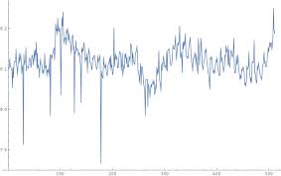
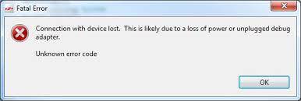
LIMITATIONS OF MINDWAVE SENSOR
Lot of noise in data
Unreliable connection.

Slide 9
SIGNALS
Gamma Waves :-
  Reflects Consciousness
  Frequency is 31Hz and higher
Beta Waves :-
  Frequency range is 12 – 30 Hz
  Associated with focused Concentration
  Eg. Solving a math task
  Beta Waves and Gamma Waves together are associated with attention, recognition and perception.

Slide 10
signals
Alpha Waves :-
  Frequency range is 3.5 – 7.5 Hz
  Linked with inefficiency and Day Dreaming
  Represent the fine line between being Awake and Asleep
  Arises from emotional stress, frustration and disappointments
Delta Waves :-
  Frequency is between 0.5 – 3.5 Hz
  Slowest wave form and occur in sleeping state.

Slide 11


environment
Visual Studio
Think Gear Connector

Slide 12
Current implementation
Video
Receive Data
2
4
Mindwave.cs
1
Simulator
Process Data
3

Slide 13
Current implementation
Input Simulation Values
Read the data and categorize them
Process the information
Send output signal

Slide 14

Component diagram
1
5
Simulation data Index Cell
Video Player Index Cell
2
4
3
Mindwave Data Parsing Index Cell
Mindwave Data Processing Index Cell

Slide 15
Component Diagram
1
Sample Simulation Data from user
Parse Simulated Data
Process Data
Pass Play/Pause Control to Output
Final Information to the User
2
3
4
5

Slide 16
Sequence diagram
USER
SIMULATOR
PARSER
PROCESS
OUTPUT
Add Data
Parse Data
Process Data
Success
Play/Pause
Output to User

Slide 17
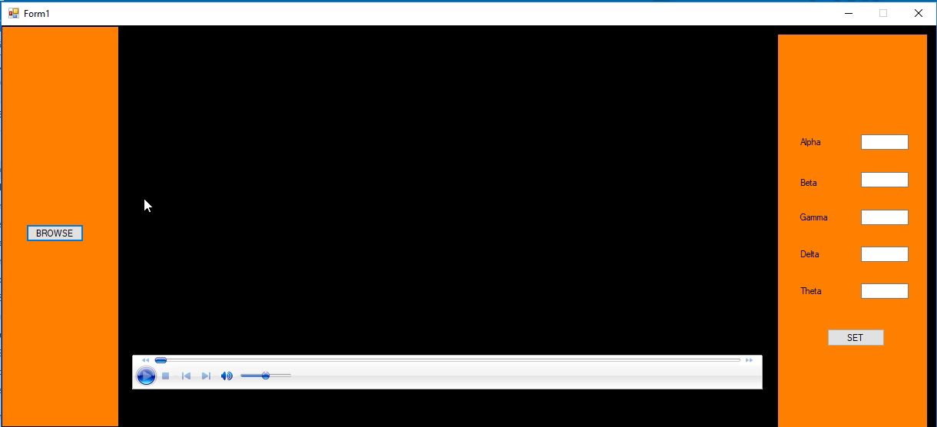
demo
https://youtu.be/tzTQy0rsh70

Slide 18
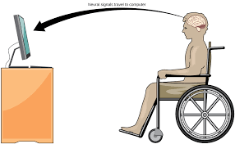
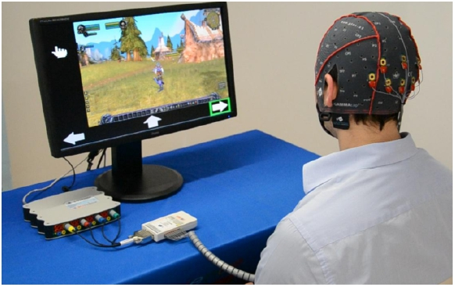
Future Applications
GAMES
MEDICAL

Slide 19
references
http://support.neurosky.com/kb/science/how-are-brainwaves-read-and-converted-in-to-energy
Classification of EEG Signals in a BrainComputer Interface System by Erik Andreas Larsen

