Slide 1

CS2310 Fall 2017 Final Project Report
Emotion Diary
Yuhuan Jiang
yuhuan@cs.pitt.edu
December 12, 2017

Slide 2
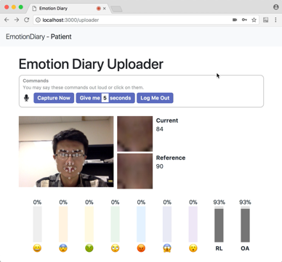
What Is Emotion Diary?
A system to allow patients to share their emotions more efficiently with their doctors.
4 Components:
  A speech-enabled web client for patients to upload emotions at home
  A mobile (iOS) client for patients to upload emotions on the go
  A web client for doctors to monitor patients’ latest emotions
  A datastore of emotion data
Two Clients for Patients
Monitor Client for Doctors

Slide 3
Updates
What has changed since Milestone II?

Slide 4
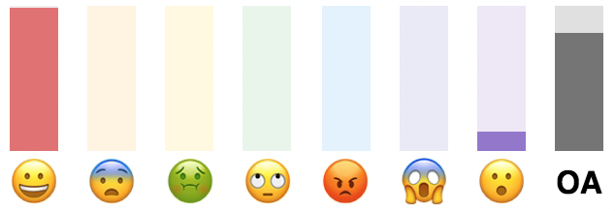
Changes Since Milestone II
Change 1: Additional dimension in the result vector
  Before: only 7 emotions
  Now: overall-appearance is added
  Overall-Appearance = (1 – Sadness) * Luminance between Eyebrows
  Will discuss luminance in just a few slides
Works on both web and iOS clients for patients!
New Dimension:
Overall-Appearance

Slide 5
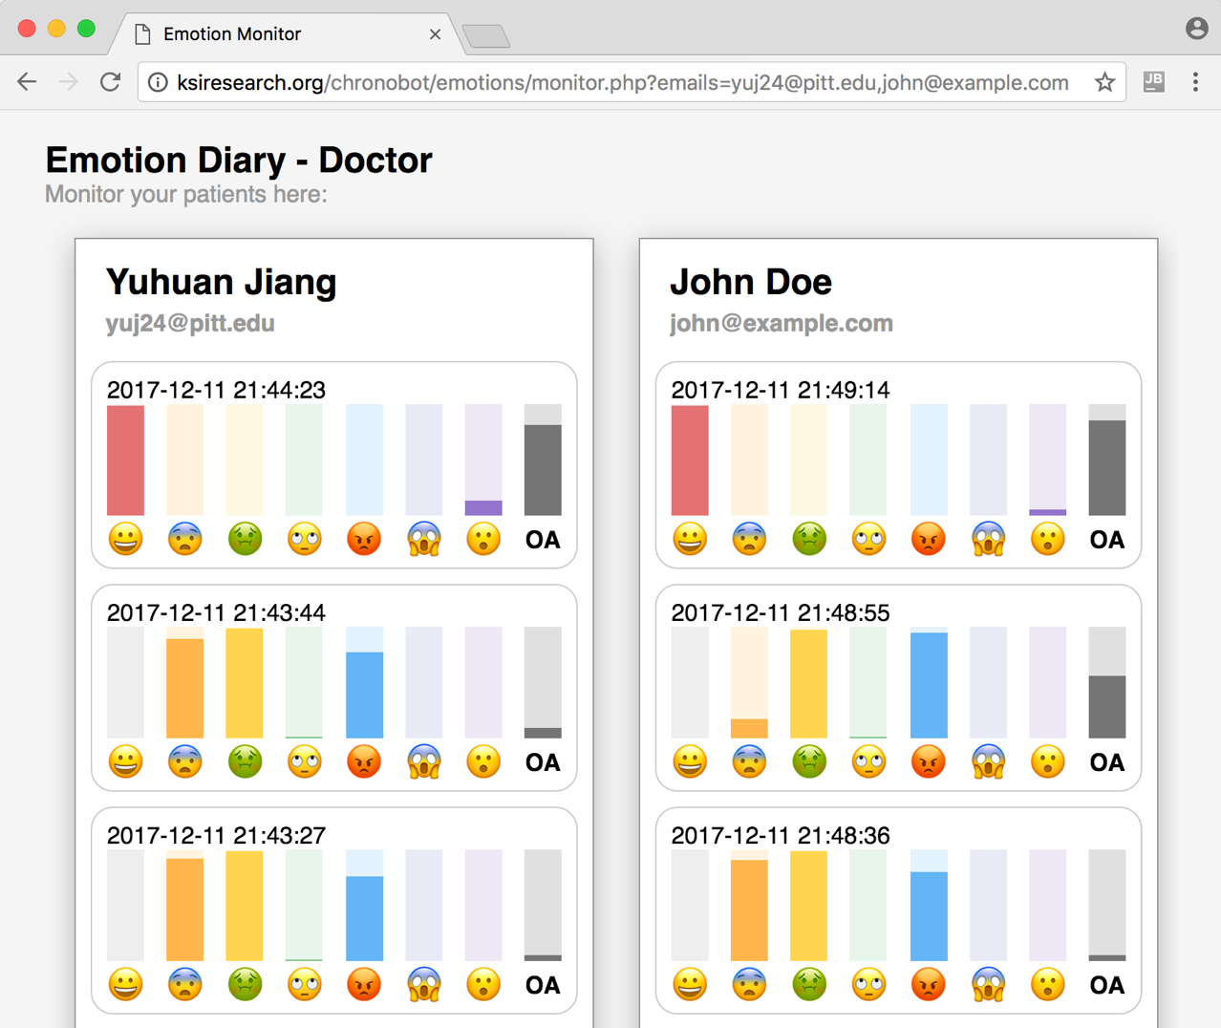
Changes Since Milestone II
Change 2: Doctor’s web client now runs on iPage server
  http://ksiresearch.org/chronobot/emotions

Slide 6
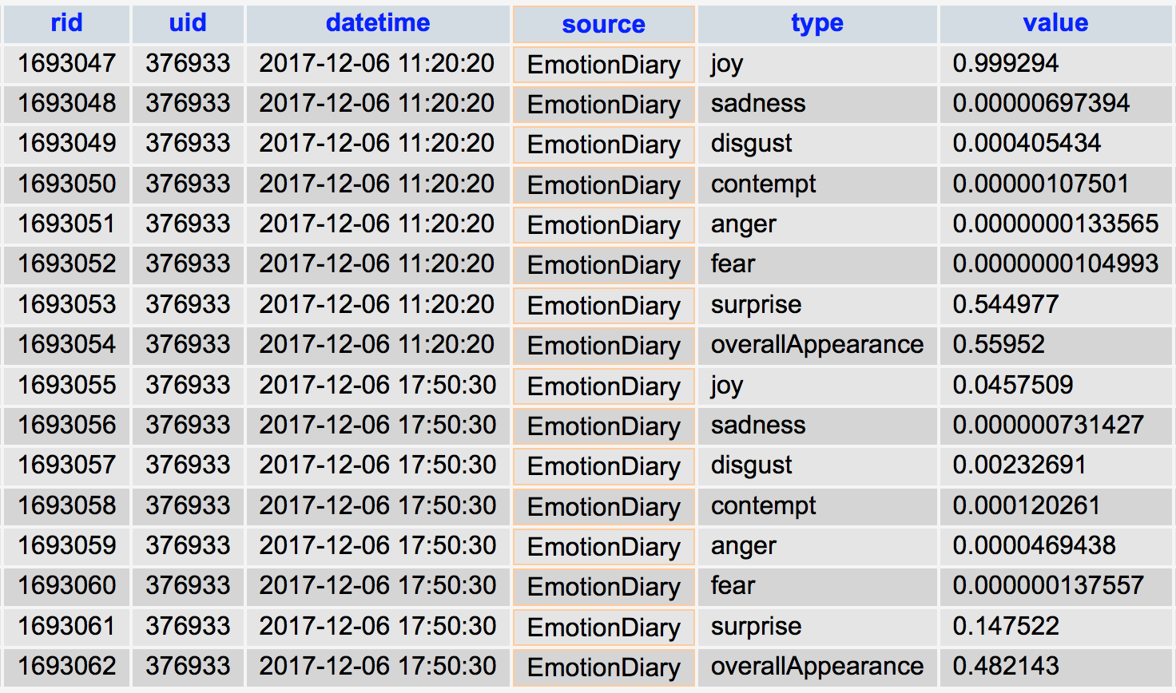
Changes Since Milestone II
Change 3: Data are migrated from my local MySQL to Chronobot
  Now stored in the records table
Entry 1
Entry 2

Slide 7
Implementation Details
What technologies are used? How are each component connected?

Slide 8

Technologies Used
Chronobot Database
PHP
jQuery
iOS Cocoa Touch
For user authentication and storing all emotion and OA values
For doctor’s web client
For both web clients
(JavaScript)
For building the iOS client for Patients
(Swift)
WebSpeechAPI
Affdex Facial Emotion Detection
Web Speech API
Node.js
Bootstrap
For recognizing voice commands
(JavaScript)
For patient web client
(JavaScript)
For patient web client
For recognizing emotions of faces
(Objective-C & JavaScript)

Slide 9
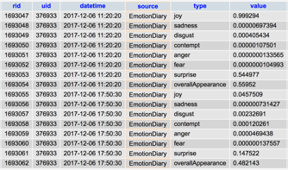
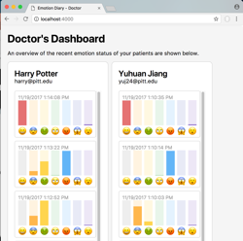
System Architecture
Chronobot Database
/api/auth.php
/api/get.php
/api/post.php
…
RESTful APIs
HTTP POST
HTTP GET
Patient’s Clients (iOS or Web)
Doctor’s Client (Web)

Slide 10
Absolute Luminance Computation
Luminance histogram is defined in terms of RGB histograms as
where:
  G is the red histogram
  R is the green histogram
  B is the blue histogram
  L is the luminance histogram
The mode of the lumiance histogram is used as the absolute luminance
  Mode refers to the luminance value which has the most number of pixels
L = 0.2126 R + 0.7152 G + 0.0722 B

Slide 11
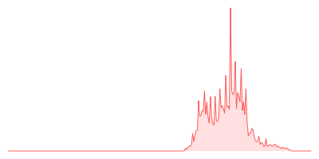

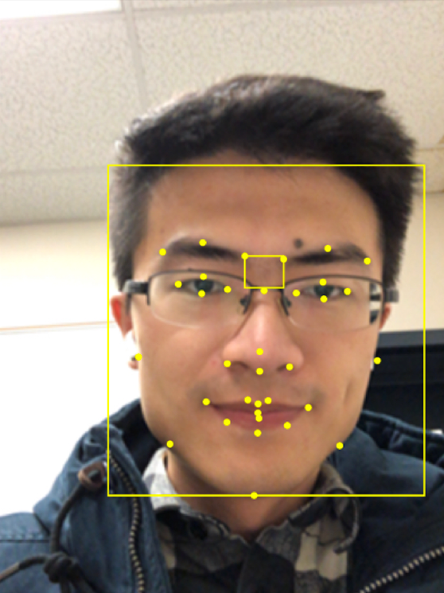
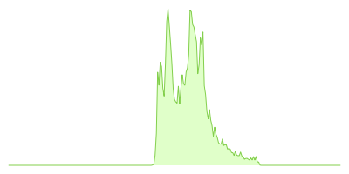
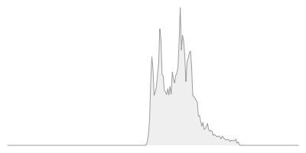
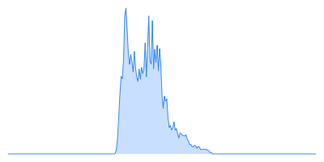
Absolute Luminance Computation: Example
Area between Eyebrows
× 0.2126
Mode
(The luminance value with highest pixel count)
+
× 0.7152
+
0
133
255
× 0.0722
Whole Face

Slide 12
Converting Absolute to Relative
Relative luminance is a value between 0 and 1
  Computed based on two absolute luminance values.
Suppose the luminance value of the area between eyebrows in the reference face is L_{Ref} , a value between 0 and 255;
Suppose the luminance value of the area between eyebrows in the current face the user is uploading is L_{Cur} , a value between 0 and 255;
We compute the relative luminance L_{Rel} of the area between eyebrows by mixing the two values above:
I.e., relative luminace is the ratio of the luminance of the current face and the luminance of the reference face, capped at 100%.
L_{Rel} = max ( L_{Cur} / L_{Ref} , 1.0 )

Slide 13
Usage Scenarios
Screenshots of the usages of each client

Slide 14
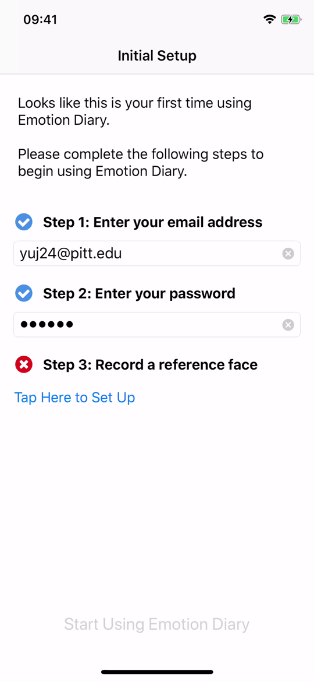
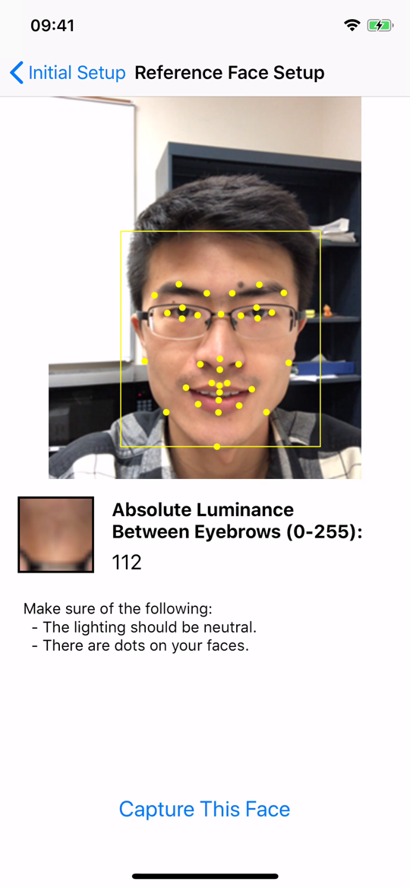
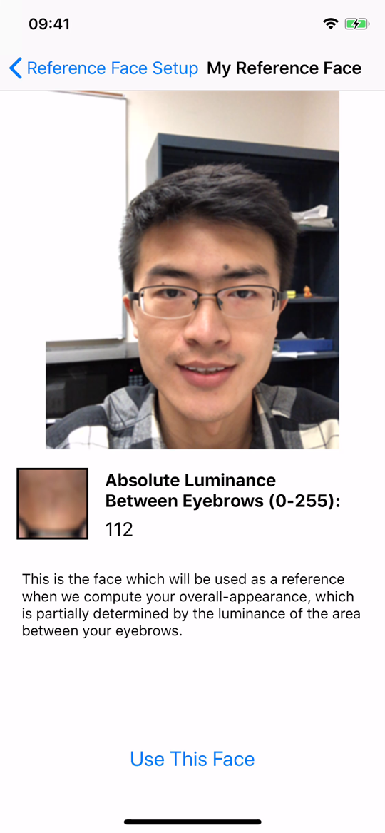
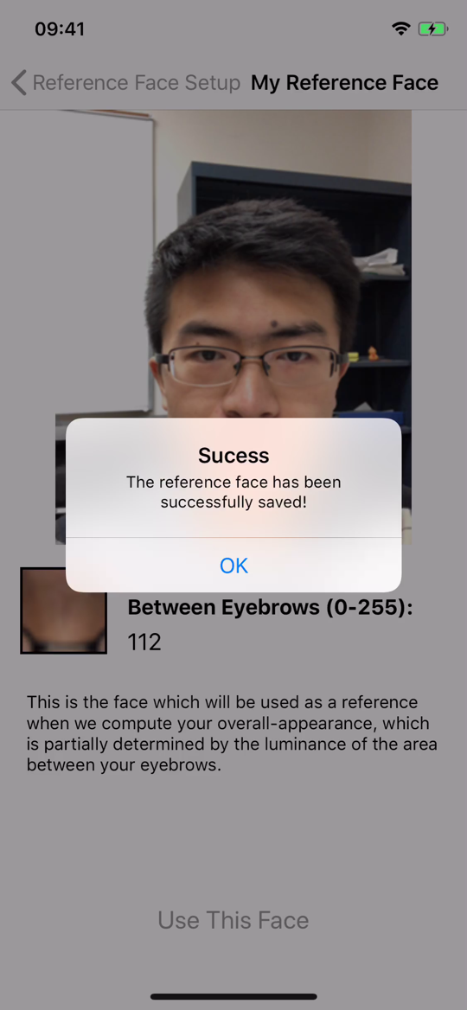
Scenario: Using Patient iOS Client
6. A success message will show up.
3. View your absolute luminance between eyebrows here (0-255)
1. Enter email and password
4. Tap this button when the luminance value is ready
2. Tap this button to set up the reference face
5. Tap this button to confirm your reference face

Slide 15
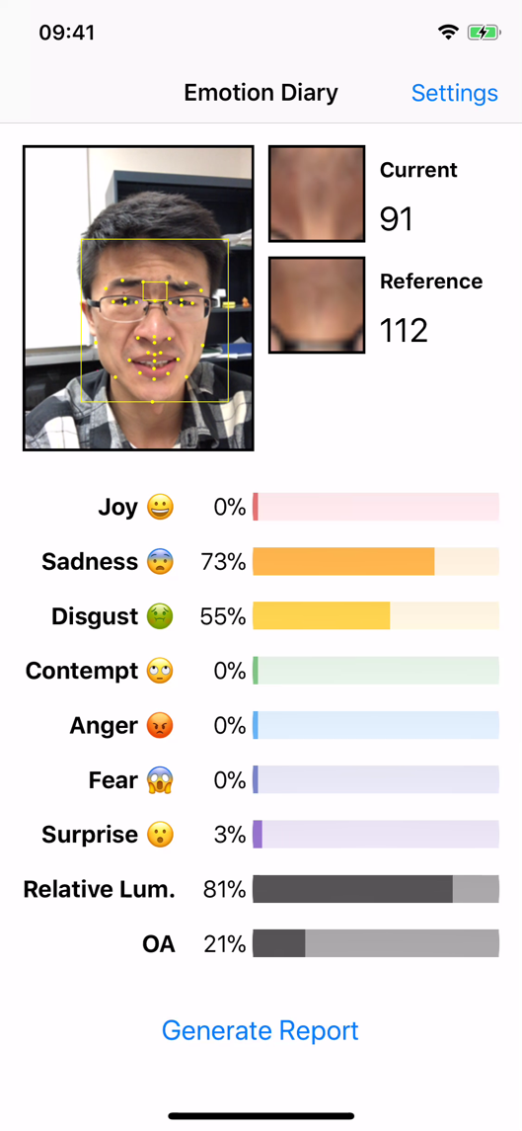
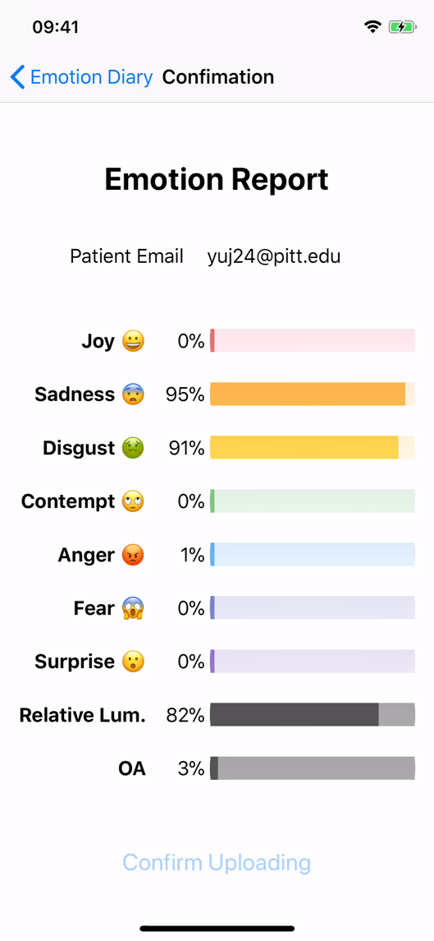
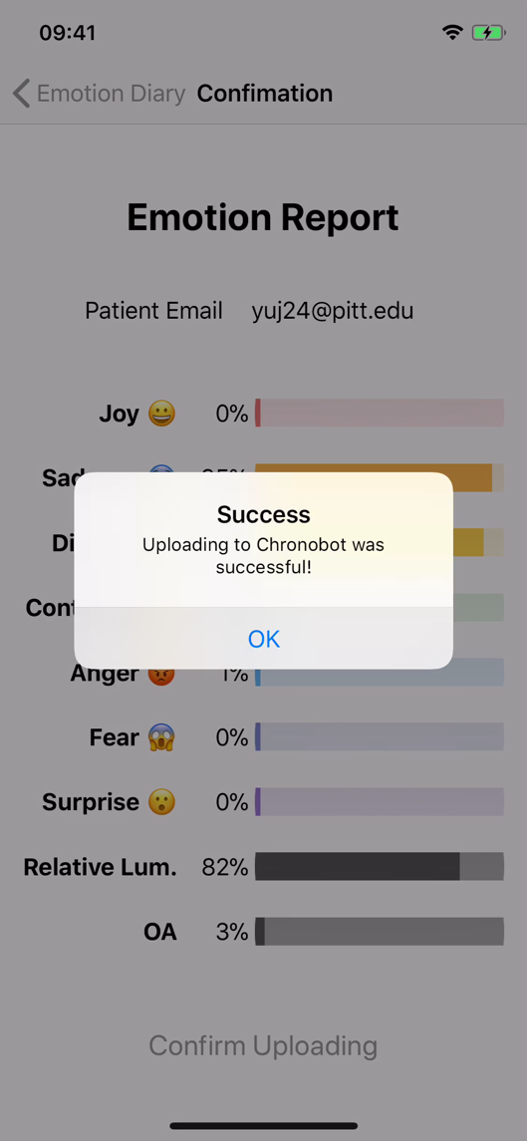
Scenario: Using Patient iOS Client (Cont.)
7. Your whole face
13. Successfully uploaded to Chronobot
8. Your current luminance (0-255)
9. Your reference luminance (0-255)
11. View the report
= min(100%, cur/ref)
= (1 – sad) * relative lum.
12. Tap this button to confirm uploading
10. Tap this button

Slide 16
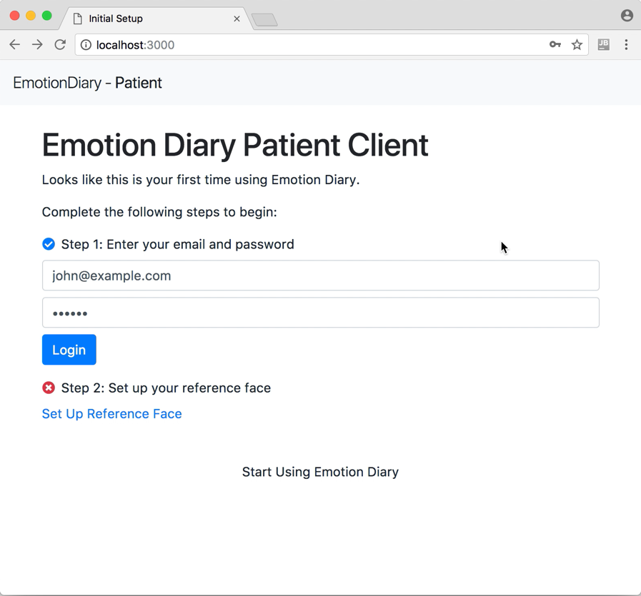
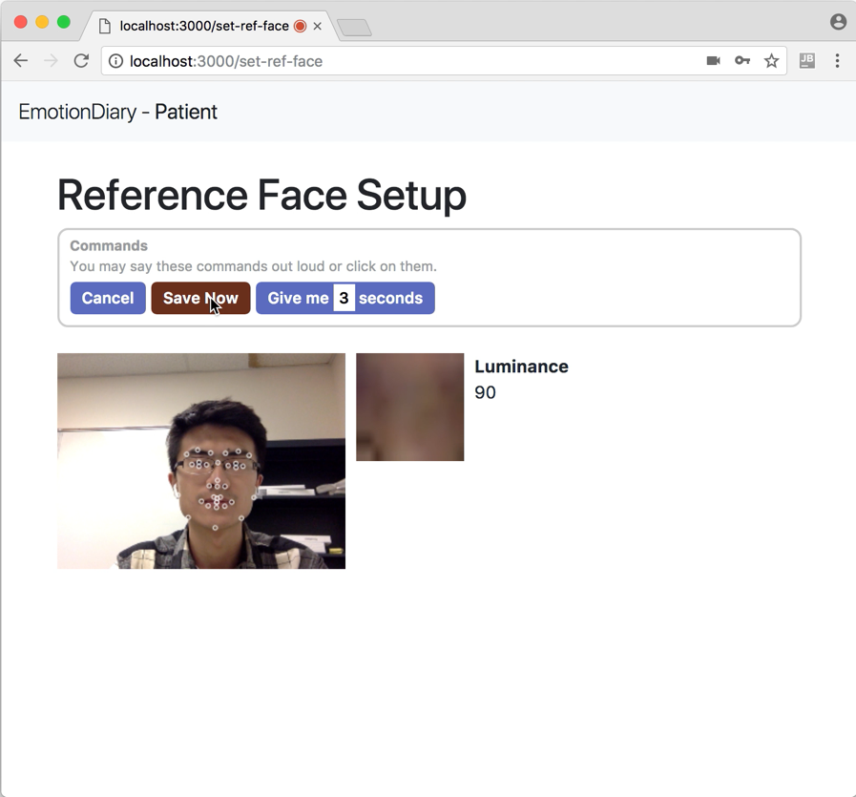
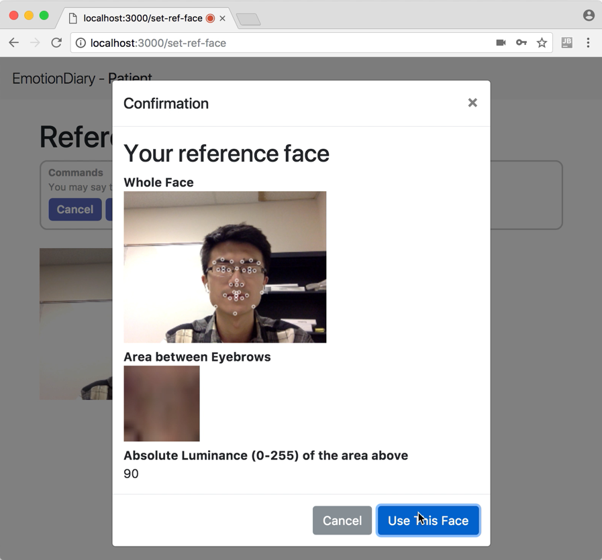
Scenario: Using Patient Web Client
5. Click this button to confirm your reference face
4. Click this button when the luminance value is ready
1. Enter email and password,
then press click the Login button
2. Click this link to set up reference face
3. View your absolute luminance value between eyebrows here (0-255)

Slide 17
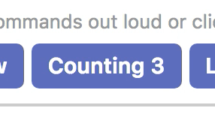

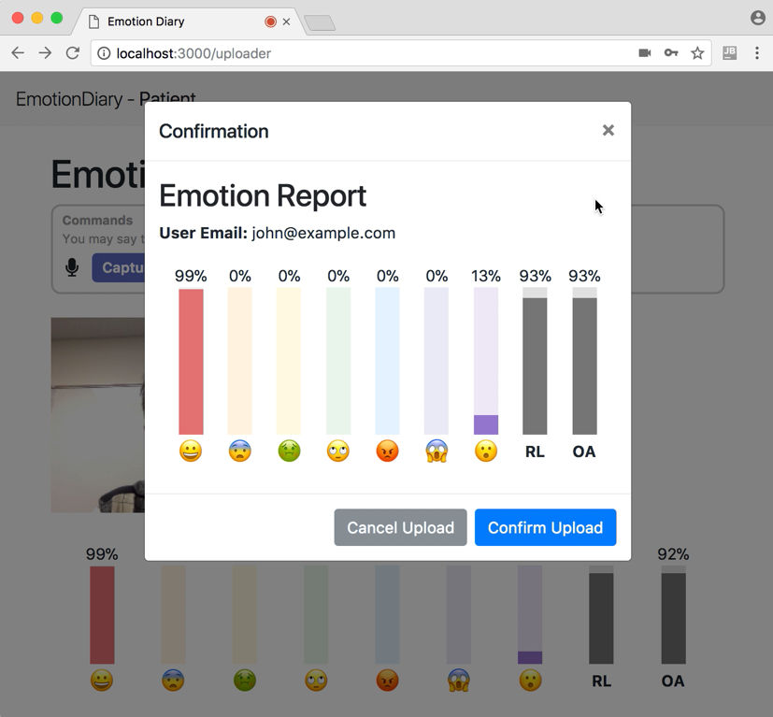
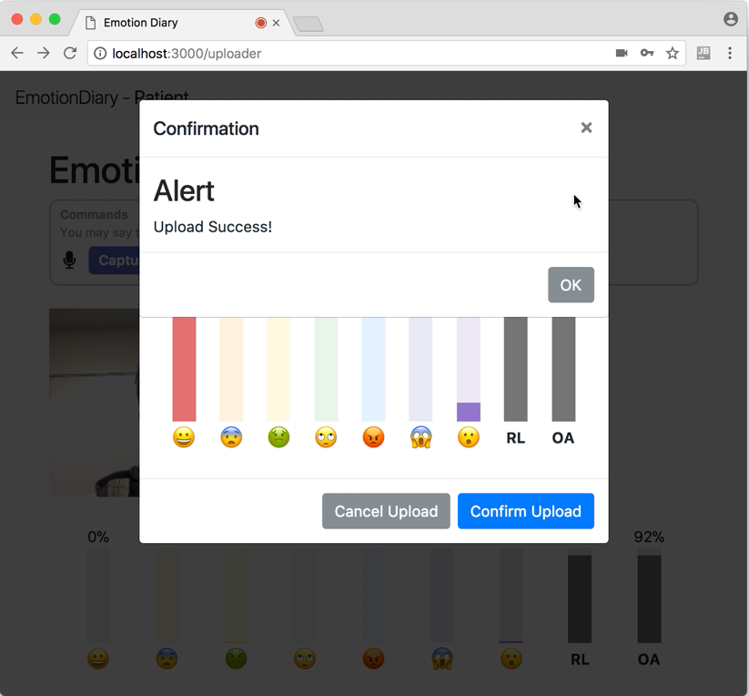
Scenario: Using Patient Web Client (Cont.)
6. Your whole face
9. Say “Give me 3 seconds”
(the countdown will start)
10. View the report after countdown finishes
12. A success message shows up
7. Your current luminance (0-255)
11. Say “Confirm Upload” to confirm
8. Your reference luminance (0-255)

Slide 18
Scenario: Using the Doctor Web Client
4. An alert will be shown if a patient has been unhappy for three times in a row
1. Enter email addresses of users you wish to monitor
3. View patients’ new emotions as they come. The latest emotions will appear at the top
2. Click on Start Monitoring

Slide 19
Demo
Demo live in class.
After class, a recorded demo video will be available on YouTube:
https://www.youtube.com/watch?v=ERVCorjSO6c

Slide 20
Conclusion, Drawbacks, and Future Work
What has been achieved? What are the remaining challenges? What can be further improved?

Slide 21
Conclusion
A complete system of 4 interacting components is implemented.
  Namely: 1 data server, 2 patient clients (iOS and web), and 1 doctor’s client.
The patients are able to upload their emotions and overall-appearance values using both clients, under different scenarios:
  When they are at home, they can use the web client by voices on a laptop.
  When they are on the go, they can use the iOS client on their mobile phones.
The doctor is able to monitor the users’ latest emotions and overall-appearance values using an intuitive web UI:
  The doctors can choose the patients to monitor.
  The latest values are shown as they are uploaded by each user in real time.
Lines of Code:
  Swift: ~1700, JavaScript: ~1300, PHP: ~600, and some CSS and HTML code.

Slide 22
Drawbacks
Emotion values are often extreme
  Even though the emotion values provided by Affdex are expressed in percentages (0% - 99%), they are mostly on the extreme ends.
Unstable face points on the web client
  Possible reason: low res front-facing camera leads to less accurate classification of facial features.
Unable to serve the patient web client on any public service:
  iPage does not host Node.js websites.
  Other hosting services (such as Heroku or Amazon AWS) are HTTPS-based. They do not allow communication with the HTTP-based Chronobot database.
Cannot deploy the iOS client to too many devices
  Free Apple developer account only allows a small number of devices.
  The iOS client app will live on the phone for only a few days.

Slide 23
Future Work
Improve the accuracy of emotion detection.
  As described on the previous slide, there are limitations of the Affdex emotion detection library which we currently use. Future efforts may:
    Use the advanced facial feature detection on iPhone X. The data is not yet available to the developers. Once available, we can use the feature points provided by the TrueDepth camera system to get smoother and more accurate emotion values.
Improve the doctor’s client.
  Due to time constraints, there are less features implemented for the doctor’s client than for the patients’ clients. To make the system more useful, future efforts may work on:
    More ways to plot emotions. Instead of plotting the barcharts of all emotions as a list, we could simply show only the latest emotion as a barchart, and provide a button to go back in time to view past emotions within the same barchart.
    More types of queries. Currenlty, all emotion records are displayed. As more users start to upload more emotions, displaying all emotion records will no longer be appropriate. Filters should be allowed to support queries such as “average happiness over the last 5 days”, “standard deviation of the patient’s sadness in the past month”, etc.

Slide 24
Documentation
Where is the source code? How to deploy the system?

Slide 25
Code & Documentation
The following are the GitHub repositories of the two patient clients:
  iOS: https://github.com/jyuhuan/emotion-diary-patient-ios
  Web: https://github.com/jyuhuan/emotion-diary-patient-web
  Each repository contains a README which describes how to run the client.
  Future efforts may consult the README files to make improvements.
The following are the directories of the source code of the data service on iPage (please use FTP or SSH to access them):
  The PHP pages for the doctor’s client are under:
    http://ksiresearch.org/chronobot/emotions/
  The RESTful API is under:
    http://ksiresearch.org/chronobot/emotions/api/
The database table holding the emotion data is chronobot/records

Slide 26
References & Useful Links
Affectiva – Emotion Recognition Software and Analysis. https://www.affectiva.com
The 34 Facial Feature Points of Affectiva (Requires Login). https://affectiva.readme.io/docs/facial-landmarks-1
Computing Luminance Value from RGB Values. https://en.wikipedia.org/wiki/Relative_luminance
Web Speech API - Web APIs. https://developer.mozilla.org/en-US/docs/Web/API/Web_Speech_API
How to Enroll in a Paid Apple Developer Program. https://developer.apple.com/programs/enroll/

Slide 27
Thank You
Q&A

