Slide 1
Voice User Interface for Flash Card on Android Device
Xingtian Dong
xid31@pitt.edu

Slide 2
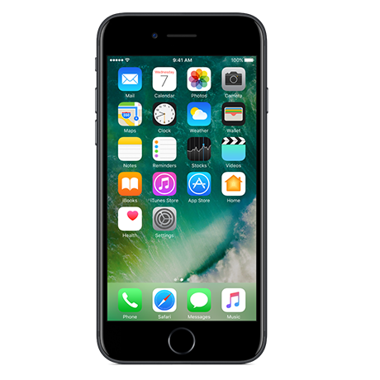


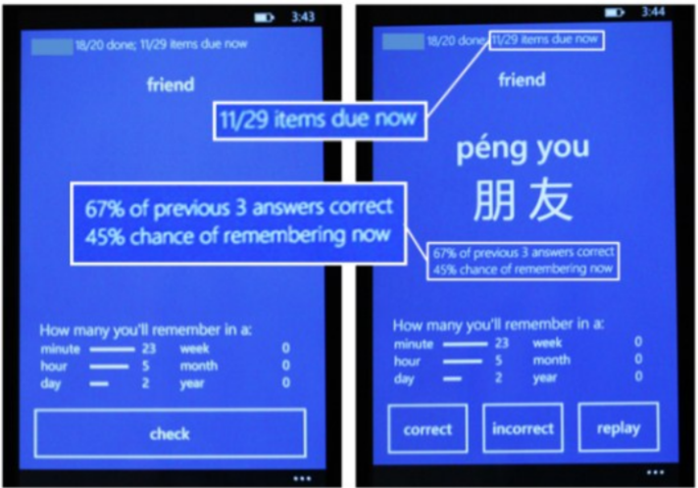

Background
Related work
MemReflex: Adaptive Flashcards for Mobile Microlearning[1]
Adaptive Flashcards[1]
New opportunities for learning?

Slide 3
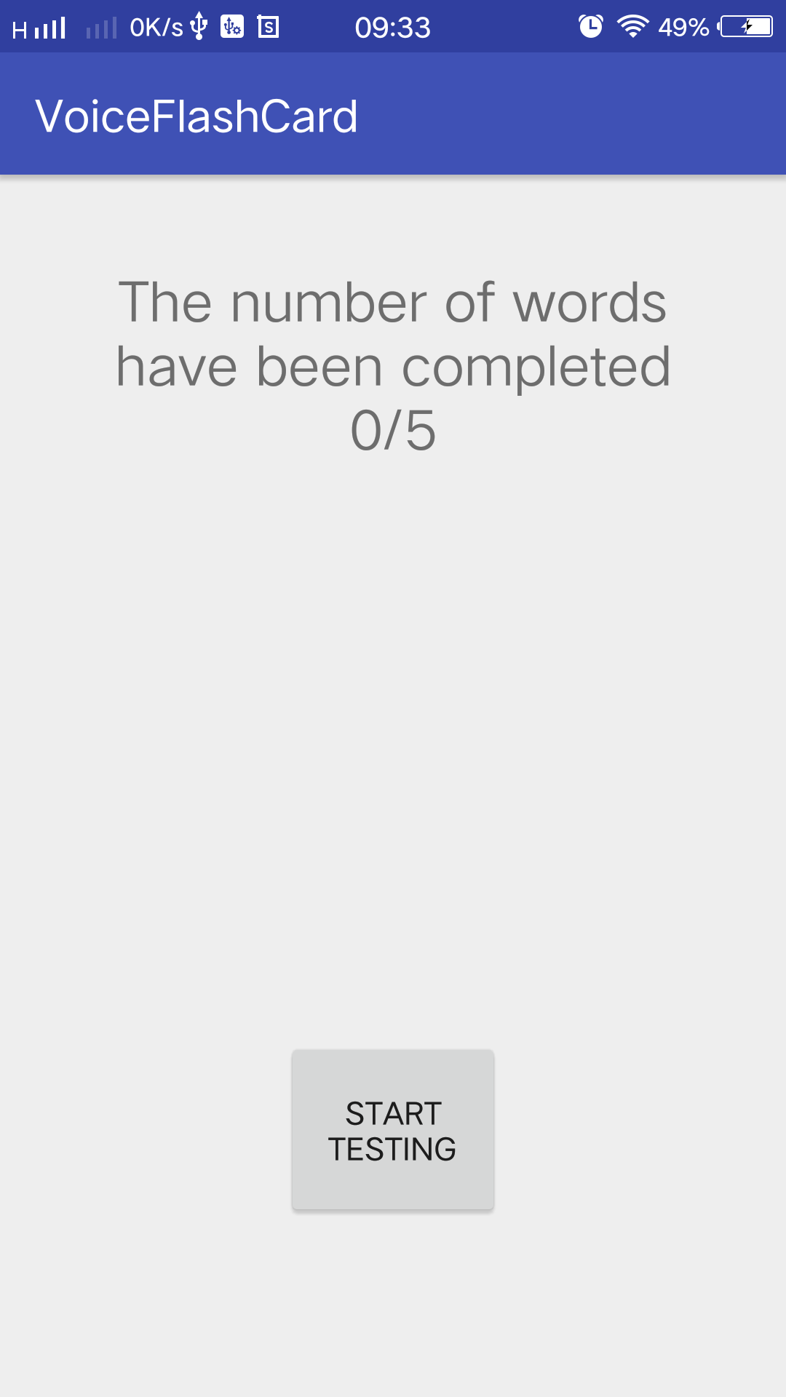
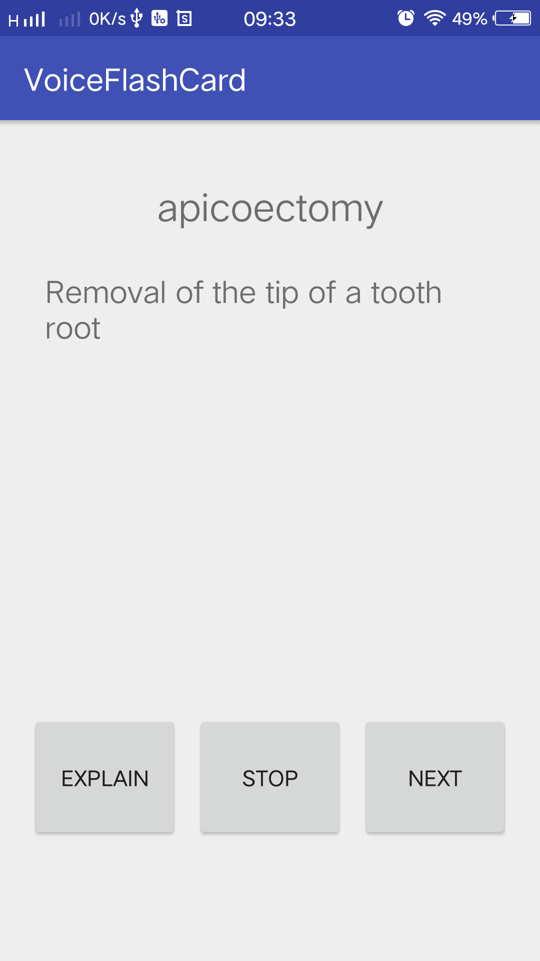
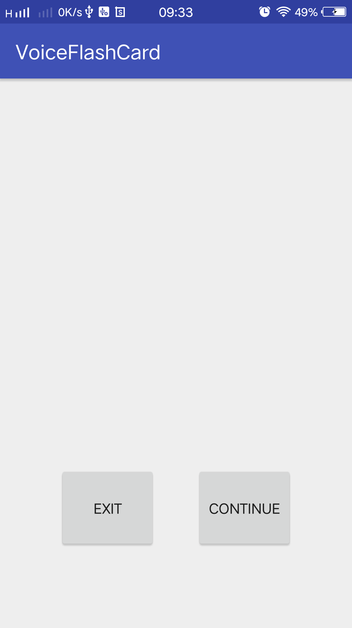
Interface

Slide 4

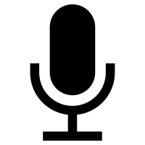

Libraries
android.speech.tts.TextToSpeech
android.speech.tts.UtteranceProgressListener
edu.cmu.pocketsphinx[2]

Slide 5
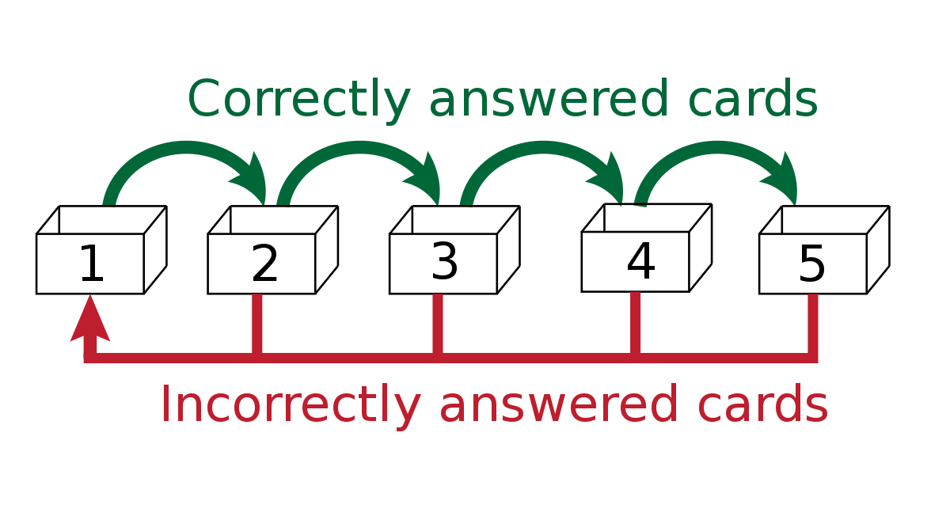
Main Algorithm
Spaced repetition:
  increase interval of time
  exploit the psychological spacing effect
  correct: next interval, wrong: the first interval
Implementation:
  record the interval sequence
  shift time when fetching the next
  next timestamp generated when finishing

Slide 6
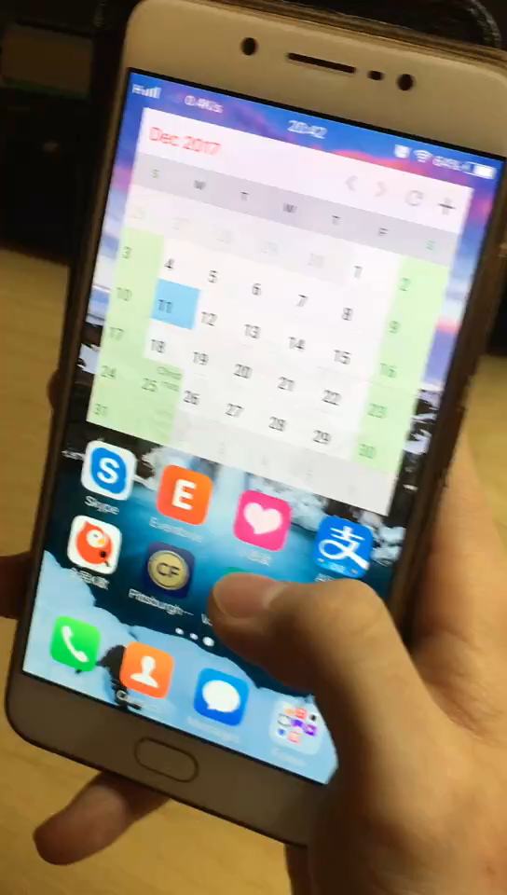
Demo
https://youtu.be/Xoo8bE1EX90

Slide 7
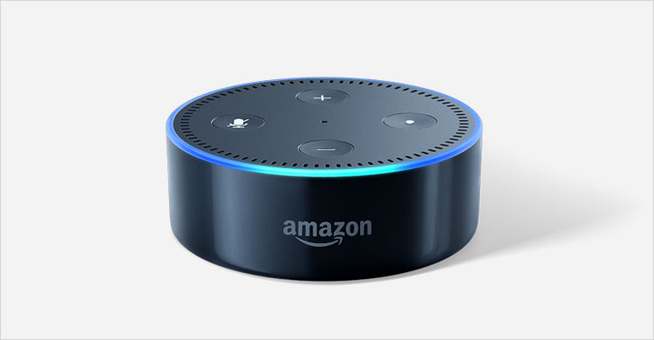
Study Design
Compare Voice Flashcards on Alexa and smart phone.
VS

Slide 8
Study design
Hypothesis:
1. Spaced repetition algorithms can help with short-term language learning on smart phones.
2. Learning on smart phones is better than learning on Alexa.
Recruitment plan and study design:
We recruited 5 participants(2 females, 3 males) with a mean age of 23. All of them have been United States for about two years and use English as their second language. Each participants flipped cards while using Alexa and smart phone to learn new words. Each participants used both devices to learn new words for 20 minutes and was examined by a word test before and after using Learning.

Slide 9
Study result
A paired T-test was conducted to compare the words they know before learning and after learning.
There was a significant difference in the numbers of words they know before learning(M = 4.8, SD = 1.01) and after learning(M = 13.2, SD = 1.92), t = 72, p < 0.0001.
These results suggest that learning with smart phone do have effect on the words they know. Specifically, the result suggests participants know more words after learning with phone.

Slide 10
Study result
A paired T-test was conducted to compare the words they learned using Alexa and smart phone.
There was a significant difference in the numbers of words they know before learning(M = 6.2, SD = 1.64) and after learning(M = 8.4, SD = 1.14), t = 6.05, p < 0.05.
These results suggest that there is significant difference between using Alexa and smart phone. Specifically, the result suggests using smart phone is better then using Alexa.

Slide 11
Feedback from participants
For Alexa:
Participants find it hard to understand the explanation. There are some unknown terms in the explanation and they think the speed which Alexa explains is a little fast. It is difficult for them to follow.
Some participants get bored at about 14 mins during the experiment.
Sometimes the participants find it difficult to detect if Alexa receives the command or not. And it is also difficult to detect why Alexa gives no response, whether Alexa is waiting for the set time to generate next word or it doesn’t receive a command.
For smart phone:
Sometimes, it will automatically activate ‘stop’ or ‘next’ when the user doesn’t response for long.
Also get bored, but feels better than using Alexa.

Slide 12
Conclusion
Pure voice interface is not ideal for learning new language, because it is hard for users to access the content.
Audio technique is a great augment to other interfaces.
Audio technique provides new opportunities for learning.

Slide 13
Future work
Using adaptive space repetition algorithm instead of fixed space repetition algorithm.
Adding Chinese explanation option to the app, so that the user can choose the one he wants.
Explore more testing modes like check the spelling or explanation.

Slide 14
References
[1] Derren, E.,Stephen, F., Michael, W., & James, L. (2012) MemReflex: Adaptive Flashcards for mobile Microlearning. MobileHCI’12, September 21-24.
[2] https://cmusphinx.github.io/wiki/tutorialandroid/

