Slide 1
Retrieval of audio testimonials via voice search
David Cyphert
CS 2310 – Software Engineering
Fall 2017

Slide 2
Project Goals
Read in keywords specified by the user via speech recognition
Take the recognition and search audio files for specified keywords
Dictate entire audio file and calculate sentiment

Slide 3






Components
Sentiment Analysis
(dictation)
Keyword spotting
Client-side processing to get search criteria for audio testimonial.
Analyze the audio file to spot keywords.
Sentiment Analysis – determine if the review was positive or negative
Notes:
Web based approach. HTML/CSS/JavaScript front-end. ASP.NET (C#) backend with SQL Server database.
Client side processing: Web Speech API (Speech Recognition)
Come up with an algorithm to determine if an audio testimonial stored on the server is good or bad. Will probably use a predefined set of “good” and “bad” descriptor words to make this determination.
Server side processing will be using SpeechRecognitionEngine

Slide 4
Client-side processing
Web Speech API
  Part of the HTML5 specifications
  JavaScript API to enable web developers to incorporate speech recognition and synthesis into their web pages.
  Used speech-to-text to get input from the user.
  Sending ajax requests to the server with the search criteria

Slide 5
Server-side analysis of audio files
Microsoft’s Speech Recognition Engine
“Keyword spotting”
Defined “grammars” to process only certain utterances that have particular semantic meaning (spoken search criteria)
Based on confidence level calculated by the engine, it determines if a given word is spoken in an audio file.
Returns the rows that are above confidence threshold

Slide 6
Sentiment Analysis
Also known as opinion mining or emotion AI.
Aims to determine the attitude of a speaker, writer, or other subject with respect to some topic.
Examples:
  typical negations (e.g., "not good")
  use of contractions as negations (e.g., "wasn't very good")
  using degree modifiers to alter sentiment intensity (e.g., intensity boosters such as "very" and intensity dampeners such as "kind of")
VADER API
  Valence Aware Dictionary and sEntiment Reasoner
  The compound score is computed by summing the valence of each word in the lexicon, adjusted with rules, and then normalized to be generally between -1 (most extreme negative) and +1 (most extreme positive)
  “normalized weighted composite score”

Slide 7
Problems
Turns out, keyword spotting in general is a hard problem
  Not very accurate for short words (# of syllables). Shorter words are easily confused and cause false positives.
Microsoft’s Recognition Engine for keyword spotting
  It works, but not 100% accurate
  Works great for dictation of entire file

Slide 8
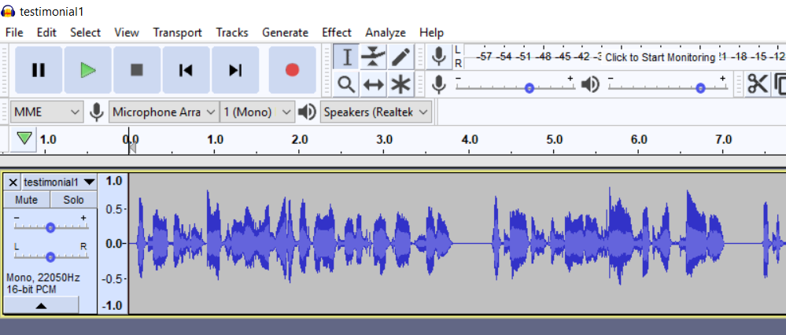
Improving accuracy
Lowering the amplitude of the audio
  Not sure why – possibly when using this library through the microphone, it programmically reduces the volume as its processing.
  Wildly inaccurate without doing this
Stereo -> Mono, 16-bit PCM (Pulse-code Modulation). This is a requirement by the library

Slide 9
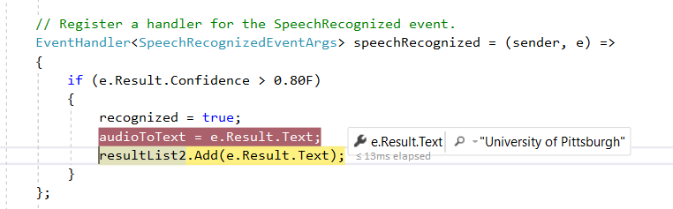
Improving accuracy (cont.)
Only accepting higher confidence values
  This reduces false positives. Currently I’m only accepting detections with 80% confidence.
  Problems with this: Could reject an accurate detection

Slide 10
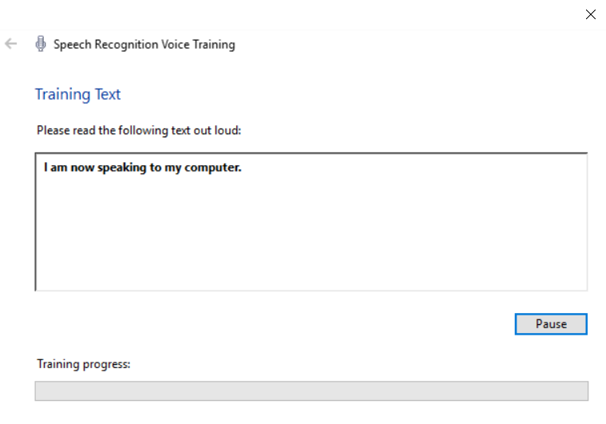
Improving accuracy (cont.)
“Training” the Speech Recognition Engine

Slide 11
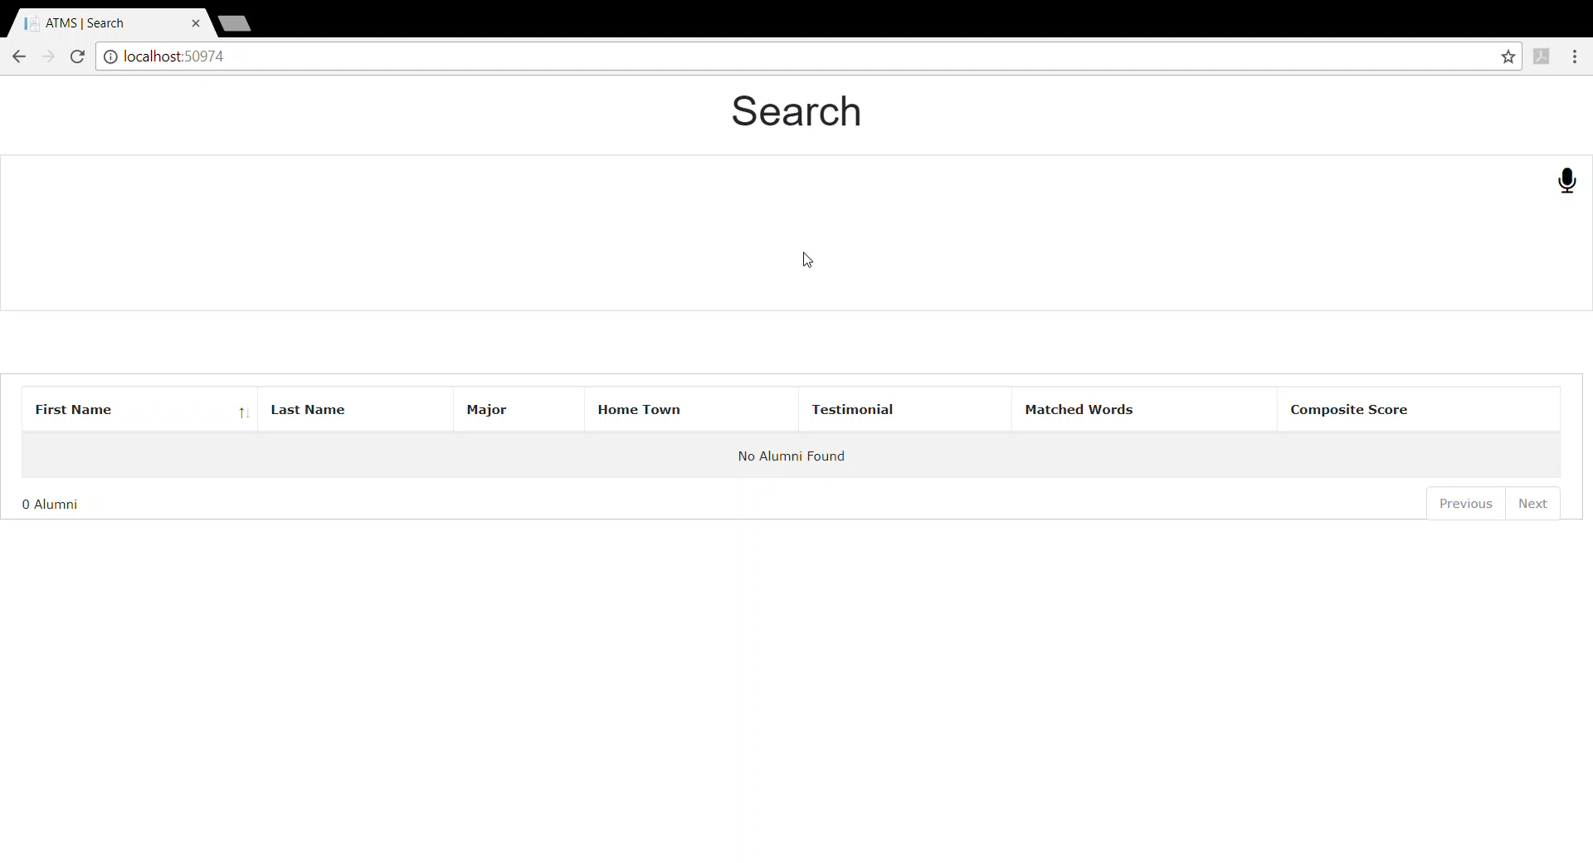
DEMO

