Slide 1
‘17 Fall CS2310 Project – Final Presentation WEONJI CHOI
Gesture Recognition Software
Weonji Choi

Slide 2
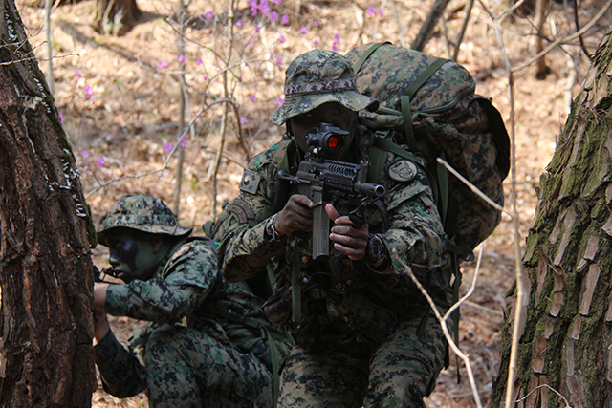

Why we need a gesture recognition?
‘17 Fall CS2310 Project – Final Presentation WEONJI CHOI
If we can send a message
Using simple arm
or hand movement?

Slide 3
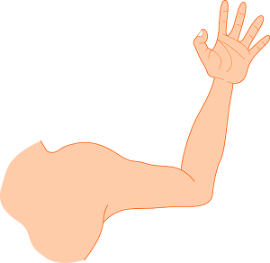

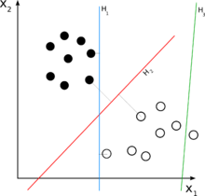
Original Goal & Scenario
‘17 Fall CS2310 Project – Final Presentation WEONJI CHOI
: Develop a software using smartwatch sensors
to converts arm movements into messages
1.Arm Movement
3.Send a message
2.Pre-precessed classifier

Slide 4
Original Goal & Component diagram
‘17 Fall CS2310 Project – Final Presentation WEONJI CHOI
: Develop a software using smartwatch sensors
to converts arm movements into messages
Smartwatch
(Sensors)
Component
Training SW
Component
Classifier
Component
Training
Process
Smartwatch
(Sensors)
Component
Classifier
Component
Message
Component
Practical
Using

Slide 5
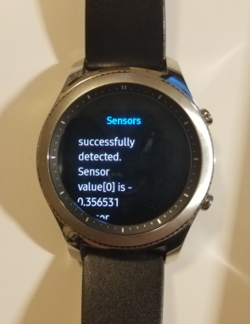
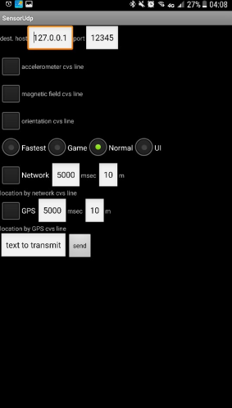
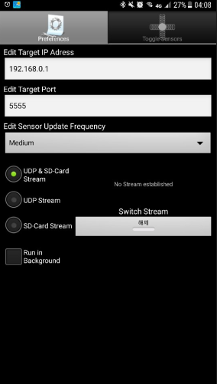
Obstacles at each steps
‘17 Fall CS2310 Project – Final Presentation WEONJI CHOI
Operating System : Tizen doesn’t support real-time sensor data transmission from Gear to PC
(official answer from Tizen developer support team)
- should buy new smartwatch using Android OS
- should use recorded(not-real time) data
- should use smartphone instead of smartwatch
- should use not off-the-shelf device, like Arduino, Raspberry pi

Slide 6
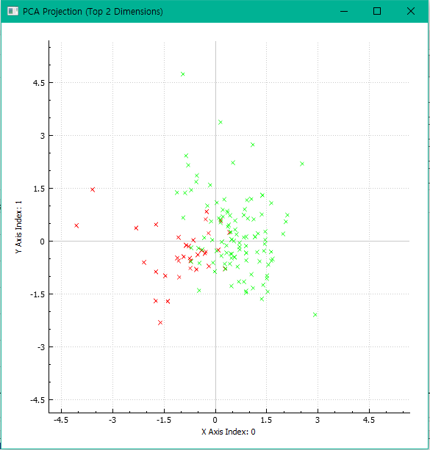
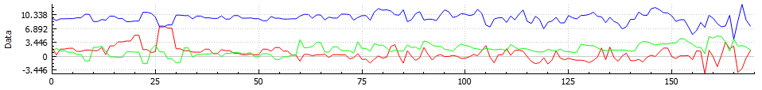
Obstacles at each steps
‘17 Fall CS2310 Project – Final Presentation WEONJI CHOI
Noise of data : Smartwatch sensors’ data is really noisy,
human’s movement is not much different from noise.
GRT(Gesture Recognition Toolkit) cannot digest recorded data for gesture classification prediction
Make classification and training was possible, but I can’t use GRT to predict my gesture’s result.

Slide 7
Restart everything
‘17 Fall CS2310 Project – Final Presentation WEONJI CHOI
Gesture + Smart Device
: Develop a mobile application
users can customize
their on-screen gesture control

Slide 8
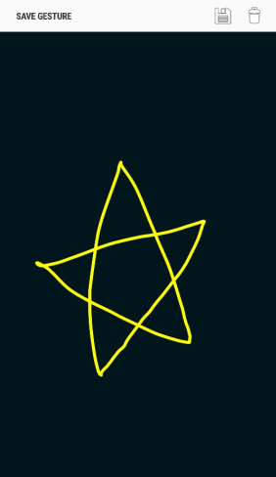
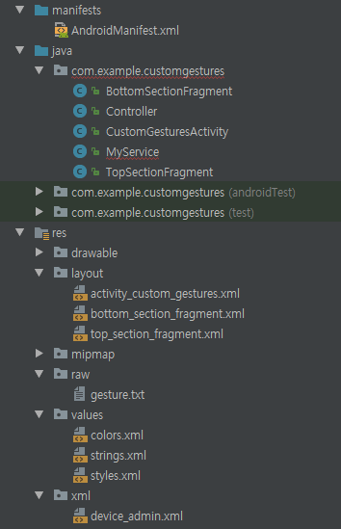
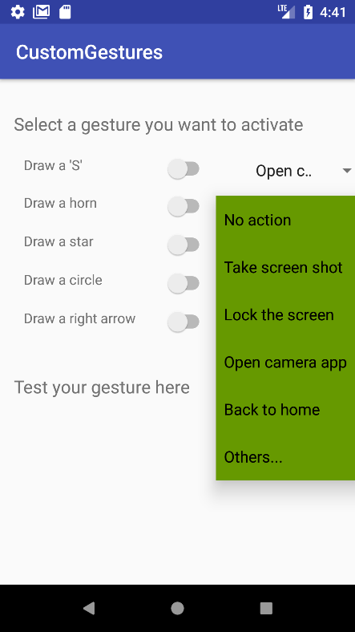
Scenario & Component diagram
‘17 Fall CS2310 Project – Final Presentation WEONJI CHOI
1.Store customized
gesture
2.Merge with gesture detector application
3.Link each gesture
And activity
Gesture
Builder
Upload
Gesture
Activity
Assign

Slide 9

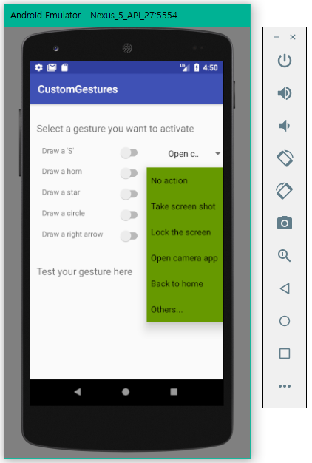
Application Development Environment
‘17 Fall CS2310 Project – Final Presentation WEONJI CHOI
Android Studio 3.0
Android Emulator with Nexus_5
SDK: Android 6.0.1 API27 (Oreo)

Slide 10
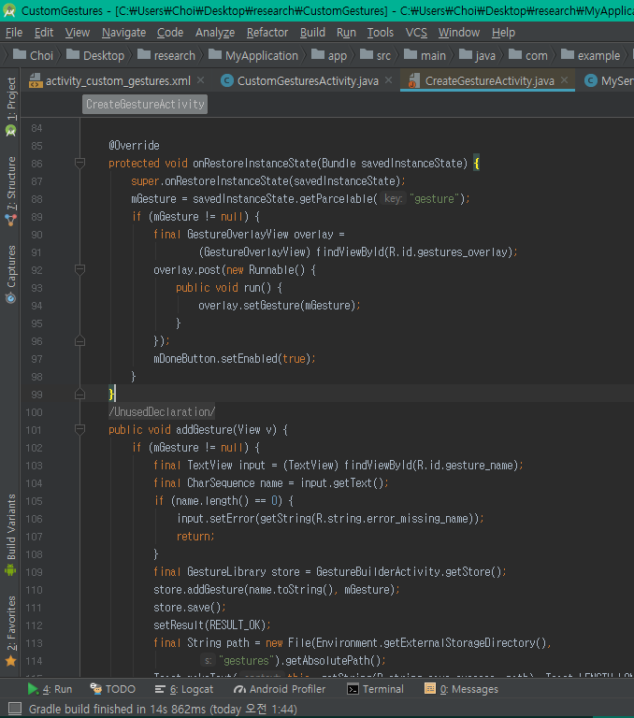
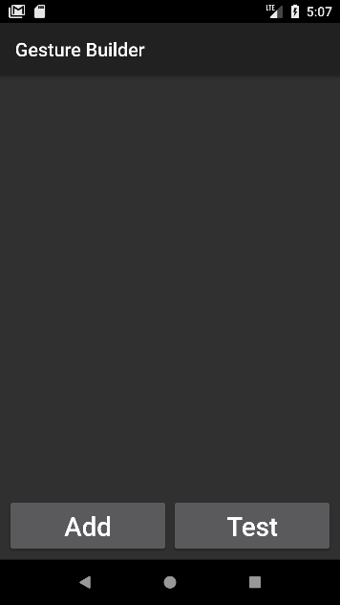
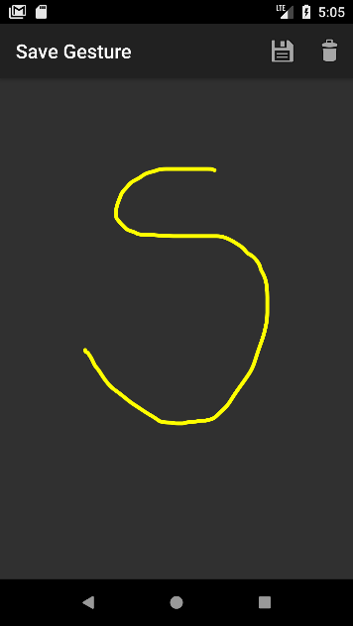
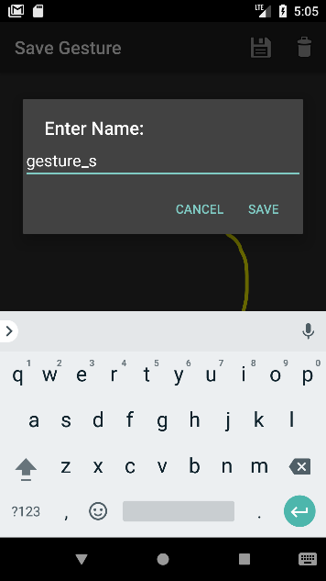
‘17 Fall CS2310 Project – Final Presentation WEONJI CHOI
Gesture Building

Slide 11
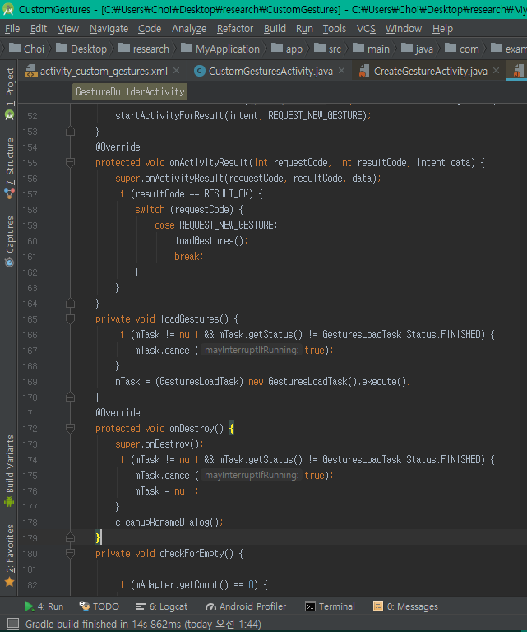

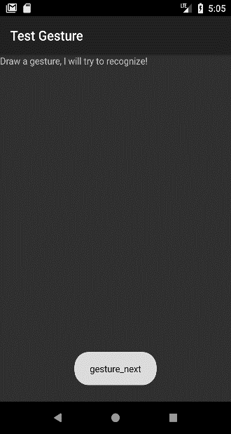
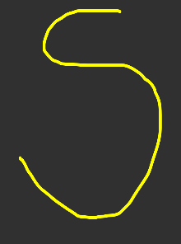
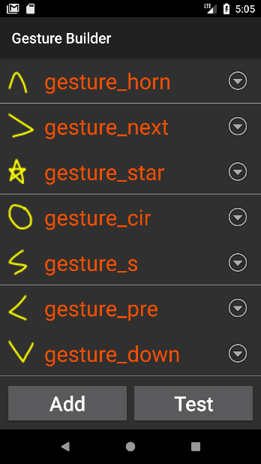
‘17 Fall CS2310 Project – Final Presentation WEONJI CHOI
Gesture Building

Slide 12
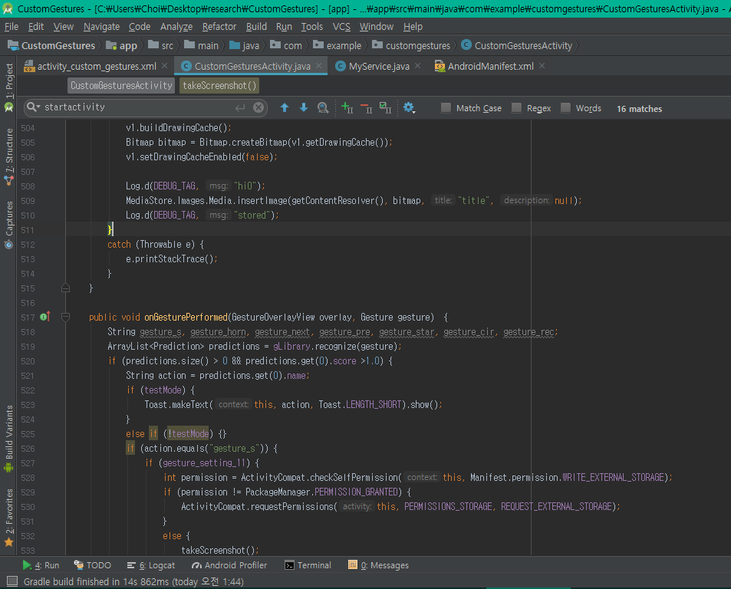
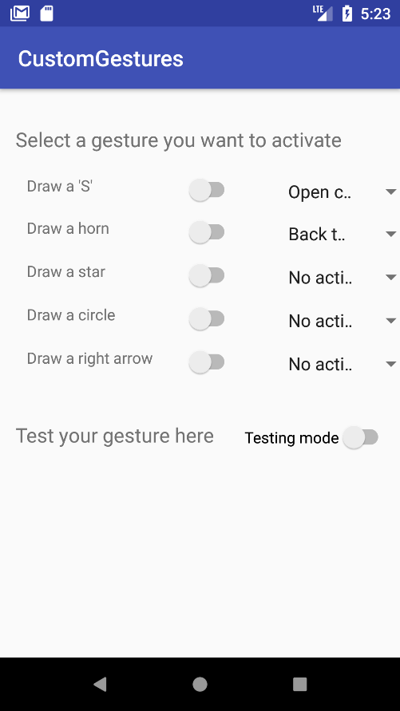
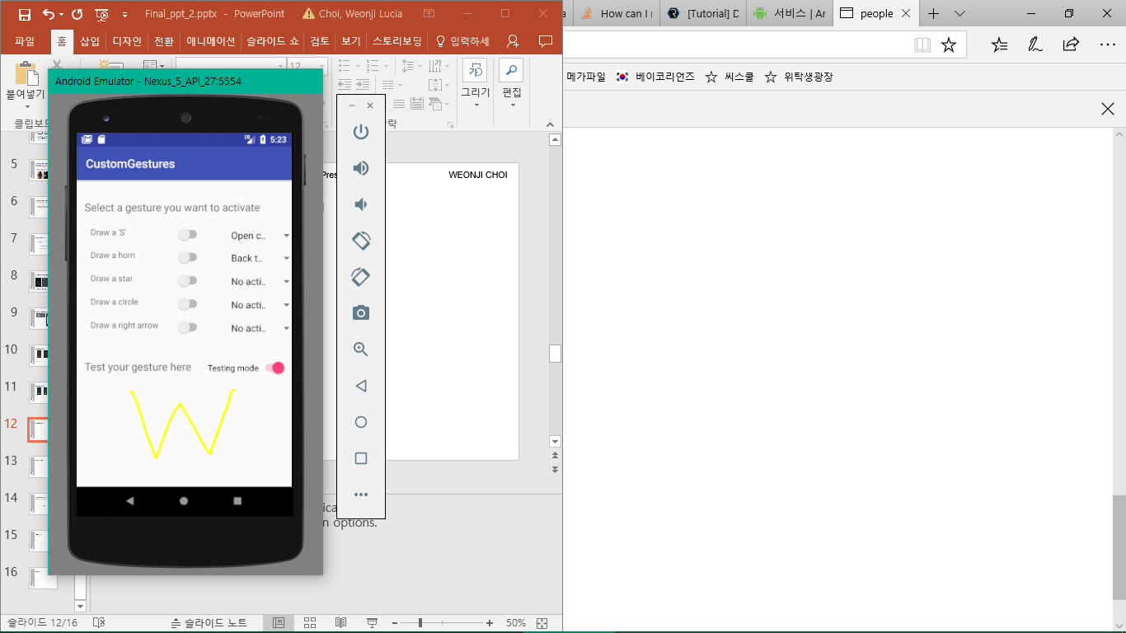
‘17 Fall CS2310 Project – Final Presentation WEONJI CHOI
Gesture Setting

Slide 13

‘17 Fall CS2310 Project – Final Presentation WEONJI CHOI
Gesture Setting

Slide 14
‘17 Fall CS2310 Project – Final Presentation WEONJI CHOI
Demo
(recorded demo : https://youtu.be/ZkXxbHBIhBk)
Notes:
https://youtu.be/ZkXxbHBIhBk

Slide 15
Conclusion & Future Work
‘17 Fall CS2310 Project – Final Presentation WEONJI CHOI
Arm movement tracking software
- I will not stop here...!
- It can be my research for master.
Gesture Custom Setting app
- Users can control their device more dynamically
-> The default customization range is very limited
- It can be used as an background application
using Service API
-> Not just this application, custom gesture control
can be used on another app
-> For any application, this code can be a part.

Slide 16
References
‘17 Fall CS2310 Project – Final Presentation WEONJI CHOI
Application
- https://play.google.com/store/apps/details?id=jp.ac.ehime_u.cite.sasaki.SensorUdp
- https://play.google.com/store/apps/details?id=de.lorenz_fenster.sensorstreamgps
- https://play.google.com/store/apps/details?id=pack.GestureApp
Paper
- Gillian, Nicholas & Paradiso, Joseph. (2014). The Gesture Recognition Toolkit. Journal of Machine Learning Research. 15. 3483-3487. 10.13140/2.1.4216.2886.
- Wang, C., Guo, X., Wang, Y., Chen, Y., & Liu, B. (2016). Friend or Foe?: Your Wearable Devices Reveal Your Personal PIN. Proceedings of the 11th ACM on Asia Conference on Computer and Communications Security, 189–200. https://doi.org/10.1145/2897845.2897847
Huang, H., & Lin, S. (2016). Toothbrushing Monitoring using Wrist Watch. Proceedings of the 14th ACM Conference on Embedded Network Sensor Systems CD-ROM - SenSys ’16, 202–215. https://doi.org/10.1145/2994551.2994563
- de Arriba-Pérez, F., Caeiro-Rodríguez, M., & Santos-Gago, J. M. (2016). Collection and processing of data from wrist wearable devices in heterogeneous and multiple-user scenarios. Sensors (Switzerland), 16(9). https://doi.org/10.3390/s16091538
Website
- http://nickgillian.com/grt/api/0.2.5/index.html
- https://developer.android.com/training/run-background-service/index.html
- https://developer.android.com/training/run-background-service/create-service.html

Slide 17
Thank you
And Warm Winter!

Slide 18
Appendix#1 (main code)
‘17 Fall CS2310 Project – Final Presentation WEONJI CHOI
GitHub link for CustomsGesturesActivity.java
: https://github.com/wec69/CustomGesturesActivity/blob/master/CustomGesturesActivity.java
Notes:
This is main code.

