Slide 1
Using Social Media to Enhance Emergency Situation Awareness
Jie Yin, Andrew Lampert, Mark Cameron, Bella Robinson and Robert Power

Slide 2
Motivation
Situation Awareness
  Perception, comprehension and projection.
  Critical part of making effective decisions for emergency response
Social Media
  Twitter
  Source of information and rapid communication
  Record real-world events
CCC:
  Australian government’s Crisis Coordination Centre
  Response to national security and natural disaster incidents
  Hazard monitoring and situation awareness
Notes:
Situation awareness: “ The perception of elements in the environment within a volume of time and space, the comprehension of their meaning and the projection of their status in the near future.

Slide 3
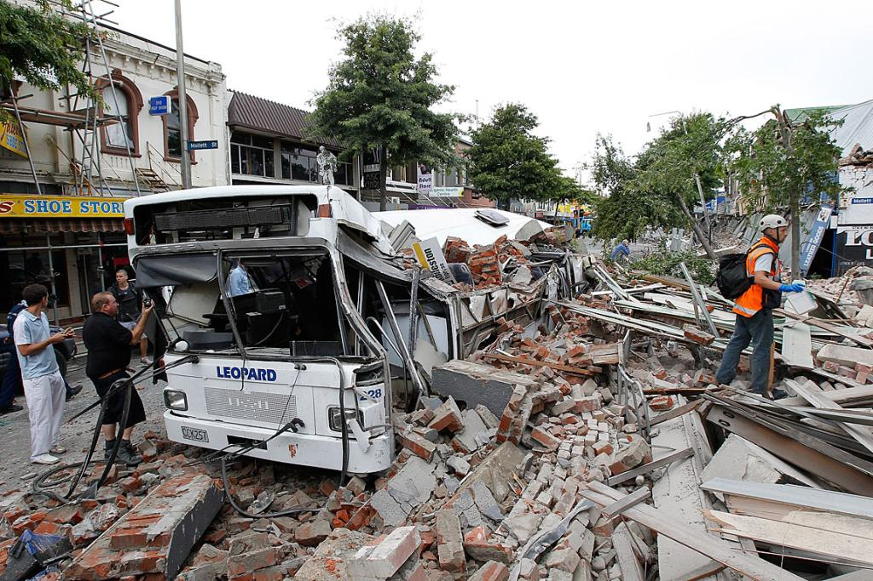
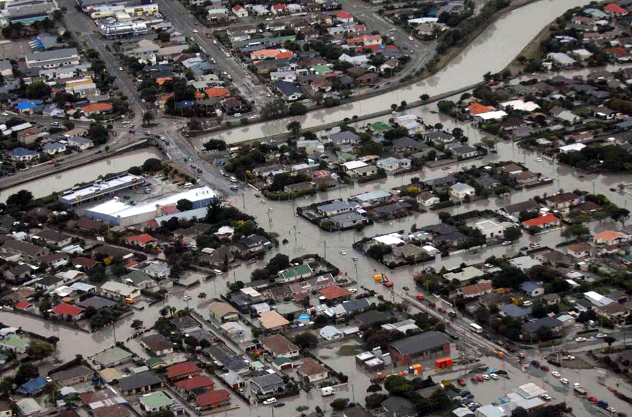
Natural Disaster: ChristChurch in new Zealand

Slide 4
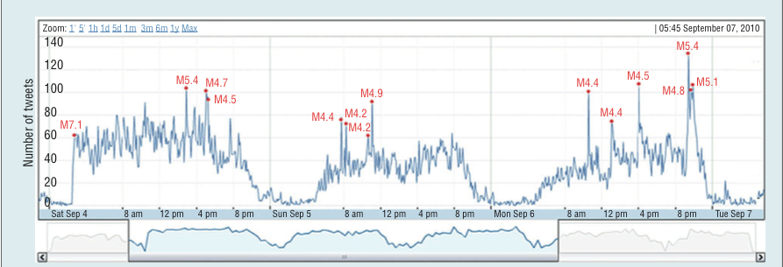
Twitter Traffic
Notes:
ChristChurch new Zealand earthquakes.2011. M is the magnitude of the earthquake.

Slide 5
Introduction
A system that extracts situation awareness information from Twitter messages generated during various disasters and crises.
Data sources are high-speed text streams retrieved from Twitter during natural disasters and crises

Slide 6
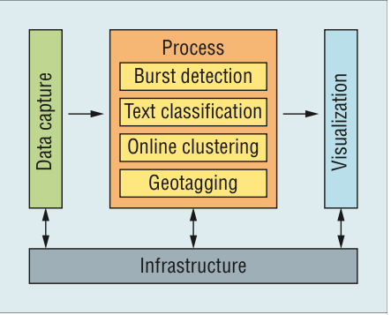
Introduction
System Overview

Slide 7
Data Capture
Component that gathers raw Twitter messages and forwards to other component.
Location: Australia, New Zealand
66 millions distinct Tweets from 2.51 million distinct Twitter profiles
Covers:
  tropical cyclone Ului (March 2010)
  the Brisbane storms (June 2010)
  the gunman in Melbourne (June 2010)
  the Christchurch earthquake (September 2010)
  the Qantas A380 incident (November 2010)

Slide 8

Burst Detection
Continuously monitors a Twitter feed and raises an alert for immediate attention when it detects an unexpected incident with real-time efficiency
For word f_j in time window W_i, the probability that the number of tweets will contain f_j is binomial distribution:

Slide 9


Burst Detection
Determine whether a word f_j is bursty by comparing the actual probability that the word f_j occurs in the time window W_i against the expected probability P_j that this word occurs in a random window(L is the number of time windows containing f_j) :
vs

Slide 10
Burst Detection Evaluation
Training: 30 millions tweets between June-September 2010
Testing: annotated 2400 features as actual burst.
Result:
Detection rate(Correct labled/ total burst) | False-Alarm(False labled /total nonburst)
72.13 | 1.4

Slide 11
Text Classification
Automatically identify tweets containing information about the infrastructure status(including road,bridges,railways,hospitals…...)
Naive Bayes and support vector machines(SVM)
Features:
  Word unigrams
  Word bigrams
  Word length
  …...

Slide 12
Text Classification
Training : 450 tweets during 2011 Christchurch earthquake
Manually labeled
10-fold-cross-validation
Result(Unigram baseline 60%):
Naive Bayes | SVM
86.2 | 87.5

Slide 13

Online Clustering
Automatically groups similar tweets into topic clusters so that each cluster corresponds to an event-specific topic.
Scalable
TF-IDF represents text
Cluster is represented by a centroid feature(burst detection filtered).
Similarity measurement(t is the time of posting this tweet):
Notes:
New sim takes time in conderation

Slide 14
Online Clustering
Training: 3500 tweets during 2011 Christchurch earthquake.
Measure: Silhouette score that describe the ratio between cluster coherence and separation
Result:
Jaccard Sim(T_i,T_j) | Cosine Sim(T_i,T_j)
0.42 | 0.34
Notes:
Jaccard sim(T1,T2) = |v1 ^ v2|/|v1 v v2|, cosine sim = |v1 * v2|/||v1|x |v2||

Slide 15
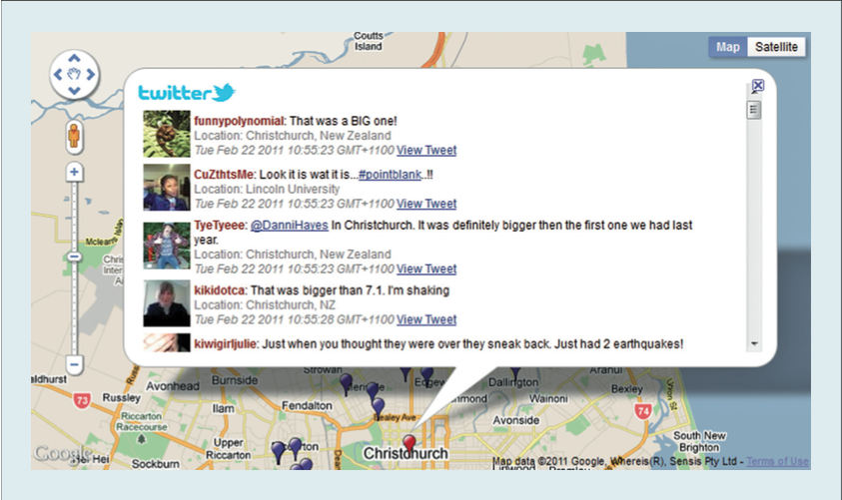
Geotagging
Displays the content of a tweet at its geographic location on a map
Using the geographic tags that if tweets have or the location of user profile.

Slide 16
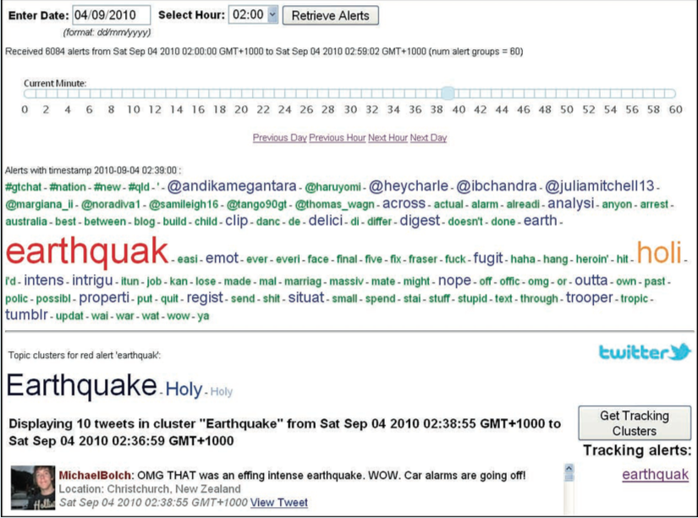
Visualization
Visualization interfaces for exploring and interacting with the information the system generated as well as the raw data extracted from Twitter.
Notes:
ChristChurch Equathquake

Slide 17
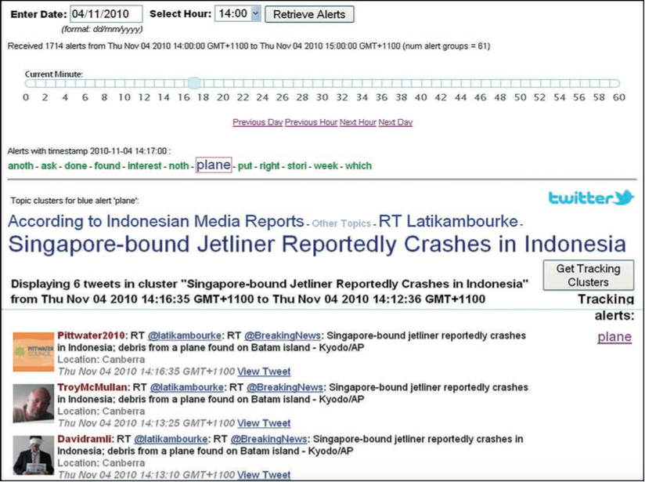
Visualization
Notes:
Qantas A380 incident : landing in singapore’s changi airport in 2010

Slide 18
Conclusion
The System clearly provides useful situation awareness information
Use NLP
Tightly integrated components
Enhance timely situation awareness across a range of crisis types
Future we test on the overall performance on the whole system
Notes:
Personal opinion: In the future using social media to enhance situation awareness is useful and promising. More similar applications or systems could be came out.

Slide 19
Reference
Yin, Jie, et al. "Using social media to enhance emergency situation awareness." IEEE Intelligent Systems 27.6 (2012): 52-59.

Slide 20
Questions?

