Slide 1
Deep Reinforcement Learning
CS 2310 - Multimedia Software Engineering
Mohammad H. Mofrad
University of Pittsburgh
Thursday, October 27, 2016

Slide 2
Preface
Machine Learning
Reinforcement Learning
Artificial Neural Network
Deep Learning
Deep Reinforcement Learning

Slide 3
Machine Learning
ML in a Nutshell
y = f(x)
Supervised Learning
  Discrete space: X (classification) Y
  Continuous space X (regression) Y
Reinforcement Learning
Unsupervised Learning
  Discrete space: X (clustering)Y
  Continuous space: X (dimensionality reduction) Y

Slide 4



Reinforcement Learning
State
s_{t}
Agent
Action
a_{t}
Reward
r_{t}
Environment
Reward
Action
State
Terminal State
s₀, a₀, r₁, s₁, a₁, r₂, s₂, s₂, . . . , r_{n-1}, s_{n-1}, a_{n-1}, r_{n}, s_{n}

Slide 5
Q – Learning
Select an action
Observe the reward
Update the Q – table
Reward
Learned value
$$Q\left(s_{t},α_{t}\right)=Q\left(s_{t},a_{t}\right)+α \left(r_{t+1} γ \left(max\text{α}Q\left(s_{t+1},α\right)\right)−Q\left(s_{t},α_{t}\right)\right)$$
New state
Old state
Learning
rate
Discount
factor
Estimate of optimal
new state
Old state

Slide 6
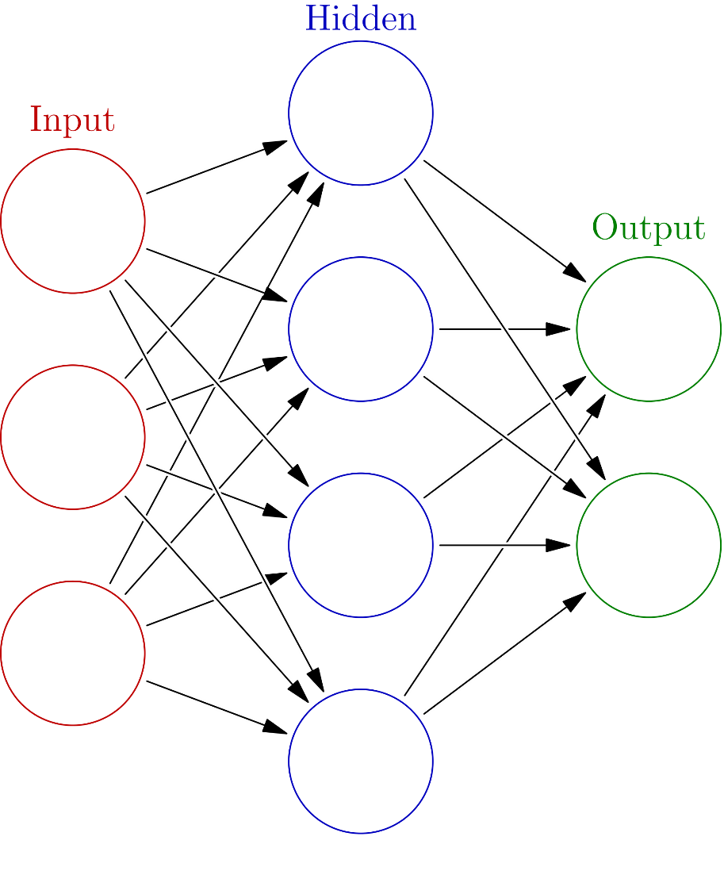
Artificial Neural Network (ANN)
A system of loosely coupled neural units modeling the brain neurons connected by axons.
Mathematical model: f: X → Y
Network structure:
  f is the Neuron’s network function: f(x) = K(∑_{i} w_{i}g_{i}(x))
  x = (x₁, x₂, …, x_{n}) is the input vector
  w = (w₁, w₂, …, w_{n})is the weight vector
  g = (g₁, g₂, …, g_{n}) is the composition of other functions
  K is the activation function
Learning: ANNs learn using a cost function
  C = E[(f(x) - y)²] like mean squared error
  C’ = 1/N ∑_{i} (f(x_{i}) - y_{i})² where N is the number of samples

Slide 7
Deep Learning
A class ANN which is a combination of many layers of nonlinear processing units
+ Feature extraction
+ Classification
+ pattern recognition
Combination of heterogeneous algorithms, mainly unsupervised
Learn different levels of representation
The output can be used as a feature vector for other classification schemes

Slide 8
Deep Reinforcement Learning

Slide 9



DeepMind
British-based AI Company founded in 2010
Acquired by Google in 2014
A Neural Network that learns how to play video games
Neural Turing Machine
Healthcare
  Searching for early signs of diseases leading to blindness.
  Differentiate between healthy and cancerous tissues in head and neck area.
AlphaGo

Slide 10

Selected Article
  Title: Human-level control through deep reinforcement learning
  Authors: Volodymyr Mnih et al.
  Affiliation: Google DeepMind
  Journal: Nature – International Weekly Journal of Science
  Volume: 518
  Issue: 7540
  Date: 2015
  Pages: 529 – 533
  Journal Impact Factor: 38.138
  Citation: 542

Slide 11

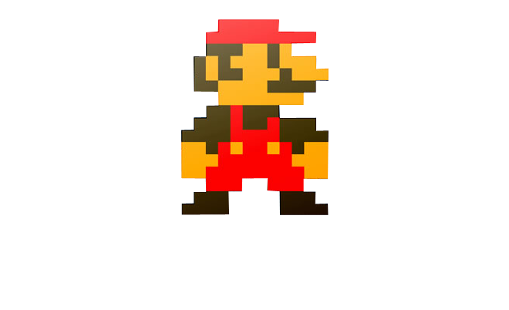


Reinforcement Learning in Atari
Action
a_{t}
State
s_{t}
Reward
r_{t}
State representation = Screen Pixels

Slide 12
Deep Q – Learning (DQL)
Deep Learning + Reinforcement Learning?
Bellman Equation with Value Function Q(s, a)
Where Value Iteration Algorithm can recursively find the optimal value
Represent the Deep Q – Network’s Value Function by the with weights W
$$Q\left(s_{t},α_{t}\right)=r+γ \left(maxa Q\left(s_{t+1},α\right)\right)$$
$$Q\left(s_{t},α,w\right)≈Q\left(s_{t},α\right)$$

Slide 13
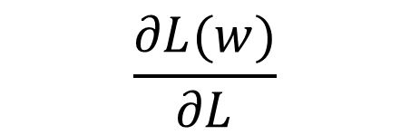
Deep Q – Learning (DQL)
Define a new Objective Function by Mean-Squared Error (MSE) in Q-values
Leading to the following Q – learning Gradient
Optimize objective function by Stochastic Gradient Descent (SGD) using
$$L=E\left[{\left(\left.r+γ{(max}_{α} Q(s_{t+1},α,w\right))−Q(st, at)\right)}^{2}\right]$$
$$\frac{∂L(w)}{∂L}=E\left[\left(\left.r+γ(\max_{α} Q(s_{t+1},α,w\right))−Q(st, at,w)\right)\frac{∂Q(st, at, w)}{∂w}\right]$$
$$\frac{∂L(w)}{∂L}$$

Slide 14
The Convolutional Neural Network in Atari
Fully-connected
Linear output layer (5)
Fully-connected layer
of rectified linear units (4)
Stack of 4
previous frames (1)
Convolutional Layer
of rectified linear units (2)
Convolutional Layer
of rectified linear units (3)
Notes:
End-to-end learning of values Q(s; a) from pixels s
Input state s is stack of raw pixels from last 4 frames
Output is Q(s; a) for 18 joystick/button positions
Reward is change in score for that step

Slide 15
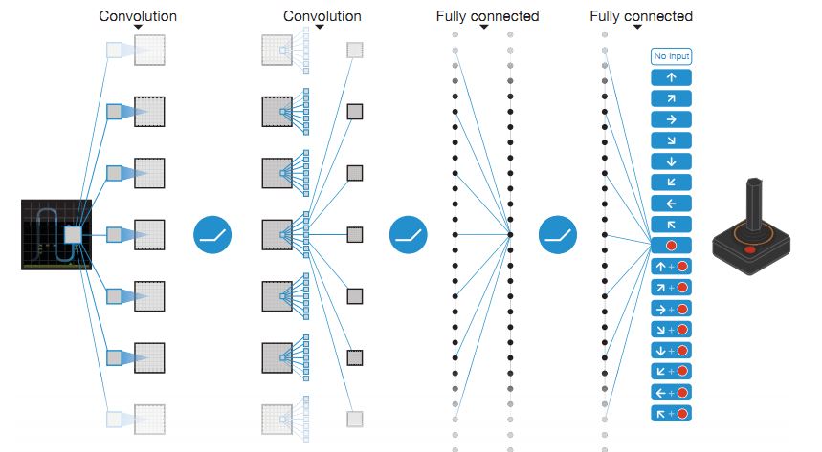
Schematic illustration of Deep Q – Network
Notes:
Figure 1 | Schematic illustration of the convolutional neural network. The details of the architecture are explained in the Methods. The input to the neural network consists of an 8438434 image produced by the preprocessing map w, followed by three convolutional layers (note: snaking blue line symbolizes sliding of each filter across input image) and two fully connected layers with a single output for each valid action. Each hidden layer is followed by a rectifier nonlinearity (that is, max(0,x)).

Slide 16
Deep Q – Network characteristics
Layer | Input | Filter size | Stride | # Filters | Activation Function | Output
Convolution 1 | 84 x 84 x 4 | 8 x 8 | 4 | 32 | ReLU | 20 x 20 x 32
Convolution 2 | 20 x 20 x 32 | 4 x 4 | 2 | 64 | ReLU | 9 x 9 x 64
Convolution 3 | 9 x 9 x 64 | 3 x 3 | 1 | 64 | ReLU | 7 x 7 x 64
Fully connected 4 | 7 x 7 x 64 |  |  | 512 | ReLU | 512
Fully connected 5 | 512 |  |  | 18 | Linear | 18
*Rectified Linear Unit (ReLU)

Slide 17
Results

Slide 18
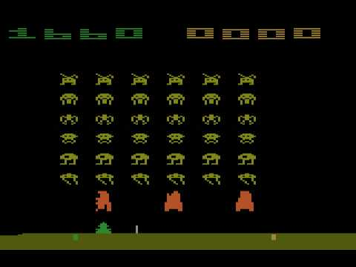
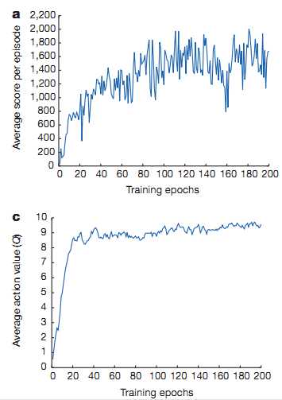
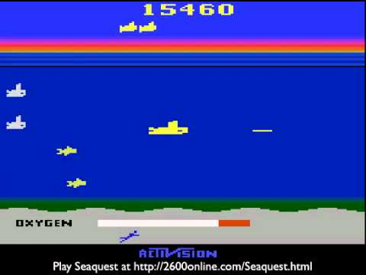
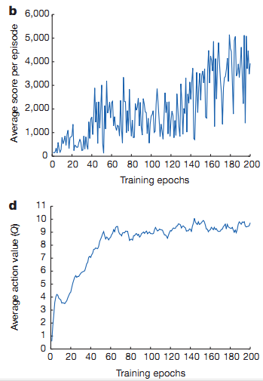
Training Curve
Space Invaders
Seaquest
Mnih, Volodymyr, et al. "Human-level control through deep reinforcement learning."
Notes:
Figure 2 | Training curves tracking the agent’s average score and average predicted action-value. a, Each point is the average score achieved per episode after the agent is run with e-greedy policy (e50.05) for 520 k frames on Space Invaders. b, Average score achieved per episode for Seaquest. c, Average predicted action-value on a held-out set of states on Space Invaders. Each point
on the curve is the average of the action-value Q computed over the held-out set of states. Note that Q-values are scaled due to clipping of rewards (see Methods). d, Average predicted action-value on Seaquest. See Supplementary Discussion for details.

Slide 19
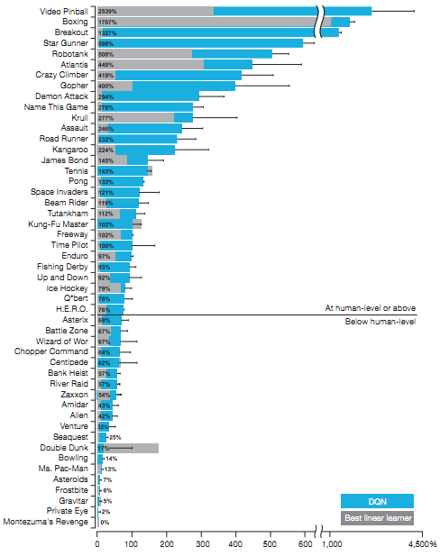
Comparing
DQN performance
  Audio was disables
  30 iterations
  Normalized results
Notes:
Figure 3 | Comparison of the DQN agent with the best reinforcement learning methods in the literature. The performance of DQNis normalized with respect to a professional human games tester (that is, 100% level) and random play (that is, 0%level).Note that the normalized performance of DQN, expressed as a percentage, is calculated as: 1003(DQN score2random play score)/(human score2random play score). It can be seen that DQN outperforms competing methods (also see Extended Data Table 2) in almost all the games, and performs at a level that is broadly comparable with or superior to a professional human games tester (that is, operationalized as a level of 75% or above) in the majority of games. Audio output was disabled for both human players and agents. Error bars indicate s.d. across the 30 evaluation episodes, starting with different initial conditions.

Slide 20
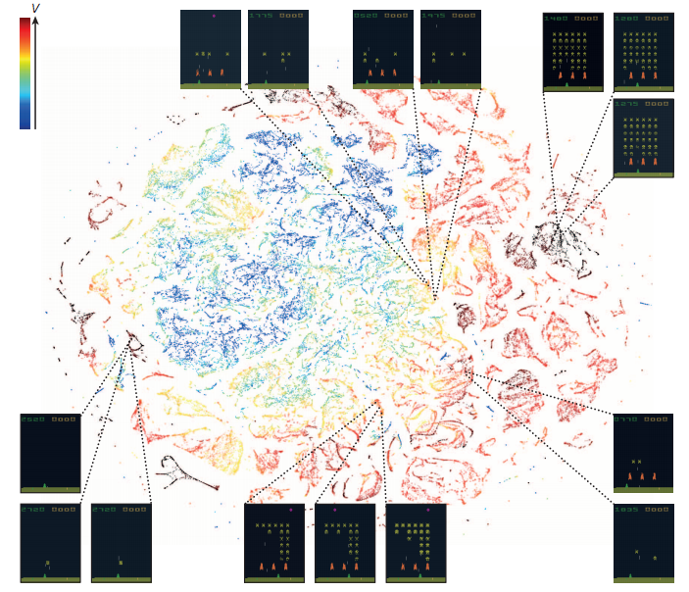
Last hidden layer representation
  tSNE representation of game states
Notes:
Figure 4 | Two-dimensional t-SNE embedding of the representations in the last hidden layer assigned by DQN to game states experienced while playing Space Invaders. The plot was generated by letting the DQN agent play for
2 h of real game time and running the t-SNE algorithm 25 on the last hidden layer representations assigned by DQN to each experienced game state. The points are coloured according to the state values (V, maximum expected reward of a state) predicted by DQN for the corresponding game states (ranging from dark red (highest V) to dark blue (lowest V)). The screenshots corresponding to a selected number of points are shown. The DQN agent predicts high state values for both full (top right screenshots) and nearly complete screens (bottom left screenshots) because it has learned that completing a screen leads to a new screen full of enemy ships. Partially completed screens (bottom screenshots) are assigned lower state values because less immediate reward is available. The screens shown on the bottom right and top left and middle are less perceptually similar than the other examples but are still mapped to nearby representations and similar values because the orange bunkers do not carry great significance near the end of a level. With permission from Square Enix Limited.

Slide 21
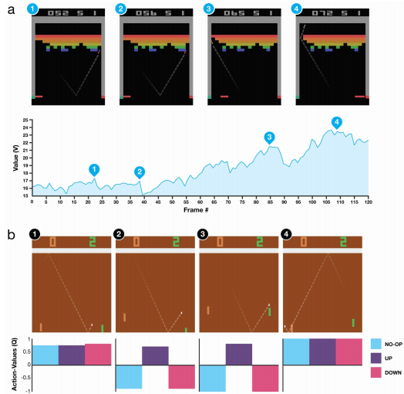
Visualization of the learned value
Function Breakout game
Notes:
Extended Data Figure 2 | Visualization of learned value functions on two games, Breakout and Pong. a, A visualization of the learned value function on the game Breakout. At time points 1 and 2, the state value is predicted to be,17 and the agent is clearing the bricks at the lowest level. Each of the peaks in the value function curve corresponds to a reward obtained by clearing a brick. At time point 3, the agent is about to break through to the top level of bricks and the value increases to ,21 in anticipation of breaking out and clearing a large set of bricks. At point 4, the value is above 23 and the agent has broken through. After this point, the ball will bounce at the upper part of the bricks clearing many of them by itself. b, A visualization of the learned action-value function on the game Pong. At time point 1, the ball is moving towards the paddle controlled by the agent on the right side of the screen and the values of all actions are around 0.7, reflecting the expected value of this state based on previous experience. At time point 2, the agent starts moving the paddle towards the ball and the value of the ‘up’ action stays high while the value of the ‘down’ action falls to20.9. This reflects the fact that pressing ‘down’ would lead to the agent losing the ball and incurring a reward of 21. At time point 3, the agent hits the ball by pressing ‘up’ and the expected reward keeps increasing until time point 4,when the ball reaches the left edge of the screen and the value of all actions reflects that the agent is about to receive a reward of 1. Note, the dashed line shows the past trajectory of the ball purely for illustrative purposes (that is, not shown during the game). With permission from Atari
Interactive, Inc.

Slide 22
Visualization of the learned value
Function Pong game
Notes:
Extended Data Figure 2 | Visualization of learned value functions on two games, Breakout and Pong. a, A visualization of the learned value function on the game Breakout. At time points 1 and 2, the state value is predicted to be,17 and the agent is clearing the bricks at the lowest level. Each of the peaks in the value function curve corresponds to a reward obtained by clearing a brick. At time point 3, the agent is about to break through to the top level of bricks and the value increases to ,21 in anticipation of breaking out and clearing a large set of bricks. At point 4, the value is above 23 and the agent has broken through. After this point, the ball will bounce at the upper part of the bricks clearing many of them by itself. b, A visualization of the learned action-value function on the game Pong. At time point 1, the ball is moving towards the paddle controlled by the agent on the right side of the screen and the values of all actions are around 0.7, reflecting the expected value of this state based on previous experience. At time point 2, the agent starts moving the paddle towards the ball and the value of the ‘up’ action stays high while the value of the ‘down’ action falls to20.9. This reflects the fact that pressing ‘down’ would lead to the agent losing the ball and incurring a reward of 21. At time point 3, the agent hits the ball by pressing ‘up’ and the expected reward keeps increasing until time point 4,when the ball reaches the left edge of the screen and the value of all actions reflects that the agent is about to receive a reward of 1. Note, the dashed line shows the past trajectory of the ball purely for illustrative purposes (that is, not shown during the game). With permission from Atari
Interactive, Inc.

Slide 23
Conclusion
Deep nets are most suitable while dealing with unlimited high dimensional training data
DQN
  Reinforcement Learning acts as the function approximator
  Extract high level features from high dimensional raw sensory data
Final Quote:
“Reinforcement learning + deep learning = AI”

Slide 24
References
[1] Mnih, Volodymyr, et al. "Human-level control through deep reinforcement learning." Nature 518.7540 (2015): 529-533.
[2] Mnih, Volodymyr, et al. "Asynchronous methods for deep reinforcement learning." arXiv preprint arXiv:1602.01783 (2016).
[3] Mnih, Volodymyr, et al. "Playing atari with deep reinforcement learning." arXiv preprint arXiv:1312.5602 (2013).

