Slide 1
Perceived Benefits of Agile Software Engineering
-----A Case Study from SAP
Zinan Zhang
Notes:
Empirical Insights into the Perceived Benefits of Agile Software Engineering Practices: A Case Study from SAP

Slide 2
Content
Quick review about agile
  Agile definition
  Agile values
  Agile principle
  Agile method
A case study from SAP
  Research approach
  Survey findings
    Adoption intensity
    Perceived benefits
  Insights from two high adopter team
    Team A
    Team B
References

Slide 3

What is agile
The term agile was first coined for this in 2001, in the Manifesto for Agile Software Development (Agile Manifesto)
Agile software development describes a set of principles for software development under which requirements and solutions evolve through the collaborative effort of self-organizing cross-functional teams.
Quick review

Slide 4
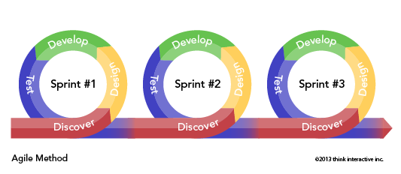
What is agile valued
Individuals and interactions over processes and tools.
Working software over comprehensive documentation.
Customer collaboration over contract negotiation.
Responding to change over following a plan.
Quick review

Slide 5
Agile Principle
Customer satisfaction by early and continuous delivery of valuable software
Welcome changing requirements, even in late development
Working software is delivered frequently (weeks rather than months)
Close, daily cooperation between business people and developers
Projects are built around motivated individuals, who should be trusted
Face-to-face conversation is the best form of communication (co-location)
Quick review

Slide 6
Agile Principle
Working software is the principal measure of progress
Sustainable development, able to maintain a constant pace
Continuous attention to technical excellence and good design
Simplicity—the art of maximizing the amount of work not done—is essential
Best architectures, requirements, and designs emerge from self-organizing teams
Regularly, the team reflects on how to become more effective, and adjusts accordingly
Quick review

Slide 7
What method is included
Agile methods support a broad range of the software development life cycle.
Some focus on the practices (e.g., XP, pragmatic programming, agile modeling),
while some focus on managing the flow of work (e.g., Scrum, Kanban).
Some support activities for requirements specification and development (e.g., FDD),
while some seek to cover the full development life cycle (e.g., DSDM, RUP).
Quick review

Slide 8
Content
Quick review about agile
  Agile definition
  Agile values
  Agile principle
  Agile method
A case study from SAP
  Research approach
  Survey findings
    Adoption intensity
    Perceived benefits
  Insights from two high adopter team
    Team A
    Team B
References

Slide 9
Insights into the Perceived Benefits of Agile Software Engineering Practices
A case study
------- A case study from SAP

Slide 10
Why choose SAP
During the last years, there has been a growing interest to understand how Agile Software Engineering impacts the development work and the performance of software developers. But still today, research in this field remains limited and there is a constant call for more empirical studies with professional software developers as many studies are based on single case studies or student-based experiments.
A case study

Slide 11

Why choose SAP
SAP AG is a world leader in enterprise software and software related services. It is a large global organization with locations in more than 130 countries.
During the last years, SAP has fundamentally changed its development methodology.
A case study

Slide 12
Why choose SAP
After 2010, the Agile Software Engineering training program was introduced at large scale.
The aim of the training program was to improve development efficiency and bring innovation to customers at faster rates.
The team-based program teaches Agile Software Engineering practices such as test-driven development, test isolation, continuous integration, refactoring, pair programming besides a general Scrum refresher.
A case study

Slide 13
Content
Quick review about agile
  Agile definition
  Agile values
  Agile principle
  Agile method
A case study from SAP
  Research approach
  Survey findings
    Adoption intensity
    Perceived benefits
  Insights from two high adopter team
    Team A
    Team B
References

Slide 14
Research approach
Participation:
  More than 200 people involved the survey. The respondents included 15 product owners and 174 developers who had indicated in the questionnaire to be spending more than 20% of their working time developing software. Overall, all respondents worked in 74 development teams in five countries.
Questionnaire:
  how intensively the developers used the taught development practices in their daily work
  if the developers experienced a change in the quality of software they delivered
  to rate how proud they were of their own work
Research approach

Slide 15
Content
Quick review about agile
  Agile definition
  Agile values
  Agile principle
  Agile method
A case study from SAP
  Research approach
  Survey findings
    Adoption intensity
    Perceived benefits
  Insights from two high adopter team
    Team A
    Team B
References

Slide 16
Survey Findings
The authors analysis the adoption intensity of the survey.
They focus on two agile development practices: pair programming and test-driven development.
Both development practices are not only the most widely used agile engineering practices, but also the ones that most fundamentally change the way how the software is developed. Both practices endorse core agile principles [7]
Survey Findings

Slide 17

What is pair programming
Two developers work on a single computer with only one keyboard and one computer mouse to collaboratively develop software. One developer is the so-called driver who has the keyboard at that time to write new code. The partner is the navigator who permanently monitors the driver, provides feedback, and gives suggestions how to better solve the implementation tasks. The two developers frequently switch their roles.
Survey Findings

Slide 18
What is test-driven development
Before writing the software code, developers write an automated test case that covers the to be implemented software functionality. Test cases comprise a set of specified conditions under which the software code is working as originally expected. After a test cases is implemented, only the necessary software code to pass exactly that newly added test case is added. Once the implemented functionality passes the test cases, the productive code is refactored, i.e. the internal code quality is improved without changing its external functionality, and the test-driven development cycle is repeated. Developers use their test cases to automatically and continuously check the quality of their software code.
Survey Findings

Slide 19
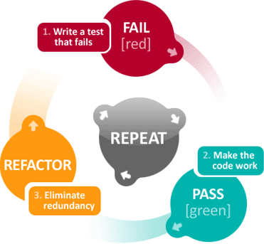
Survey Findings

Slide 20
Content
Quick review about agile
  Agile definition
  Agile values
  Agile principle
  Agile method
A case study from SAP
  Research approach
  Survey findings
    Adoption intensity
    Perceived benefits
  Insights from two high adopter team
    Team A
    Team B
References

Slide 21
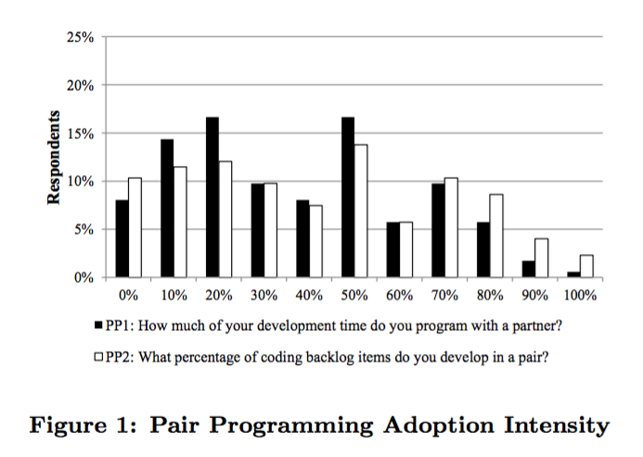
Adoption intensity
Survey Findings
Notes:
The given answers correlated strongly

Slide 22
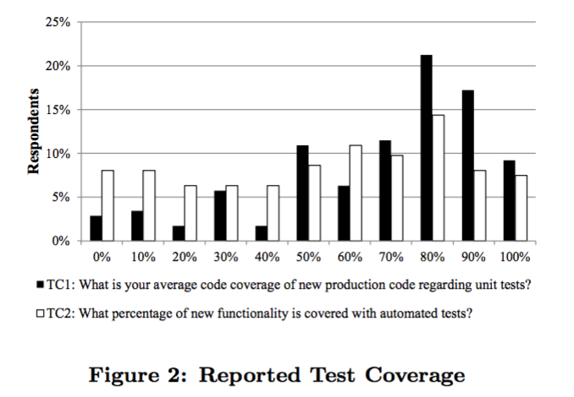
Adoption intensity
Survey Findings
Notes:
The given answers correlated strongly

Slide 23
Content
Quick review about agile
  Agile definition
  Agile values
  Agile principle
  Agile method
A case study from SAP
  Research approach
  Survey findings
    Adoption intensity
    Perceived benefits
  Insights from two high adopter team
    Team A
    Team B
References

Slide 24
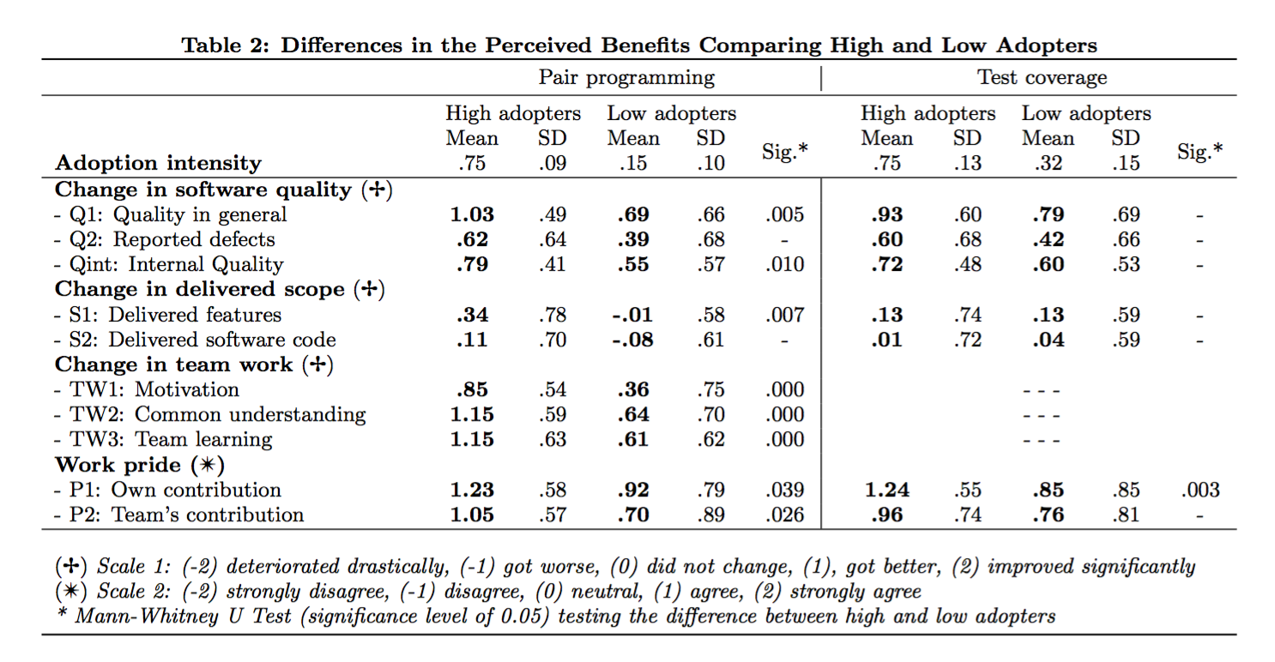
Perceived Benefits

Slide 25
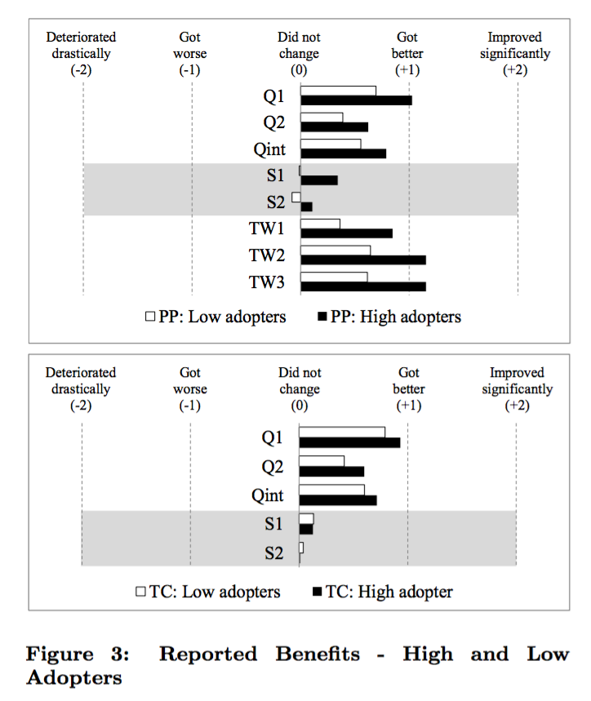

Slide 26
Pair Programming Benefits
Pair programmers to have a higher team motivation, which is generally considered to be an important antecedent for successful team work.
pair programming helps developers share their ideas, build an awareness of other team members’ expertise, and develop a common understanding of what good software quality is, about common team goals, and what needs to be done for development task to be considered ’done’.
Pair programmers permanently learn from each other on how to develop software.
Survey Findings

Slide 27
Content
Quick review about agile
  Agile definition
  Agile values
  Agile principle
  Agile method
A case study from SAP
  Research approach
  Survey findings
    Adoption intensity
    Perceived benefits
  Insights from two high adopter team
    Team A
    Team B
References

Slide 28
Insights from two high adopter teams
  The deficient of the previous survey approach:
  Their data is based on developers’ subjective perceptions asked about six months after the trainings.
  Developers answers are based on subjective self-assessment which might be biased towards individuals’ expectations.
  The survey findings do not allow the authors to study team specific context factors to understand
  So, the choose two specific teams to study

Slide 29
Team A
Team A is located in Germany and develops software with Java technology.
before the training, the team had faced many quality issues at the end of their development cycles of previous releases causing a lot of stress and bug fix efforts.
Release x was developed before the training and release x+1 was developed shortly afterward.

Slide 30
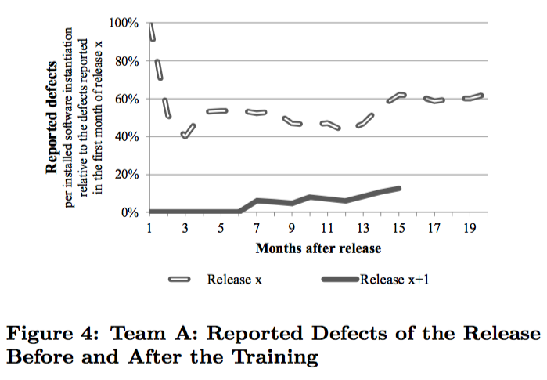

Slide 31
Positive impact to Team A
The high test coverage helped the team not only to deliver better software quality but also to reduce the work stress during the development sprints and before the end of the releases
Due to pair programming, developers appreciated the improved knowledge transfer in the team and the continuous partner who reviewed the code. Both practices helped the developers to “sleep well at night” knowing the software they build is safeguarded by automated tests while being away from their desk.

Slide 32
Team B
Team B is located in India and is a little less experienced than Team A with young developers who are mostly new to the used technology.
They worked on a release without Agile Software Engineering practices and took the Release y Release y+1 training just before the release y+1.

Slide 33
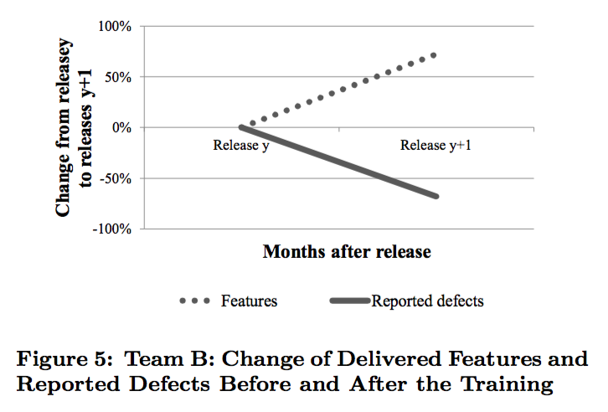

Slide 34
Conclusion
The survey results indicate that the studied engineering practices are well established among more than half of the responding developers.
High adopters report a positive impact on the software quality while delivering the same scope of features. In particular, respondents’ answers confirm the expectations that pair programming helps developers deliver better internal software quality.
High adopters report a positive impact on different team work factors, i.e. high adopters of pair programming experience a positive effect for their team work. They see a higher motivation in their team, a better common understanding among team members, and an improved knowledge transfer within the development team.
Finally, high adopters of both practices are more proud of their contributions.

Slide 35
Reference
Schmidt C T, Ganesha Venkatesha S, Heymann J. Empirical insights into the perceived benefits of agile software engineering practices: A case study from SAP[C]//Companion Proceedings of the 36th International Conference on Software Engineering. ACM, 2014: 84-92.
M. Fowler and J. Highsmith. The agile manifesto. Software Development, 9(8):28–35, 2001.
J. Schnitter and O. Mackert. Large-Scale Agile Software Development at SAP AG, volume 230 of Communications in Computer and Information Science, chapter 15, pages 209–220. Springer Berlin Heidelberg, 2011.

