Slide 1
Deep Learning
Amin Sobhani

Slide 2
Conventional Machine Learning
Process natural data in raw form
Constructing features by hand
  Requires domain expertise
  Difficult and time consuming
Raw Input
(pixels from an image)
Feature Extraction
(SIFT, HOG)
Learning System
(Classifier)

Slide 3
Representation Learning
Representation Learning: allows a machine to be fed with raw data and to automatically discover representations needed for detection/classification
Deep Learning: representation learning with multiple layers of representation (more than 3)
  Transformed into higher, slightly more abstract level
  Very complex functions can be learned

Slide 4
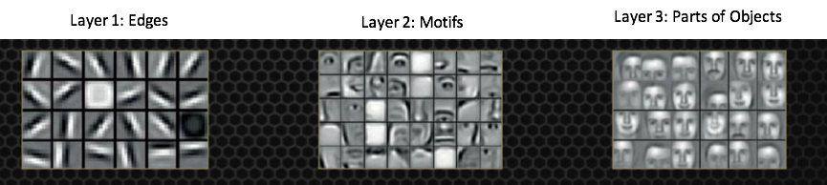
Deep Learning
Layers are not handcrafted
Features are learned from raw data via a general-purpose learning algorithm
https://devblogs.nvidia.com/parallelforall/accelerate-machine-learning-cudnn-deep-neural-network-library/

Slide 5
Applications of Deep Learning
Domains in science, business and government
Beat current records in image and speech recognition
Beaten other machine-learning techniques at
  Predicting activity of potential drug molecules
  Analyzing particle accelerator data
  Reconstructing brain circuits
Produced promising results in natural language understanding
  Topic classification
  Sentiment analysis
  Question answering

Slide 6
Overview
Supervised Learning
Backpropagation to Train Multilayer Architectures
Convolution Neural Networks
Image Understanding with Deep Convolution Networks
Distributed Representation and Language Processing
Recurrent Neural Networks
Future of Deep Learning

Slide 7
Supervised Learning
Most common form of machine learning
  Data set
  Labeling
  Training on data set (tuning parameters, gradient descent)
  Testing
Objective function: measures error between output scores and the desired pattern of scores
Modifies internal adjustable parameters (weights) to reduce error

Slide 8
Supervised Learning
Objective Function → “Hilly landscape” in high dimensional space of weight values
Computes a gradient vector
  Indicates how much the error would increase or decrease if the weight were increased by a tiny amount
  Negative gradient vector indicates the direction of steepest descent in this landscape
  Taking it closer to a minimum, where the output error is low on average

Slide 9
Stochastic Gradient Descent (SGD)
Input vector for a few examples
Compute the outputs and the errors
Compute the average gradient
Adjusting the weights
Repeated for many small sets from the training set until the average of the objective function stops decreasing
Stochastic: small set gives a noisy estimate of the average gradient over all examples

Slide 10
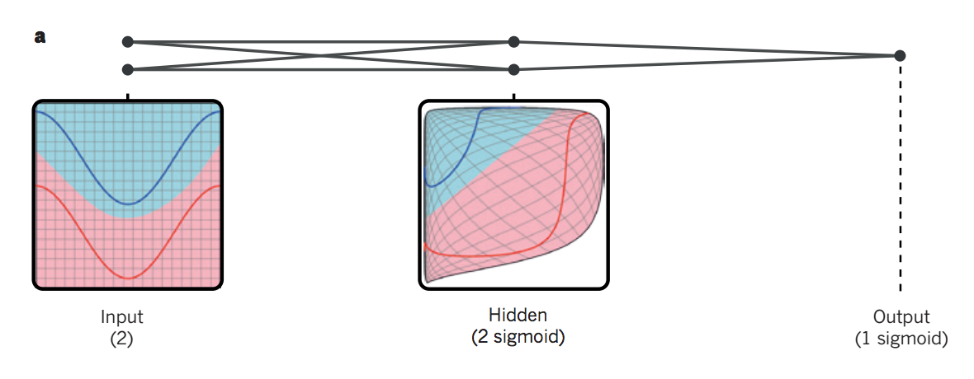
Multi Layer Neural Network
Distort the input space to make the classes of data (ex: red and blue lines) linearly separable
Illustrative example with only two input units, two hidden units and one output unit

Slide 11
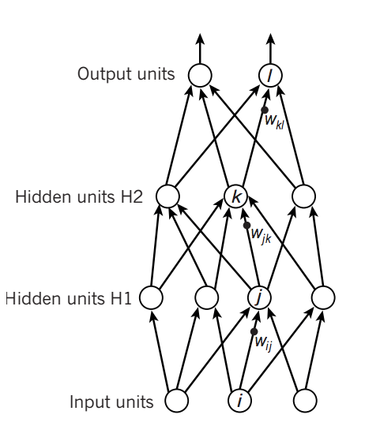
Feed Forward
Map a fixed-size input (Ex: an image) to a fixed-size output (Ex: a probability for each of several categories)
A set of units compute a weighted sum of their inputs from the previous layer
Pass the result through a nonlinear function

Slide 12
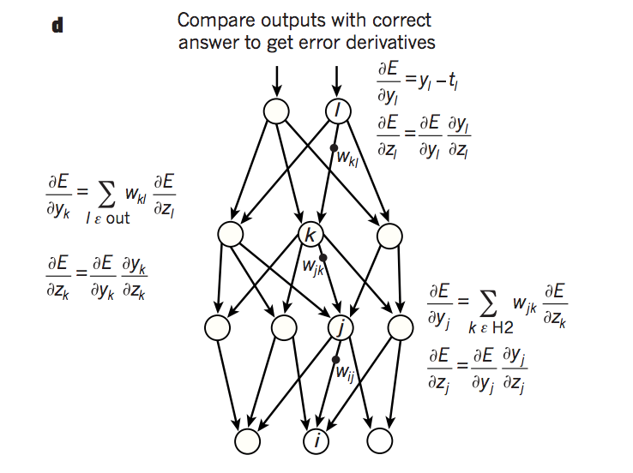
Backpropagation to Train Multilayer Architectures
Feed Forward the input
Calculate the error function
Calculate the gradient backward

Slide 13
Convolutional Neural Networks
Use many different copies of the same feature detector with different positions
Replication greatly reduces the number of features to be learned
Enhanced generalization
Use several different feature type, each with its own map of replicated detectors.

Slide 14
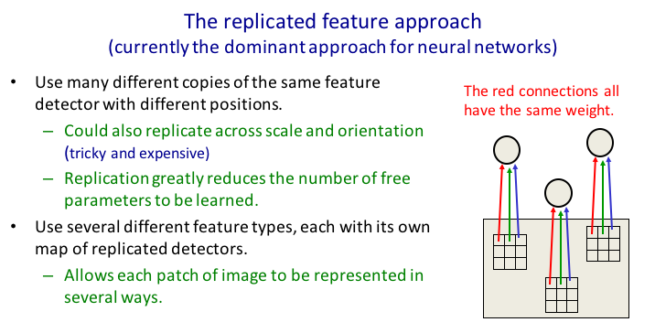
Convolutional Neural Networks

Slide 15
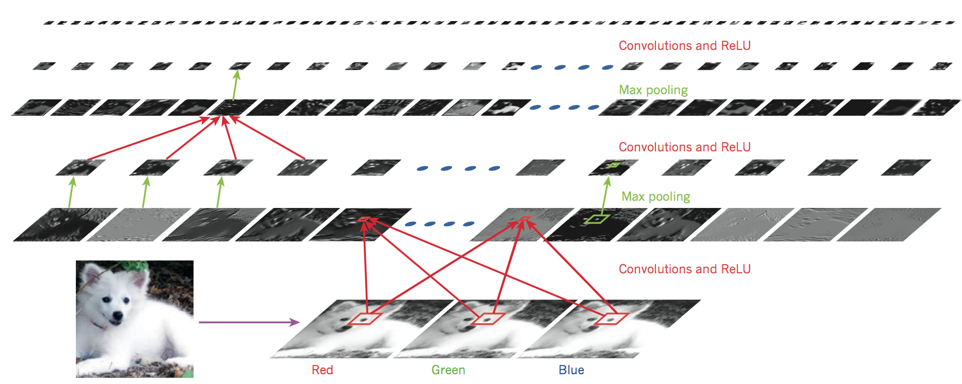
Image Understanding with Deep Convolutional Networks

Slide 16
Distributed Representation and Language Processing
Data is represented as a vector
Each element is not mutually dependent
Many possible combination for the same input (stochastic representation)
Enhanced classification accuracy

Slide 17
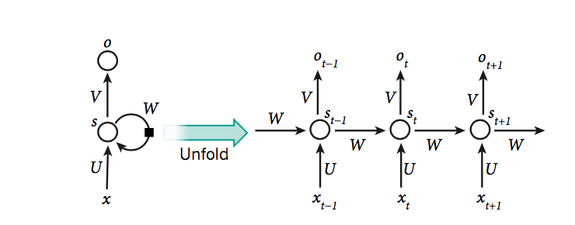
Recurrent Neural Networks
RNNs process an input sequence one element at a time
Tasks that involve sequential input
  speech, language
Trained by backpropagation
  problematic because the back propagated gradients either grow or shrink at each time step
  over many time steps they typically explode or vanish

Slide 18
My View Over Future of Deep Learning
Expect unsupervised learning to become more important
  Human and animal learning is largely unsupervised
Future progress in vision
  Systems trained end-to-end
  Combine ConvNets with RNNS that use reinforcement learning to decide where to look
Natural language
  RNNs systems will become better when they learn strategies for selectively attending to one part at a time
Ultimate progress → systems that combine representation learning with complex reasoning

Slide 19
Discussion
Deep Learning has already drastically improved the state-of-the-art in
  image recognition
  speech recognition
  natural language understanding
Deep Learning requires very little engineering by hand and thus has the potential to be applied to many fields

Slide 20
References
Y. LeCun, Y. Bengio, G. Hinton (2015). Deep Learning. Nature 521, 436-444.

