Slide 1
Too Long; Didn’t Watch!
Extracting Relevant Fragments from Software Development Video Tutorials
Manali Shimpi

Slide 2
Overview
Background
Introduction
CodeTube Overview
Crawling and Analyzing Video Tutorials
Identifying Video Fragments
CodeTube Parameters and Estimating Video Fragments Similarity
CodeTube Evaluation
Conclusion
Discussion

Slide 3
Background
Developers need to continuously acquire new knowledge to keep up with their daily tasks. E.g. learn a new programming language
Source of information:
  Blogs
  Forums
  Q&A Websites
  Video Tutorials

Slide 4
Background
Video Tutorials are the recent and rapidly emerging source of information.
Advantages of Video Tutorial
  Ability to visually follow the changes made to the source code
  Can see the environment where the program is executed
  View execution results

Slide 5
Background
Limited support for helping developers to find the relevant information they require within video tutorials.
Video tutorials are lengthy
Difficult to find specific fragment of interest.
No approach aimed at leveraging relevant information found within fragments of video tutorials and linking these fragments to other relevant sources of information.

Slide 6
Introduction
CodeTube , an approach which mines video tutorials found on the web, and enables developers to query their contents
Recommands video tutorial fragments relevant to a given textual query
Complements video fragments with Stack Overflow discussions
Currently available through web interface
http://codetube.inf.usi.ch/

Slide 7
CodeTube Overview
CodeTube is a multi-source documentation miner to locate useful pieces of information for a given task at hand
The results are fragments of video tutorials relevant for a given textual query, augmented with additional information mined from other \classical", text-based online resources.

Slide 8
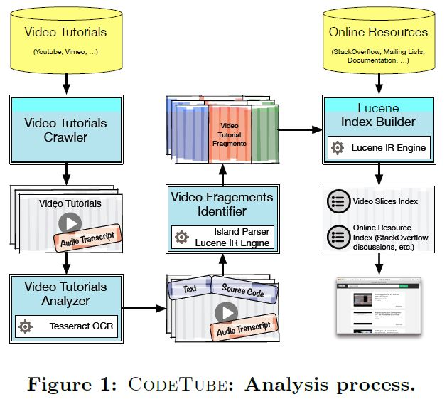
CodeTube Overview

Slide 9
Crawling and Analyzing Video Tutorials
User provides :
  a set of queries Q describing the video tutorials she is interested in. (e.g. Android Development)
  a set of related tags T to identify and index relevant Stack Overflow discussions (e.g. Android)
Each query in Q is run by the Video Tutorials Crawler using the YouTube Data API to get the list of YouTube channels relevant to the given query
Metadata and audio transcripts are extracted for each channel by Video Tutorials Crawler using Google2Srt

Slide 10
Crawling and Analyzing Video Tutorials
Metadata and transcripts are given to Video Tutorial Analyzer as input.
Extracts pieces of information to isolate video fragments related to a specific topic
Aims at characterizing each video frame with the text and the source code it contains
Uses multi-threading to analyze batches of videos.

Slide 11
Crawling and Analyzing Video Tutorials
Frame Extraction
Downloads video at maximum resolution using multimedia framework FFmpeg and saves frames in png format
Compare subsequent pairs of frames (fi, fi+1) to measure their dissimilarity in terms of their pixel matrices.
If the difference is less than 10% , keeps only one such frame for analysis
Reduces the computational cost without losing important information

Slide 12
Crawling and Analyzing Video Tutorials
English Terms Extraction
Uses optical character recognition tool tesseractor to extract the text from the frame
High variability of the background, and the potential low quality of a frame can result in a high amount of noise
Dictionary-based filtering is used to ignore strings that are invalid English words

Slide 13
Crawling and Analyzing Video Tutorials
Java Code Identification
To limit the noise produced by the OCR , the sub-frames containing code are identified using :
  Shape Detection
  Frame Segmentation

Slide 14
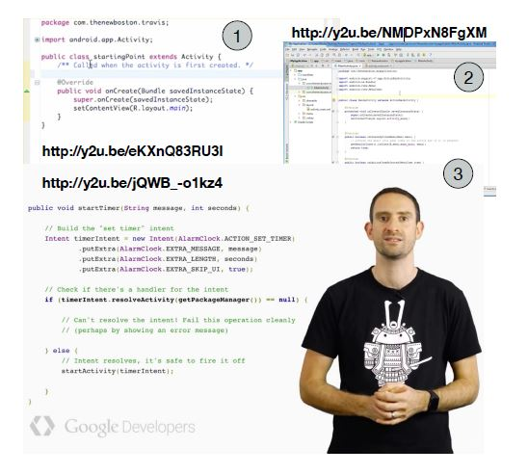
Crawling and Analyzing Video Tutorials

Slide 15
Crawling and Analyzing Video Tutorials
Shape Detection
  Uses BoofCV to apply shape detection on frames
  identifies all quadrilaterals by using the difference in contrast in the corners
  Successful to detect code editors in the IDE
Frame Segmentation
  Sampling of small sub-images having height and width equal to 20% of the original frame size
  Mark all sub-images Sm containing at least one valid English word and/or Java keyword
  Use an island parser on the extracted text to cope with the noise

Slide 16
Identifying Video Fragments
Challenges
  Incremental writing in a tutorial
  Scrolling causes frames showing the same code snippet to show different “portions" of it.
  Tutor could interleave two frames showing the same snippet of code with slides or other material (e.g., the Android emulator).

Slide 17
Identifying Video Fragments
Compute the Longest Common Substring (LCS) between the pixel matrices representing the code frames.
Each pixel is converted to a 8-bit grayscale representation.
Two frames are showing same code snippet if the LCS between them includes more than α pixels.

Slide 18
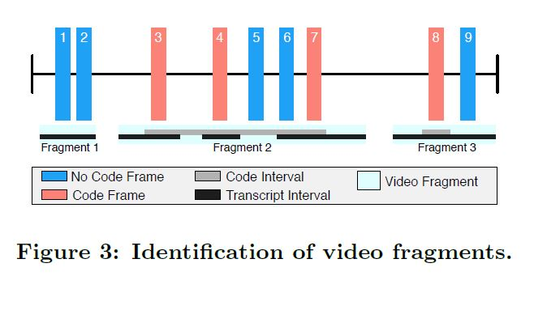
Identifying Video Fragments

Slide 19
Identifying Video Fragments
CodeTube analyzes the audio transcripts to refine the already identified code intervals
CodeTube uses the beginning of the first and the end of the last relevant audio transcript for a code interval to extend its duration and avoid that the code interval starts or ends with a broken sentence.

Slide 20
CodeTube Parameters
α - minimum percentage of LCS overlap between two frames to consider them as containing the same code fragment
β - minimum textual similarity between two fragments to merge them in a single fragment
γ - minimum video fragment length

Slide 21
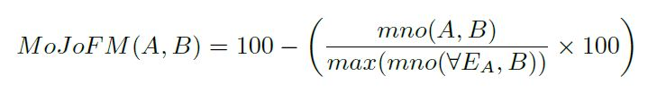
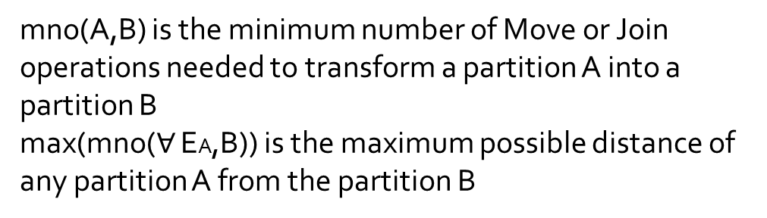
Estimating Video Fragments Similarity
MoJo effectiveness Measure (MoJoFM)
mno(A,B) is the minimum number of Move or Join
operations needed to transform a partition A into a partition B
max(mno($∀$ EA,B)) is the maximum possible distance of any partition A from the partition B

Slide 22
Integrating Other Resources
Mining and extraction of discussions related to the topics of the extracted video tutorials
Indexing both the extracted video fragments and the Stack Overflow discussions, using Lucene

Slide 23
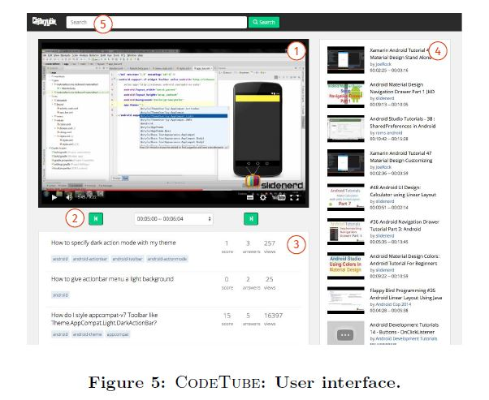
CodeTube
User Interface

Slide 24
STUDY I: INTRINSIC EVALUATION
Goal is to determine the quality of the extracted video fragments and related Stack Overflow discussions perceived by developers.
The four research questions:
RQ1: What are the perceived benefits and obstacles of using video tutorial?
RQ2: To what extent are the extracted video tutorial fragments are cohesive and self-contained?
RQ3: To what extent are the Stack Overflow discussions identified by CodeTube relevant and complementary to the linked video fragments?
RQ4: To what extent is CodeTube able to return results relevant to a textual query?

Slide 25
STUDY I: INTRINSIC EVALUATION
40 Participants
4,747 Videos
38,783 Fragments
Survey included 3 sections
Section 1 addresses RQ1
In Section 2, respondents were shown 3 video fragments and the original video to address RQ2 and RQ3
The third section aims to assess the relevance of the top three returned video fragments to a given query (RQ4).
All assessment related questions follow a 3-level Likert scale

Slide 26
STUDY I: INTRINSIC EVALUATION
The population who completed the survey is composed of
  70.6% of professional and open source developers
  17.6% of master students
  11.8% of PhD students.

Slide 27
Study Results
73% of fragments were found to be cohesive and only one fragment was not cohesive.
47 % of fragments scored 3 on self –containment.
82% Stack Overflow discussions were considered as complementary.

Slide 28
STUDY II: EXTRINSIC EVALUATION
Research question aimed to answer with this second evaluation is
RQ5: Would CodeTube be useful for practitioners?
The context of the study is represented by three leading developers ,all with more than 5 years of experience in app Development and are part of three Italian software companies, namely Next, IdeaSoftware, and Genialapps

Slide 29
Conclusion
CodeTube is a novel approach to extract relevant fragments from software development video tutorials
Mixes several existing approaches and technologies like OCR and island parsing to analyze the complex unstructured contents of the video tutorials
CodeTube is the first, and freely available approach to perform video fragment analysis for software development.

Slide 30
Discussion
Pros
  Tool solves an important and challenging problem
  It’s a better approach and has enormous potential.
Cons
  Limited to android related videos
  User study could have been expanded to include more participants
  User experience can be improved

Slide 31
Thank You

