Slide 1
MIDI
An introductory seminar by Austin Orth

Slide 2

What is MIDI?
Musical Instrument Digital Interface
More than just a “digital interface”
    Protocol
    Digital interface
    Connectors
Notes:
MIDI stands for Musical Instrument Digital Interface, but it actually refers to a lot more than just a digital interface. MIDI is now considered a technical standard, and is used by almost every modern digital instrument manufacturer and every music software company. As a technical standard, MIDI describes a communication protocol, a digital interface, and the physical connectors themselves.

Slide 3
What is MIDI?
A Short History
MIDI Today
Tech Specs
MIDI Hardware
MIDI Software
Current Research in MIDI
Demonstration using Linux Multimedia Studio

Slide 4
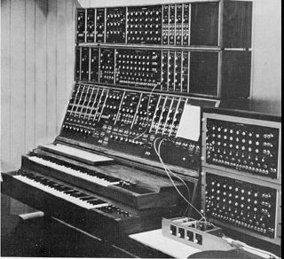
A Short History
Synthesizers
Compatibility Issues
Something had to be done
Notes:
The development of MIDI is intrinsically connected to the advent of the synthesizer. Robert Moog, whose company is now a widely-popular keyboard and synthesizer manufacturer, is credited as being the first person to modularize the massive music computing devices being developed in universities enough to be purchased and used by musicians. Once other companies caught on to the technology, synthesizers were being produced left and right by companies like Roland and Sequential Circuits. This gave rise to fears of compatibility issues that would inhibit users from making full use of synths.

Slide 5
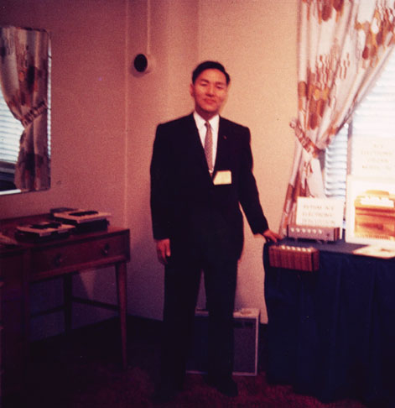
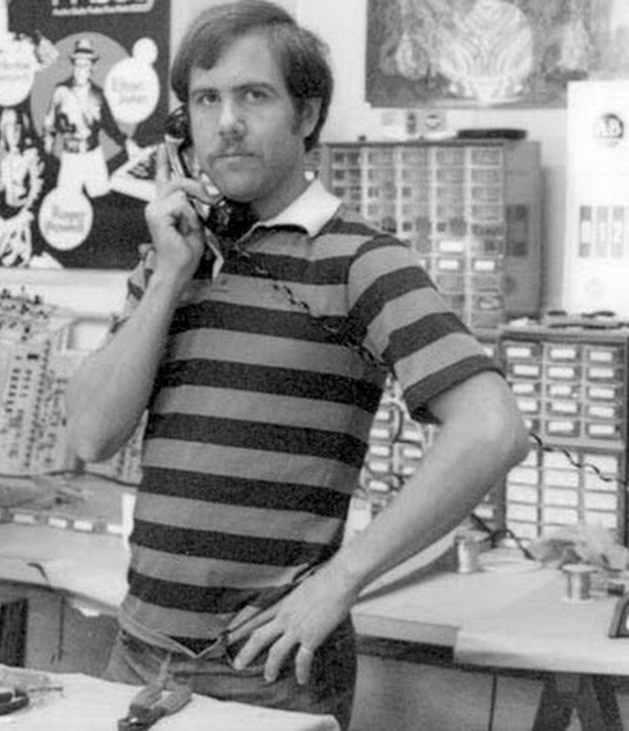
A Short History
Ikutaru Kakehashi and Dave Smith
Manufacturers Meeting
Thus, MIDI was born
Notes:
The leaders of two leading keyboard companies, Dave Smith of Sequential Circuits and Ikutaru Kakehashi of Roland, decided a universal standard was needed. They began developing what would become MIDI, and in January, 1982, leaders from all major synth manufacturers met to discuss and refine the standard. It was announced to the public shortly afterward, and less than a year later, devices began shipping with MIDI. Then, in 1983, it was demonstrated that with MIDI a Roland synth was able to communicate with a Sequential Circuits synth, demonstrating that whether your keyboard was made in America or Japan, MIDI could make their music work together.

Slide 6
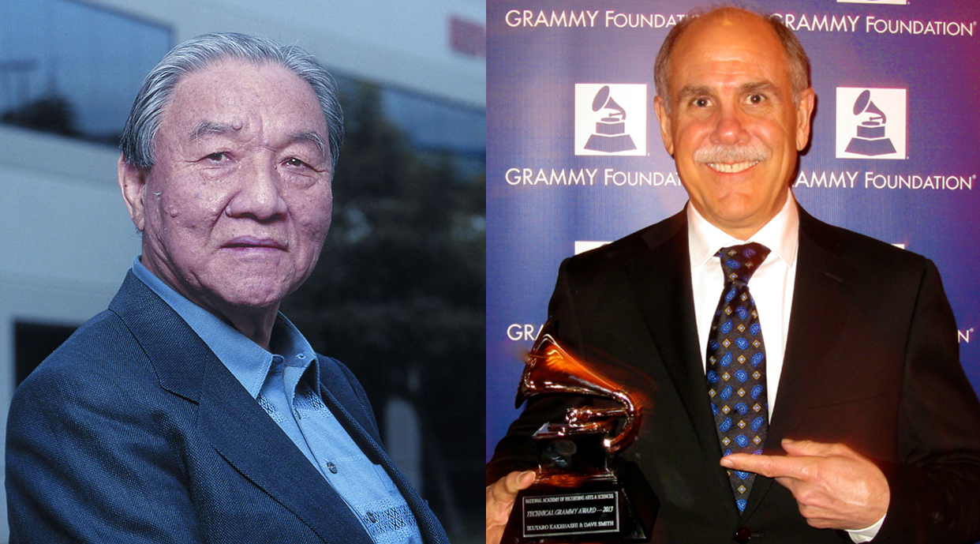
MIDI Today
In 2013, Kakehashi and Smith were awarded a Technical Grammy
MIDI is used by every modern music producer
Computers can now be applied to make music
Notes:
List of producers that use MIDI: All of them.
DAWs and score-writing software are the cornerstones of modern music.

Slide 7
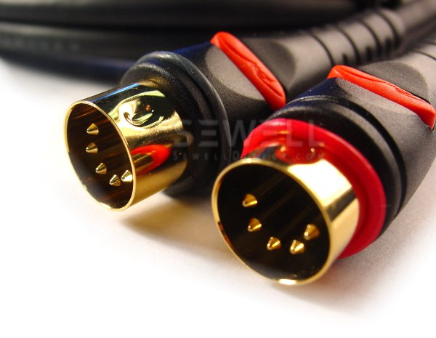
Tech Specs of MIDI
MIDI Links
  16 Channels
  Omni On vs. Omni Off
  Monophonic vs. Polyphonic
Notes:
Omni on and omni off means that the device can be configured to listen to all channels, or just data from a specific channel.
Monophonic means that the device counts the start of a new note as an end-note command for the previous note.

Slide 8
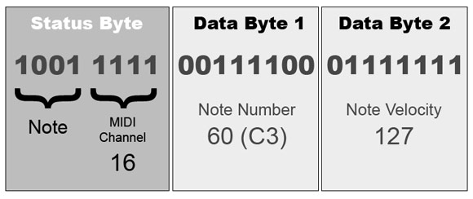
Tech Specs of MIDI
MIDI messages
  Bytes
  Transmitted serially at 31.25 kbit/s
  Start and stop bits added
Notes:
This transmission rate is one of the few remnants of the early days of the standard, being as it was an exact division of 1 MHz, an early microprocessor speed.
The start and stop bits are added for framing purposes, so that means that each message actually requires 10 bits to transfer.

Slide 9
Tech Specs of MIDI
  Channel Messages
      Channel Voice
      Channel Mode
Notes:
Channel Voice = real time performance data on one channel. Ex. Note on, note off, velocity.
Channel mode = controls polyphonic, monophonic, omni and not omni settings, as well as other general reset messages.

Slide 10
Tech Specs of MIDI
System Messages
    System Common
    System Real-Time
    System Exclusive (SysEx)
Notes:
System messages are received by every device in the chain.
System common would be like MIDI time.
System real-time would be for beat synchronization based on the MIDI clock.
System exclusive messages are manufacture proprietary messages. They are part of what makes MIDI so versatile.

Slide 11
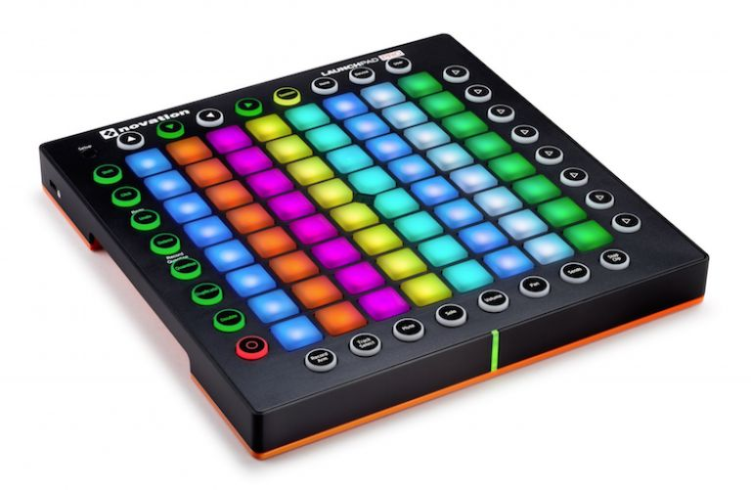
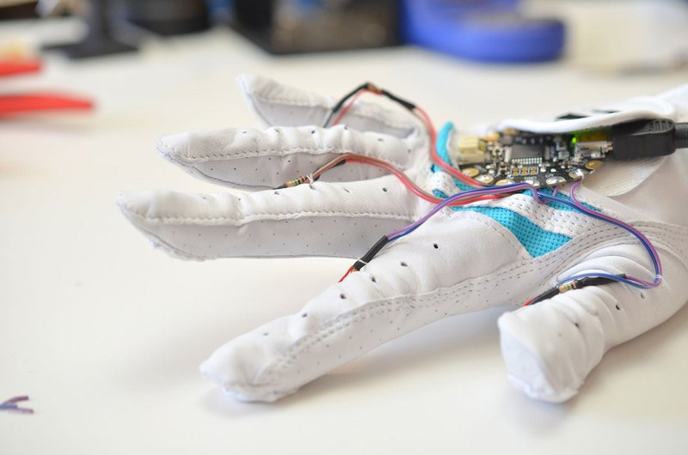
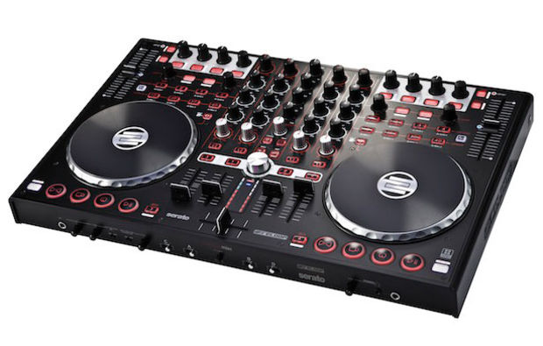
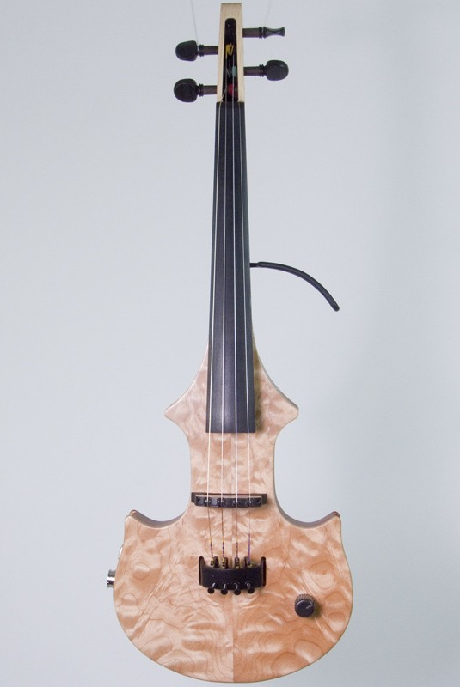
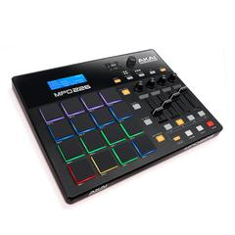
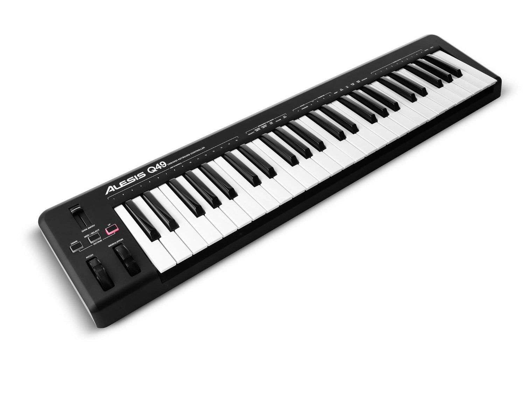
MIDI Hardware
Notes:
Novation Launchpad
AKAI Drum Pads
Alesis Keyboard
MIDI Turntable
MIDI Violin
MIDI Drum Glove

Slide 12



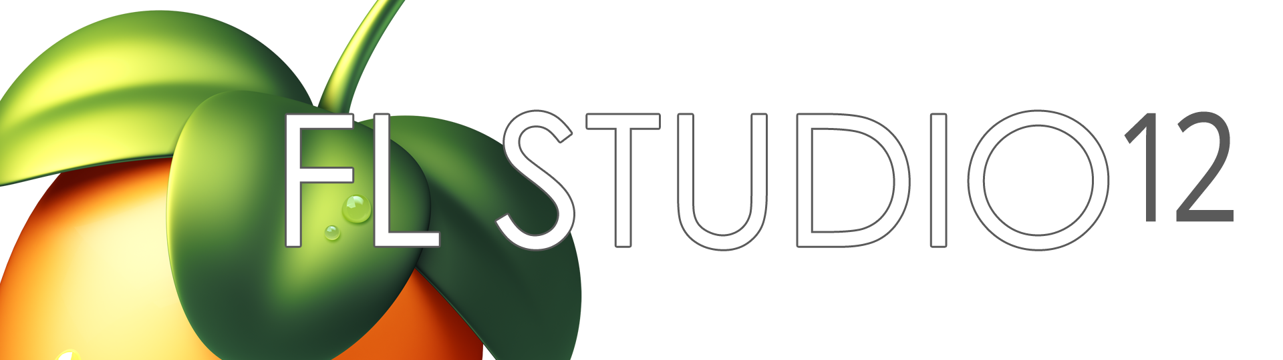
MIDI Software
Notes:
DAWs (Digital Audio Workstations) are the backbone of music production.
Native Instrument Komplete
Ableton Live
Ardour
FL Studio

Slide 13

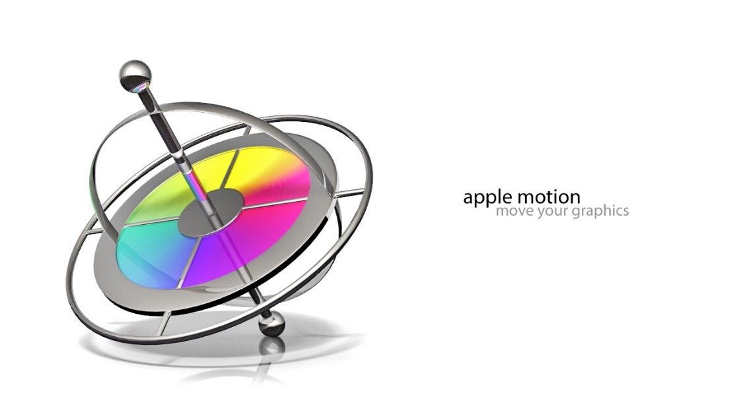

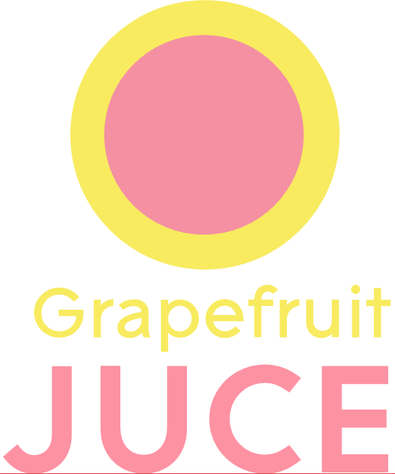

Other MIDI Software
Notes:
Finale – Music Notation Software
Band in a Box – Accompaniment Software
Apple Motion – create animation based on MIDI!
Grapefruit JUCE – Program plugins and instruments for DAWs
LightJams – Synchronize a lightshow using MIDI

Slide 14

MIDI Research
ChucK
    Music Language
    Strongly-timed, On-the-fly
    Ongoing Development
Notes:
ChucK: A Strongly Timed
Computer Music Language
Developed at Stanford
Allows for live coding music performance in a way never implemented before. Allows you to code instruments to be played with MIDI, or even play themselves!

Slide 15
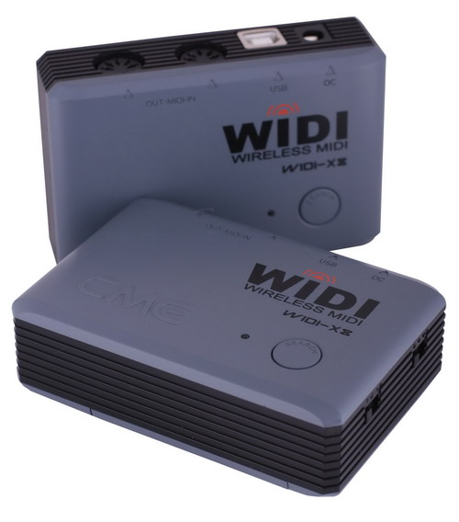
MIDI Research
Wireless MIDI Collaboration
    MIDI Ensembles
    Reactive AI Musicians
    Shared Annotation of Music
Notes:
Paper:
Enabling Collaborative Musical Activities through Wireless Sensor Network
Wireless MIDI is the future. Just like an orchestra can make live music with each other using analog instruments, so too will ensembles be able to use MIDI instruments.
Each instrument will be able to react to the other instruments in the ensemble using wireless sensors and a host application.
Allows for development of AI musicians that will adapt how they play to help accompany the human (or the human can accompany it!)
Could also be used to make the scoring/music annotation process for traditional ensembles more efficient.

Slide 16
Questions?

Slide 17
References
[4]S. Barro, T. Fernández-Caramés and C. Escudero, "Enabling Collaborative Musical Activities through Wireless Sensor Networks", International Journal of Distributed Sensor Networks, vol. 2012, pp. 1-13, 2012.
[1]"MIDI Manufacturers Association Website", Midi.org, 2016. [Online]. Available: https://www.midi.org/. [Accessed: 15- Oct- 2016].
[3]G. Wang, P. Cook and S. Salazar, "ChucK: A Strongly Timed Computer Music Language", Computer Music Journal, vol. 39, no. 4, pp. 10-29, 2015.
[2]"Wikipedia Article on MIDI", En.wikipedia.org, 2016. [Online]. Available: https://en.wikipedia.org/wiki/MIDI. [Accessed: 15- Oct- 2016].

Slide 18
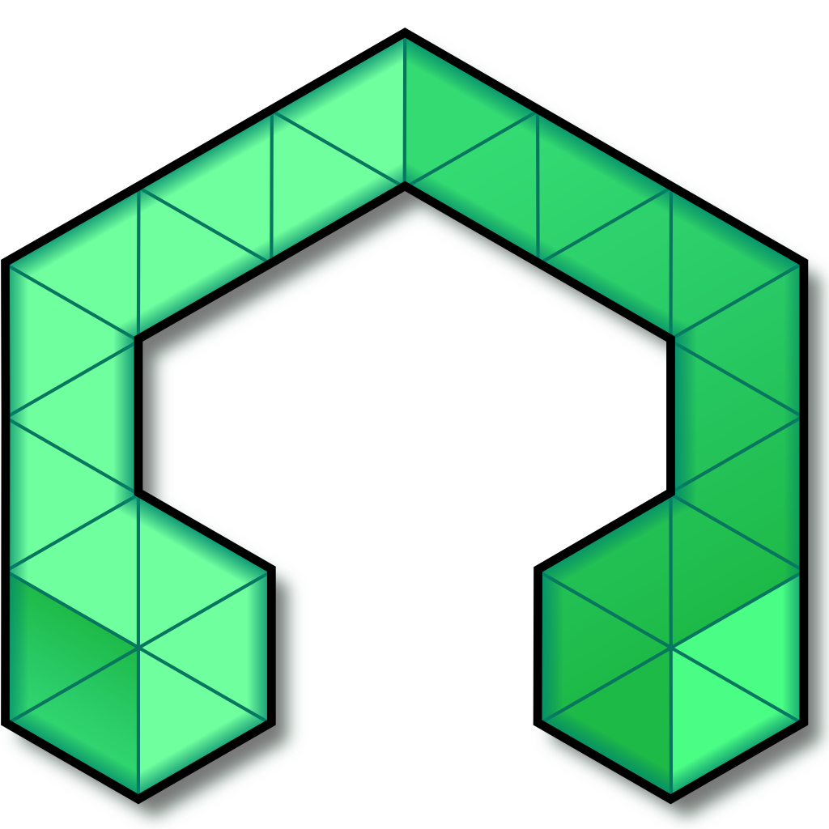
MIDI Demonstration

