Slide 1
A Hierarchical Model for Object-Oriented Design Quality Assessment
Ankita Mohapatra
CS2310 Multimedia Software Engineering

Slide 2
Agenda
Introduction
Background
Overall Approach
Model Development
Model Validation and Results
Conclusion
Discussion

Slide 3
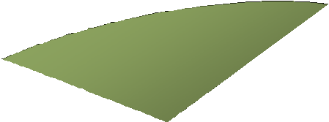
















Introduction
Software Quality
Garvin’s work(1984)
Focus on the software production process
Ex: Built right without rework?
Focus on meeting
user’s needs
Ex: Easy to use,
Available?
Quality Views
User
Product
Focus on the software product itself, its internal characteristics Ex: Well-structured code,
Flexible designs?
Value-based
Quality has become more important with our increasing dependence on software

Slide 4


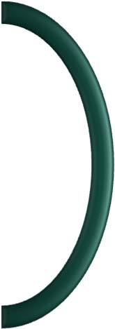


contd…
Software Quality Model
  Assess software quality by measuring its attributes
  Use metrics to obtain objective measurements in numbers
    Product-View assumes: Internal attributes influence external attributes
Reliability? Usability? Flexibility?
…
External
Software Quality Model
Size Abstraction Complexity
…
Internal
METRICS

Slide 5


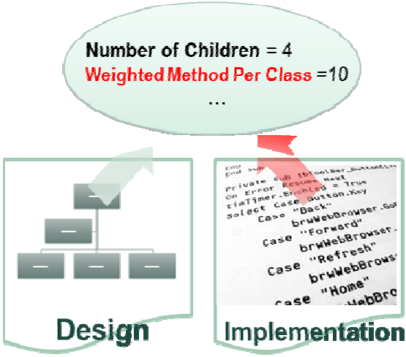
contd…
Previous Work on Quality Models and Metrics
Software Quality Model – ISO 9126
  A hierarchical model, lacking specifics in lower-level details
Suitability
Functionality
Reliability
Usability
Efficiency
Maintainability
Portability
Accuracy
…
…
➔ Little guidance to developers trying to improve quality
Adaptability Conformance
…
Metrics for object oriented software – C.K. Metrics
  Complete measurements only possible after a product is complete
➔ Too late to improve quality

Slide 6
contd…
Motivation
Current models and metrics for object-oriented (OO) design contain ambiguous details that limit applicability
Goal
To develop an improved hierarchical model for OO design quality assessment with
  Lower-level metrics well-defined in terms of design characteristics only

Slide 7

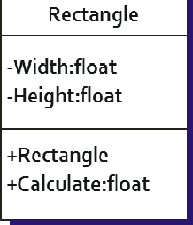

Background
Object-Oriented (OO) Design
  Identify a set of interacting objects to meet requirements
    Components with their own data and operations
  Contain careful structuring of objects required to capture
    Encapsulation, inheritance, polymorphism
Shape
Requirements
Attributes
DESIGN
Objects (classes)
Methods
Implementation
Result: a blueprint for implementation

Slide 8


































Overall Approach
Quality Model for Object-Oriented Design (QMOOD)
Quality= Total Quality Index
Abstract
First Level (L1)
Design Quality Attributes
L12
OO Design Properties
Second Level (L2)
L23
OO Design Metrics
Third Level (L3)
L34
OO Design components
Concrete
Fourth Level (L4)

Slide 9






Model Development
Identifying Design Quality Attributes (L1)
  Abstract concepts that describe desirable characteristics of design
ISO 9126 QMOOD
Functionality
Functionality
Classes that satisfy needs
Effectiveness
Design achieves desired functionality
Functions that satisfy needs
Efficiency
Design Quality Attributes
Performance and resource
OO Design Properties
Maintainability
Understandability
Ease of learning
Effort to make modifications
OO Design Metrics
Portability
Can be transferred
Reliability
Probability of failure
Usability
Effort needed to use
Extendibility
Can incorporate new requirements
Reusability
Can be reapplied to new problem
Flexibility
Can be adapted to new problem
OO Design components

Slide 10


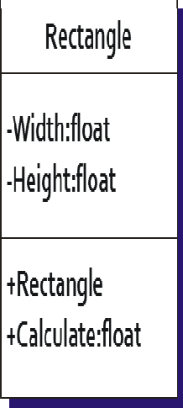





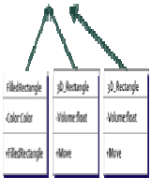
contd…
Identifying Object-Oriented Design Properties (L2)
  Tangible concepts that are directly observable in design
    Describe the internal and external structure of classes
Abstraction
Encapsulation
Coupling
Cohesion
Complexity
Design size
Messaging
Composition
Inheritance
Polymorphism
Class hierarchies
Shape
Design Quality Attributes
OO Design Properties
OO Design Metrics
OO Design components
New design properties introduced by OO approach

Slide 11


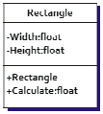
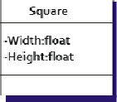


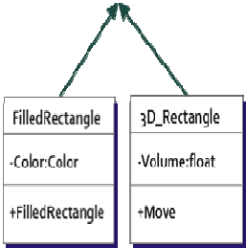


contd…
Identifying Object-Oriented Design Metrics (L3)
  Measurement system for assessing design properties
    States exactly what to count in class definitions and relationships
Design Size in Classes
Number of Hierarchies
Average Number of Ancestors
Number of Polymorphic Methods
Class Interface Size
Number of Methods
Direct Class Coupling
Cohesion Among Methods
Data Access Metric
Measure of Aggregation
Measure Functional Abstraction
Shape
Design Quality Attributes
OO Design Properties
OO Design Properties
OO Design Metrics
OO Design components
New metrics introduced by OO paradigm
DSC = 6
✓ …
✓ ANA = 2.75
✓ …

Slide 12







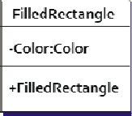
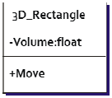
contd…
Object-Oriented Design Components (L4)
  Entities that make up the architecture of an OO design
Contain properties that influence object’s quality
Help analyze an OO design
Name (self-descriptive?) Encapsulation (private or public?) Inheritance (base or derived?)
Design Quality Attributes
…
Objects (classes)
Name Encapsulation Size
Type
…
OO Design Properties
Rectangle
OO Design Metrics
‐Width:float
Attributes
‐Height:float
OO Design Components
Name Encapsulation Parameters Type
…
+Rectangle
Methods
+Calculate:float
Class hierarchies

Slide 13



contd…
Mapping OOD Components to OOD Metrics (L34)
  Identify component properties that are needed by metrics
Name (self-descriptive?) Encapsulation (private or public?) Inheritance (base or derived?)
…
Data Access Metric = number of private attributes to the total number of attributes
Design Quality Attributes
OO Design Properties
Objects (classes)
Design Size in Classes
Number of Hierarchies
Average Number of Ancestors
Number of Polymorphic Methods
Class Interface Size
Number of Methods
Direct Class Coupling
Cohesion Among Methods
Data Access Metric
Measure of Aggregation
Measure Functional Abstraction
Rectangle
OO Design Metrics
‐Width:float
‐Height:float
OO Design Components
+Rectangle
+Calculate:float

Slide 14



contd…
Assigning OOD Metrics to OOD Properties (L23)
  Determine which metric contains information about design property
Number of Classes
Number of Hierarchies
Average Number of Ancestors
Number of Polymorphic Methods
Class Interface Size
Number of Methods
Direct Class Coupling
Cohesion Among Methods
Measure of Aggregation
Measure Functional Abstraction
Data Access Metric
→ Design size
→ Hierarchies
→ Abstraction
→ Polymorphism
→ Messaging
→ Complexity
→ Coupling
→ Cohesion
→ Composition
→ Inheritance
→ Encapsulation
Design Quality Attributes
OO Design Properties
OO Design Metrics
OO Design components
Property of preventing access to attributes by defining them to be private, thus protecting the object
Number of private attributes in the total number of attributes

Slide 15










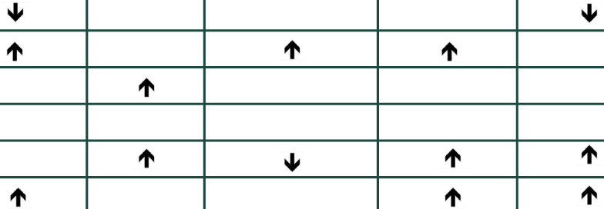






contd…
Linking OOD Properties to Quality Attributes (L12)
  Identify properties’ positive and negative influence on attributes
 | Reusability | Flexibility | Understandability | Functionality | Extendibility | Effectiveness
Design Size
Hierarchies
Abstraction
Encapsulation
Coupling
Cohesion
Composition
Inheritance
Polymorphism
Messaging
Complexity
Design Quality Attributes
OO Design Properties
OO Design Metrics
OO Design components
Weighting the linkages
Qual Attribute Index Computation Equation
Reusability
-0.25*Coupling+0.25*Cohesion+0.5*Messaging+0.5*Design Size
Weights can be experimented with to best reflect organizational objectives.
Flexibility
0.25*Encapsulation-0.25*Coupling+0.5*Composition+0.5*Polymorphism
Understandability
-0.33*Abs+0.33*Enc-0.33*Cou+0.33*Coh-0.33*Pol-0.33*Com-0.33*Des
Functionality
0.12*Cohesion+0.22*Polymorphism+0.22*Messaging+0.22*Design Size+0.22*Hierarchies
Extendibility
0.5*Abstraction-0.5*Coupling+0.5*Inheritance+0.5*Polymorphism
Effectiveness
0.2*Abstraction+0.2*Encapsulation+0.2*Composition+0.2*Inheritance+0.2*Polymorphism

Slide 16
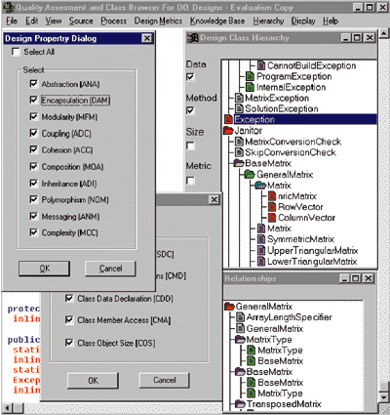

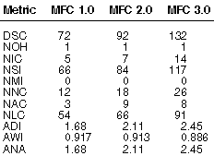

contd….
QMOOD++
  Collects metrics data from components of C++ design
  Automatically carries out the process of measurement in flexible and nonintrusive manner
Design Quality Attributes
OO Design Properties OO Design Metrics
OO Design Components

Slide 17











Model Validation and Results
QMOOD Individual Attribute Validation
  Goal
    Verify quality attribute values are in valid ranges
  Method
Quality=
Total Quality Index
Use QMOOD++ to compute quality attribute values
Compare to expected results
– All quality attributes except for understandability should increase in value (improve) from version to version
Understandability:
Qualities:
Functionality
Effectiveness
• …
Ver 1.0
Ver 2.0
Ver 3.0
Ver 4.0
Ver 5.0
Microsoft Foundation Classes (MFC)
And 4 versions of Borland Object Windows Library (OWL)

Slide 18




contd…
QMOOD Individual Attribute Validation
Results
  Normalized Metric Values for MFC and OWL Frameworks
Metric | MFC 1.0 | MFC 2.0 | MFC 3.0 | MFC 4.0 | MFC 5.0 | OWL 4.0 | OWL 4.5 | OWL 5.0 | OWL 5.2
Design Size | 1.00 | 1.28 | 1.83 | 2.86 | 3.24 | 1.00 | 1.73 | 4.35 | 4.34
Hierarchies | 1.00 | 1.00 | 1.00 | 5.00 | 6.00 | 1.00 | 1.33 | 2.42 | 2.25
Abstraction | 1.00 | 1.26 | 1.46 | 1.39 | 1.37 | 1.00 | 0.97 | 1.56 | 1.55
Encapsulation | 1.00 | 0.79 | 0.88 | 0.92 | 0.94 | 1.00 | 0.94 | 0.88 | 0.89
Modularity | 1.00 | 1.13 | 1.15 | 1.21 | 1.28 | 1.00 | 1.01 | 1.04 | 1.04
Coupling | 1.00 | 1.26 | 1.50 | 1.55 | 1.48 | 1.00 | 1.21 | 2.53 | 2.52
Cohesion | 1.00 | 0.74 | 0.81 | 0.79 | 0.83 | 1.00 | 1.00 | 1.00 | 1.00
Aggregation | 1.00 | 3.46 | 5.27 | 5.23 | 5.49 | 1.00 | 1.90 | 3.85 | 3.72
Inheritance | 1.00 | 5.39 | 6.55 | 7.61 | 7.57 | 1.00 | 0.92 | 1.06 | 1.06
Polymorphism | 1.00 | 2.66 | 2.83 | 4.14 | 4.19 | 1.00 | 1.66 | 3.71 | 3.59
Messaging | 1.00 | 1.81 | 2.23 | 2.65 | 2.55 | 1.00 | 0.95 | 1.83 | 1.80
Complexity | 1.00 | 1.70 | 2.13 | 2.56 | 2.44 | 1.00 | 0.87 | 1.34 | 1.33
Computed Quality Attribute Indices for MFC and OWL
Index Computation Equation
Reusability = -0.25*Coupling
+0.25*Cohesion +0.5*Messaging
+0.5*Design Size
Quality Index | MFC 1.0 | MFC 2.0 | MFC 3.0 | MFC 4.0 | MFC 5.0 | OWL 4.0 | OWL 4.5 | OWL 5.0 | OWL 5.2
Reusability | 1.00 | 1.41 | 1.86 | 2.57 | 2.73 | 1.00 | 1.29 | 2.71 | 2.69
Flexibility | 1.00 | 2.94 | 3.89 | 4.53 | 4.71 | 1.00 | 1.72 | 3.37 | 3.24
Understandability | -0.99 | -2.18 | -2.66 | -3.56 | -3.61 | -0.99 | -1.48 | -3.83 | -3.77
Functionality | 1.00 | 1.57 | 1.83 | 3.32 | 3.61 | 1.00 | 1.37 | 2.83 | 2.76
Extendibility | 1.00 | 4.03 | 4.67 | 5.80 | 5.82 | 1.00 | 1.17 | 1.90 | 1.84
Effectiveness | 1.00 | 2.71 | 3.40 | 3.86 | 3.91 | 1.00 | 1.28 | 2.21 | 2.16

Slide 19
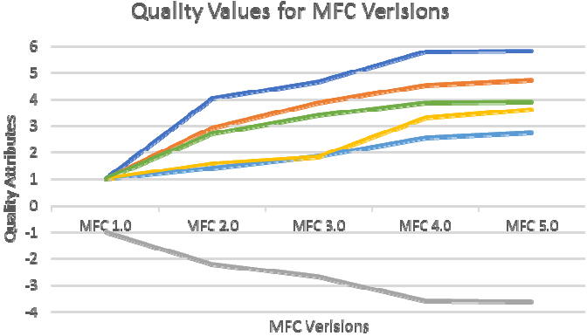
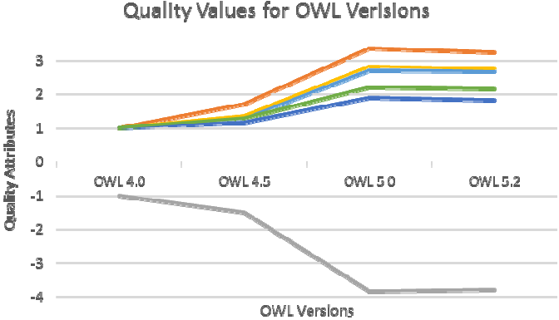
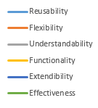
contd…
QMOOD Individual Attribute Validation
  Plots
Agreement with the expected results
All quality attribute values increased with new versions, except for Understandability.
Understandability decreases significantly and levels off

Slide 20
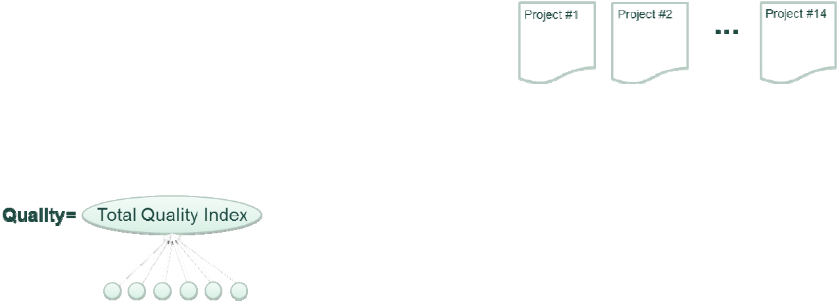





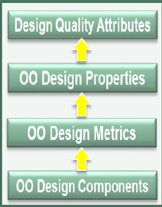











contd…
QMOOD Validation
  Goal:
    See how well QMOOD predicts the “overall quality” of an OO software design
  Method
A suite of 14 C++ projects developed for the same set of requirements by different people
QMOOD
Human evaluators
#1
#2
…
#13
…
…
Rankings
Perform correlation analysis

Slide 21

contd…
QMOOD Validation
  Results
Project | QMOOD | E1 | E2 | E3 | E4 | E5 | E6 | E7 | E8 | E9 | E10 | E11 | E12 | E13
1 | 13 | 12 | 9 | 11 | 11 | 13 | 12 | 12 | 13 | 13 | 13 | 11 | 8 | 9
2 | 9 | 13 | 12 | 12 | 12 | 12 | 6 | 13 | 6 | 10 | 12 | 12 | 12 | 10
3 | 3 | 2 | 6 | 2 | 1 | 7 | 1 | 4 | 1 | 2 | 7 | 4 | 2 | 4
4 | 12 | 9 | 7 | 9 | 10 | 2 | 9 | 10 | 9 | 6 | 11 | 10 | 5 | 6
5 | 1 | 1 | 1 | 1 | 2 | 1 | 7 | 1 | 2 | 1 | 2 | 2 | 3 | 2
6 | 5 | 8 | 11 | 10 | 7 | 9 | 11 | 6 | 12 | 11 | 9 | 3 | 11 | 12
7 | 11 | 4 | 13 | 13 | 13 | 8 | 13 | 11 | 8 | 12 | 4 | 1 | 13 | 8
8 | 8 | 3 | 8 | 9 | 8 | 11 | 10 | 9 | 10 | 8 | 3 | 7 | 6 | 11
9 | 7 | 5 | 10 | 7 | 9 | 10 | 3 | 5 | 4 | 5 | 6 | 6 | 7 | 7
10 | 2 | 6 | 2 | 3 | 3 | 4 | 5 | 2 | 3 | 3 | 1 | 5 | 1 | 5
11 | 4 | 11 | 3 | 5 | 6 | 5 | 8 | 3 | 11 | 9 | 8 | 8 | 10 | 13
12 | 6 | 7 | 5 | 6 | 4 | 3 | 2 | 8 | 5 | 7 | 5 | 9 | 9 | 3
13 | 10 | 10 | 4 | 4 | 5 | 6 | 4 | 7 | 7 | 4 | 10 | 13 | 4 | 4
14 | 14 | 14 | 14 | 14 | 14 | 14 | 14 | 14 | 14 | 14 | 14 | 14 | 14 | 14
Close agreement between the assessments done by the evaluators
Results Comparison: Spearman’s rank coefficient
6 ∑ d²
^{rs = 1 —} n(n² — 1)
r_{s} X 0.55 means significant
QMOOD had statistically significant correlations with 11 of 13 evaluators
Evaluator | 1 | 2 | 3 | 4 | 5 | 6 | 7 | 8 | 9 | 10 | 11 | 12 | 13
r_s | 0.60 | 0.68 | 0.80 | 0.85 | 0.56 | 0.57 | 0.91 | 0.66 | 0.69 | 0.70 | 0.63 | 0.53 | 0.43
r_s > 0.55 | Y | Y | Y | Y | Y | Y | Y | Y | Y | Y | Y | N | N

Slide 22
Conclusion
Presented and empirically validated a hierarchical model for assessing quality of object-oriented designs based on well-defined lower-level design metrics.
Offered a tool, QMOOD++, that is nonintrusive, flexible, and applicable to real-world projects

Slide 23
Discussion
Pros
Empirical validation using human assessment
Model supported by an automated tool
Cons
Unclear mapping from the components to the metrics
Lack of explanation in index computation equations
Limited set of projects for model validation

Slide 24
THANK YOU

