Slide 1
Genetic Algorithm in TDR System
Mahbaneh Eshaghzadeh Torbati

Slide 2
Outline:
Genetic algorithms
TDR system
Using GA in TDR system.

Slide 3
Genetic Algorithm overview:
A class of probabilistic optimization algorithms.
Inspired by the biological evolution process.
Uses concepts of “Natural Selection” and “Genetic Inheritance” (Darwin 1859).
Originally developed by John Holland (1975).
Particularly well suited for hard problems where little is known about the underlying search space.
Widely-used in business, science and engineering.

Slide 4
Genetic Algorithm Definition:
A genetic algorithm maintains a population of candidate solutions for the problem at hand, and makes it evolve by iteratively applying a set of stochastic operators
parents
selection
modification
modified
offspring
initiate &
population
evaluation
evaluate
evaluated offspring
deleted
members
discard

Slide 5
The Metaphor:
Nature | Genetic Algorithm
Environment | Optimization problem
Individuals living in that environment | Feasible solutions
Individual’s degree of adaptation to its surrounding environment | Solutions quality (fitness function)

Slide 6
The Metaphor:
Nature | Genetic Algorithm
A population of organisms (species) | A set of feasible solutions
Selection, recombination and mutation in nature’s evolutionary process | Stochastic operators
Evolution of populations to suit their environment | Iteratively applying a set of stochastic operators on a set of feasible solutions

Slide 7
Representation
Phenotype space
Genotype space = {0,1}^{L}
Encoding
(representation)
10010001
10010010
010001001
011101001
Decoding
(inverse representation)

Slide 8
Stochastic operators
Fitness function Numerical function estimate the quality of each individual.
Selection replicates the most successful solutions found in a population at a rate proportional to their relative quality. We have two kinds of selection: Parent selection and survivor selection.
Recombination decomposes two distinct solutions and then randomly mixes their parts to form novel solutions.
Mutation randomly perturbs a candidate solution.

Slide 9
Simple Genetic Algorithm:
Representation | Binary strings
Recombination | N-point crossover
Mutation | Bitwise bit-flipping with fixed probability
Parent selection | Fitness function estimate
Survivor selection | All children replace parents

Slide 10
Simple Genetic Algorithm
produce an initial population of individuals
evaluate the fitness of all individuals
while termination condition not met do
select fitter individuals for reproduction
recombine between individuals
mutate individuals
evaluate the fitness of the modified individuals
generate a new population
End while

Slide 11
Example: The MAXONE problem
Suppose we want to maximize the number of ones in a string of L binary digits
Is it a trivial problem?
It may seem so because we know the answer in advance
However, we can think of it as maximizing the number of correct answers, each encoded by 1, to L yes/no difficult questions`

Slide 12
Example: Representation and Fitness Function
An individual is encoded (naturally) as a string of l binary digits
The fitness f of a candidate solution to the MAXONE problem is the number of ones in its genetic code
We start with a population of n random strings. Suppose that l = 10 and n = 6

Slide 13
Example: Population Initialization
We toss a fair coin 60 times and get the following initial population:
s₁ = 1111010101 f (s₁) = 7
s₂ = 0111000101 f (s₂) = 5
s₃ = 1110110101 f (s₃) = 7
s₄ = 0100010011 f (s₄) = 4
s₅ = 1110111101 f (s₅) = 8
s₆ = 0100110000 f (s₆) = 3

Slide 14
Example: Selection
Suppose that, after performing selection, we get the following population:
s₁` = 1111010101 (s₁)
s₂` = 1110110101 (s₃)
s₃` = 1110111101 (s₅)
s₄` = 0111000101 (s₂)
s₅` = 0100010011 (s₄)
s₆` = 1110111101 (s₅)

Slide 15
Example: Crossover1
Next we mate strings for crossover. For each couple we decide according to crossover probability (for instance 0.6) whether to actually perform crossover or not.
Suppose that we decide to actually perform crossover only for couples (s1`, s2`) and (s5`, s6`). For each couple, we randomly extract a crossover point, for instance 2 for the first and 5 for the second

Slide 16
Example: Crossover2
Before crossover:
s₁` = 1111010101
s₂` = 1110110101
s₅` = 0100010011
s₆` = 1110111101
After crossover:
s₁`` = 1110110101
s₂`` = 1111010101
s₅`` = 0100011101
s₆`` = 1110110011

Slide 17
Example: mutation
The final step is to apply random mutation: for each bit that we are to copy to the new population we allow a small probability of error (for instance 0.1)
Before applying mutation:
s₁`` = 1110110101 s₁``` = 1110100101 f (s₁``` ) = 6
s₂`` = 1111010101 s₂``` = 1111110100 f (s₂``` ) = 7
s₃`` = 1110111101 s₃``` = 1110101111 f (s₃``` ) = 8
s₄`` = 0111000101 s₄``` = 0111000101 f (s₄``` ) = 5
s₅`` = 0100011101 s₅``` = 0100011101 f (s₅``` ) = 5
s₆`` = 1110110011 s₆``` = 1110110001 f (s₆``` ) = 6

Slide 18
Example: Result of First Iteration.
In one generation, the total population fitness changed from 34 to 37, thus improved by ~9%
At this point, we go through the same process all over again, until a stopping criterion is met

Slide 19
TDR system:
The TDR system consists of multi-level super-components each with different computation cycles specified by an abstract machine model. The TDR system has three major super-components: Tian (Heaven), Di (Earth) and Ren (Human), which are the essential ingredients of a human-centric psycho-physical system following the Chinese philosophy. This experimental TDR system provides a platform for exploring novel visual languages and interaction patterns among different super-components in personal health care, emergency management and social networking.

Slide 20
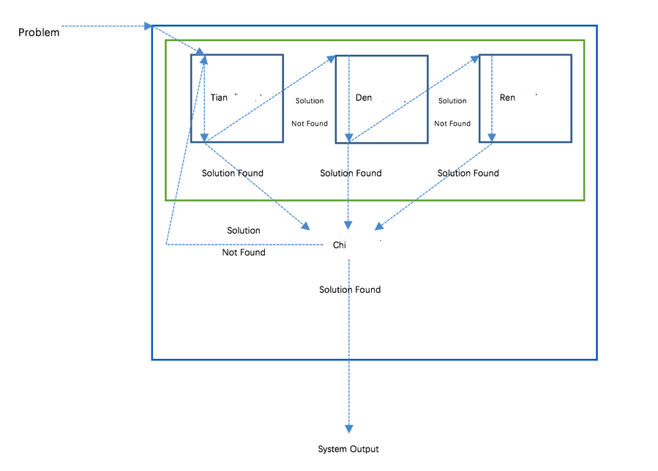
TDR system:
Cycle1 [guard1,1]: P¹0 -enum< = P¹1 -enum< = P¹2 >conc= P¹3
(Recombination) (Mutation) (Selection)

Slide 21
Genetic Design For TDR system
Representation: Integer string of features.
Fitness function: Patient health level.
The goal is reaching value zero.
Euclidean distance between the goal and the individual.
Initialization: 50 individual of length 30.
Recombination: One point cross over.
Mutation: Replace worst individual with a new individual.
Parent selection: Randomly assign parents.
Survivor selection: Best individuals from Parents and offspring.

Slide 22
Result:
Initial Health Level: 70814.391484
Chi supercomponent Iteration: ( 0 )
    Tian Component: Selected cycle is "GA" Health level is: 66137.180321 ( success )
    Den Component: Selected cycle is "GA" Health level is: 52086.854157 ( success )
    Ren Component: Selected cycle is "GA" Health level is: 41148.0256807 ( success )
Chi supercomponent Iteration: ( 41 )
    Tian Component: Selected cycle is "GA" Health level is: 7901.81056381 ( Failure )
    Den Component: Selected cycle is "GA" Health level is: 7901.81056381 ( Failure )
    Ren Component: Selected cycle is "GA" Health level is: 7901.81056381 ( Failure )
    Chi supercomponent Iteration: ( 181 )
    Tian Component: Selected cycle is "GA" Health level is: 75.7582860922 ( success )
    Den Component: Selected cycle is "GA" Health level is: 75.7582860922 ( Failure )
    Ren Component: Selected cycle is "GA" Health level is: 75.7582860922 ( Failure )
    Chi supercomponent Iteration: ( 313 )
    Tian Component: Selected cycle is "GA" Health level is: 0.0063399450953 ( success )
    Den Component: Selected cycle is "GA" Health level is: 0.0063399450953 ( Failure )
    Ren Component: Selected cycle is "GA" Health level is: 0.0063399450953 ( Failure )

Slide 23
References:
[1] Sastry, K., Goldberg, D.E. and Kendall, G., 2014. Genetic algorithms, Chapter 4. In Search methodologies (pp. 93-117). Springer US.
[2] Reeves, C., 2003. Genetic algorithms, Chapter 3. In Handbook of metaheuristics (pp. 55-82). Springer US.
[3] Tang, Y., Zhang, H., Liang, Z. and Chang, S.K., Social Network Models for the TDR System.

Slide 24
Thank You!

