Slide 1
Personal Home Healthcare System for the Cardiac Patient of Smart City Using Fuzzy Logic
Shijia Liu

Slide 2
Overview
Introduction
Related Work
Internet of Things for Healthcare
Data Collection from Sensors
Model of Fuzzy Expert System for Cardiac Disease Medical Diagnosis
Fuzzy Scheme for Cardiac Disease Diagnosis
Inference Mechanism and System Output
Conclusion

Slide 3
Introduction
The quality of life of residents is an important objective of smart cities, and the daily mobile health care service become more and more important for the solitary people ( disabled and elderly people).
Chronic diseases such as cardiovascular and cerebrovascular diseases affect people’s daily life a lot.
Since 1900, the cardiovascular disease is the foremost cause of death in the United States and Europe. More than ten million people are affected in Europe, one million in the US, and twenty two million people in the world. The number is expected to be triple by 2020.

Slide 4
Introduction
Expenditure: The Health care expenditure in US is expected to increase from $2.9 trillion in 2009 to $4 trillion in 2015. The future health crisis attracts the researchers, industrialists, and economists towards optimal and rapid health solutions.
The needs of patient in-home health-care, and changes in health care towards the more cost–effective approaches.
The Cardiac disease patient compulsory require their continuous health monitoring.

Slide 5
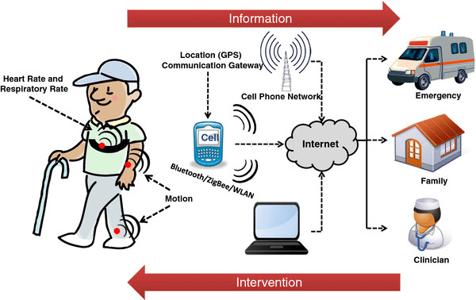
Remote Health Monitoring System
A remote health monitoring system is mainly is made up of portable, wearable and battery pack powered sensing unit that’s assigned with the task of sensing a variety of physical parameters of the human body.

Slide 6
Related Work
Various researched works using portable sensors along with communication technologies:
  Using a physician equipment that interactively monitors the patient’s health by asking the sufferer questions and getting answers to those people question.
  A technique of monitoring patients within their own homes using electronic devices and wireless technology.
  A centralized checking station that receives data from remote patients using mobile phone lines and allows medical procedures to be administered.

Slide 7
Related Work
Our purposed system mainly focuses on the patients with chronic heart disease who are in stable conditions.
The major objective of the system is to provide the 24/7 health monitoring.
This paper design the model that efficiently utilized the wearable battery powered sensors unit and fuzzy scheme to diagnosis the health parameter for the chronic cardiac diseases.

Slide 8
Internet of Things for Healthcare
loT:
  The IoT is a new era of intelligence computing and it’s providing a privilege to communicate around the world.
  The objective of IoT is anything, anyone, any place, any service and any network. IoT enabled objects to communicate with each other, access information over the Internet, and interact with users creating smart, pervasive and always connected environments.
  loT enabled patients can be accessed over the Internet and by other machines, the health condition of a patient can be monitored uninterruptedly, allowing critical illness to be detected at the right time so that proper actions can be taken.

Slide 9
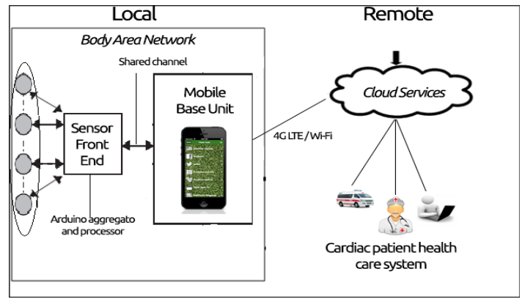
Architecture of health-care System
Two parts:
(a) Local: local part deals with collection of information from the sensors connected to a patient.
(b) Remote: the remote part enables storing and distributing the data to remote service seekers like emergency service providers, doctors, and insurance providers.
Arduino-based data aggregator processes the collected raw data to generate meaningful information’s that can be understood by specialists and doctors. Then, it displays the processed information and sends it to the remote servers.

Slide 10
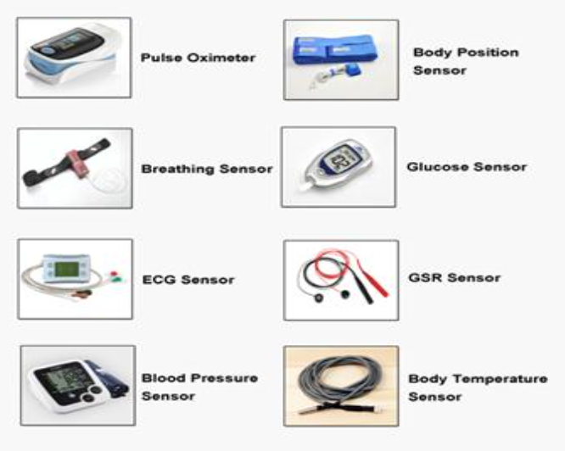
Data Collection from Sensors
Health-care applications need to acquire different types of sensor-data.
When health sensor-data are forwarded to the data aggregator node, more sensing data may be accumulated along the route. Traffic.
Huge amount of data may lead to burdened payload, the latency for data collection becomes longer.
Concept: Crisp input – Fuzzy output – Crisp output

Slide 11
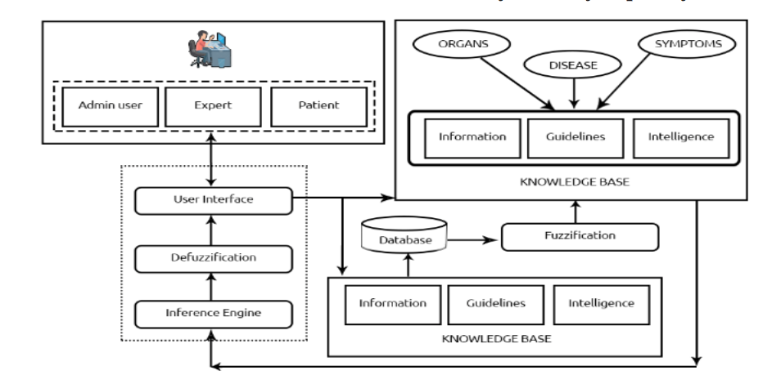
Model of Fuzzy Expert System for The Cardiac Disease Medical Diagnosis
Primarily it consists of GUI, knowledge base and inference engine modules.
The patient data is stored in a database and knowledge is retrieved from the knowledge base by matching the symptoms and some fuzzy rules.
In knowledge base to make the decision as the disease name or the risk of the disease.
Model of proposed fuzzy expert system

Slide 12
Fuzzy Scheme for Cardiac Disease Diagnosis
The input variables considered are blood pressure, blood oxygen, body temperature, ECG, heart rate, respiration rate etc.
Membership values are assigned to the linguistic variables such as symptoms low, medium, high and very high.
Decision: which sensor is required to be activated and when it is required to be activated.
The system activates few sensors which record some basic parameters of the human body.
All data are fed into the fuzzifier. Fuzzifier is used to detect whether the parameters are normal, low or high.(By some predefined membership functions)

Slide 13
Fuzzy Scheme for Cardiac Disease Diagnosis
The output from the fuzzy system is used to detect if the heart condition is bad, critical or normal. Depending on these fuzzy output, the actions and alerts like starting the ECG, alerting heart specialist etc. are generated.

Slide 14
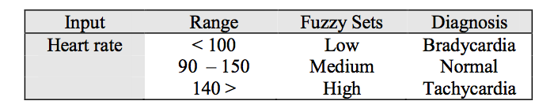
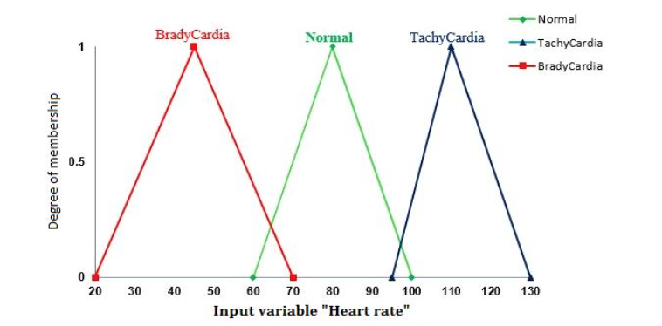
Membership Function of Heart Rate
The average heart rate ranges from 60 to 100 beats per minute. Here, the heart rate parameter range is divided into three fuzzy sets, namely, ‘low’, ‘medium’ and ‘high’.

Slide 15
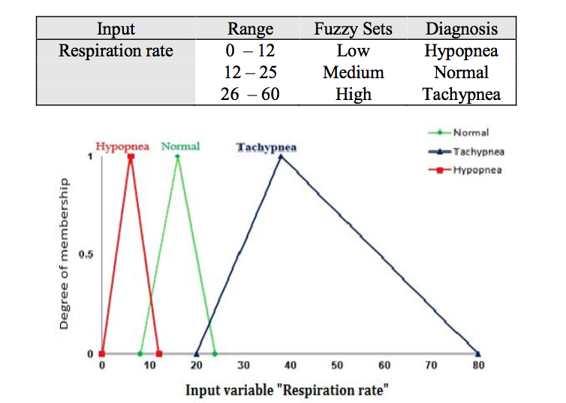
Membership function of respiration rate
A human being has a normal respiration rate between 9 and 23 breaths per minute.
A respiration rate below 9 is considered as low and a respiration rate above 25 is considered high.

Slide 16
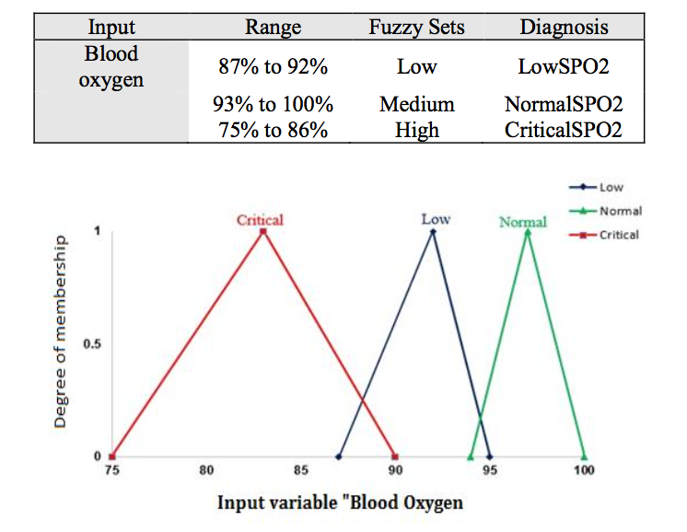
Membership function of blood oxygen
The blood oxygen sensor reads the percentage of oxygen in the blood. Normal range is 93 and above. Percentage of oxygen between 87 and 92 is taken as low and below 86 is considered as critical.

Slide 17
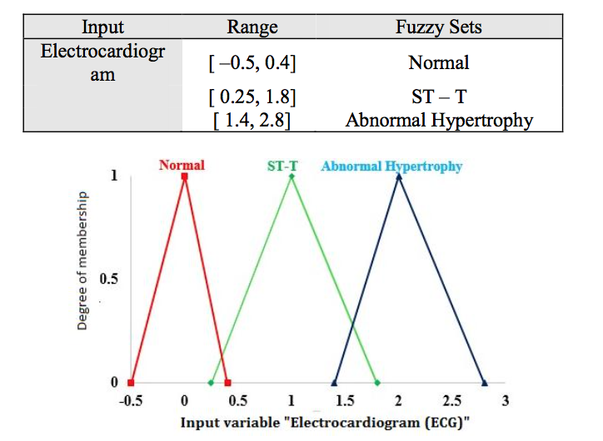
Membership function of ECG
Electrocardiogram (ECG) is a test that measures the electrical activity of the heart. It uses ultrasound to evaluate the heart muscle, heart valves, and risk for the heart disease. ECG parameter range is divided into three fuzzy sets, namely, ‘Normal’, ‘ST-T Normal’ and ‘Hypertrophy’.

