Slide 1
Hidden Database Sampling
Haoran Zhang

Slide 2
Outline
Introduction
Problem & Task
Preliminaries
Random Walk Based Sampling
Extensions
Experiments Results
Conclusion

Slide 3
Introduction

Slide 4
Hidden Databases
A large portion of data available on the web is present in the so called “deep web”.
Query interfaces allow external users to browse these databases in a controlled manner.
Typically users provide inputs in the form interface which are then translated into SQL queries for execution and results provided to the user on the browser.

Slide 5
Hidden Databases
The interfaces allows users to specify range conditions on various attributes.
However, instead of returning all satisfying tuples, such interfaces restrict the returned results to only a few tuples, sorted by a suitable ranking function.
Alert the user if there was an “overflow”.

Slide 6
Problem & Task

Slide 7
Problem
Given such restricted query interfaces, how can one efficiently obtain a uniform random sample of the backed database by only accessing the database via the public front end interface?
Notes:
Database sampling is the process of randomly selecting tuples from a database and is useful in gathering statistical information about the data. Extremely useful to third-party applications in obtaining insight into the hidden data.

Slide 8
Task
Sample bias: Produce samples that have small bias.
Efficiency: Design an efficient sampling procedure that executes as few queries as possible.
Notes:
Sample bias: Due to the restricted nature of the interface, it is challenging to produce samples that are truly uniform random samples. Consequently, the task is to …
Efficiency: We measure efficiency of the sampling process by the number of queries that need to be excused via the interface in order to collect a sample of a desired size. The task is to …

Slide 9
Preliminaries

Slide 10
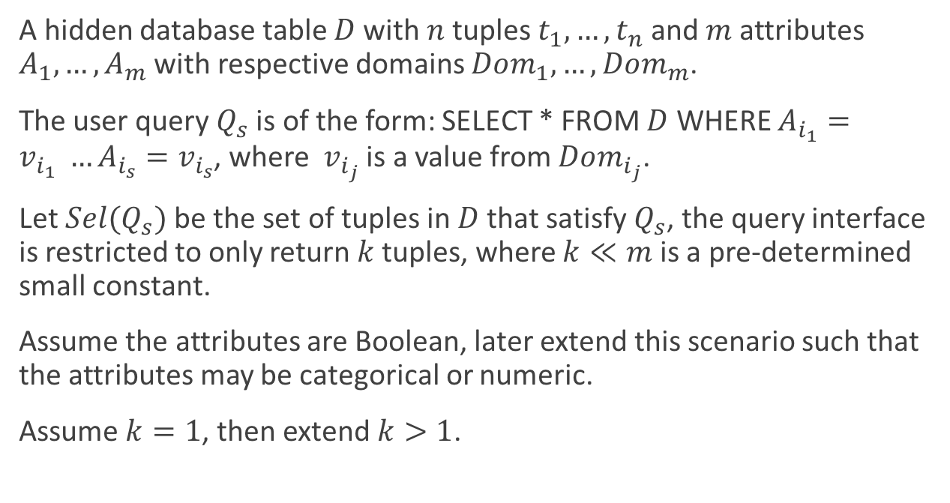
Models of Hidden Databases
A hidden database table $D$ with $n$ tuples $t_{1},…,t_{n}$ and $m$ attributes $A_{1},…,A_{m}$ with respective domains $Dom_{1},…,Dom_{m}$.
The user query $Q_{s}$ is of the form: SELECT * FROM $D$ WHERE $A_{i_{1}}=v_{i_{1}} …A_{i_{s}}=v_{i_{s}}$, where $v_{i_{j}}$ is a value from $Dom_{i_{j}}$.
Let $Sel(Q_{s})$ be the set of tuples in $D$ that satisfy $Q_{s}$, the query interface is restricted to only return $k$ tuples, where $k≪m$ is a pre-determined small constant.
Assume the attributes are Boolean, later extend this scenario such that the attributes may be categorical or numeric.
Assume $k=1$, then extend $k>1$.
Notes:
Assume a simple discretization of numerical data to resemble categorical data.
The table is only accessible to users through a web interface. User can query the database by specifying values for a sub set of attributes.

Slide 11

Models of Hidden Databases
Overflow query: The query is too broad, not all tuples satisfying $Q_{s}$ can be returned.
Underflow query: The query is too specific and returns no tuple.
Valid query: Neither overflow nor underflow

Slide 12
Brute Force Sampler
Generate a random Boolean tuple of m-bit, and query the interface to determine whether such a tuple exists.
Two possible outcomes: either the query underflows, or else it returns a valid result.
The sampler repeats these randomly generate queries until a tuple is returned.
Notes:
Perfect uniform random sample, but this is an extremely inefficient process.

Slide 13
Random Walk Based Sampling

Slide 14
Random Walk Based Sampling
Modification to Brute Force Sampler.
Improving Efficiency: Early Detection of Underflows and Valid Tuples
Reducing Skew: Random Ordering of Attributes
Reducing Skew: Acceptance/Rejection Sampling

Slide 15
Early Detection of Underflows and Valid Tuples
Instead of taking the random walk all the way until we reach a leaf and then making a single query, what if we make queries while we are coming down the path?

Slide 16
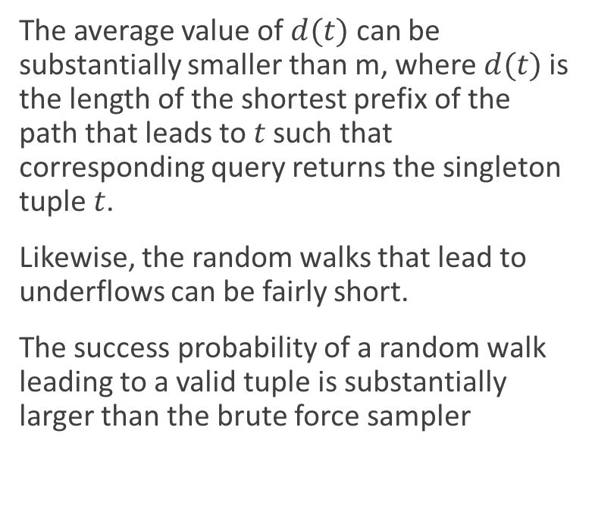
Early Detection of Underflows and Valid Tuples
The average value of $d(t)$ can be substantially smaller than m, where $d(t)$ is the length of the shortest prefix of the path that leads to $t$ such that corresponding query returns the singleton tuple $t$.
Likewise, the random walks that lead to underflows can be fairly short.
The success probability of a random walk leading to a valid tuple is substantially larger than the brute force sampler
Notes:
We will rarely have to go all the way to the leaves.

Slide 17

Early Detection of Underflows and Valid Tuples
Note that the success probability of brute force sampler is $\frac{n}{2^{m}}$, which is significantly smaller because it depends upon m.
Notes:
We will rarely have to go all the way to the leaves.

Slide 18
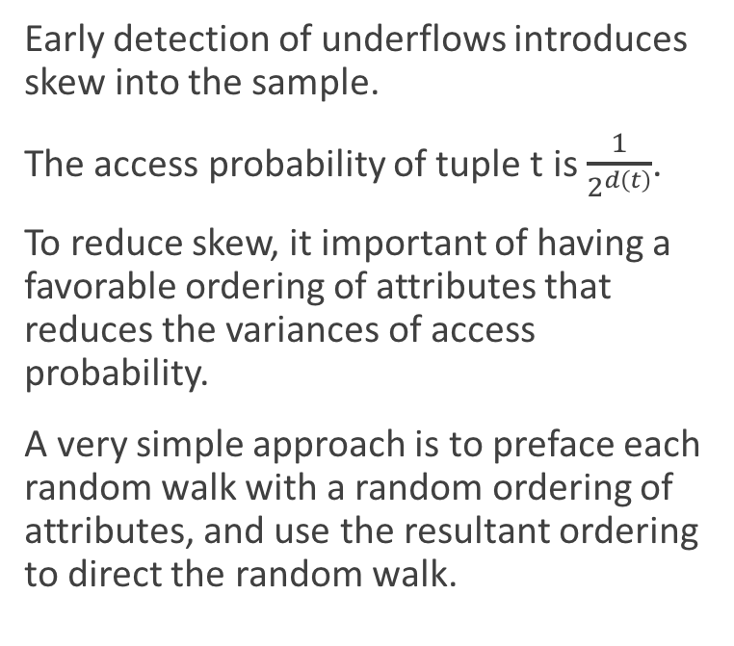
Random Ordering of Attribute
Early detection of underflows introduces skew into the sample.
The access probability of tuple t is $\frac{1}{2^{d\left(t\right)}}$.
To reduce skew, it important of having a favorable ordering of attributes that reduces the variances of access probability.
A very simple approach is to preface each random walk with a random ordering of attributes, and use the resultant ordering to direct the random walk.
Notes:
Thus the probability that a tuple is selected depends very strongly on its depth, and the sampling procedure has a strong bias towards rows with small depth, i.e., towards tuples that are separated from others by short query prefixes.

Slide 19
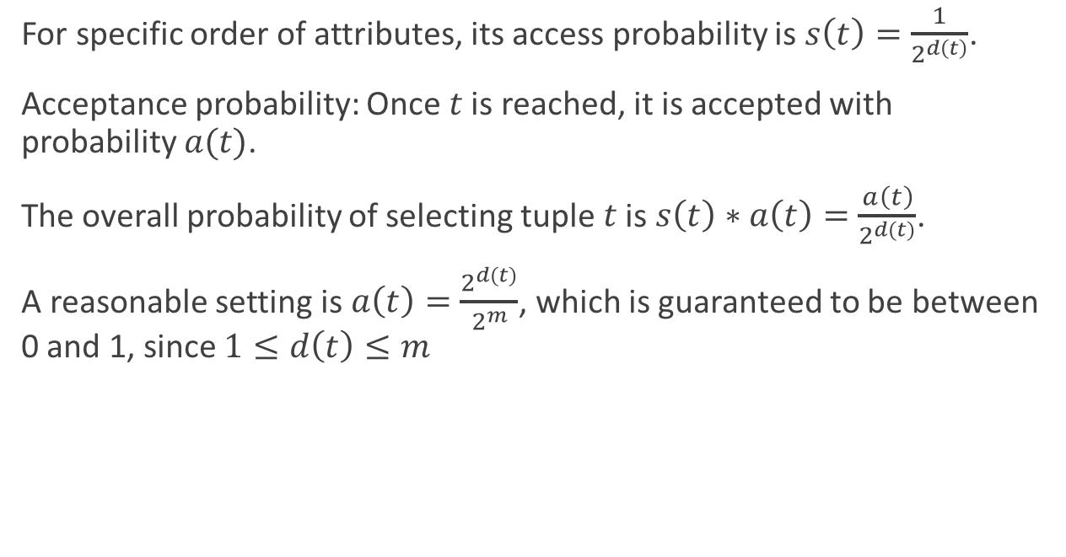
Acceptance/Rejection Sampling
For specific order of attributes, its access probability is $s\left(t\right)=\frac{1}{2^{d\left(t\right)}}$.
Acceptance probability: Once $t$ is reached, it is accepted with probability $a(t)$.
The overall probability of selecting tuple $t$ is $s\left(t\right)∗a\left(t\right)=\frac{a\left(t\right)}{2^{d\left(t\right)}}$.
A reasonable setting is $a\left(t\right)=\frac{2^{d\left(t\right)}}{2^{m}}$, which is guaranteed to be between 0 and 1, since $1≤d\left(t\right)≤m$
Notes:
Produce unbiased samples

Slide 20
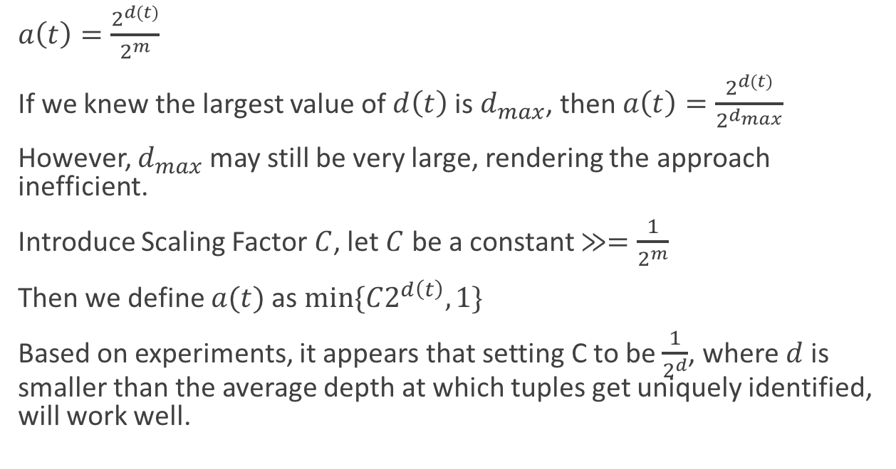
Acceptance/Rejection Sampling
$a\left(t\right)=\frac{2^{d\left(t\right)}}{2^{m}}$
If we knew the largest value of $d\left(t\right)$ is $d_{max}$, then $a\left(t\right)=\frac{2^{d\left(t\right)}}{2^{d_{max}}}$
However, $d_{max}$ may still be very large, rendering the approach inefficient.
Introduce Scaling Factor $C$, let $C$ be a constant $≫=\frac{1}{2^{m}}$
Then we define $a(t)$ as $min⁡\{C2^{d\left(t\right)},1\}$
Based on experiments, it appears that setting C to be $\frac{1}{2^{d}}$, where $d$ is smaller than the average depth at which tuples get uniquely identified, will work well.
Notes:
Produce unbiased samples, but possibly more efficiently, because dmax may smaller than m.

Slide 21
Extensions

Slide 22
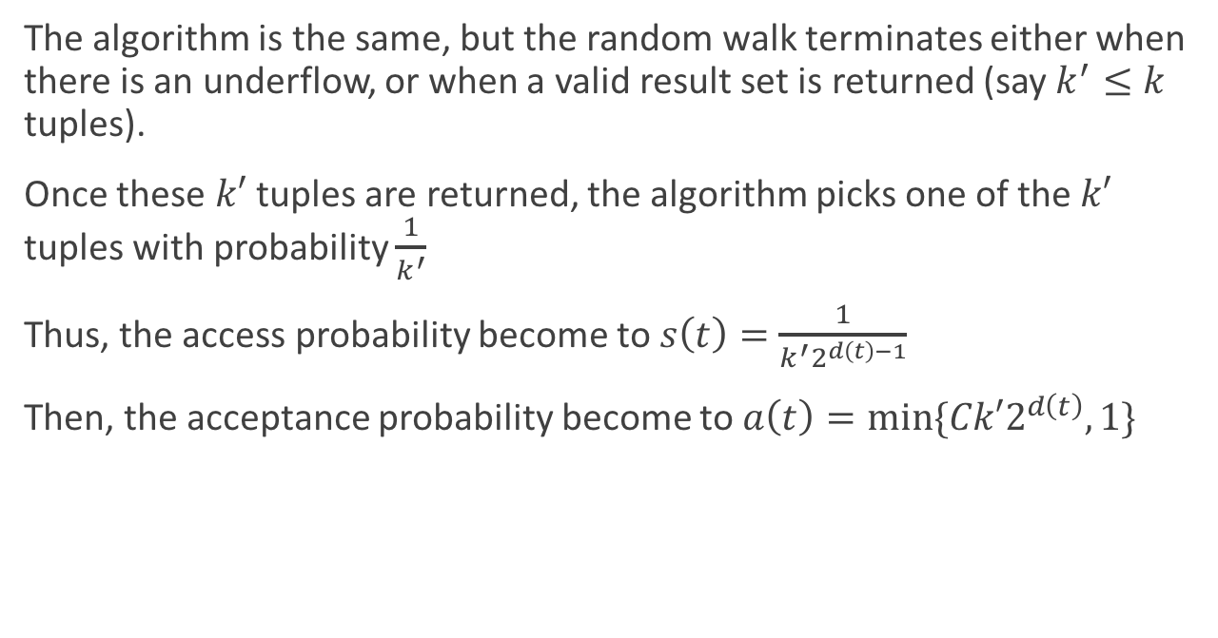
Generalizing for k > 1
The algorithm is the same, but the random walk terminates either when there is an underflow, or when a valid result set is returned (say $k^{′}≤k$ tuples).
Once these $k′$ tuples are returned, the algorithm picks one of the $k′$ tuples with probability $\frac{1}{k^{′}}$
Thus, the access probability become to $s\left(t\right)=\frac{1}{k^{′}2^{d\left(t\right)−1}}$
Then, the acceptance probability become to $a\left(t\right)=min⁡\{Ck′2^{d\left(t\right)},1\}$

Slide 23
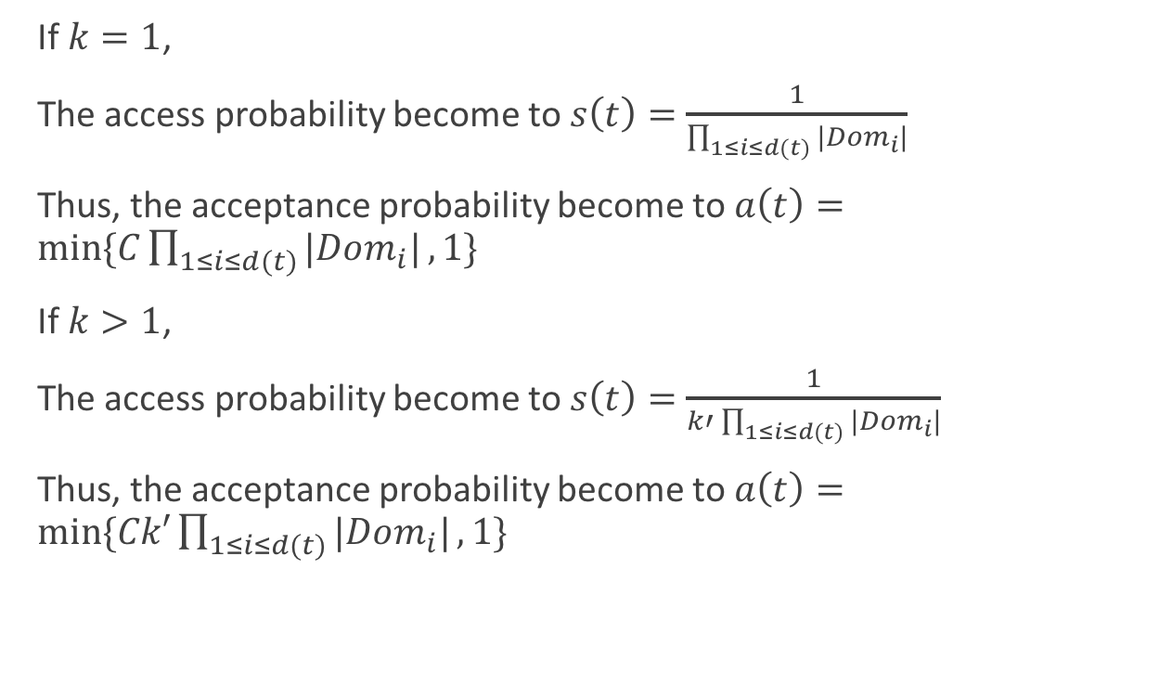
Categorical Databases
If $k=1$,
The access probability become to $s\left(t\right)=\frac{1}{\prod_{1≤i≤d(t)}{|Dom_{i}|}}$
Thus, the acceptance probability become to $a\left(t\right)=min⁡\{C\prod_{1≤i≤d(t)}{|Dom_{i}|},1\}$
If $k>1$,
The access probability become to $s\left(t\right)=\frac{1}{k′\prod_{1≤i≤d(t)}{|Dom_{i}|}}$
Thus, the acceptance probability become to $a\left(t\right)=min⁡\{Ck′\prod_{1≤i≤d(t)}{|Dom_{i}|},1\}$

Slide 24
Numerical Databases
Partition each numeric domain into suitable discrete ranges.

Slide 25
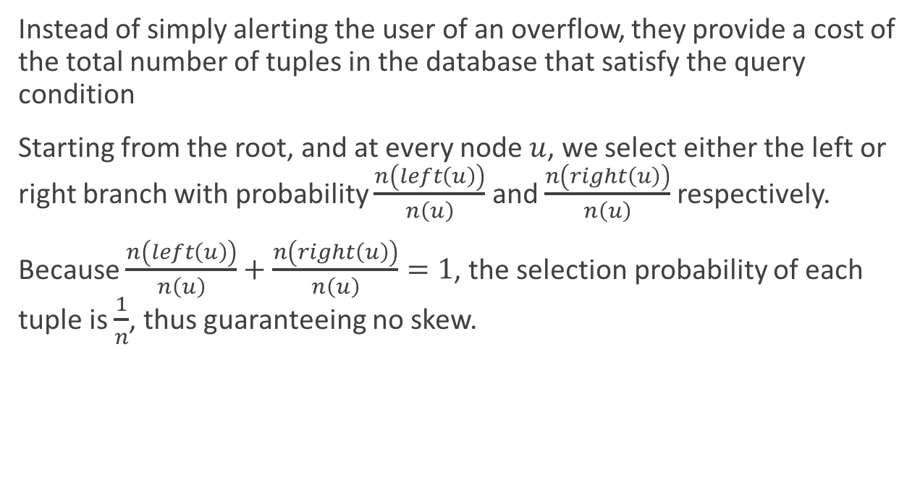
Interfaces that return Result Counts
Instead of simply alerting the user of an overflow, they provide a cost of the total number of tuples in the database that satisfy the query condition
Starting from the root, and at every node $u$, we select either the left or right branch with probability $\frac{n\left(left\left(u\right)\right)}{n\left(u\right)}$ and $\frac{n\left(right\left(u\right)\right)}{n\left(u\right)}$ respectively.
Because $\frac{n\left(left\left(u\right)\right)}{n\left(u\right)}+\frac{n\left(right\left(u\right)\right)}{n\left(u\right)}=1$, the selection probability of each tuple is $\frac{1}{n}$, thus guaranteeing no skew.

Slide 26
Experiments Results

Slide 27
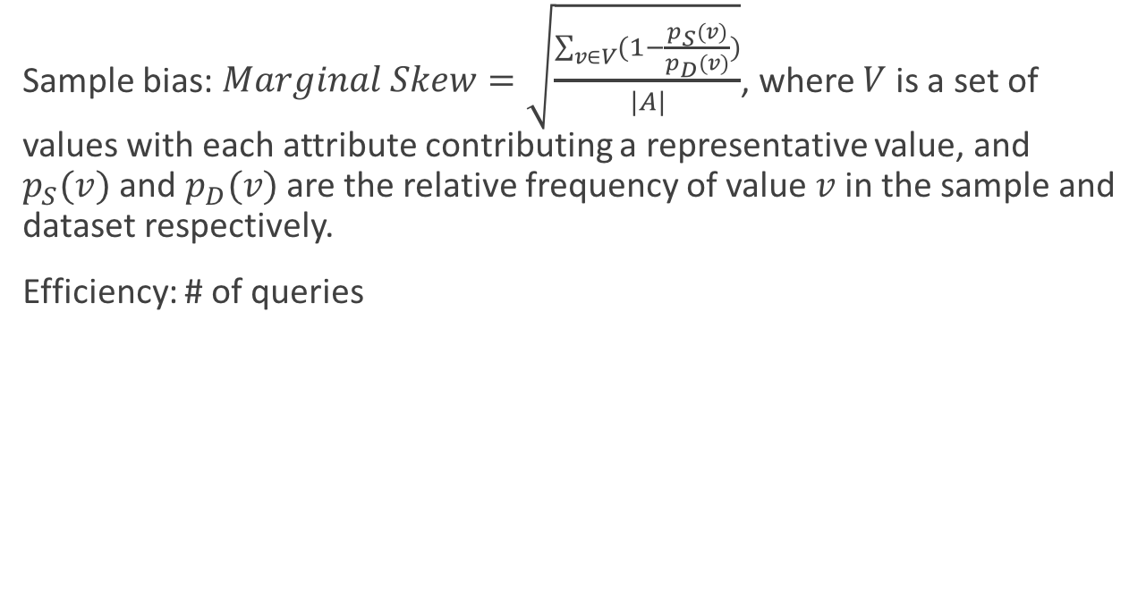
Evaluation Metric
Sample bias: $Marginal Skew=\sqrt{\frac{\sum_{v∈V}{(1−\frac{p_{S}\left(v\right)}{p_{D}\left(v\right)})}}{|A|}}$, where $V$ is a set of values with each attribute contributing a representative value, and $p_{S}(v)$ and $p_{D}(v)$ are the relative frequency of value $v$ in the sample and dataset respectively.
Efficiency: # of queries

Slide 28
Effect of Scaling Constant C on Skew for small datasets

Slide 29
Effect of Scaling Constant C on Skew for Mixed Data

Slide 30
Effect of C on skew for Correlated data

Slide 31
Marginal Skew v/s C for synthetic large data

Slide 32
Marginal Skew based measure for real large data

Slide 33
Performance of top-1 query interface

Slide 34
Effect of varying k on performance

Slide 35
Performance for synthetic dataset with p=0.3

Slide 36
Performance on real large dataset with differing orders

Slide 37
Performance versus Quality measure

Slide 38
Quality Comparisons

Slide 39
Conclusion

Slide 40
Conclusion
Authors proposed a random walk schemes over the query space provided by the interface to sample such databases.
They gave simple methods for the sampling and provided some theoretical analysis of the quantitative impact of the ideas on improving efficiency and quality of the resultant samples.
They also described a comprehensive set of experiments that demonstrate the effectiveness of our sampling approach.

Slide 41
Reference
Arjun Dasgupta, Gautam Das, and Heikki Mannila. 2007. A random walk approach to sampling hidden databases. In Proceedings of the 2007 ACM SIGMOD international conference on Management of data (SIGMOD '07). ACM, New York, NY, USA, 629-640. DOI=http://dx.doi.org/10.1145/1247480.1247550

