Slide 1
Designing an Agile Methodology for Mobile
Software Development: A Hybrid Method
Engineering Approach
Presented by:
Debarun das (DED59)

Slide 2
Agenda
Challenges Of Mobile Software Development
Solution
Agile Methodology
General Categories Of Agile Methodology
Popular Types Of Agile Methodology
New Product Development Methodology
Method Engineering For Mobile Software Development
Suitability Of Agile Methodology For Mobile Software Development
Characteristics Of An Ideal Mobile Software Development Methodology
Proposed Hybrid Methodology Design
Discussions and Future Scope

Slide 3
Challenges Of Mobile Software Development
Increase in the number of mobile devices with computation capabilities
Ever Increasing demand of specialized software for mobile devices
Software development of mobile devices is different from traditional software development
Some of the challenges are:
  Wireless Communication Issues (bandwidth variability, heterogeneous networks etc)
  Mobility Issues (address migration, location dependent information)
  Portability Issues
  Limited Capabilities (lower storage capacity, small sized user interface etc)
  Special privacy and customizability needs

Slide 4
Solution
Application of Agile methodology using Method Engineering
The approach applied is called Hybrid Methodology Design
Iterative-incremental development of methodologies
Based on a predefined set of requirements and knowledge from existing methodologies
Ideas from ASD (Adaptive Software Development) methodology and New Product Development (NPD)

Slide 5
Agile Methodology
Agile methodologies help teams respond to unpredictability through incremental, iterative work cadences and empirical feedback.
Alternative to traditional sequential development
More value is given to the following things:
  Individuals and interactions over processes and tools
  Working software over comprehensive documentation
  Customer collaboration over contract negotiation
  Responding to change over following a plan

Slide 6
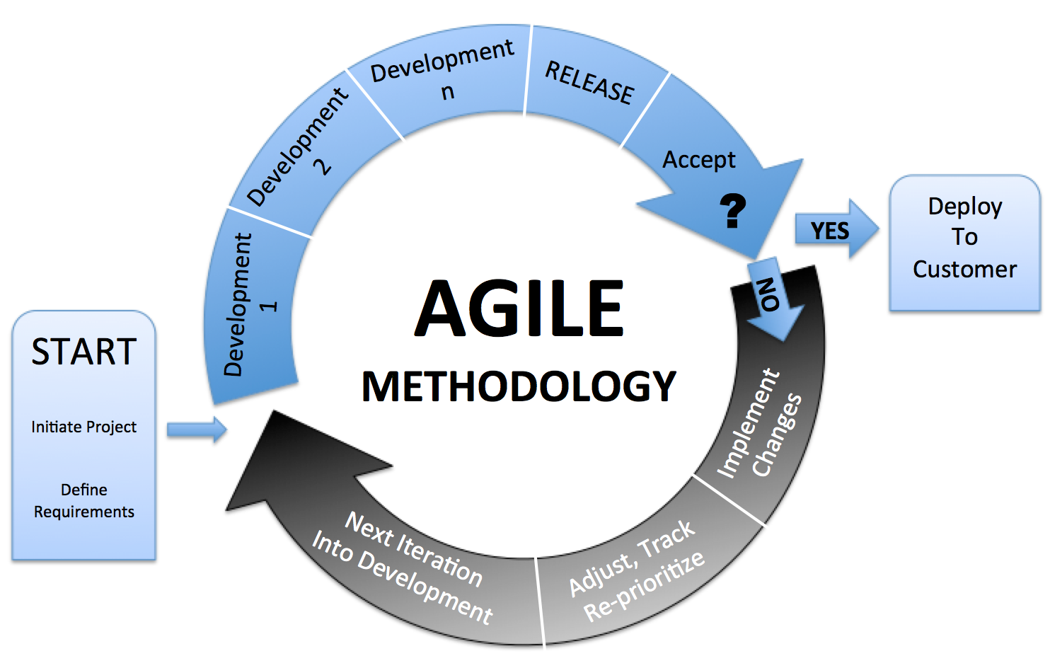

Slide 7
General Categories Of Agile Methodology
Incremental: Small software releases, with rapid development cycles
Cooperative: Close Customer and Developer interaction
Straightforward: Method is easy to learn and sufficiently documented
Adaptive: Ability to make and react to last moment changes

Slide 8
Popular Types of Agile Methodology
Adaptive Software Development (ASD)
  Incremental And Iterative Development
  Constant Prototyping
  Enough guidance provided to prevent a project from falling into chaos
  Not enough guidance to suppress creativity
Scrum
  Developed for managing software development in a volatile environment
  Empirical approach based on flexibility, adaptability, productivity
  Developers can choose the specific software development technique
  Frequent management activities to identify deficiencies

Slide 9
New Product Development Methodology (NPD)
Complete process of bringing a new product to market
Transformation of a market opportunity to a product for sale
Main Requirements: Customer Needs And Nature of the market
Iterative development of new products to better satisfy customer requirements

Slide 10
METHOD ENGINEERING For Mobile Software Development
Method Engineering
“ The engineering discipline to design, construct, and adapt methods, techniques and tools for the development of information systems”
The main motivation is the belief that NOT one methodology fits all situations.

Slide 11
Approaches To Method Engineering
  Ad Hoc: Constructing a new methodology from scratch
  Paradigm Based: Adapting An existing methodology to produce target methodology
  Extension Based: Enhancing existing methodology with new concepts and properties
  Assembly Based: Constructing methodology by assembly of method fragments from a repository

Slide 12
Suitability Of Agile Methodology For Mobile Software Development
Ideal Agile Characteristic | Rationale | Mobile Software
High environment volatility | Due to high change of requirements, less need for upfront design & planning, need for an incremental and iterative development approach. | High uncertainty, dynamic environment: Hundreds of new mobile phones produced each year
Small development teams | Small teams are able to react more rapidly, share information, need less documentation , etc. | Majority of mobile software is developed in micro or SME companies, or development teams.
Object-oriented development environment | Most tools that support agile development exist for object oriented platforms. | E.g., Java and C++ used; some problems in proper tooling e.g. for refactoring and test-first approach
Small systems | Less upfront design needed | Mobile applications vary in size, but are generally less than 10000 lines of code.
Short development cycles | For the purposes of rapid feedback | Development cycles vary. Typical mobile applications and services can be developed within a 1-6 month time-frame.

Slide 13
Characteristics Of An Ideal Mobile Software Development Methodology
AGILITY
Agile characteristics of highest importance in mobile software development includes:
  Iterative and Incremental process.
  Test driven development
  Enhanced Quality Assurance
  Continuous Process Wide Reviews
  Shorter Time-to-Market

Slide 14
Market Consciousness
  Need for shift from Project development to Product Development
  Use NPD practices for market analysis
  Balance between market oriented and technical activities
  Main goal is to analyze market and customer needs to meet time to market requirements.
Software Product Line Support
  A set of software intensive systems having similar features that satisfy similar mission or market needs
  Makes life cycle of mobile software products even shorter
  Also Reduces development cost.

Slide 15
Architecture-Based Development
  Development Of A Common Platform or General Architecture
Support For Reusability
  Need for component reusability to prevent delay of product delivery and to reduce cost
  Component based and Layer based development approaches needed
Inclusion Of Review And Learning Sessions
  Review sessions needed to analyze and log experiences
Early Specification Of Physical Architecture
  Mobile terminals’ constraints to be addressed from an early stage

Slide 16
Proposed Hybrid Methodology Design
It is a Top-down incremental process consisting of the following tasks:
Prioritization Of The Requirements
  Performed at the Start And Repeated At The End Of Each Iteration
  Requirements ordered according to relevance to current scope and level of abstraction
  Start Of Process: Highest level of abstraction and Scope covers whole lifecycle
  As design progresses to lower level of abstraction, priority is given to finer grained aspects

Slide 17
Iterative Design Engine
The following tasks are performed in each iteration:
Selection Of Design Approach in current iteration. These include:
  Instantiation: Instantiating an already available process meta-model
  Artifact Oriented: Devising a set of artifacts and building process around it
  Composition: Using one of the available libraries of process patterns
  Integration: Integrating features from existing methodologies
Application Of The Selected Design Approach
Revision of the methodology built so far to accommodate the changes made in the current iteration
Specification of the level of abstraction for the next iteration
Revision of the requirements including the prioritization according to scope and level of abstraction

Slide 18
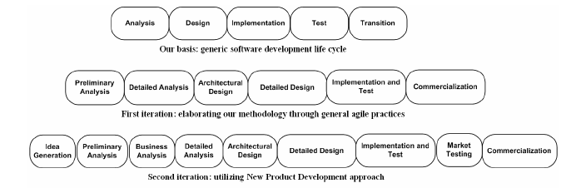

Slide 19
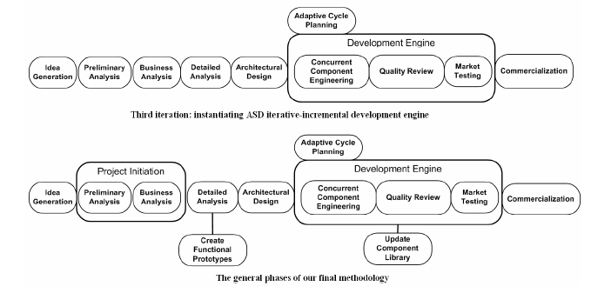

Slide 20
Discussions And Future Scope
In iteration 1, design approach is instantiation
In iteration 2 and 3, design approach is integration (from NPD and ASD)
In final iteration, design approach is composition and integration
Proposed Methodology is a high-level abstraction and does not apply to specific lower levels of abstraction for customized mobile software development
Future scope include:
  Applying this methodology to lower levels of abstraction by further iterations
  Testing this methodology for commercial mobile software development

Slide 21
References
https://en.wikipedia.org/wiki/Agile_software_development
http://agilemethodology.org/
https://en.wikipedia.org/wiki/New_product_development
V.Rahimian and R.Ramsin, "Designing an Agile methodology for mobile software development: A hybrid method engineering approach", Second International Conference on Research Challenges in Information Science, RCIS pp. 337-342. 2008.
Pekka Abrahamssona, Juhani Warstab, Mikko T. Siponenb and Jussi Ronkainena, “New Directions on Agile Methods: A Comparative Analysis”, Proceedings of the International Conference on Software Engineering, IEEE May 3-5, 2003, Portland,Oregon, USA.

Slide 22
Agile is more a “direction,” than an “end.” Transforming to Agile culture means the business knows the direction they want to go on.
-- Pearl Zhu
Thank You!

Slide 23
Questions ??

