Slide 1
Smart Kitchen
(Ambient Assisted Living)
Ameya Daphalapurkar

Slide 2
Overview
Introduction
Related Work
System Description
Software Architecture
System Evaluation
Conclusions and Comments

Slide 3
AAL
Ambient Assisted Living (AAL) are concepts, products and services which combine new technologies and the social environment in order to improve quality of life in all periods of life.

Slide 4
Problem
Ageing of the population
Ratio of people aged 65 or more will increase to
30.0% in 2060 in Europe
20.2% in 2050 in USA
39.6% in 2050 in Japan

Slide 5
Issues
Physical and/or Cognitive Impairments as age increases
Reduced speed and increased time to make precise movements
Affects sensing and information processing capability
Difficulties in multi tasking
Loss in capabilities to autonomously perform activities

Slide 6
Need for Safety
Old people most vulnerable to domestic accidents
Most domestic injuries are related to working in kitchen
Harm from kitchen tools, cutlery and household appliances
Consequence : may decide moving to nursing home

Slide 7
About the paper
Easy Line+
Increasing elderly and disabled people’s autonomy
The kitchen is the focus
Many activities that are key for autonomy are performed

Slide 8
Ambient Intelligence
Ambient Intelligence (AmI) can be defined as a “sensitive and adaptive electronic environment that responds to the actions of the persons and object and cater for their needs”
This approach includes the entire environment, taking into account each individual object, associating its interaction with humans
AAL uses the AmI as the essential tool to provide integral solutions for supporting the person in his/her independent living in different contexts: dwellings, transport, workplaces, etc.

Slide 9
The three macros for AAL
AAL4persons – ageing well for the person
AAL in the community – social inclusion
AAL@work – elderly and people with disabilities at work

Slide 10
Related Work
MONAmI project selects suites of technological services to support people at risk of exclusion and loss of autonomy
Necessity system proposed by Muñoz et al. which offers a system to represent and validate alerts in a domestic environment
Lei show a system based only in a RGB-D camera (modern depth cameras that provide synchronized color and depth information at high frame rates) which identifies activity and tools used from a set of objects and actions

Slide 11
Related Work
Suryadevara and Mukhopadhyay developed and tested an intelligent home monitoring system based on a wireless sensors network (no camera or vision sensors) to monitor and evaluate the well-being of the elderly
Ficocelli and Goldie present an assistive kitchen with speech communication and an automated cabinet system to ease storing and retrieving items and to obtain recipes for meal preparation.
Schwartze present their work in graphical interfaces for Smart Environments with the “4-star Cooking Assistant” application which proves the capability of their system to dynamically adapt a graphical user interface to the current context of use

Slide 12
System Description
Four main functionalities within the kitchen scenario:
Facilitates the use of household appliances
It provides useful information and warnings
It detects emergency situations and takes corrective actions
It analyzes all the data gathered to extract relevant information

Slide 13
Principles
Two main principles guided the system design:
Resistance to obsolescence
Ability to interoperate with existing systems in the field (such as white goods, sensors or RFID from different manufacturers)

Slide 14
Requirements
Need – to reduce unitary price and complicate installations
A central intelligence entity
It is conceived as a set of interchangeable blocks with defined communication interfaces to grant interoperability among existing systems
Any electrical appliance with communication capability can be integrated. As a result, the development and stability of the appliances eases, they don’t change their current way of functioning, but they just need to add communication to inform about their status and execute actions

Slide 15
Integrations for the system
Power Line Communication (PLC) for the white goods
RFID for item identification
ZigBee as wireless sensor network
Infrared for the remote control
Bluetooth for audio streaming
Ethernet (WiFi and cable) for cloud and user interaction

Slide 16
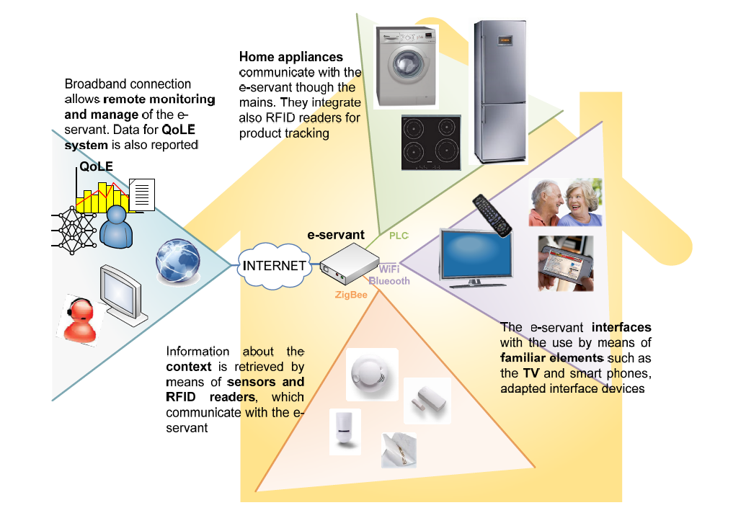
Fig: Smart Kitchen

Slide 17
Context Interaction
RFID with ZigBee communication
A stand-alone RFID reader in worktop to gather any information
Patching label including RFID chip and metalized thread technology
Not so standard sensors with ZigBee: Magnetic, Light, Presence
Human-Machine Interface (HMI) devices
Mobile, Tactile, Embedded devices

Slide 18
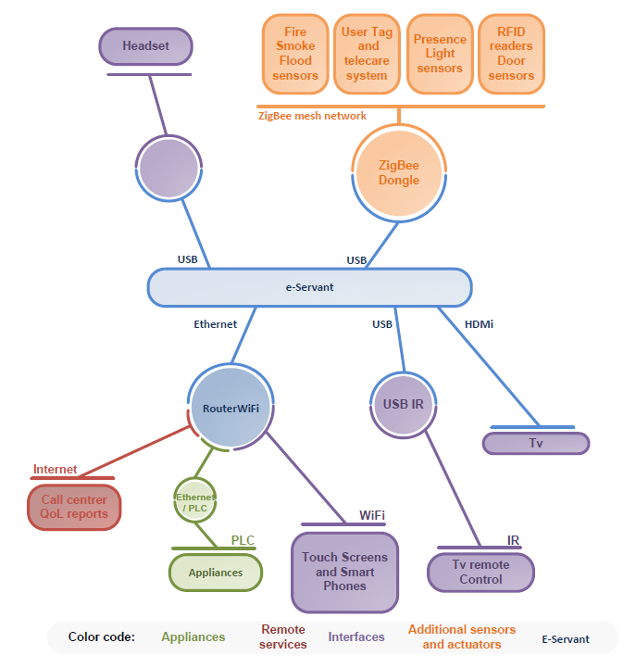
Fig: Communication diagram for context interaction in the Smart Kitchen

Slide 19
E-Servant
System intelligence is provided by the e-Servant
Learning system, which detects and compensates the behavior, habit changes and loss of abilities of the user.
Checks continuously the state of the kitchen appliances, providing warnings through its user interfaces if there is any problem or event to be notified
Detects emergency situations and takes corrective actions
Also manages records with the relevant events that have occurred in the kitchen gathered from the context and user interaction

Slide 20
E-Servant
Data is processed and analyzed in order to extract findings about the cognitive level of the person that could be useful to the guardian and/or relatives.
Information is used to create Quality of Life Evaluation (QoLE):
A detailed report – food management, cooking, doing laundry
Suggestion on the support level of the system

Slide 21
Software Architecture
Designs based in Service Oriented Architectures (SOA)
SOA technology - Open Services Gateway initiative (OSGi)
Pieces of code are organized into bundles that can be managed separately.
Handling a serial port, providing a command line interface, collecting, aggregating and analyzing data, etc.

Slide 22
OSGi
Manages these bundles dynamically
Providing new features and capabilities by adding new services
Backbone of the e-Servant in order to enhance its capabilities, and decreasing the cost of maintenance in a future

Slide 23
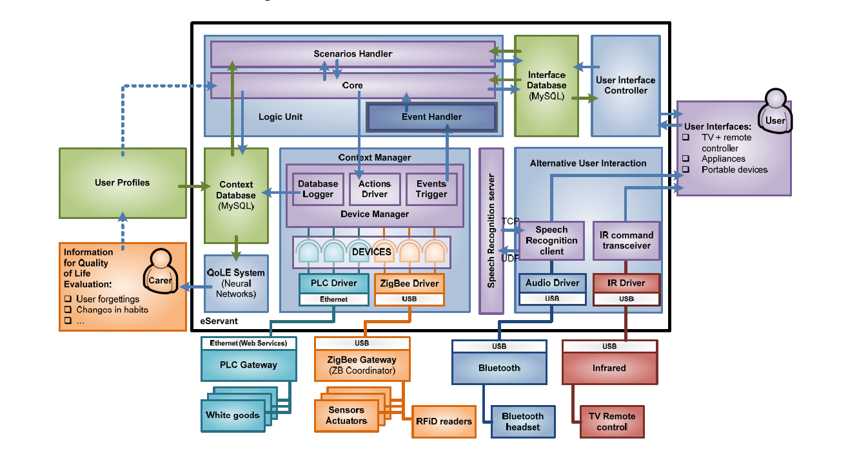
Fig: Software architecture of the e-Servant

Slide 24
Context Manager
Information about the status of the appliances, product inventory, user actions or any other event is gathered by the CM and sent to the Logic Unit (LU) which will decide whichever operation must be performed
The CM is the agent responsible for retrieving that information, processing and presenting it in a structured way, and it is organized in three levels:
Drivers
Devices
Devices management

Slide 25
Driver
Lowest layer of CM which communicates with physical devices
Three important tasks:
Physical channel establishment
Device enumeration and network support
Device installation and messaging service
PLC driver, ZigBee driver

Slide 26
Devices
Devices maintain a link with the driver which has instantiated them, and OSGi provides the mechanism to dynamically modify this link if the base driver disappears (for example, if a network gateway becomes unavailable)

Slide 27
Device Manager
The Device Manager is responsible for manipulating and aggregating information from the devices and effectively offering the context awareness to the upper layers
Database logging
Action driving
Event triggering

Slide 28
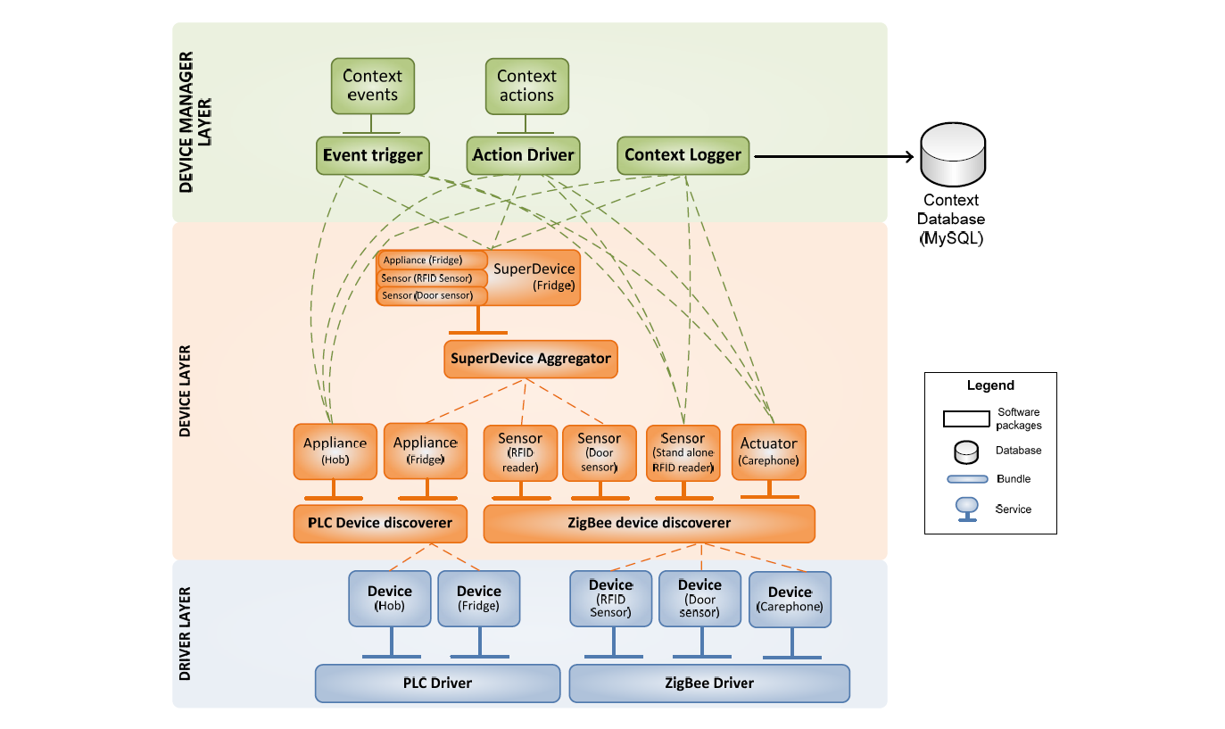
Fig: Architecture of Context Manager

Slide 29
Logic Unit
“Brain” of the e-Servant
Important tasks:
Process all the information provided by the context manager
Reason through that information and deciding actions in order to support the user
Cooperate with the User Controller Interface (UIC) to manage the interaction with the user from a logical perspective

Slide 30
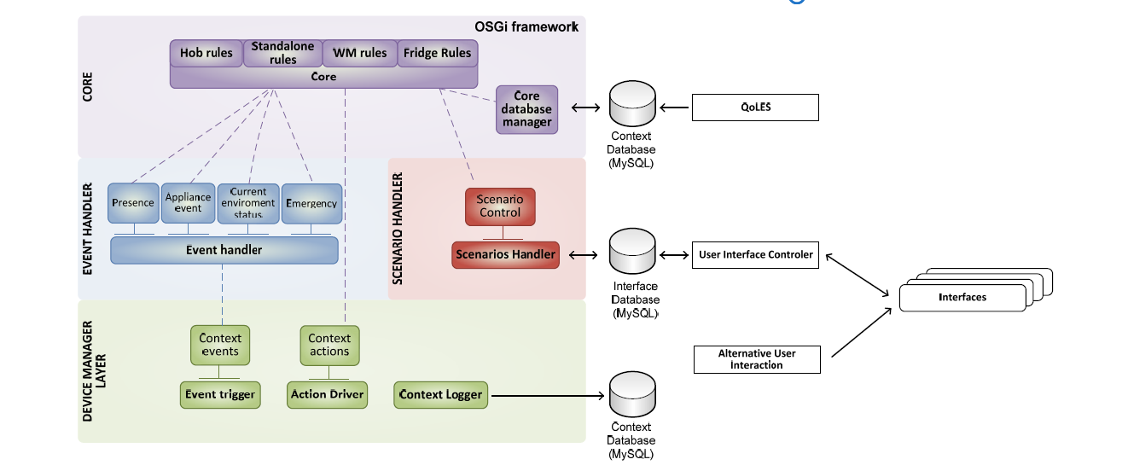
Fig: Architecture detail of the Logic Unit

Slide 31
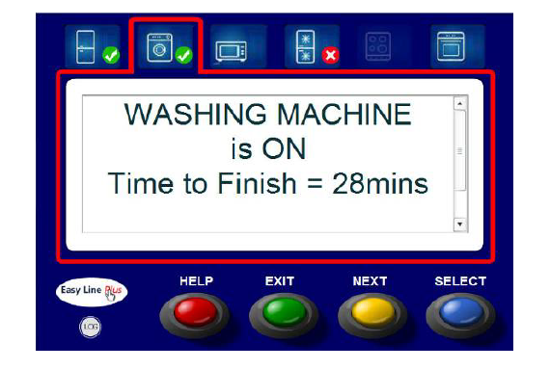
Fig: User interface screen showing information about the washing machine status

Slide 32
Quality of Life Evaluation System
The Quality of Life Evaluation System is a service that periodically (a period configurable between 1 and 3 months) analyses the context database looking for changes in the user washing, shopping and cooking habits which could be relevant in order to detect a loss of physical, cognitive or sensorial capabilities
Example, if the user starts going to the fridge at night (might indicate insomnia) or if s/he is doing the laundry less and less often (might indicate that he/she is wearing dirty clothes). This allows performing an indirect evaluation of the quality of life of the user
Designed for the use of non-technical people

Slide 33
Use Case
Smoke sensors notify the system that there is smoke in the kitchen, oven and hob are on but nobody is in the kitchen.

Slide 34
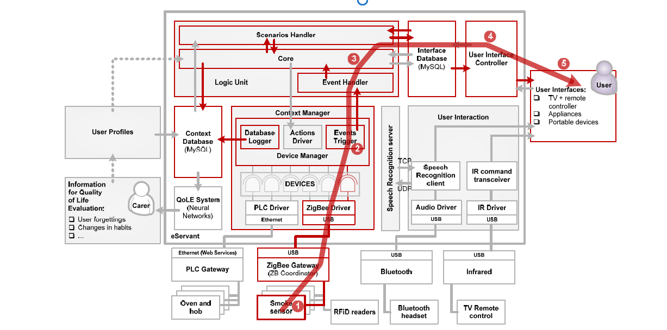
Fig: Use Case Scenario 1 to 5

Slide 35
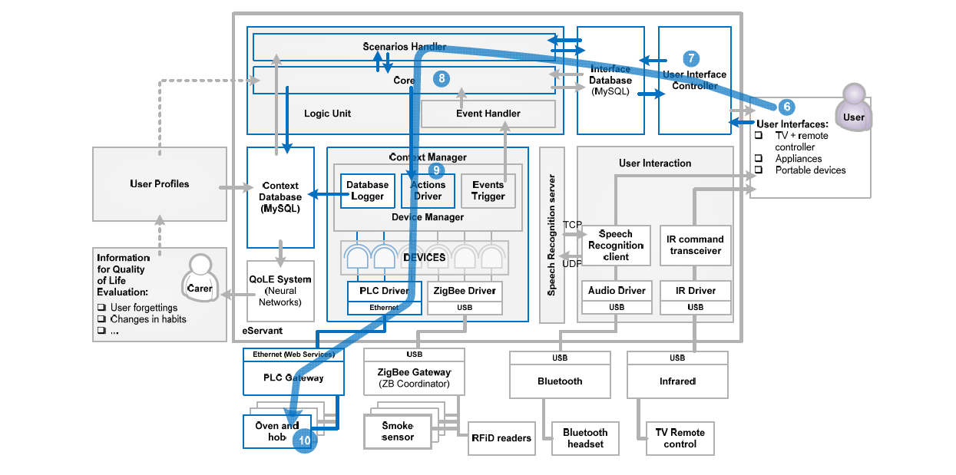
Fig: Use Case Scenario 6 to 10

Slide 36
System Evaluation
The system has been evaluated by 63 end users and 31 formal and informal carers in two living labs placed in Spain and UK
Each user evaluates the system through four specific situations
There are three people participating in the assessment whose roles are:
- The user is the person who will evaluate the technology
- The test moderator who leads the sessions
- The test observer who is watching the different situations evaluated without contact with the user

Slide 37
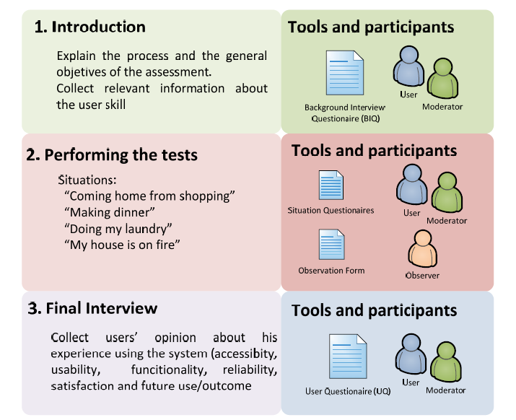
Fig: Evaluation Process

Slide 38
Evaluation Results
In summary, we can say that:
The system has good usability and physical, sensory and cognitive accessibility
90% of the users that evaluated the system found it accessible
Usability has been evaluated with a score of 3.85 out of 5 overall, on a rating scale of 1 (poor) to 5 (excellent).

Slide 39
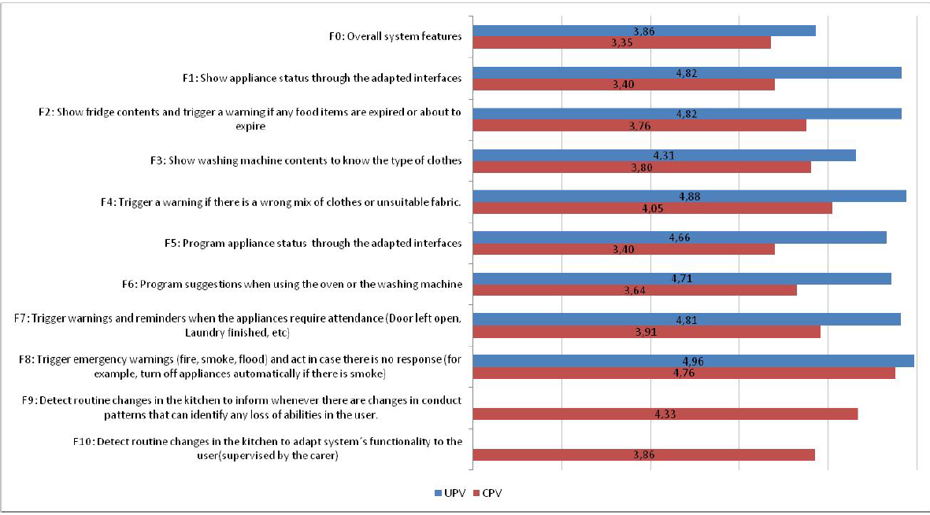
Fig: Functionalities of the e-Servant evaluated by the caregivers and users

Slide 40
Conclusions
The system concept and its implementation are innovative
The backbone of the system is its modular architecture based on an OSGi framework
Functionalities of the system can be easily expanded by adding rules and user-scenarios
Quality of Life Evaluation Service allows progressive personalization of the system

Slide 41
Comments on the paper
PROS:
A great innovative concept with never ending possibilities for improvement and advancements.
Very well explained architecture and software organization description
Modularity in bundles clearly paves the way for ease in updates for the system without causing any huge change in the functioning of the system.
CONS:
I think the usability part could have been better explained by the authors especially as the target demographic is the elderly people and we should understand their grasp towards technology and user interfaces

Slide 42
THANK YOU

