Slide 1
Bringing Deep Causality to Multimedia Data Streams
Laleh Jalali, Ramesh Jain
University of California, Irvine
Seminar Presentation
CS 2310 : Multimedia Software Engineering
Presented by –
Tazin Afrin

Slide 2
Outlines
Correlational vs causal models
What is qualitative causality ?
Hypothesis driven and data driven analysis
A framework for qualitative causality
Application in asthma risk management

Slide 3
Feature Extraction
Notes:
In reality we have human all over the world constantly communicating with each other..
The communication data are collected through sensors/web or some kind of infrastructure.
Data abstruction like graphs/plots / just raw data like numbers are used to what is happening is the real world. So we can explain/understand the real world. Or we can also predict events.
To do that we need a model. Many diiferent kinds of models we use. Using

Slide 4
Abundance of data
Notes:
Abundance of multimedia data can be used to solve challenging socital problems.
Have to find the true potential of the data.
Structured, semi-structured or unstructured information.
Before any analysis unified signals need to be created.

Slide 5
Correlated data
Notes:
Y-axis is how many cars, over the years from 1999 to 2009
They are highly correlated but does it mean one casued the other ?
Inferring causal relationship is one of the heavily debated topic.
We have a mental model of cause and effect

Slide 6
Causal Relation
Notes:
Data from tokyo city
This is not necessarily predicting when will asthma attack, but modeling the relation of multiple asthma risk factor.
Finding such pattern within one dataset does not prove the validity of causal model, but it lends credibility to it
Repeatedly test this on more data fo rmore city and can infer the same thing then it will gain more credibility – DATA DRIVEN
But causal discovery is not easy, that’s why need to incorporate human expert judgement here, cause data driven models are quite useful to refine human judgement.

Slide 7
Qualitative Causality
Mimics human thinking/reasoning.
Aims to discover potential causal pattern of the underline phenomena for the purpose of understanding and planning and empowerment using qualitative events rather than quantitative variables.

Slide 8
Qualitative Causal Modeling Framework

Slide 9
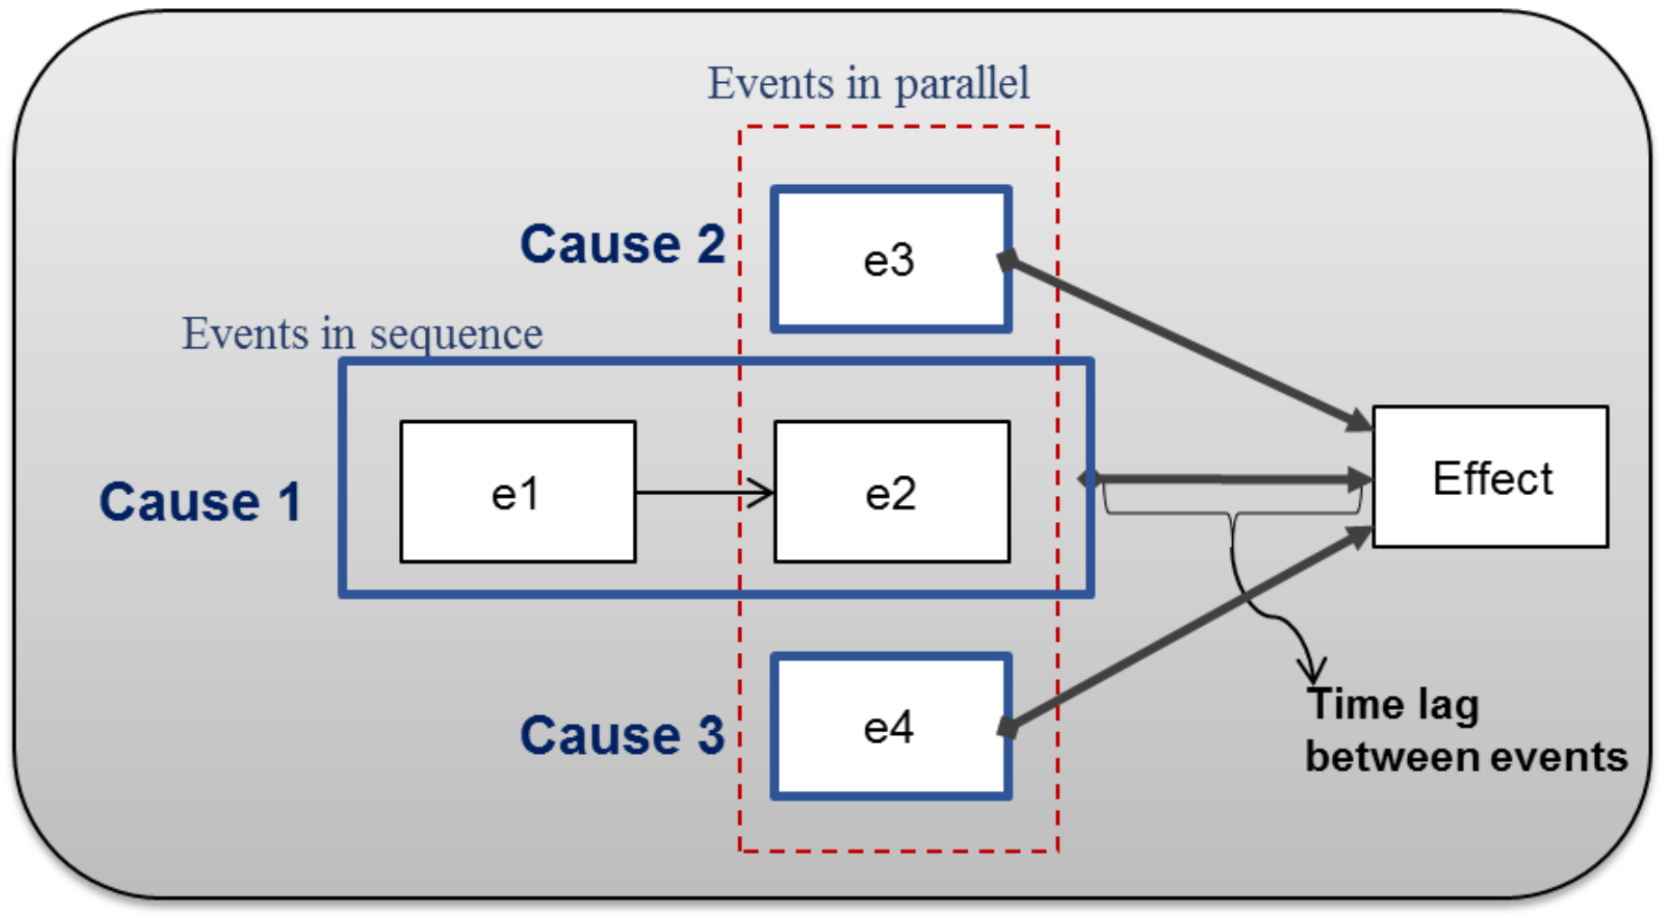
Cause-Effect Pattern Structure
(No Medication ; Exercise) => Asthma Attack
(Exercise || Pollen high) => Asthma Attach
(Exercise || (Pollen high|Polution High)) => Asthma Attack
Notes:
It places constraint on the possible pattern that can be observed

Slide 10
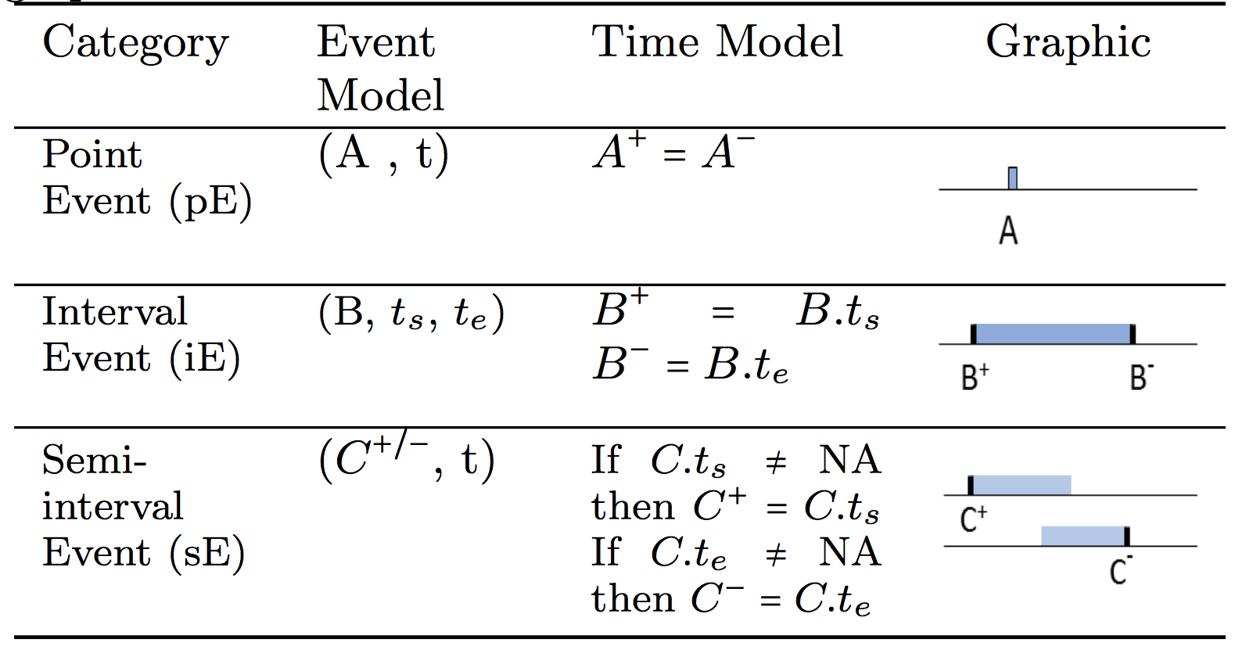
Event Categories
Notes:
Semi interval – one of the event boundary is missing

Slide 11
Event Stream
Event stream is an ordered set of events
  ES^{(i)} = {e₁^{(i)} , e₂^{(i)} , …, e_{n}^{(i)} }
Multi-event stream is a finite set of event streams.
  ES = {ES⁽¹⁾ , ES⁽²⁾ , …, ES^{(I)} }

Slide 12
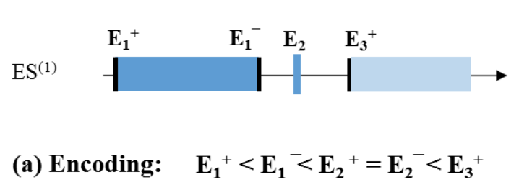
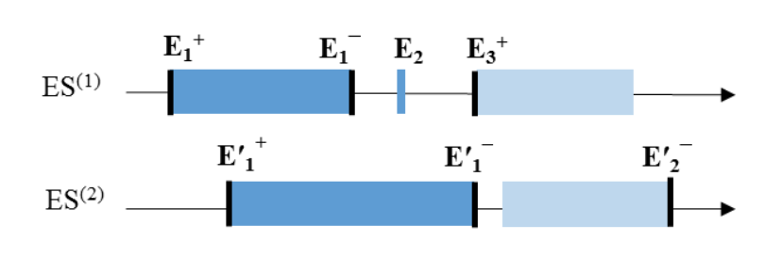
Encoding of Multi-event Stream

Slide 13
Processing Operators
Notes:
To formally define the language they define an operation algebra to formulate the causal pattern
Combination can be used for arbitrary sophisticated pattern formulation

Slide 14
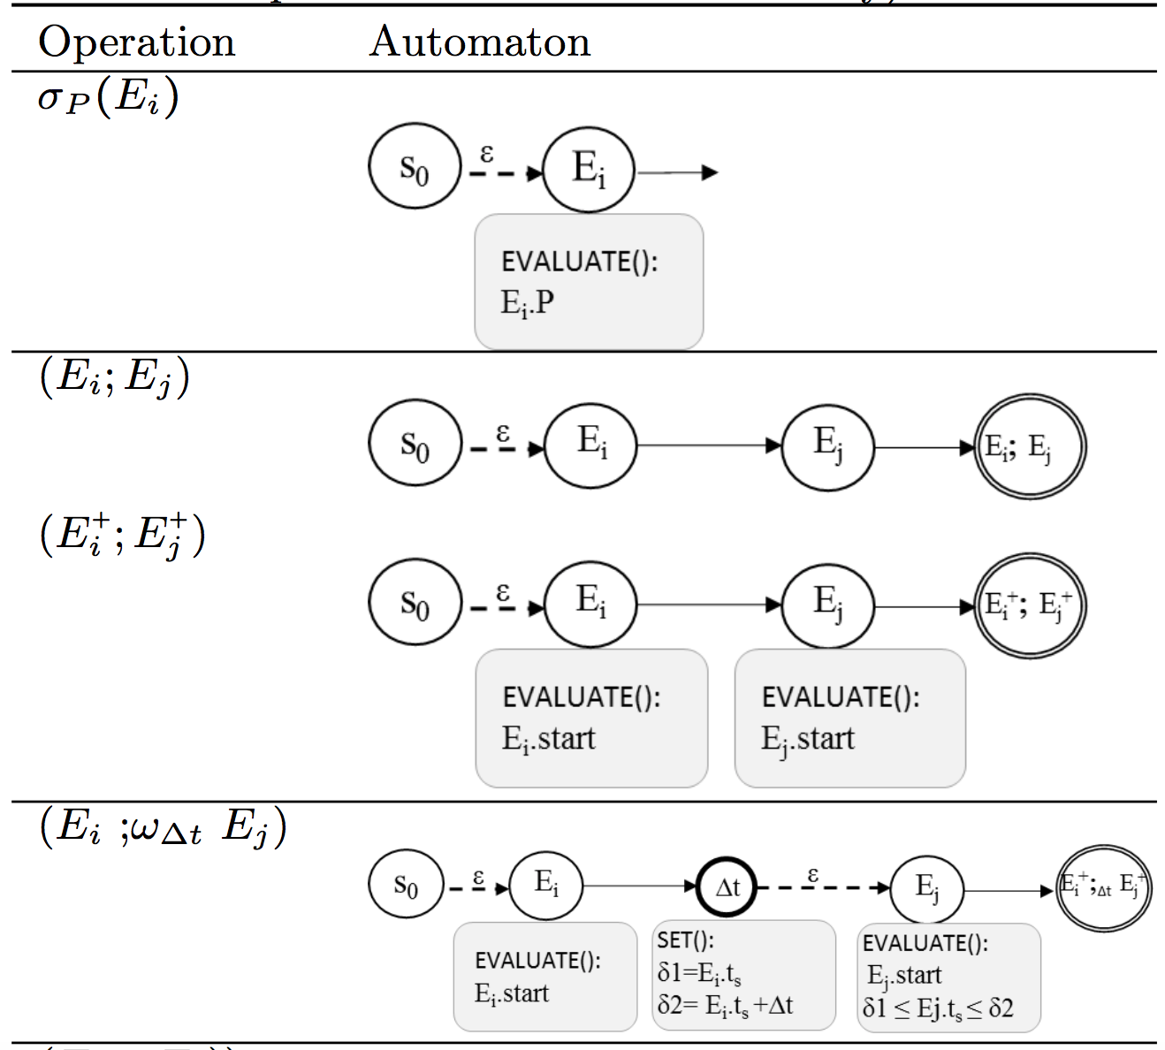
Corresponding Automation for Operations

Slide 15
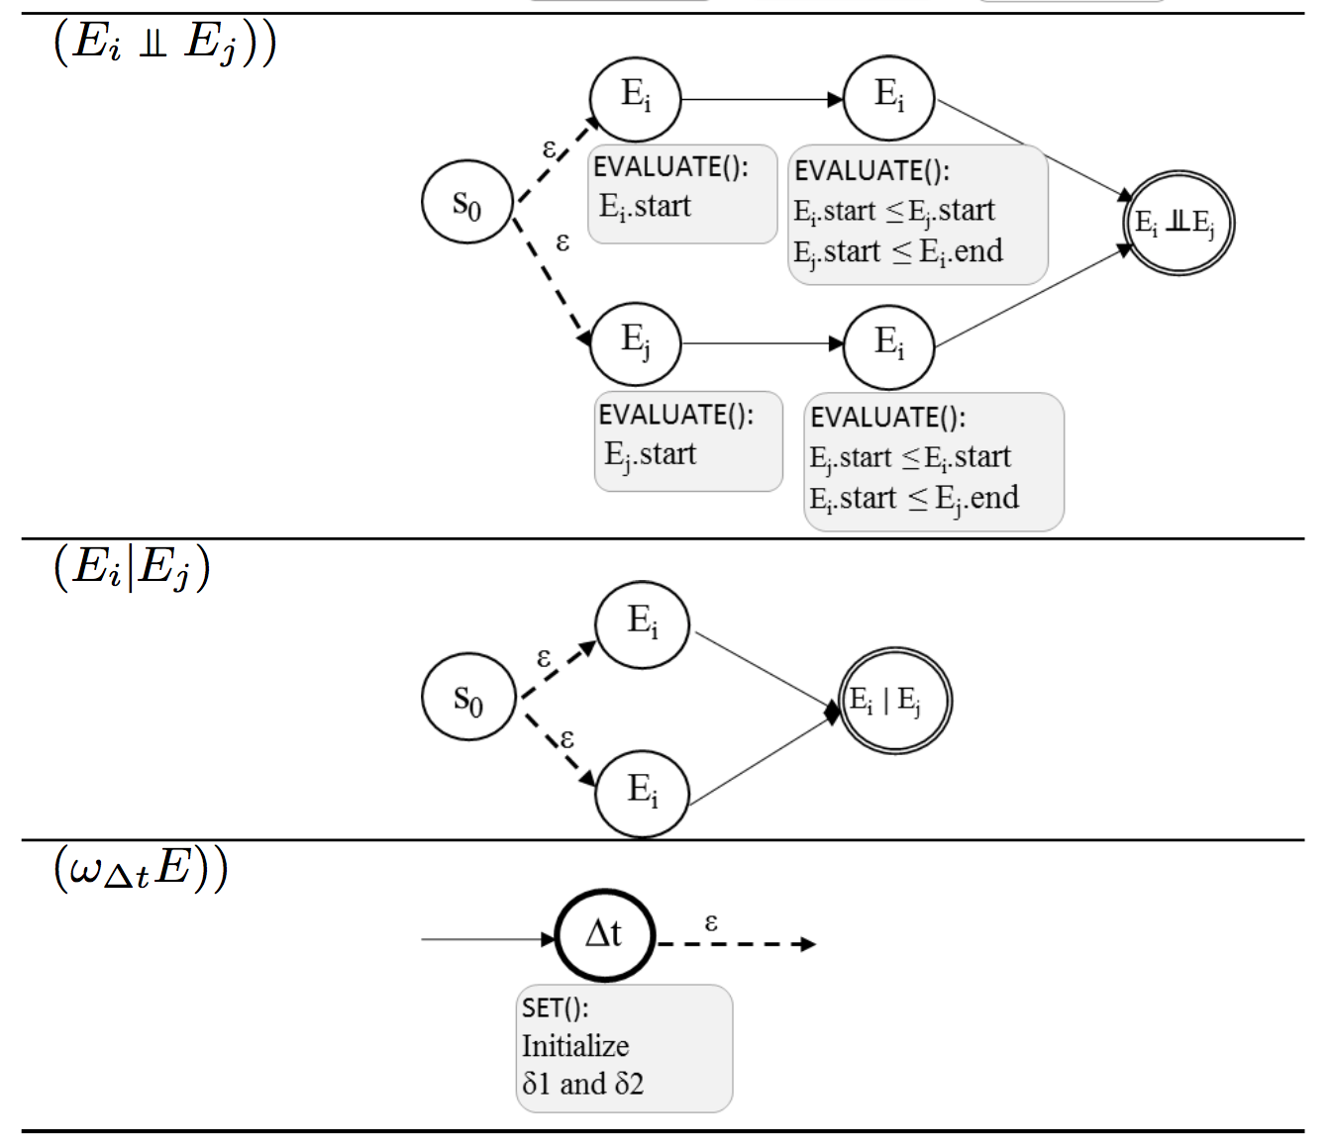
Corresponding Automation for Operations

Slide 16
Experiment

Slide 17
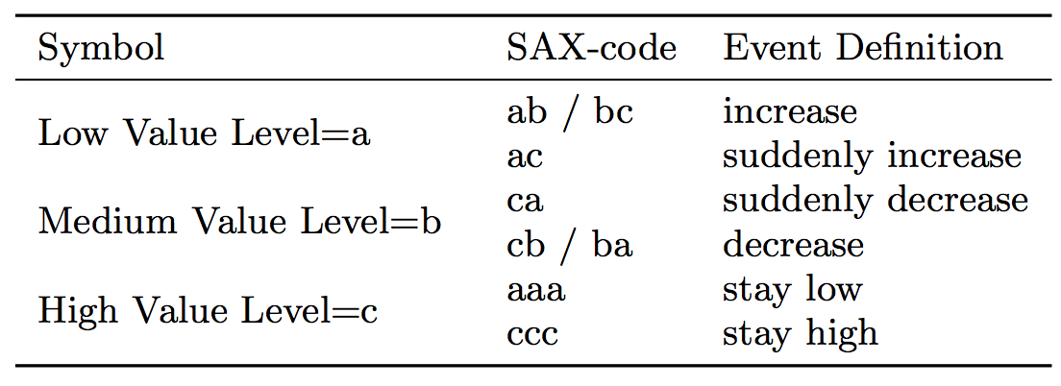
Symbolic Aggregate Approximation

Slide 18
Asthma Risk Factor Recognition

Slide 19
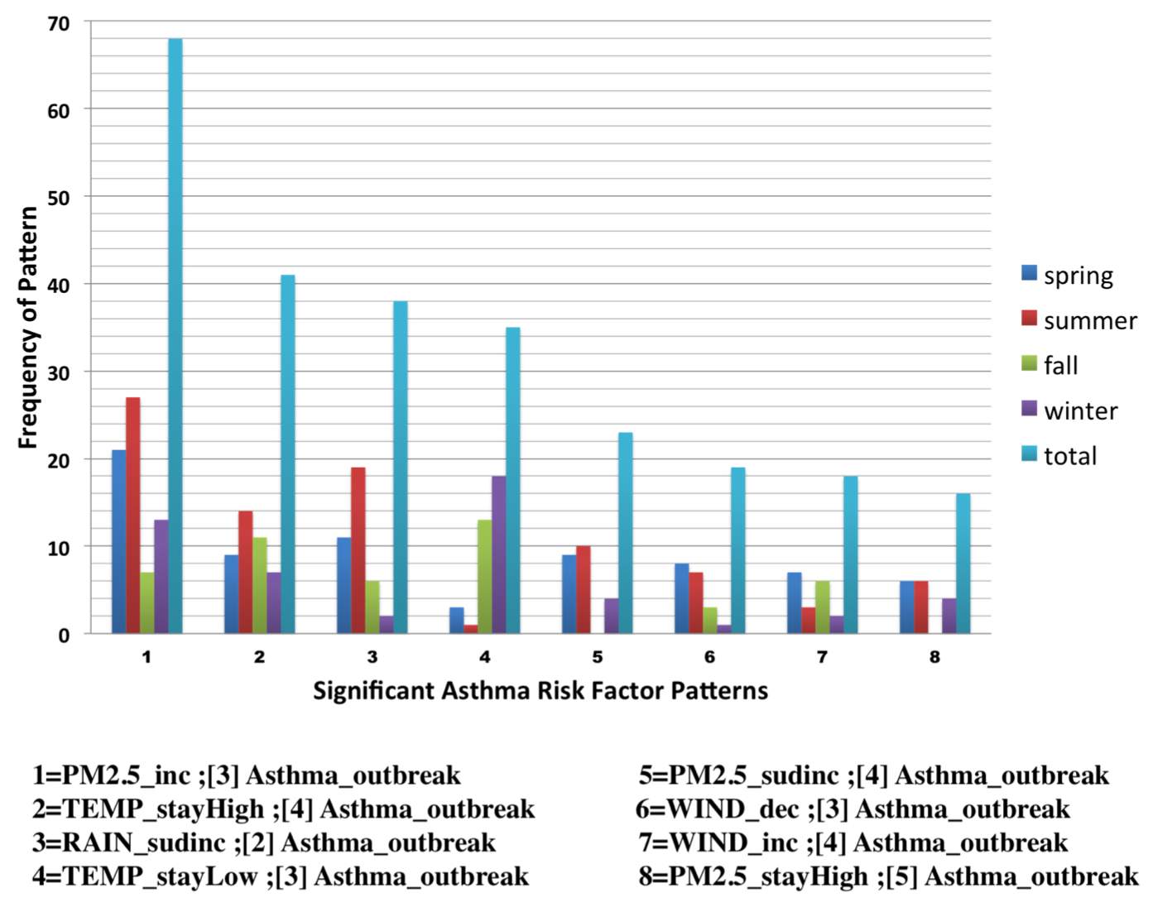
Results

Slide 20
Results
Temperature fluctuation has the most impact in fall and winter and not a risk factor in summer
During spring and summer when rain suddenly increases to a very high level, asthma outbreak is probable

Slide 21
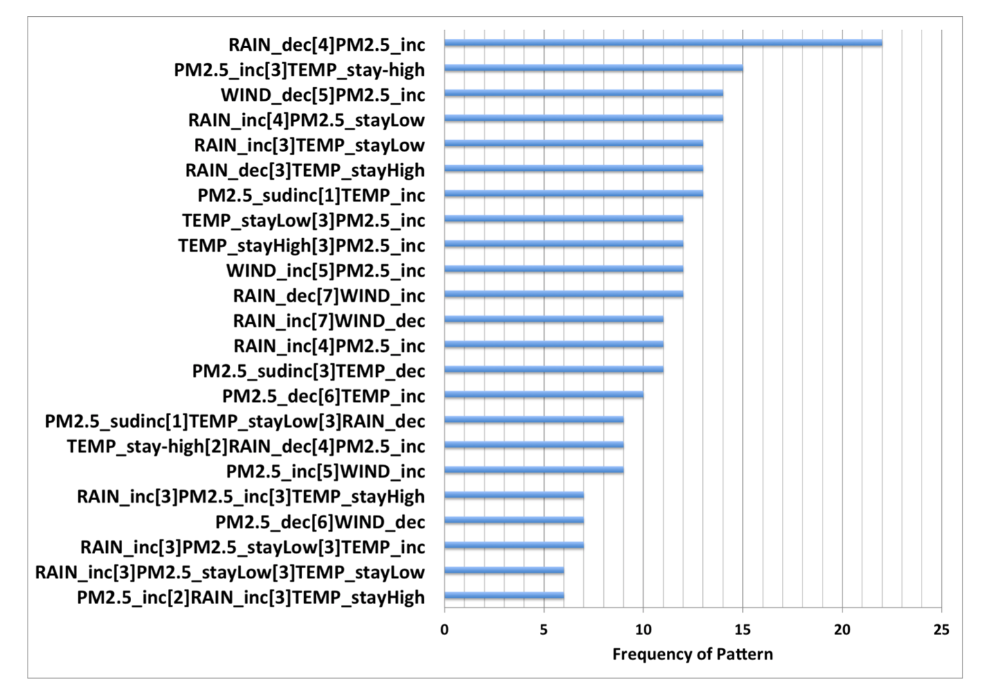
Results

Slide 22
Results
When PM2.5 increases followed by temperature stay high within 3 days, then asthma outbreak is probable
when wind decreases followed by PM2.5 increases within 5 days, then asthma outbreak is probable.

Slide 23
Thank you
Questions ?

