Slide 1
Design Pattern Support
based on principles of model driven development
Zihao Zhao

Slide 2
Introduction
Pattern:
In SE, applying pattern solutions to common recurring problems
An important tool for developers in software design construction,
Pattern can be found and defined in software analysis, integration, testing and other areas.
Pattern application can produce better software efficiency
As system become larger and more complex, it is important to have support of design pattern in the source code.
Notes:
The concept of patterns was first introduced in the work of Alexander dealing with urban solutions, but soon the patterns were defined and used in software engineering also.
Patterns have been applied in various phases of the software development lifecycle. Design patterns represent an important tool for developers in the process of software design construction, and provide especially effective ways to improve the quality of software systems.
the functionality of software systems requested by the users becomes continually more and more complicated. As a result of this fact, the software systems become progressively larger and more complex. Developers are forced to investigate more and more lines of source code in order to ensure the correct functionality of the software systems after requested system change or evolution. Large amount of plain source code itself is very difficult to its analysis and understating by developers. Therefore the clear visibility and support of the design patterns in the source code has significant importance as well.

Slide 3
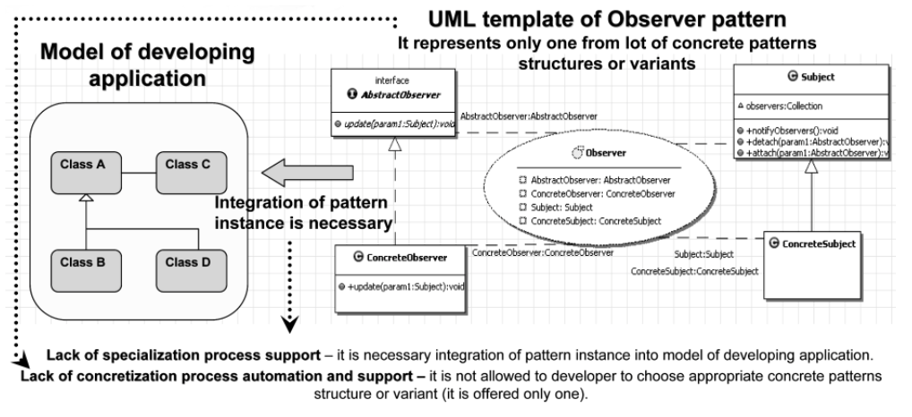
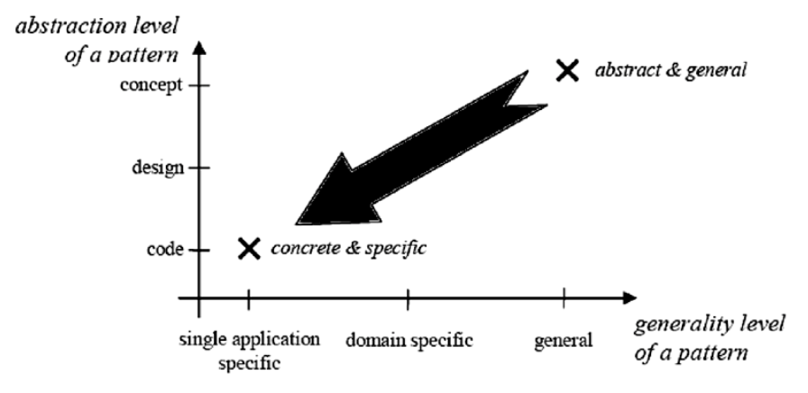
Open Problems
Abstraction only at one level
Specialization of pattern is difficult to automate
Just copy is not enough!
Notes:
1. For an example, many of the approaches focus mainly at the design level (i.e. model), but by the transition to the source code level the pattern instances become almost invisible in the huge amount of source code lines without any further support. As consequence, the evolution of the pattern instances is very difficult without any tool-based support, because a developer does not have a good view of all the participants of pattern instances in the source code. Moreover, due to the inability to identify the individual participants of pattern instances in the source code, they may be modified in an incorrect way during the system evolution and maintenance, and this may result in the breakdown of the pattern and the loss of the benefits gained by its application in the software system.
2. Since the patterns provide abstracted and generalized solutions to recurring problems, its application to solve a specific problem requires to concretize and to specialize the solution described by the pattern.
The more parts the structure of the pattern instance contains, the more concrete it becomes. The most concrete level of a design pattern instance is source code, because at this level of abstraction the pattern instance contains all parts from its structure.
3. CASE or other modeling tools and approaches provide today some kind of support for design pattern instantiation, but it is often based on simple copying of pattern template into the model with minimal possibilities for modification and with minimal support for instance integration into the context – application model
That is to say, a developer is not allowed to choose an appropriate variant or concrete structure of the design pattern. Only one generic form is offered to the developer for use. Any other adjustments need to be performed manually without any tool based support
Also, the instance of a pattern is not integrated into the application model, i.e. the context. It lacks associations and the names of pattern participants are general. All these activities of instance specialization have to be done by the developer manually

Slide 4
Main Idea
Abstraction
Model
Tranformation
Semantics
Notes:
The abstraction, semantics and model transformations represent the key principles of Model Driven Development and Model Driven Architecture.The semantics applied in the models enable the possibility to understand the model and its elements, and also to recognize which elements play which roles in the model. Consequently, on the basis of the understanding of the models and its elements, it is possible to construct the transformations which transform the models to a lower levels of abstraction. These principles represent the basis of the elaborated method of design pattern support.

Slide 5
Main Idea
Make suggestion
Specify Variant to employ
Make transformations
Notes:
We want the developer to make a suggestion by the application of semantics as to where and which design pattern he wishes to be applied in the model and to specify the domain dependent roles. Then he can also specify which variant of the pattern to employ, and in what way he wants it to generate. Subsequently the rest of the pattern instance structure will be automatically generated by model transformations to lower levels of abstraction according to the instance suggestion and specification.

Slide 6
Three Levels of abstraction
1. PIM
2. PSM
3. Source Code
Notes:
(i) suggested and specified platform independent instances of design patterns in the model (PIM)
(ii) more concrete and platform specific instances of design patterns in the model (PSM)
(iii) concrete and application specific instances of design patterns in the source code

Slide 7
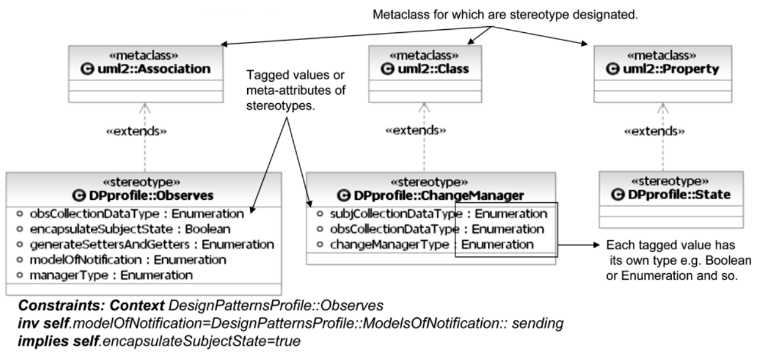
Semantics
1.Semantics of design pattern at Model Level
Notes:
In order to achieve the specified goals, it is necessary to provide an appropriate mechanism of pattern semantics in the application model and source code. It is important to support insertion of semantics directly onto the elements of the model or source code, because such approach supports the specialization of pattern instances, and makes the creation of the instances specification effortless. Thanks to the semantics, the model transformations are able to understand the model of the application and recognize its parts.
Model Level
UML profiles provide a standard way to extend the UML semantics in the form of definitions of stereotypes, tagged values - meta-attributes of stereotypes, enumeration and constraints.
All these elements can be applied directly onto specific model elements such as Classes, Attributes, and Operations
In this way it is possible to specify participants of design patterns and relations between them directly in the context - on the elements of the application model. Authored UML profile for design patterns provides semantics to various pattern instances adjustments, suggestions and specifications.
Source code
Source code annotations work as metadata information for different artifacts and fragments of the source code.
hanks to the source code annotations, the semantics and visibility of patterns can by preserved and propagated from model also into the source code.

Slide 8
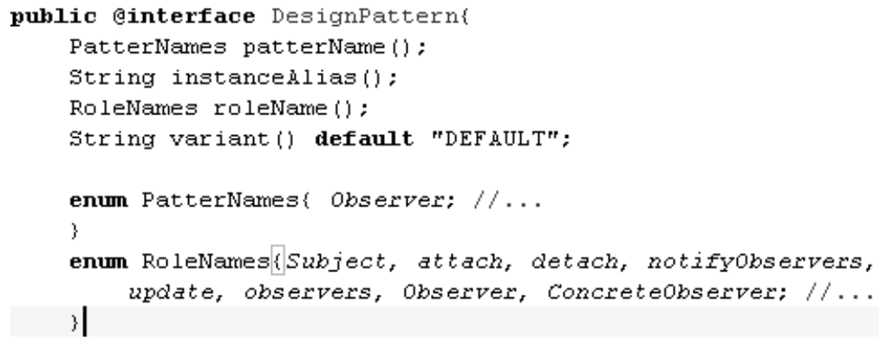
Semantics
2. Semantics of design pattern at Source Code Level
Notes:
Source code
Source code annotations work as metadata information for different artifacts and fragments of the source code.
hanks to the source code annotations, the semantics and visibility of patterns can by preserved and propagated from model also into the source code.

Slide 9
Design Pattern Support
Insert semantics
Set tagged values of stereotypes
Runs the transformation and generate the rest of pattern

Slide 10
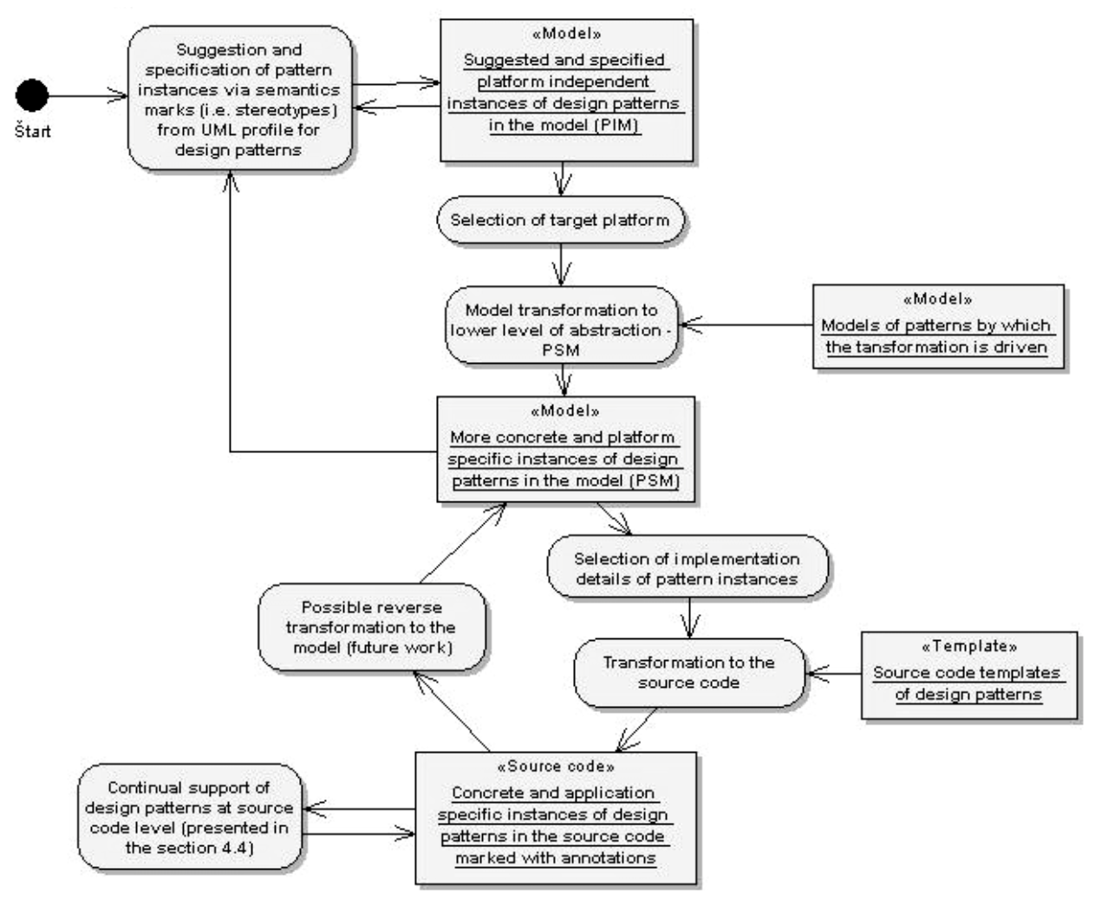
Design Pattern Support
Notes:
In the first step the developer suggests pattern instance occurrence by the insertion of semantics, i.e. application of stereotypes into the model. In the second optional step, the developer specifies a desired variant or configuration of instance by setting tagged values of inserted stereotypes. Then he runs the transformation to a lower level of abstraction. The transformation generates the rest of the pattern, and also marks the participants of the pattern. From the second step the process can be repeated at lower level of the abstraction. The only difference is that at the lower level of abstraction (PSM) in the second step, more implementation dependent choices (e.g. data types) are offered which the developer was not asked previously at the higher level (PIM). The overall illustration of design patterns support process is illustrated on the following figure 5.

Slide 11
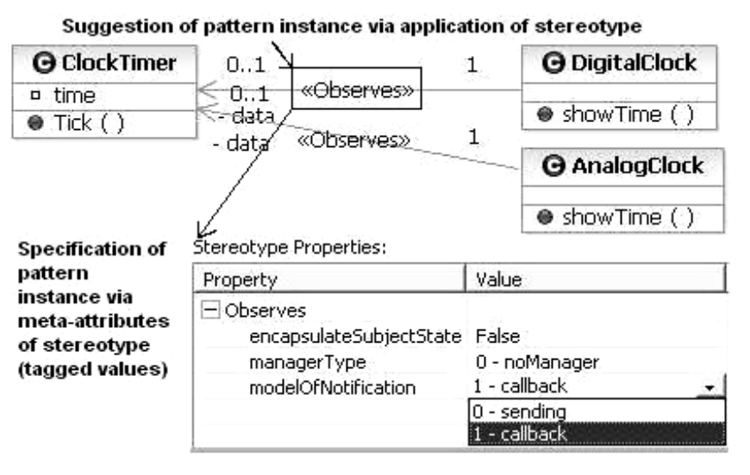
Design Pattern Support
Suggestion and specification of pattern instance
Notes:
The suggestion and the specification of pattern instance are realized by applying information on the semantics into the models provided by semantical extension of UML. For example, Figure 6 shows a suggestion of the Observer pattern instance via applying one stereotype <<Observes>> to a desired element, in this case, an association. From this information the transformation can recognize that the source element of the association represents a Concrete Observer and the destination element is a Concrete Subject. Consequently, on the basis of this information and the available pattern model and semantics, the transformation can recognize the other missing pattern participants which is necessary to add into the model.

Slide 12
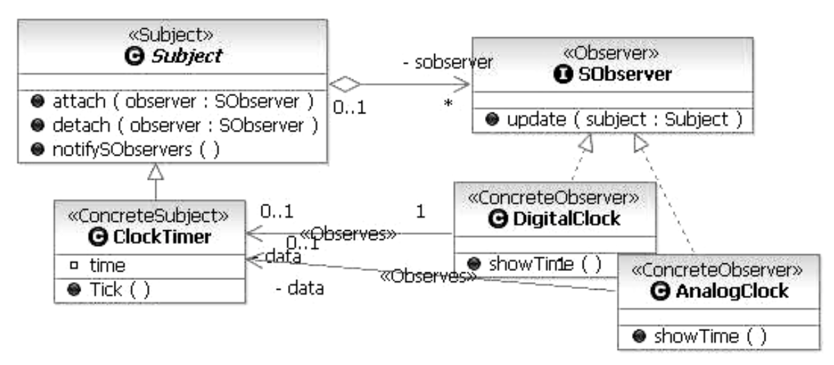
Design Pattern Support
Concretization Process in Model Level
Notes:
The concretization process is realized and automated by model transformations to lower levels of abstraction until the source code level is reached. One of the possible results of the transformation of the model from Fig. 6 is shown in Fig. 7. As can be seen the transformation generates the rest of pattern structure in a desired form in accord with pattern suggestion and specification from Fig. 6. The pattern instance becomes more concrete, so the form of the instance now represents its lower abstraction level. Thanks to
e realization of the pattern instance by placing the suggestion and specification directly into the context of elements in the application model, the transformation is also able to integrate the generated participants with participants already present in the model. As a result, the pattern instance is in the application specific form.

Slide 13
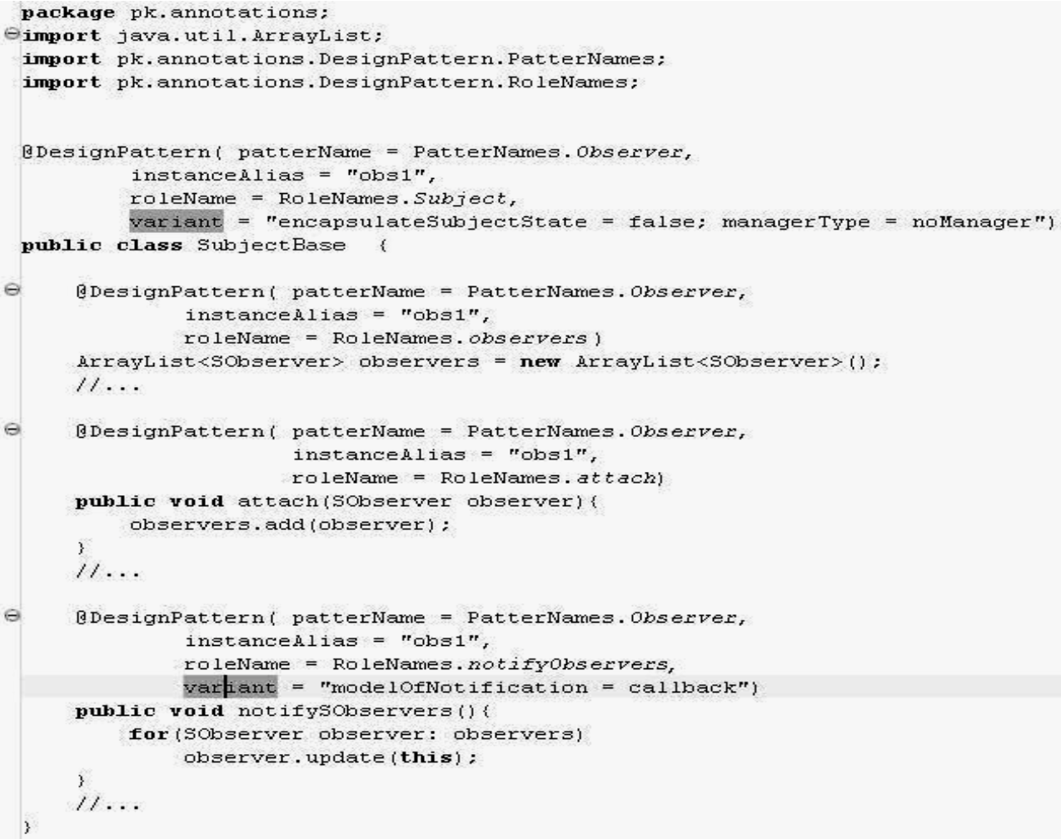
Design Pattern Support
Concretization Process in Source Code Level
Notes:
In order to propagate the visibility of the applied patterns from the model into the source code we have used proposed annotations (see Figure 4). In the Figure 8 the source code snippet of Subject generated from the model in the Figure 7 is illustrated. Each generated pattern participant is annotated with the proposed definition of annotation. The transformation of the model into the source code is realized in form of source code templates which generate the pattern participants with correct annotations as well. For classes marked with a stereotype, the template with the same name as the stereotype name is used.

Slide 14
Realization of Transformation
The model transformations are driven by properly specified and marked models of design patterns
Two types of marks
Role of the element in the pattern
Association of the element with variant of pattern
[~]StereotypeName::Meta-attributeName::value;
Notes:
The model transformations are driven by properly specified and marked models of design patterns. These prepared models cover all supported pattern variants and possible modifications. Each element of these models is marked. There are two types of marks in pattern models. The first type of marks expresses the role of the element in the scope of the pattern. On the basis of this type of marks the tool is capable of creating mappings
between models. The second type of marks expresses an association of the element with a variant of the pattern. On the basis of this type of marks the tool is capable of deciding which element should be generated into the model, which way and in what form.
For the second type of marks the following notation is defined:
[~]StereotypeName::Meta-attributeName::value;
An element from the pattern model is generated into the model only if the specified meta- attribute of the specified stereotype has the specified value. These marks can be joined via “;”, while the symbol “~” expresses negation. If an element has no mark, it is always generated into the model.

Slide 15

Realization of Transformation
First Comparison
Transformation
Second Comparison
First Comparison:
          make a mapping between models
Second Comparison:
          make a decision to which variant should be
          generated
Notes:
The first action performed by the tool after the start of the transformation is the comparison of the first type marks in pattern model to the marks in the application model. Based on the first type marks comparison the tool is capable of making a mapping between the marked models, and consequently to recognize which parts of the structure of the design pattern instance are in the model of the developing application and which are not. For example, in Figure 6 we have shown the application of the Observer pattern by applying of two stereotypes <<Observes>> on the directed association. From this way marked association the tool can recognize that the pattern roles Concrete Observer and Concrete Subject of this two Observer pattern instances are present in the model already, and also which elements (in this case classes) in the application model represent these pattern roles.
Decisions about which variant of pattern and which elements from the pattern model need to be generated into the application model are based on the comparison of the second type marks in the pattern model with the values of the meta-attributes of stereotypes. These values are set up by the developer in the second step - specification of the pattern instance (for example see Figure 6). After decision-making and selection of the desired pattern form, the final transformation is performed from the pattern suggestion level to the lower level of abstraction. The results of the transformation are correctly specialized and concrete instances of the patterns in the desired form

Slide 16
Implementation
M2M, UML2 and EMF frameworks:
    Support the first type of transformation of the model
    of highest abstraction
JET, UML2 and EMF frameworks:
    Support the second type of model transformation of lower level of abstraction(PSM) to source code
Notes:
the presented support and transformations was implemented and verified in the form of the IBM Rational Software Modeler transformation plug-in.

Slide 17
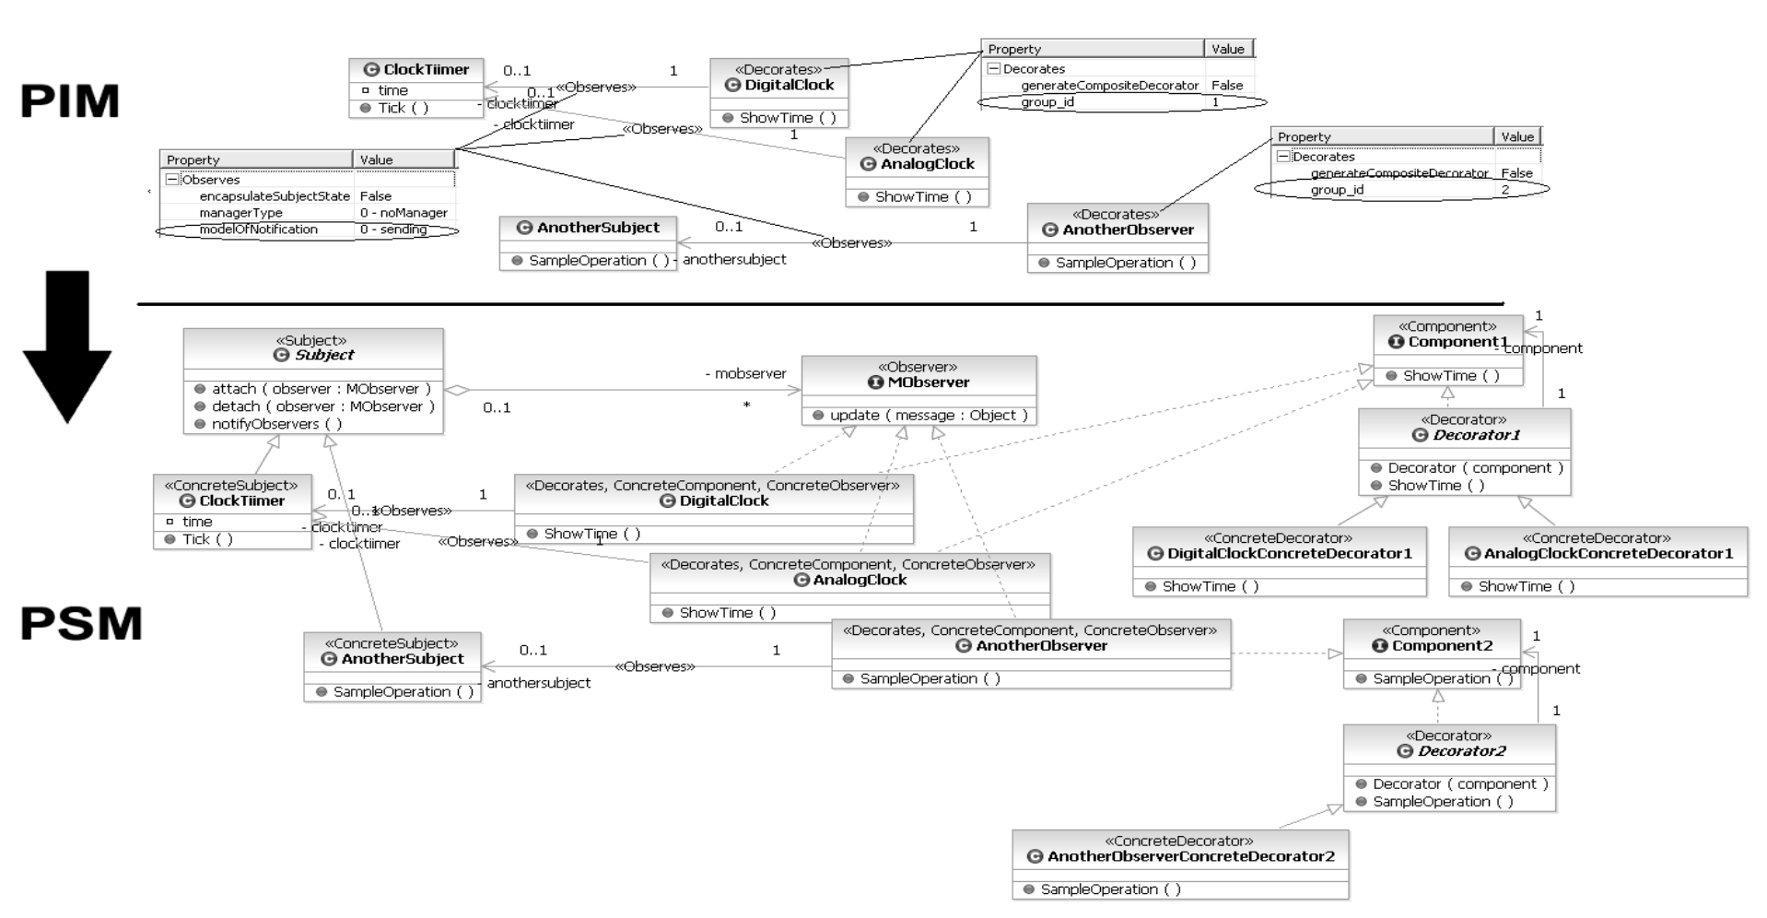
Case Study
Oberserver Pattern Application

Slide 18
Conclusion
Semantics of patterns
Specialization process of patterns
Concretization process of design pattern
model transformations
Notes:
In this paper we presented the approach to the design patterns instantiation support based on principles of model driven development.
Semantics of patterns, which is introduced into the models via UML profile and into the source code via annotations, support specialization process of patterns, because it is allowed to suggest and to specify the pattern instances participants directly on the context elements via application of specific semantic marks on them.
Subsequent model transformations support and automate the concretization process of design patterns, because they generate the rest of missing structure of suggested and specified pattern instances in desired form and directly in the context.
Consequently, both of the processes (i.e. concretization and specialization process, see Figure 1) of pattern instantiation are supported by the presented approach.
The transformations are driven by pattern instances suggestion and specification and by the pattern models as well. This way designed transformations have several capabilities. First, they provide a possibility to choose an appropriate variant of the pattern by instance specification by setting up the tagged values of the stereotypes. Second, they enable the modeling of a custom pattern or structure by modification of pattern model by which the transformation is driven, and in this way to achieve its generation into the model. The developer is enabled to model any custom structure, or even to create a new one. As a result, the method is not oriented to the GoF design pattern support only, but it can also support other custom model structures which are often created in models mechanically.
The approach splits the details of concrete design pattern instantiation into three levels of abstraction, and thus developers do not need to take care about concrete details of pattern structure in the model of the highest abstraction level.

Slide 19
Thank you

