Slide 1
Ensuring Home-based Rehabilitation Exercise by Using Kinect and Fuzzified Dynamic Time Warping Algorithm
Qiao Zhang

Slide 2
Outline
Concept Introduction
Background and Motivation
Related Work
Research Methodology
Implementation
Conclusion

Slide 3
Concept Introduction

Slide 4
Rehabilitation
Treatments and exercises concerned with remediation of impairments and disabilities.
Notes:
When physicians evaluate trajectory and speed of
rehabilitation exercise mainly based on their experience
and subjective evaluation without utilizing more precise
and measurable computer value.

Slide 5
Fuzzy Logic
In contrast with traditional logic theory, where traditional binary sets have two-valued logic: true or false, fuzzy logic variables may have a truth value that ranges between 0 and 1.
Notes:
When physicians evaluate trajectory and speed of
rehabilitation exercise mainly based on their experience
and subjective evaluation without utilizing more precise
and measurable computer value.

Slide 6
Background and Motivation

Slide 7
Rehabilitation
In the case of rehabilitation, a traditional therapy process generally conducted in a hospital setting and requires direct supervision of a skilled caregiver. The aim of home-based rehabilitation is to provide an in-home alternative to in hospital rehabilitation. Home-based rehabilitation allows
for great flexibility so that patients can tailor their program of rehabilitation and conform to individual schedules.

Slide 8
Kinect
Preprocessing that detects human object silhouette and extracts silhouette descriptors
Pose estimation that quantitatively characterizes and localizes human limbs in each frame.

Slide 9
Dynamic Time Warping Algorithm
In time series analysis, dynamic time warping (DTW) is an algorithm for measuring similarity between two temporal sequences which may vary in time or speed.
They utilize the benefit of DTW algorithm to solve comparing two sequences which have different
time length in order to determine the similarity between the
standard and the patient exercise.
Notes:
Euclidean distance measurement between frames is
generally unsuitable for comparing two sequential
movements which have different time lengths because it is
sensitive to even a small distortion in time axis.
For instance, similarities in walking patterns could be detected using DTW, even if one person was walking faster than the other, or if there were accelerations and decelerations during the course of an observation.

Slide 10
Fuzzy Logic
When physicians evaluate trajectory and speed of
rehabilitation exercise mainly based on their experience and subjective evaluation without utilizing more precise and measurable computer value.
Therefore, they cannot set a value of trajectory and speed to evaluate result using traditional logic theory.

Slide 11
Related Work

Slide 12
Rehabilitation with Device Help
Many researches use industrial motion sensors and Nintendo Wii Remote to assist physicians and patients.
(x) Uncomfortable and boring: motion sensors have some defects, such as patients need to fasten it on limbs, hold it in the hands or wear it on the body.

Slide 13
Kinect Applications
These Kinect games can let users to do exercise in their home, but the wrong exercise leads to sports injuries.
Previous work proved that patients can get more motivation and outcome of rehabilitation with Kinect.
But their rehabilitation systems are too specific.

Slide 14
Fuzzy Logic
There are a handful of existing systems that utilize fuzzy logic evaluation.
The accuracy can be as high as 80-90%.
Further, the application of fuzzy set theory can provide an effective way to formulate decision problems in a fuzzy environment where the information available is subjective and imprecise.

Slide 15
Research Methodology

Slide 16
Phases
A tailored exercise is performed by the patient and recorded under the supervision of a physician by using the proposed KEHR system.
The evaluation can then be achieved by exploring the differences derived from two factors:
1. Trajectory disparity: the motional path created by each joint over time
2. Speed variation: the time consumption in completing a designated exercise.

Slide 17
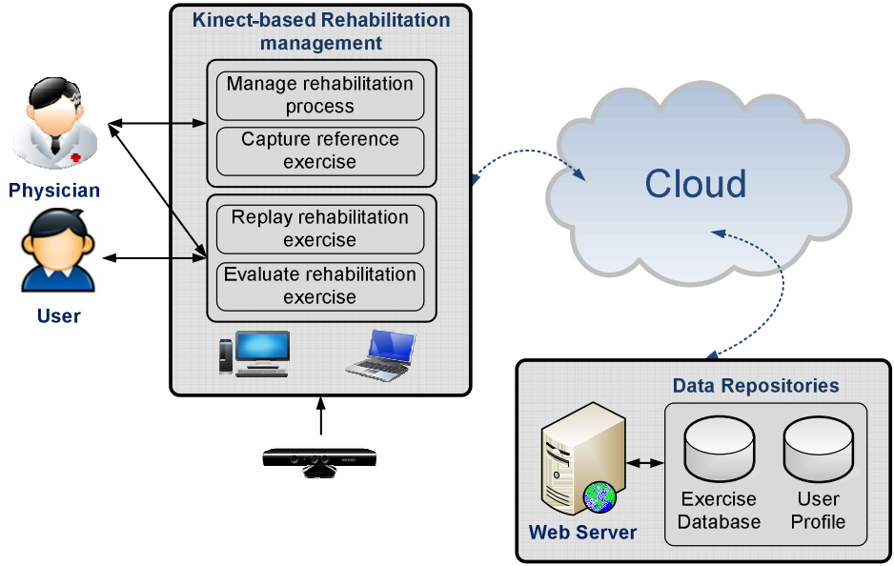
The KEHR Architecture
Notes:
The Kinect-based rehabilitation management module
provides full functionality for users to practice
rehabilitation exercise with Kinect at home.
The Data Repositories module
Exercise Database and User Profile.

Slide 18
Kinect-based Rehabilitation Management Module
Manage rehabilitation process
Capture user performed exercise under supervision of a professional
Replay the exercise for user to execute at home
Evaluate the performance of the exercise.

Slide 19
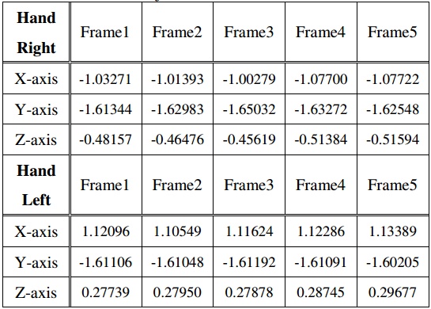
Capture
Notes:
An example of captured positional data of “Hand_right” and “Hand_left”
joints is illustrated in this table.

Slide 20
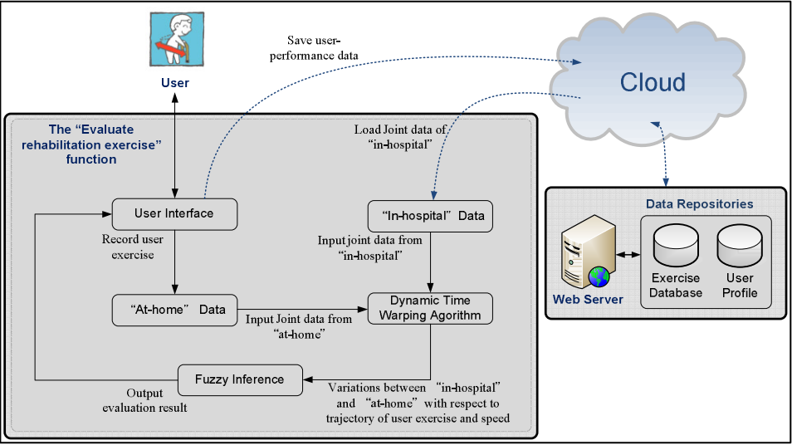
Evaluate - Overview
Notes:
This is the core function in KEHR system. This
function applies the DTW algorithm that can adapt to
sequences that vary in speed and time for measuring the
similarity of streaming joint data between “at-home” and
“in-hospital” videos.
The sequence of captured joint
data (at-home data) will then be used to compare against
the sequence stored (in-hospital data) in the data repository.

Slide 21
Evaluate - DTW
Given two time series
A = (a1, a2, … , am) and B = (b1, b2 , … , bn) where
ai = ( xi, yi, zi ), i=1,…,m; bj = ( xj , yj , zj ), j=1,…,n;
To align two sequences using DTW they construct an n-by-m matrix where the (ith, jth) element of the matrix contains the Euclidean distance between the two points ai and bj.
A warping path P is a contiguous set of
matrix elements that defines a mapping between A and B.
The warping path has too satisfy 3 criteria:
Boundary condition, Continuity, Monotonic condition
Notes:
This is the core function in KEHR system. This
function applies the DTW algorithm that can adapt to
sequences that vary in speed and time for measuring the
similarity of streaming joint data between “at-home” and
“in-hospital” videos.
The sequence of captured joint
data (at-home data) will then be used to compare against
the sequence stored (in-hospital data) in the data repository.

Slide 22
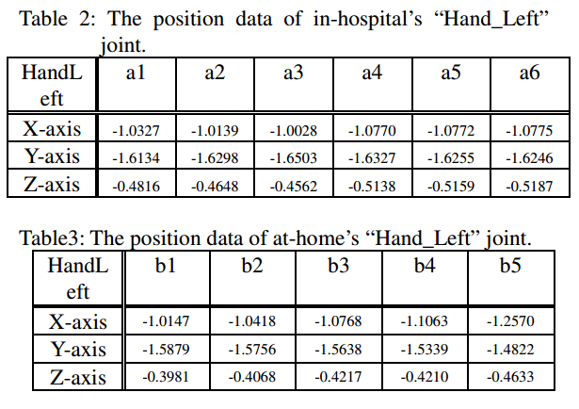
Evaluate – DTW example
Notes:
This is the core function in KEHR system. This
function applies the DTW algorithm that can adapt to
sequences that vary in speed and time for measuring the
similarity of streaming joint data between “at-home” and
“in-hospital” videos.
The sequence of captured joint
data (at-home data) will then be used to compare against
the sequence stored (in-hospital data) in the data repository.

Slide 23
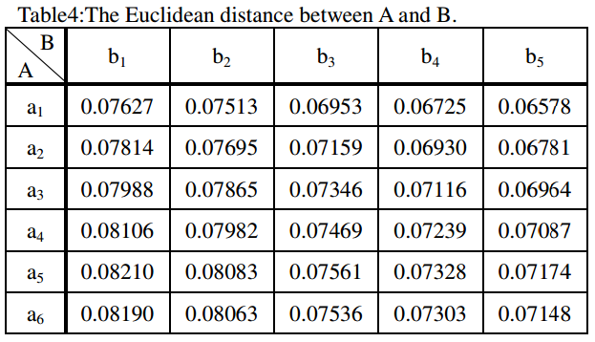
Evaluate – DTW example
Notes:
This is the core function in KEHR system. This
function applies the DTW algorithm that can adapt to
sequences that vary in speed and time for measuring the
similarity of streaming joint data between “at-home” and
“in-hospital” videos.
The sequence of captured joint
data (at-home data) will then be used to compare against
the sequence stored (in-hospital data) in the data repository.

Slide 24
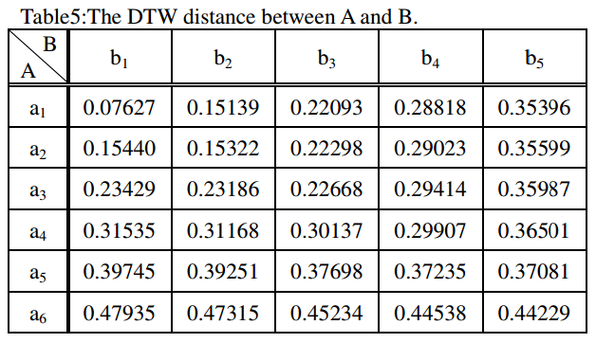
Evaluate – DTW example
Notes:
This is the core function in KEHR system. This
function applies the DTW algorithm that can adapt to
sequences that vary in speed and time for measuring the
similarity of streaming joint data between “at-home” and
“in-hospital” videos.
The sequence of captured joint
data (at-home data) will then be used to compare against
the sequence stored (in-hospital data) in the data repository.

Slide 25
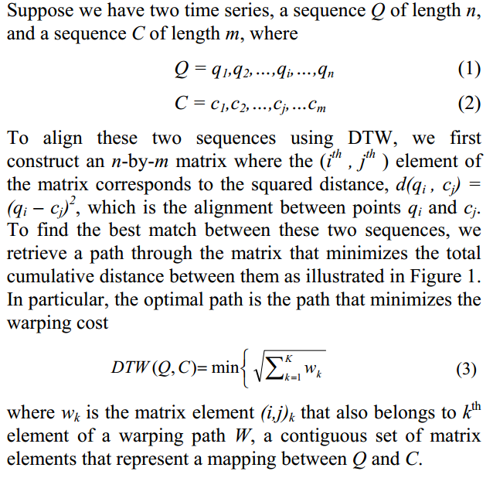
But what is DTW distance?

Slide 26
Evaluate – DTW example
{(a6,b5) (a5,b5) (a4,b4) (a3,b3) (a2,b2) (a1,b1)}
Notes:
This is the core function in KEHR system. This
function applies the DTW algorithm that can adapt to
sequences that vary in speed and time for measuring the
similarity of streaming joint data between “at-home” and
“in-hospital” videos.
The sequence of captured joint
data (at-home data) will then be used to compare against
the sequence stored (in-hospital data) in the data repository.

Slide 27
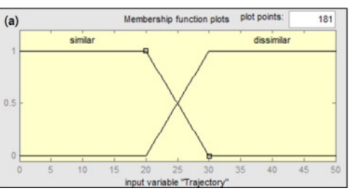
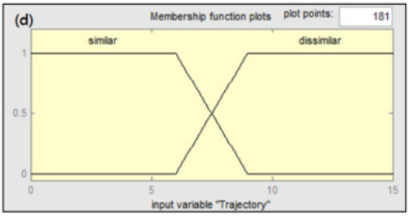
Evaluate - Fuzzy Inference
The Euclidean distance Ed of the optimal path is calculated for serving as a metric of disparity between A and B.

Slide 28
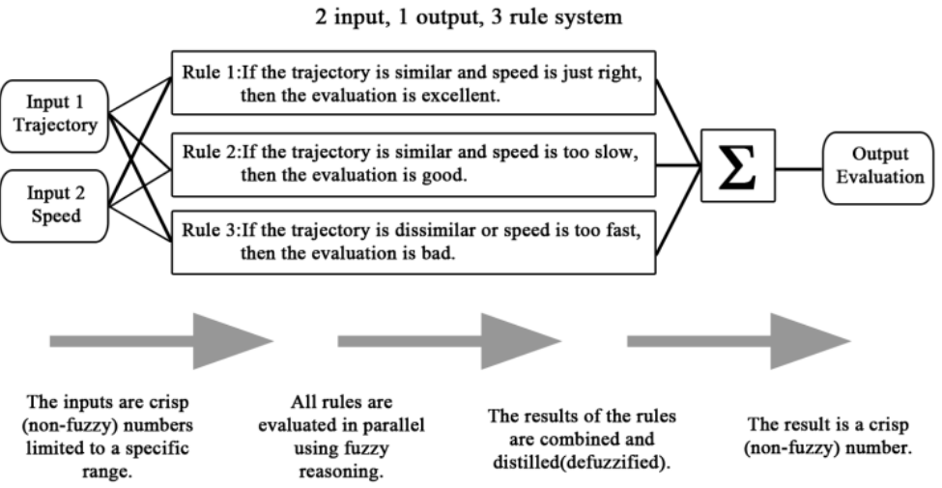

Slide 29
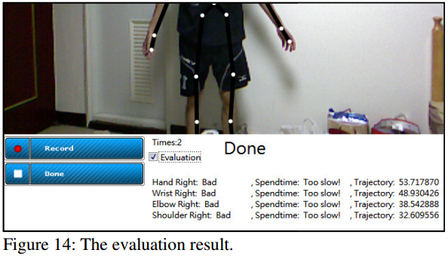

Slide 30
Implementation

Slide 31
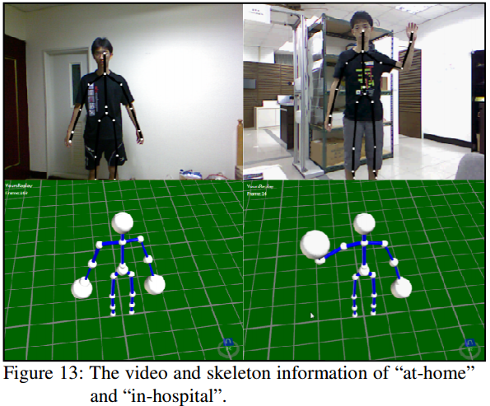

Slide 32
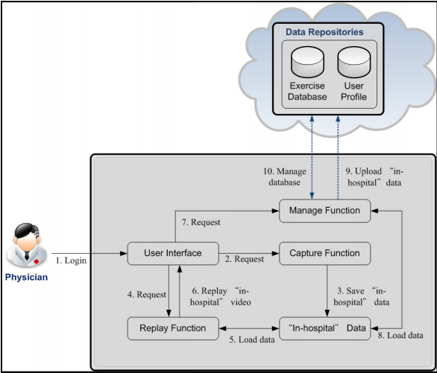

Slide 33
Conclusion

Slide 34
Conclusion
They tested the KEHR on three different shoulder rehabilitation exercises performed by four different users. The evaluation by KEHR agrees with the physician with the average of 80.01%. This result shows that KEHR is suitable for home-based rehabilitation exercise.

Slide 35
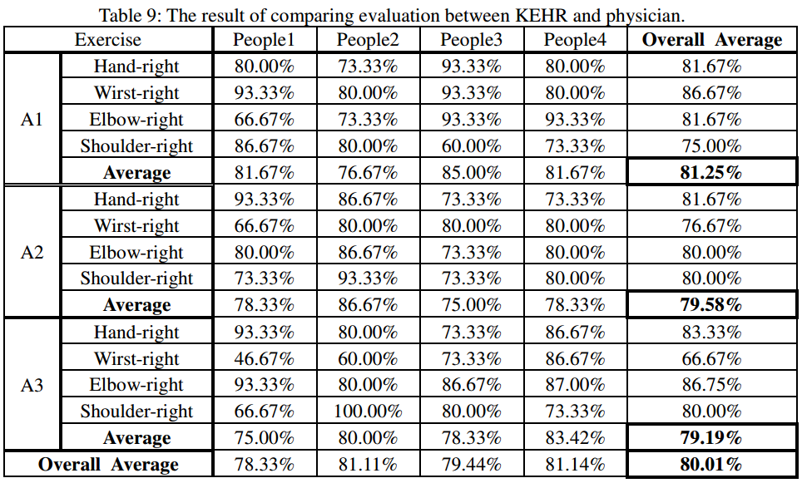

Slide 36
Using the Kinect to Encourage Older Adults to Exercise

Slide 37
Motivation
Though older adults are willing to exercise, they
fear injury, which is a hindrance. They would prefer
exercising at their convenience in the safety of their
homes and to use methods that are cost-effective and convenient to them.
Make exercise fun, such as through a game.

Slide 38
Data Gathering
Discussion with Field Expert
The prime problem areas were identified as: (a) flexibility, (b) strengthening, (c) walking, and (d) balance.
Focus Group
The discussion revealed that all of the participants
walked on a regular basis and enjoyed the activity and saw it as pleasurable. However, they were also
intimidated to take a walk by themselves because of
safety issues.

Slide 39
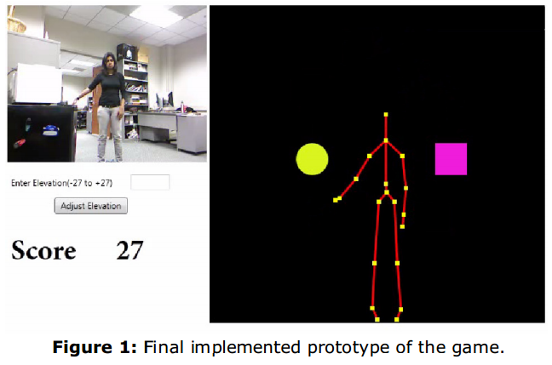
Design and Prototype

Slide 40
Questions?
Thanks for listening!

