Slide 1
Ubiquitous Advertising: the Killer Application for the 21st Century
Author: John Krumm
Presenter: Anh P. Nguyen (apn15@pitt.edu)

Slide 2
Introduction
Advertising could be a “Killer Application” for ubiquitous computing.
  Many ubiquitous computing application will be supported by advertising as a continuation of the trend from internet sites.
  Ubiquitous computing techniques can help solve problems such as ad targeting and evaluating ads’ effectiveness.
Notes:
Currently the main alternative of ad is subscription. But few users are willing to subscribe to get rid of ads, thus users are more willingly to accept ads than spending small amount of money for subscription.

Slide 3
Ad Targeting
Segmenting and targeting
Ad targeting helps advertisers reach intended customer/audience.
Segmentation: divide customers into different groups based on traits such as demographics, psychographics, behavior.
  Example: age, user’s browsing history.

Slide 4
Ad Targeting
Targeting with Ubicomp
Location sensing methods such as database of Wifi-access point and cell towers.
  Example: Skyhook Wireless, Acuity Mobile (location, time of dated).
Looking ads that change accordingly to its current context
  Example: New York city buses, shopping carts with location sensors and digital display, billboards with radio sensor.

Slide 5
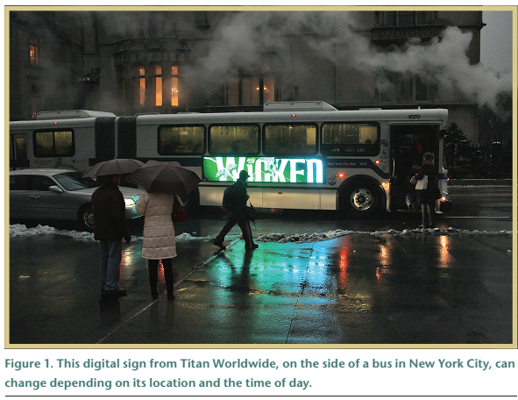

Slide 6
Ubicomp Tech for Targeted Ad – more examples and possibilities
Sense simple event at home to infer the activities.
Infer traveler’s mode of transportation based on GPS traces.

Slide 7
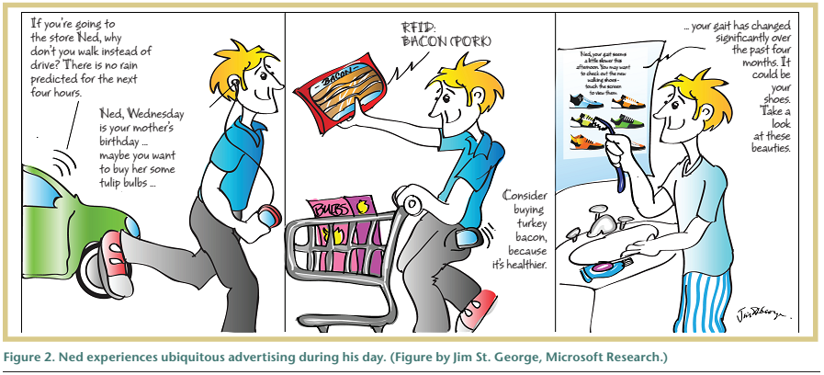
An ideal scenario of ubiquitous advertising

Slide 8
Ad-next: a Visit-Pattern-Aware Mobile Advertising System for Urban Commercial Complex
Author: Byoungjip Kim et al.
Presenter: Anh P. Nguyen (apn15@pitt.edu)

Slide 9
Introduction
Mobile advertising is going to be application that brings profit in future.
Commercial complexes such as COEX Mall has 260 stores and has hundred thousand visitor each days. Many of them go there to buy stuff.
Problems:
  Advertising in big complex mall is important business.
  How to help user find a correct store.
Two assumptions:
  Spatial relevant: if user is interested and there is relevant location nearby, user is likely to go there.
  Temporal relevant: if user is likely to purchase a product at a specific moment, a relevant ad at that moment will likely make user actually buy that product.

Slide 10
AdNext
Predict users’ next visit place based on probabilistic prediction model.

Slide 11
AdNext design
AdNext clients (mobile phone)
- Collect place-in, place-out using Wi-fi fingerprint.
- Notify user if an ad is available
- Collect user behavior
Advertising server
  - Build a prediction model
  - Send relevant ads based on prediction model
    - Collect the statistic

Slide 12
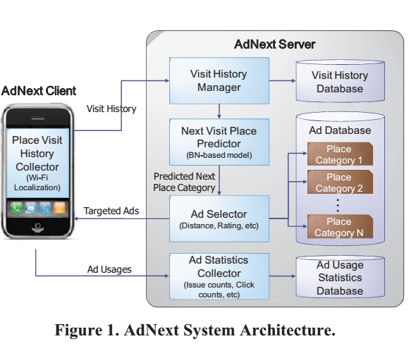

Slide 13
Collect Place Visit history
Problem:
  Need to trace the place-in and place-out event (time, duration, location)
  Technique: Wifi localization
    A database of Wifi access point ID is stored.
    A collection of signal strength and AP ID is used to predict user current location.
    The duration of time user stop at a specific location is used to predict if user enter a store or just passing by.

Slide 14
Predicting the Next Visit Place
Problems:
  Human behavior is uncertain by nature.
  Privacy problem: people do not like to be monitored.
Idea:
  Visit causality
  Common visit pattern.

Slide 15
Select Relevant Ads
Problem:
  Given a prediction result, there are many candidate ads. In COEX Mall, there are 60 placed classified as fashion shop, 50 places classified as restaurants.
  Mobile screen is small
Two parameters: distance and rating
  c is user, p_{a} is place of ad a.

Slide 16
Evaluation
A clean dataset of 76 people with 351 visits is collected.
The data include place (P), visit time (T), visit duration (D), gender (G), age (A)

Slide 17
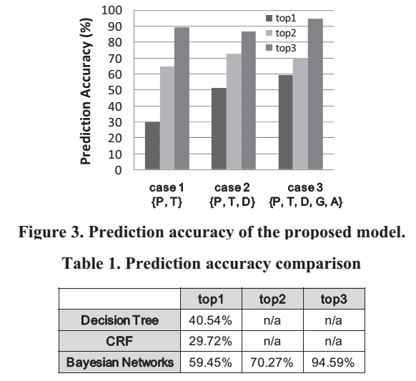
Evaluation
                CRF is conditional random field,
                a probabilistic prediction model

Slide 18
Thank you

