Slide 1
Combining Classifiers
Wen-Chyi Lin
November 11, 2014

Slide 2
Contents
On Combining Classifiers
Theoretical Framework
Combination Rules
Combination Strategies
Experimental Comparison
  Identity Verification
  Handwritten Digit Recognition
Error Sensitivity
Ensemble Based Systems in Decision Making
Reasons for Using EBS
Key Components of EBS
Decision Profile
Ensemble generation techniques
Current & Emerging Areas
Conclusions
Notes:
Problem decomposed naturally from using various sensors

Slide 3
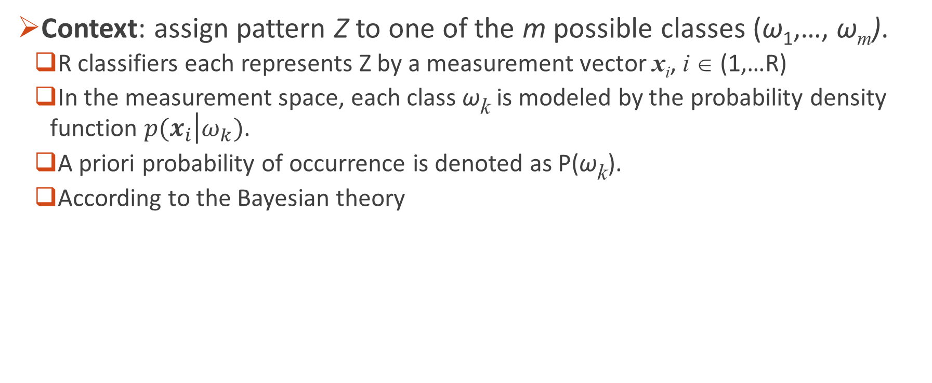
Theoretical Framework
Context: assign pattern Z to one of the m possible classes (ω₁,…, ω_{m}).
  R classifiers each represents Z by a measurement vector x_{i}, i ∈ (1,…R)
  In the measurement space, each class ω_{k} is modeled by the probability density function $p(x_{i}\left|ω_{k}\right.)$.
  A priori probability of occurrence is denoted as P(ω_{k}).
  According to the Bayesian theory
On Combining Classifiers
Notes:
We shall consider the models to be mutually exclusive which means that only one model can be associated with each pattern.

Slide 4
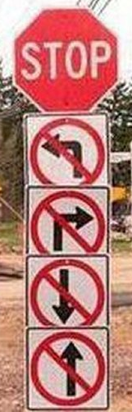
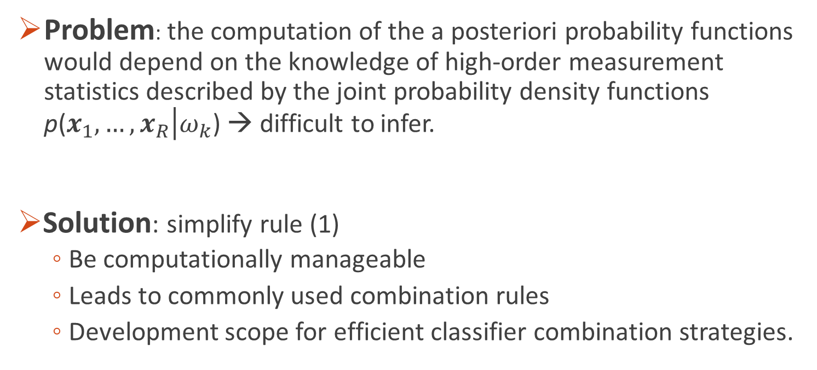
Theoretical Framework (cont.)
Problem: the computation of the a posteriori probability functions would depend on the knowledge of high-order measurement statistics described by the joint probability density functions p($x_{1},…,x_{R}\left|ω_{k}\right.$) → difficult to infer.
Solution: simplify rule (1)
    Be computationally manageable
    Leads to commonly used combination rules
    Development scope for efficient classifier combination strategies.
On Combining Classifiers

Slide 5

Combination Rules
Product Rule
Assume classifiers’ measurements are independent
Supports provided by the classifiers are multiplied
Works: provides the best estimate of the class if individual posterior probabilities are estimated correctly at the classifier outputs
Doesn’t Work: very sensitive to the most pessimistic classifiers: any classifier yields close to 0 support will remove the chance of correct discrimination
On Combining Classifiers

Slide 6
Start from here
Product Rule
supplemental information
On Combining Classifiers

Slide 7
noise
Sum Rule
Approximate by ignoring terms order >2
Use (8) again, we get
On Combining Classifiers

Slide 8
Combination Strategies
Product rule (7) & Sum rule (11) constitute basic schemes for classifier combination
The lower & upper bounds in (12) can approximate (7) & (11)
Min Rule
Median Rule
Max Rule
Voting Rule
On Combining Classifiers

Slide 9


Experimental Comparison (1/2):
Identity Verification
Based on speech, frontal face and face profile analysis: non-intrusive and user-friendly
Speech and image-based systems are less robust to imposter attack, especially if the imposter possesses information about a client:
  a photograph of client's face
  a recording of client's speech
Multi-modal system may be considered as one of the most promising approaches
On Combining Classifiers
Notes:
reliable methods of biometric personal identification exist, eg. fingerprint analysis, retinal or iris scans, most of these methods are considered unacceptable by users in all but high-security scenarios

Slide 10
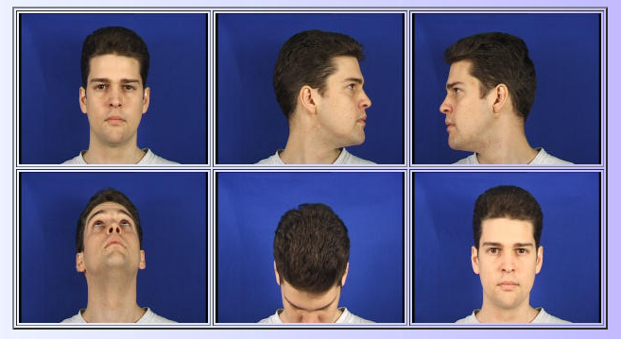
Identity Verification
Frontal Faces
Face Profile
Rotating head movements
Speech
"zero one two three four five six seven eight nine"
"five zero six nine two eight one three seven four"
"Joe took fathers green shoe bench out"
(Dataset)
On Combining Classifiers
http://www.ee.surrey.ac.uk/CVSSP/xm2vtsdb/

Slide 11

Identity Verification
profile
Experimental Results
face
speech
face
speech
On Combining Classifiers
Correlation Matrix
Notes:
correlation is 0~1 in the case of a perfect direct (increasing) linear relationship (correlation), 0~−1 in the case of a perfect decreasing (inverse) linear relationship (anticorrelation)
Table 1 show the benefits of classifier combination. It is interesting to note that the sum rule outperformed all the other combination strategies and also the
individually best expert.

Slide 12
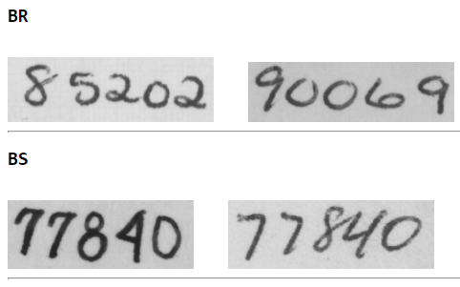
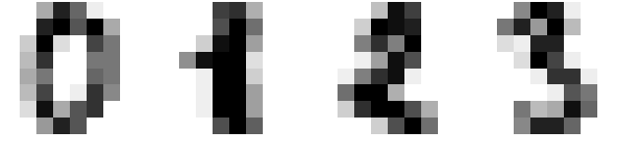
Experimental Comparison (2/2):
Handwritten Digit Recognition
4 classifiers, same dataset but different representations
  Gaussian: Pixel-level, scale into 10x10 gray level image
  Structural: thinning, skeleton decomposition
  HMM: quantized two 1D signals into 16 vectors in the codebook
  Neural Network: use pixel representation in Gaussian to derive feature description
  Input layer: 100 nodes (100 dimensions)
  Hidden layer: 25 nodes
  Output layer: 10 nodes (each node one class)
(Dataset)
On Combining Classifiers
http://www.cedar.buffalo.edu/Databases/CDROM1/

Slide 13
Handwritten Digit Recognition
Results Analysis
  Misclassification should not be strongly correlated
  Using different representations for the object
  Using different classification principles
On Combining Classifiers
Notes:
An important requirement for a combiner that uses the output of the individual classifiers is that the classifiers should not be strongly correlated in their “misclassification.” That is, classifiers should not agree with each other when they misclassify a sample, or at least they should not assign the same incorrect class to a sample.

Slide 14
Error Sensitivity
Product Rule
Sum Rule
error amplified by
error dampened by
On Combining Classifiers

Slide 15
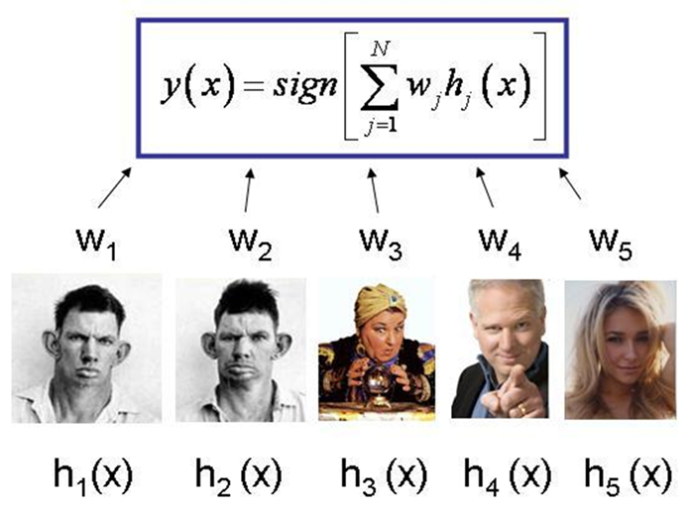

Ensemble Based Systems in Decision Making
Strong EBS
Weights
Weak Learner
friend
Avatar
Astrologist
bro
GF
Ensemble Based Systems in Decision Making

Slide 16
Reasons for Using EBS
Advantage Over Single-expert Systems
Try the questions below: ask an expert or stay with the audience?
  Pikachu is primarily what color? Red, Yellow, Green or Blue?
https://www.youtube.com/watch?v=009OFAloJWI
  George Orwell’s “1984” opens with the line, “It was a bright cold day in April, and the clocks were striking” what? 8, 12, 13 or 20?
https://www.youtube.com/watch?v=l0MWAcN5IzM
Ensemble Based Systems in Decision Making
Notes:
If the contestant did not know the answer to the question, s/he could elect to have two incorrect answers be removed from the four possible choices, telephone a friend whom s/he thought to be knowledgeable on the subject matter, or simply poll the audience.
the specific scenarios in which ensemble systems may provide a clear advantage over single-expert systems
"striking thirteen" (1:00 pm). In Nineteen Eighty-Four, the 24-hour clock is modern, the 12-hour clock is old-fashioned,
Nineteen Eighty-Four, sometimes published as 1984, is a dystopian novel by George Orwell published in 1949

Slide 17
Reasons for Using EBS
Statistical Reasons:
  reduce the overall risk when classifiers generalization performances are insufficiently represent the future field data
Large Volumes of Data:
  use magnetic flux leakage techniques to inspect gas transmission pipelines
  generates 10 GB of data for every 100 km of pipeline
  pipeline are over 2 million km
Too Little Data:
  resampling techniques can be used for drawing overlapping random subsets of the available data, each of which can be used to train a different classifier, creating the an effective ensemble system
Ensemble Based Systems in Decision Making
Notes:
In the absence of adequate training data,

Slide 18

Reasons for Using EBS
Divide and Conquer:
Data Fusion:
Ensemble Based Systems in Decision Making
Notes:
In diagnosing a neurological disorder, for example, the neurologist may order several tests, such as an MRI scan, EEG recording, blood tests, etc. Each
test generates data with a different number and type of features, which cannot be used collectively to train a single classifier. In such cases, data from each testing
modality can be used to train a different classifier, whose outputs can then be combined. Applications in which data from different sources are combined to make
a more informed decision are referred to as data fusion applications, and ensemble based approaches have successfully been used for such applications.

Slide 19
Key Components of EBS
Build an EBS as diverse as possible
Correct decisions are amplified and incorrect ones are cancelled out
Design an EBS
  how will individual classifiers (base classifiers) be generated?
  how will they differ from each other?
Ensemble Based Systems in Decision Making
Notes:
The answers ultimately determine the diversity of the classifiers, and hence affect the performance of the overall system. Therefore, any strategy for generating
the ensemble members must seek to improve the ensemble’s diversity

Slide 20
Ensemble generation techniques
Bagging (Bootstrap Aggregating):
  training subsets randomly drawn with replacement to train a different classifier
  Decisions combined via majority vote

Slide 21
Ensemble generation techniques
AdaBoost
  Consecutive training data are geared towards increasingly hard to classify instances
  Use weighted majority voting

Slide 22
Ensemble generation techniques
Mixture of Experts

Slide 23
Decision Profile
Ensemble Based Systems in Decision Making

Slide 25
Current & Emerging Areas
Incremental Learning
  Previous data may be lost or unavailable
  Generate additional EBS with subsequential database
Data Fusion: e.g. diagnosis a neurological disorder
  Combine medical test results: MRI scan, EEG and blood tests
Feature Selection
  Iteratively updated feature distribution to address the missing feature problem
  Instance with certain missing features can still be classified
Ensemble Based Systems in Decision Making
Notes:
Instance with certain missing features can still be classified by a pool of classifiers didn’t use the missing feature during training.

Slide 26
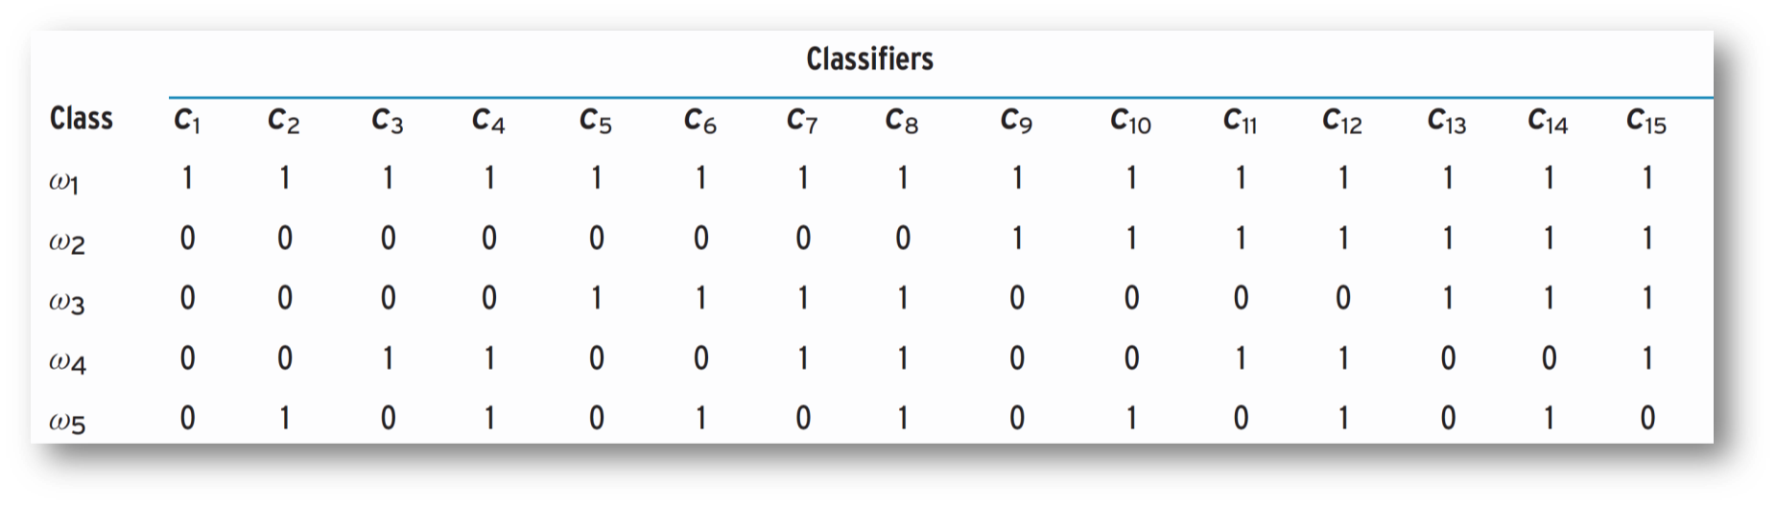
Current & Emerging Areas
Error Correcting Output Codes (ECOC)
  Decompose a multi-class problem into two-class problems
  Shortest Hamming distance → decision
  Does not match any code words exactly → error correcting ability
Ensemble Based Systems in Decision Making
[0 1 1 1 0 1 0 1 0 1 0 1 0 1 0]

Slide 27
Conclusions
EBS is beneficial
  weaknesses of one method could be compensated by the others
  a friend has a very high prior probability vs. the audience
As Diverse As Possible:
  be asynchronous: divide dataset into subsets, each used to train different classifiers
Occam‘s razor (about 8 centuries ago):
  In the absence of prior information, the best ones are usually the simplest and least complicated ones that can learn the underlying data distribution
  The Flower Garland Sutra: those who have no view can witness every law
  (無見乃能見，一切真實法；於法有所見，彼則無所見)
Notes:
EBS is beneficial since the weaknesses of one method could be compensated by the others and therefore the result is expected to be more reliable.
as diverse as possible:
the methods should not have the same decision boundaries (=be asynchronous). to meet this condition is to divide training dataset into smaller subsets when each of them is used for learning of different classifier.
If you know your friend has a very high probability of knowing the correct answer (prior probability), you are better off with the audience
Avatamsaka Sutra: 無見乃能見，一切真實法；於法有所見，彼則無所見
No-view is precisely a kind of view, those who have no view can witness every law (of the Buddha). Avatamsaka Sutra is a Buddhist Sutra also known as The Flower Garland Sutra, a good book to understand Buddha, also provides profound wisdoms about views

Slide 28

References
Kittler, Josef, et al. "On combining classifiers." Pattern Analysis and Machine Intelligence, IEEE Transactions on 20.3 (1998): 226-239.
Polikar, Robi. "Ensemble based systems in decision making." Circuits and Systems Magazine, IEEE 6.3 (2006): 21-45.
http://www.ee.surrey.ac.uk/CVSSP/xm2vtsdb/
http://www.cedar.buffalo.edu/Databases/CDROM1/

