Slide 1
SEMINAR
Wei Guo

Slide 2
Software Visualization in the Large

Slide 3
Background
  Large Computer programs are complex and difficult to maintain
  Invisible nature of software
  Large team-oriented projects
  Productivity is low, changes are error-prone, and software projects are often late.

Slide 4
Background
Software visualization tools
  Software structure
  Run-time behavior
  The code itself
Useful for small projects, do not scale to the production-sized systems.
  Hand-crafted
  Requires the designer to understand the code before visualizing it
Decomposing?
  Difficult to decompose
  “Big picture” lost
Notes:
Add Image

Slide 5
New Techniques
New scalable techniques for visualizing program text, text properties, and relationships involving program text.
  The representations of code
    Line Representation
    Pixel Representation
    File Summary Representation
    Hierarchical Representations
  Appliance of them to visualize production softwares
    Code version history
    Differences between releases
    Static properties of code
    Code profiling and execution hot spots
    Program slides

Slide 6
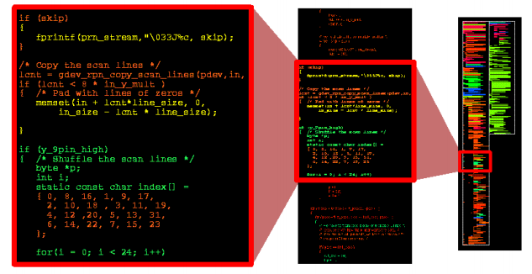
Visual Presentations
1. Line Representation

Slide 7
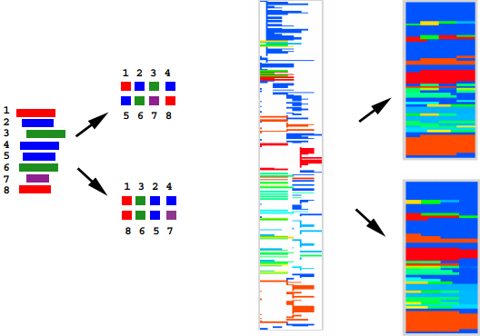
Visual Representations
2. Pixel Representation

Slide 8
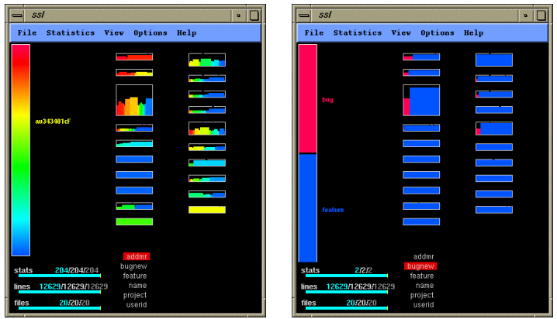
Visual Representations
3. File Summary Representation

Slide 9
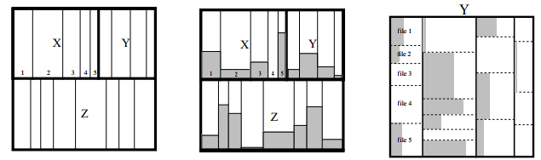
Visual Representations
4. Hierarchical Representations

Slide 10
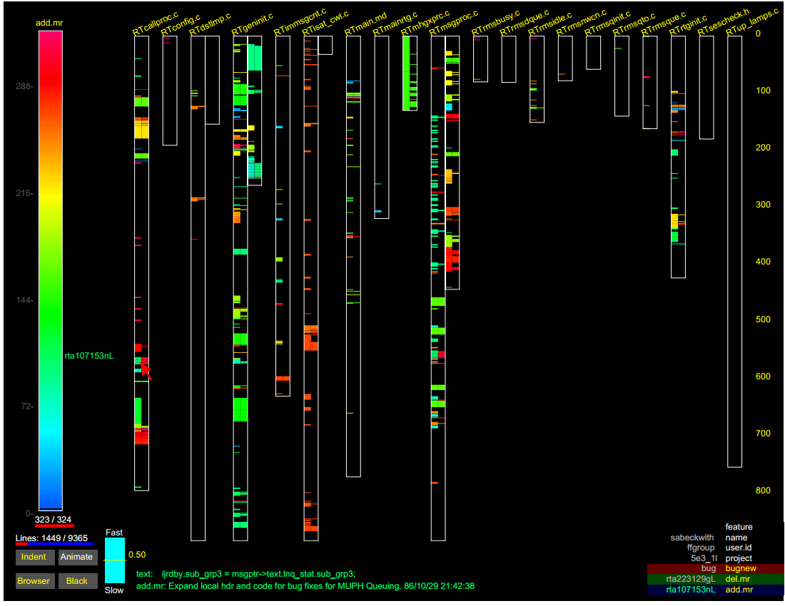
Software Engineering Examples
1. Code change history
  Code discovery
  Code decay
  Track changes

Slide 11
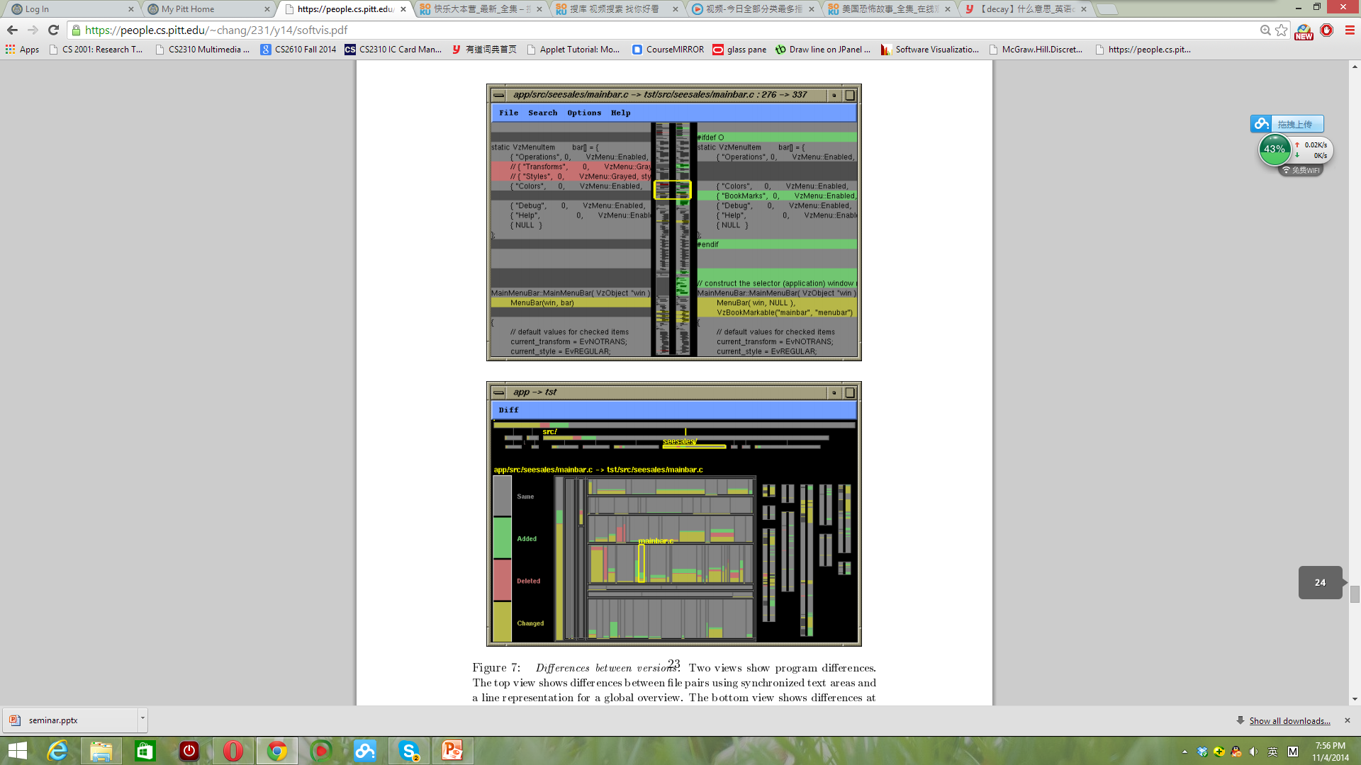
Software Engineering Examples
2. Program comparison

Slide 12
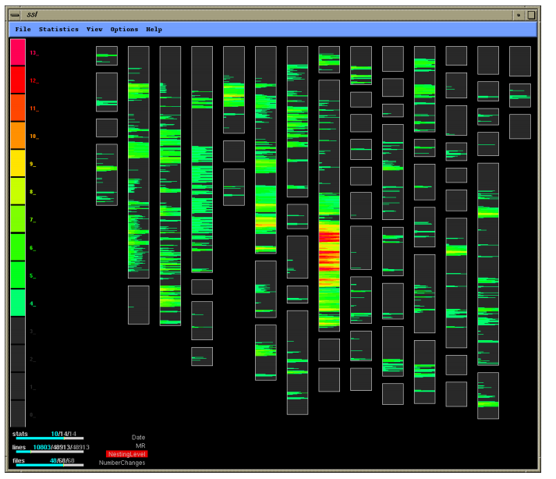
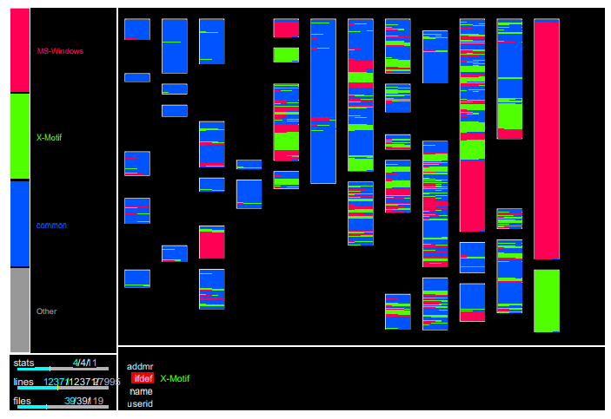
Software Engineering Examples
3. Code characteristics and software complexity
  Preprocessor directives
  Conditional nesting complexity

Slide 13
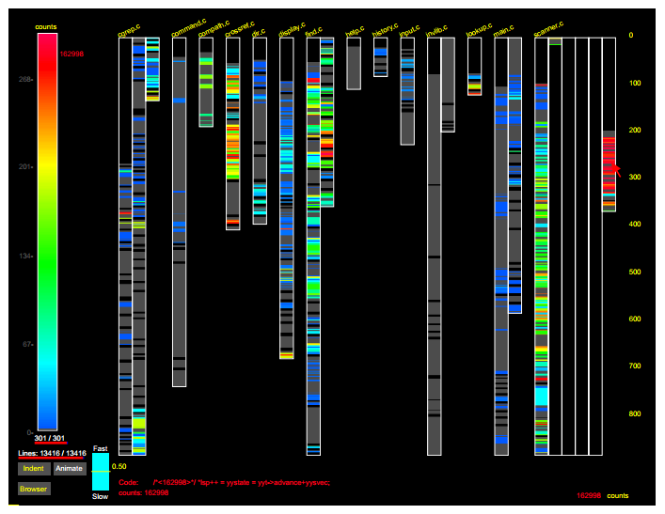
Software Engineering Examples
4. Program profiles and code coverage

Slide 14
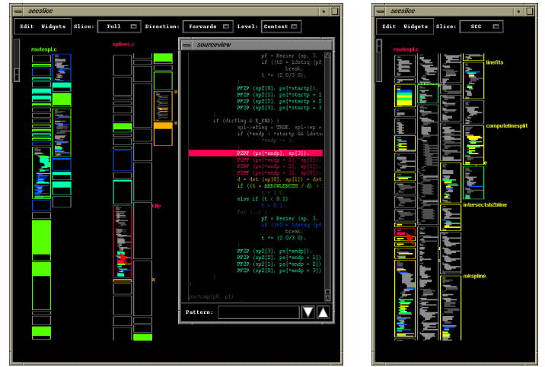
Software Engineering Examples
5. Dynamic program slices

Slide 15
Visual Data Mining in Software Archives

Slide 16
Introduction
  Software Archives: The information stored by a configuration management system and related tools. It provides the history of a software system.
  Association rules: suggests further changes that should be performed for a set of given changes.
  Sequence rules: indicates the order of these changes

Slide 17
Introduction
Analyzing the software archives can reveal regularities and anomalies in the development process of the system (rules)
This paper discusses the visualization techniques that implemented (EPOSee) to analyze both association as well as sequence rules.

Slide 18
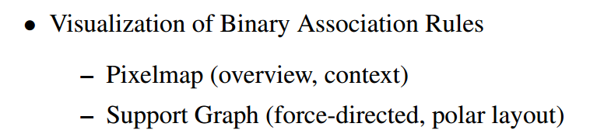
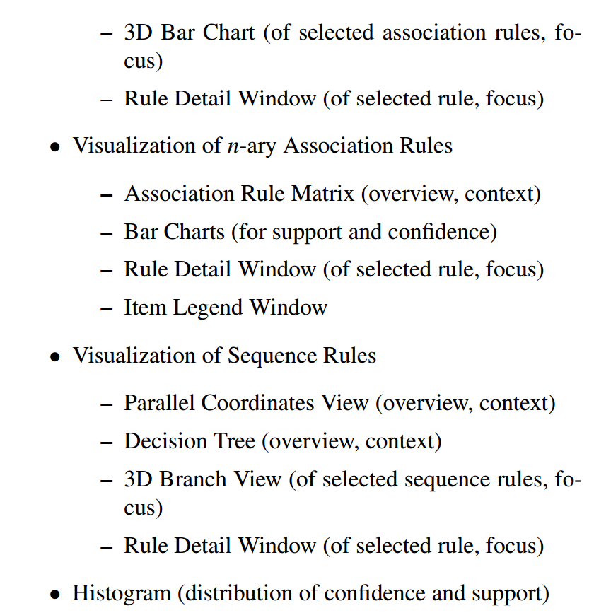
EPOSee
A visualization tool that integrates various visualization techniques.
  Provides:
Notes:
Typical visual data mining process: Overview first, zoom and filter, then details on demand.

Slide 19

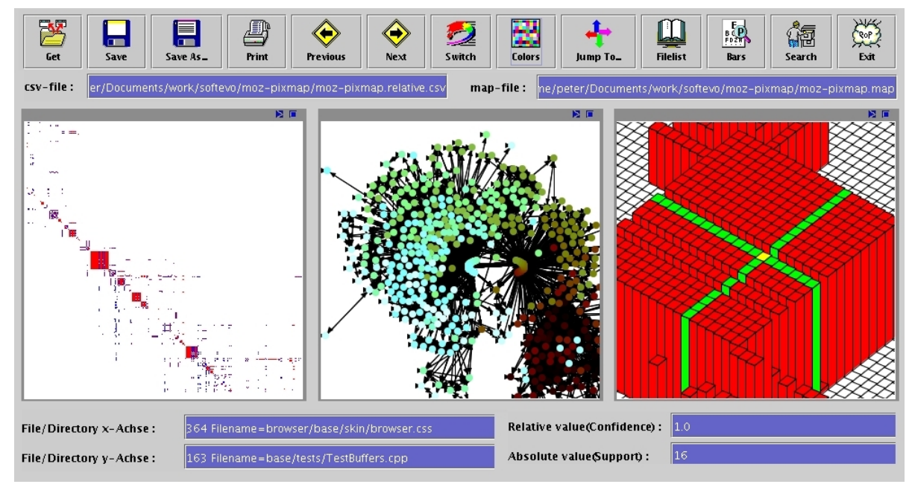
Association Rules
Binary

Slide 20
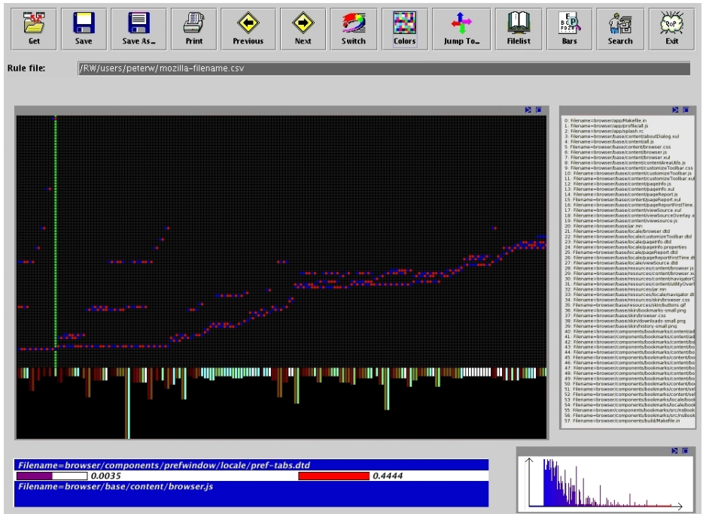

Association Rules
N-ary
A and B are disjoint sets each containing at least
one item

Slide 21
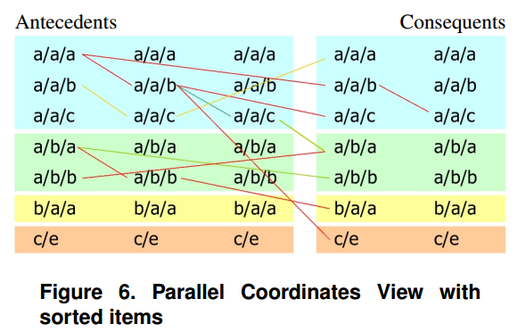
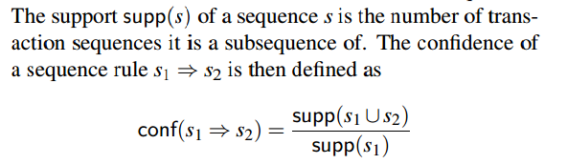
Sequence Rules
Eg: if method print() and method show() of the file Account.java have been changed in a row, then later the documentation GUI.tex has been changed, too.

Slide 22
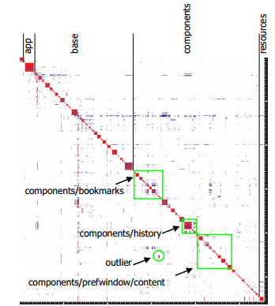
Case Study: MOZILLA
MOZILLA archive contains more than 77000 files.
We use data mining to extract rules from the MOZILLA CVS archive and applied techniques above.
Associations of the files in the /browser
subdirectory of the CVS software archive
of the MOZILLA project.

Slide 23
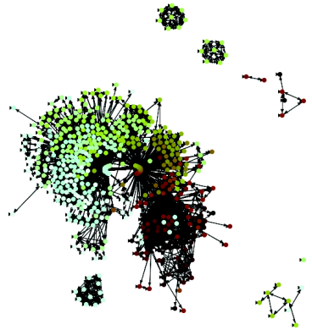
Case Study: MOZILLA
MOZILLA archive contains more than 77000 files.
We use data mining to extract rules from the MOZILLA CVS archive and applied techniques above.
Support graph for /browser directory of the
MOZILLA project to look like the clusters and
outliers.

Slide 24
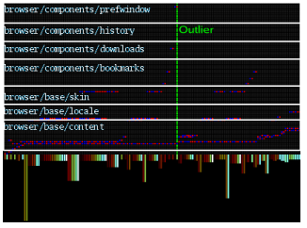
Case Study: MOZILLA
MOZILLA archive contains more than 77000 files.
We use data mining to extract rules from the MOZILLA CVS archive and applied techniques above.
Association Rule Matrix of the /browser
directory of MOZILLA.

Slide 25
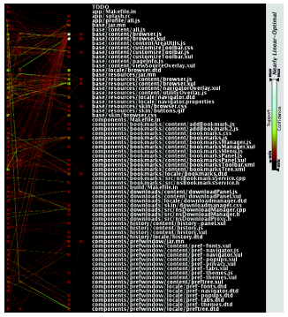
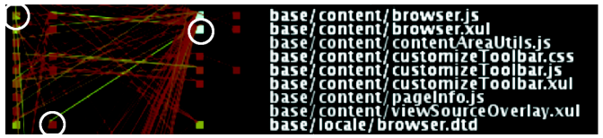
Case Study: MOZILLA
MOZILLA archive contains more than 77000 files.
We use data mining to extract rules from the MOZILLA CVS archive and applied techniques above.
Parallel Coordinates View of MOZILLA
And its enlarged area

Slide 26
Conclusion
1. Visual representations can make the process of understanding the “invisible” software easier.
2. It’s important to use Case Studies in research.

