Slide 1
Mile stone 2 report
Anh Phan Nguyen (apn15@pitt.edu)

Slide 2
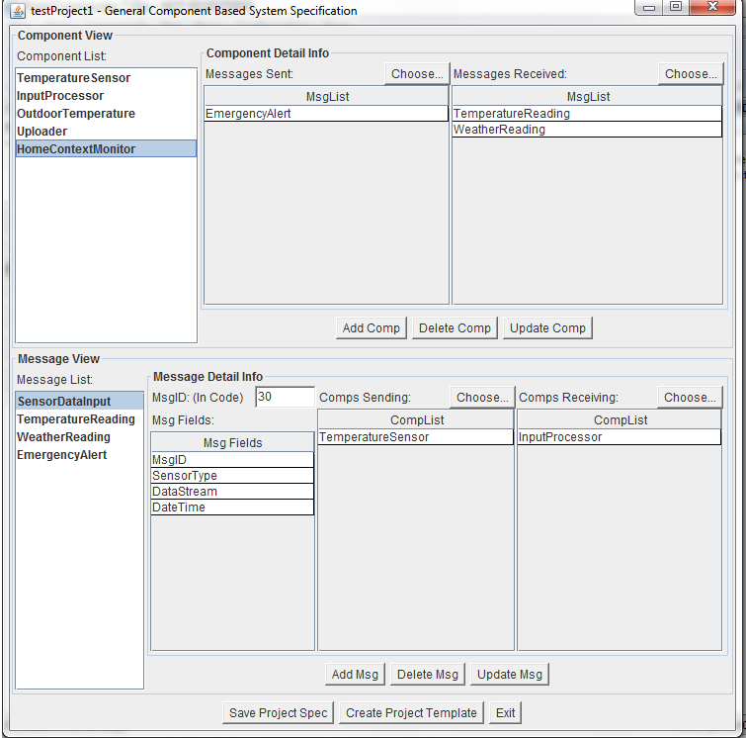
Create/recreate the project template

Slide 3
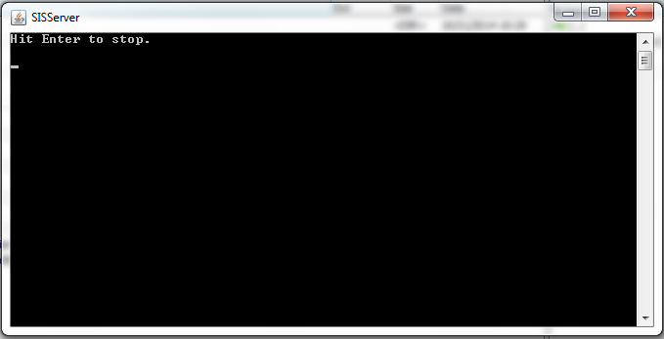
Start SIS server.

Slide 4
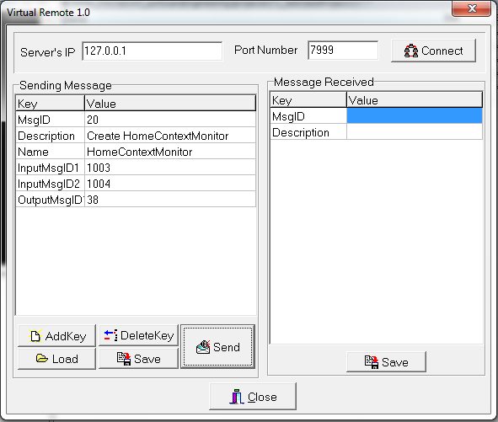
Send MsgID 20 to SIS.
Will get response after the module is created.

Slide 5
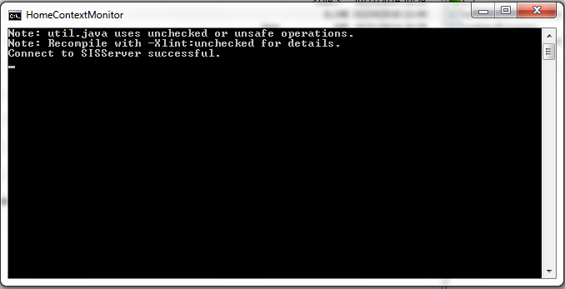
Start the modules of components.

Slide 6
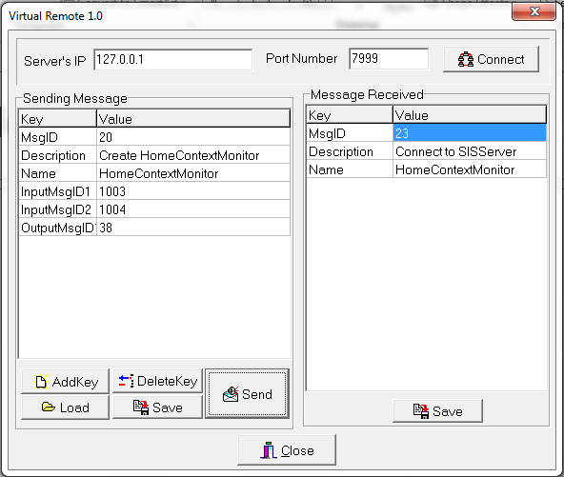
SIS returned MsgID 23 to prjRemote

Slide 7
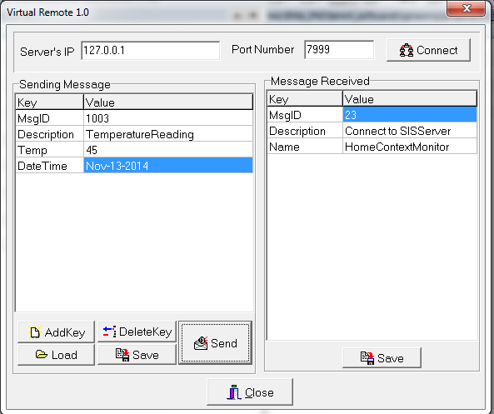
Simulate by sending Msg ID 1013 to HomContextMonitor component

Slide 8
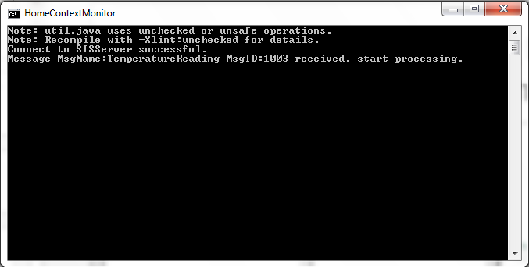
Msg received by HomeContextMonitor component

