Slide 1
CS 2310 Course Project
Qiao Zhang

Slide 2
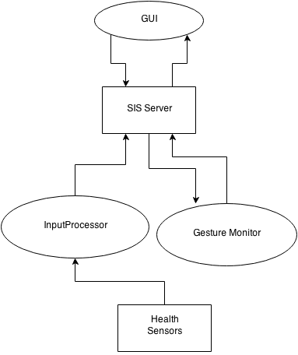
System Overview
Motivation: To detect static and dynamic gestures as a way to convey information. To be more specific, to provide the users a natural way to interact with the health care system.
Interaction: The Kinect Sensor generates the raw input; the Input Processor reads the raw input and encodes the raw input file into a representation
of the gestures; the Input Processor sends the file to the SIS Server; The SIS Server receives the message and sends it to the Gesture Monitor; the Gesture Monitor reads the file and classifies the gesture; if the gesture is recognized as a request from the user, the Gesture Monitor will send the SIS Server the corresponding message.
System Diagram

Slide 3
Messages
MSGID20 Description: Create KinectMonitor Component
<Msg>
<Head>
<MsgID>20</MsgID>
<Description>Create Uploader Component</Description>
</Head>
<Body>
<Item>
<Key>Passcode</Key>
<Value>****</Value>
</Item>
<Item>
<Key>SecurityLevel</Key>
<Value>3</Value>
</Item>
<Item>
<Key>Name</Key>
<Value>KinectMonitor</Value>
</Item>
<Item>
<Key>SourceCode</Key>
<Value>KinectMonitor.jar</Value>
</Item>
<Item>
<Key>InputMsgID 1</Key>
<Value>43</Value>
</Item>
<Item>
<Key>OutputMsgID 1</Key>
<Value>38</Value>
</Item>
<Item>
<Key>Component Description</Key>
<Value>
Process the (mock up) data from the Kinect sensor
</Value>
</Item>
</Body>
</Msg>

Slide 4
Messages
MSGID43 Description: Create KinectMonitor Component
<Msg>
<Head>
<MsgID>20</MsgID>
<Description>Create Uploader Component</Description>
</Head>
<Body>
<Item>
<Key>Passcode</Key>
<Value>****</Value>
</Item>
<Item>
<Key>SecurityLevel</Key>
<Value>3</Value>
</Item>
<Item>
<Key>Name</Key>
<Value>KinectMonitor</Value>
</Item>
<Item>
<Key>SourceCode</Key>
<Value>KinectMonitor.jar</Value>
</Item>
<Item>
<Key>InputMsgID 1</Key>
<Value>35</Value>
</Item>
<Item>
<Key>OutputMsgID 1</Key>
<Value>38</Value>
</Item>
<Item>
<Key>Component Description</Key>
<Value>
Process the (mock up) data from the Kinect sensor
</Value>
</Item>
</Body>
</Msg>

Slide 5
Messages
MSGID43 Description: Alert Message
<Msg>
<Head>
<MsgID>38</MsgID>
<Description>User Gesture Alert</Description>
</Head>
<Body>
<Item>
<Key>Gesture Command</Key>
<Value>Water Delivery</Value>
</Item>
<Item>
<Key>Alert Type</Key>
<Value>Non-emegency Alert</Value>
</Item>
<Item>
<Key>Name</Key>
<Value>Kinect Monitor</Value>
</Item>
<Item>
<Key>DateTime</Key>
<Value>Sat Feb 27 18:10:20 EST 2010</Value>
</Item>
</Body>
</Msg>
MSGID43 Description: Alert Message
<Msg>
<Head>
<MsgID>38</MsgID>
<Description>User Gesture Alert</Description>
</Head>
<Body>
<Item>
<Key>Gesture Command</Key>
<Value>Patient Lying on Ground</Value>
</Item>
<Item>
<Key>Alert Type</Key>
<Value>Emegency Alert</Value>
</Item>
<Item>
<Key>Name</Key>
<Value>Kinect Monitor</Value>
</Item>
<Item>
<Key>DateTime</Key>
<Value>Sat Feb 27 18:10:20 EST 2010</Value>
</Item>
</Body>
</Msg>

Slide 6
Messages
MSGID20 Description: Kill Component
<Msg>
<Head>
<MsgID>22</MsgID>
<Description>Kill Component</Description>
</Head>
<Body>
<Item>
<Key>Passcode</Key>
<Value>****</Value>
</Item>
<Item>
<Key>SecurityLevel</Key>
<Value>3</Value>
</Item>
<Item>
<Key>Name</Key>
<Value>KinectMonitor</Value>
</Item>
<Item>
<Key>SourceCode</Key>
<Value>KinectMonitor.jar</Value>
</Item>
</Body>
</Msg>

Slide 7
Scenarios
KinectMonitor reads from the Kinect sensor
The component generates corresponding alert messages
Then the component sends the messages to the GUI

Slide 8
Other
References
Two Java libraries for kinect:
J4K: http://research.dwi.ufl.edu/ufdw/j4k/
Jnect: https://code.google.com/a/eclipselabs.org/p/jnect/

