Slide 1
Dog Query by photo
MS1
Wen-Chyi Lin
CS2310 Software Engineering

Slide 2

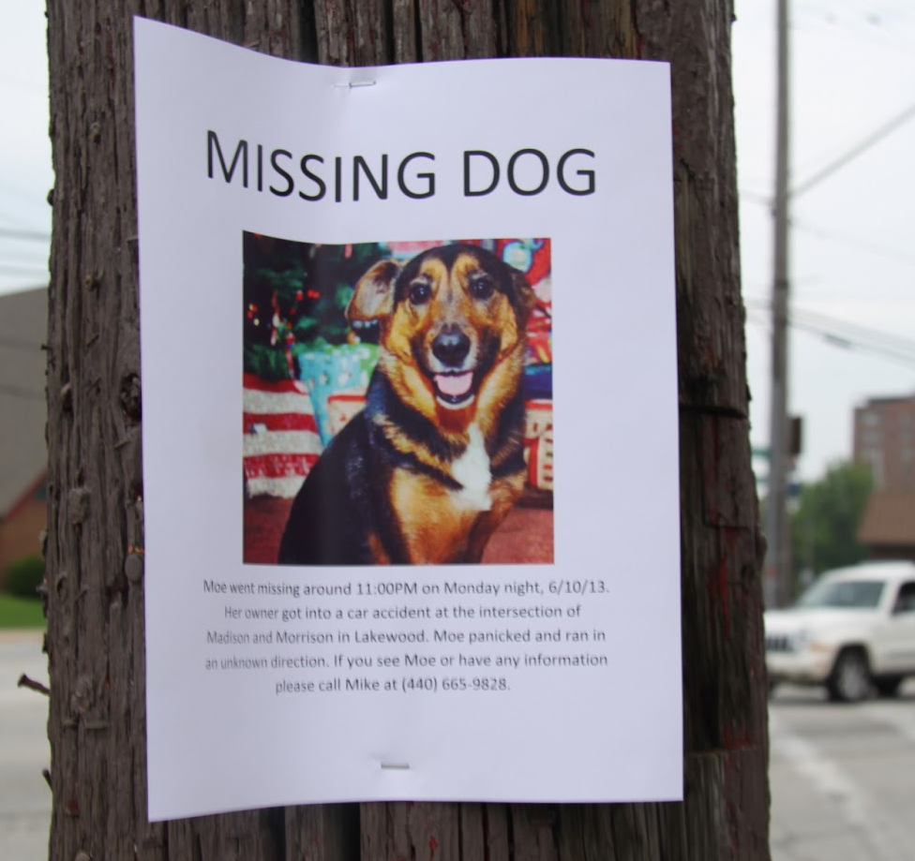
motivation
“Never express yourself more clearly than you are able to think” by Niels Bohr. However, there are times and situations we imagine what we desire, but are unable to express it in precise wording.
Type-M Functional Dependencies (MFDs) can assist to organize digital archives (video, image, sound, …) by their visual or auditory similarities (patterns).
Using a photo to retrieve the dog from the multimedia database will be helpful for pet care as well as finding lost dogs through street surveillance cameras.

Slide 3
The System
Universal
Interface
M31
M32
Video Sensor
DogRec
Monitor
SIS Server
GUI

Slide 4
Messages
Gui
DogRecMonitor
MsgID:20 | Description: Create GUI Component
Variables: Passcode: **** SecurityLevel: 3 Name: GUI SourceCode: Gui.jar InputMsgID 1: 1002 (Dog Data Stream) OutputMsgID 1: 1001 (DogRec Monitor Enable) OutputMsgID 2: 22 (Kill Component) Component Description: GUI displays the vital messages and manages SIS
MsgID:20 | Description: Create DogRec Monitor Component
Variables: Passcode: **** SecurityLevel: 3 Name: DogRecMonitor SourceCode: DRM.jar InputMsgID 1: 1001 (DogRec Monitor Enable) OutputMsgID 1: 1002 (Dog Data Stream) Component Description: DogRec Monitor checks for dog breed on the queried photo and generates a message when one is found.

Slide 5
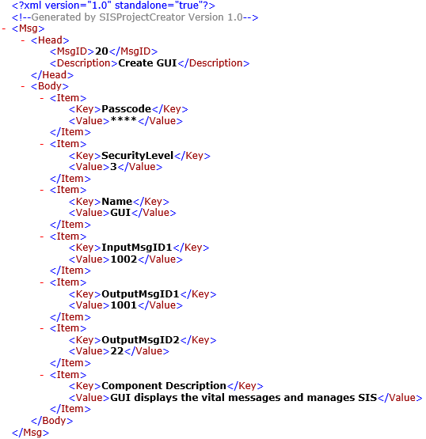
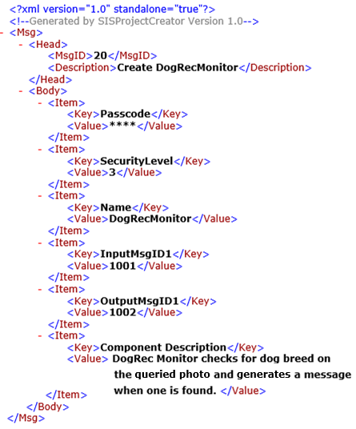
Messages
Gui
DogRecMonitor

Slide 6
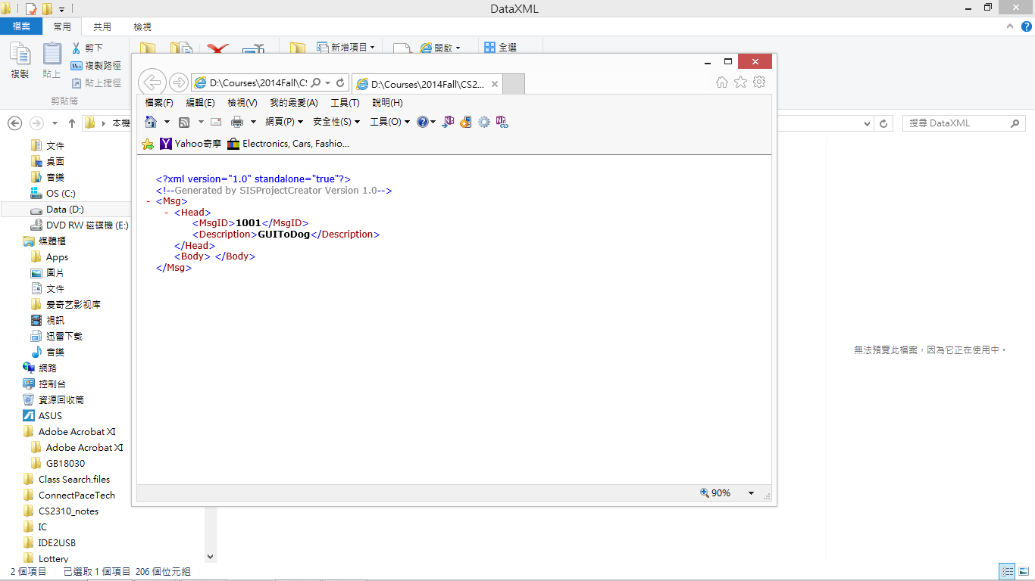
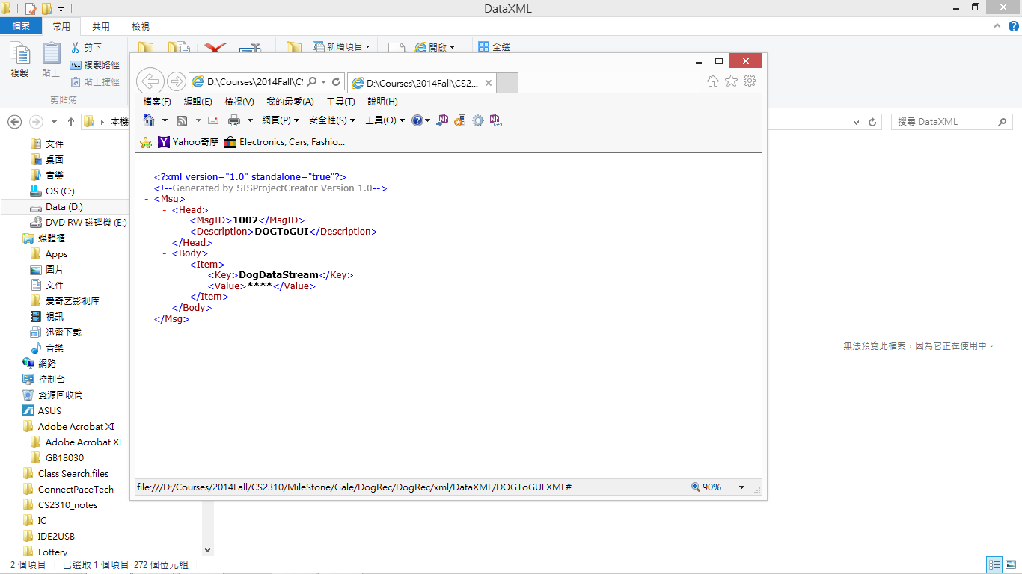
Messages
GUIToDog
DogToGUI

Slide 7

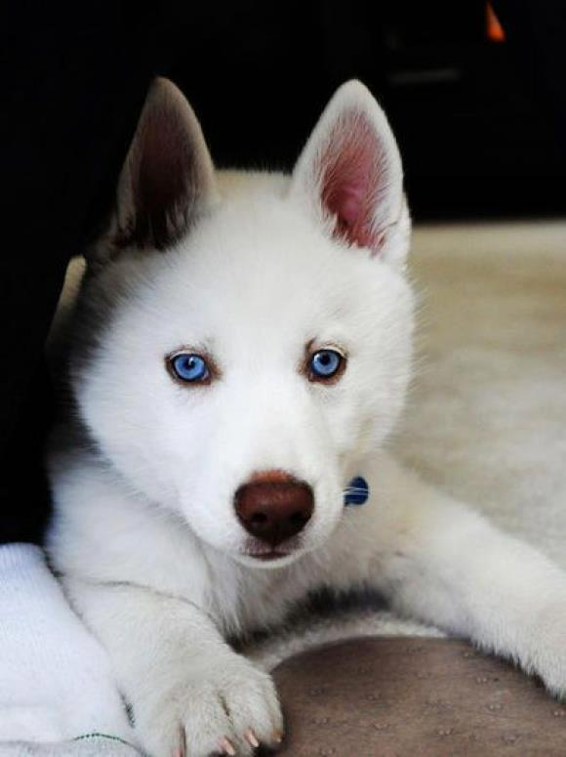



The Scenario
DogRec
Monitor
Msg: GUIToDog
Msg: DogToGUI
User
GUI
Msg: GUIToDog
Query results
SIS Server
Msg: DogToGUI

Slide 8
Method and Distance function
screen response
Dog Photo Query
Haar cascade classifier
Object Detect
Distance Function
EigenFace(PCA)
FisherFace(LDA)
LBPH
Features Extraction
DB
User
Find Dog Type

Slide 9





Intermediate results
Haar cascade classifier
EigenFace(PCA)
FisherFace(LDA)
Local Binary Patterns Histograms (LBPH)
Stanford Dogs Dataset
Notes:
LBPH: Select discriminative histograms from a pool which is obtained by extracting the LBP histograms by shifting and scaling
a local window over pairs of intra-dog and inter-dog images.

Slide 10
References
Datta, Ritendra, et al. "Image retrieval: Ideas, influences, and trends of the new age." ACM Computing Surveys (CSUR) 40.2, 2008.
Shi-Kuo Chang; Deufemia, V.; Polese, G.; Vacca, M., "A Normalization Framework for Multimedia Databases," Knowledge and Data Engineering, IEEE Transactions on , vol.19, no.12, pp.1666,1679, Dec. 2007.
Paul Viola and Michael J. Jones. Rapid Object Detection using a Boosted Cascade of Simple Features. IEEE CVPR, 2001.
Belhumeur, Peter N., João P. Hespanha, and David Kriegman. "Eigenfaces vs. fisherfaces: Recognition using class specific linear projection." Pattern Analysis and Machine Intelligence, IEEE Transactions on 19.7 (1997): 711-720.
Ahonen, Timo, Abdenour Hadid, and Matti Pietikainen. "Face description with local binary patterns: Application to face recognition." Pattern Analysis and Machine Intelligence, IEEE Transactions on 28.12 (2006): 2037-2041.
http://docs.opencv.org/trunk/modules/contrib/doc/facerec/tutorial/facerec_video_recognition.html#aligning-face-images
http://vision.stanford.edu/aditya86/ImageNetDogs/

