Slide 1
MileStone1
Thermometer SIS
Wei Guo

Slide 2
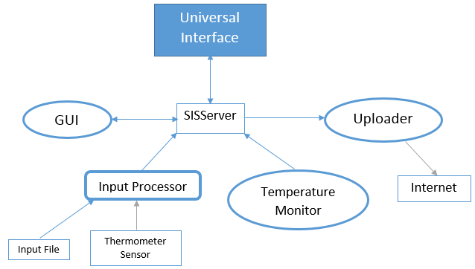
System Overview
Goal: Help senior citizen form thermometer data, and warning the abnormal thermometer.
Input processor collects sensor data, then sends the related data to Temperature Monitor.
The Temperature Monitor checks condition and sends alert message to server. Server sends the alert message to Uploader.
Uploader should upload the alert message through the Internet. In this case, the uploader also updates the GUI.
*Read Files instead of reading the real Thermometer Sensor.
*Upload alert message to GUI instead of putting it to real Internet.

Slide 3
Message
MsgID:20 | Description: Create GUI Component | Msg20.xml
Variables:
Passcode: **** SecurityLevel: 3 Name: (Name of created Component) SourceCode: (Source code file name of created Component) InputMsgID 1: OutputMsgID 1: Component Description:
MsgID:30 | Msg30.xml
Variables:
SensorType (Thermometer) DataStream(Temp) DateTime (time stamp)
MsgID:31 |  | Msg31.xml
Variables:
DataStream (blood pressure data stream) DateTime (time stamp)
MsgID:45 | Msg45.xml
Variables:
UserName (user's name such as "user001") Sex ("male" or "female") Age (age in years such as "51") Weight (weight in pounds such as "167") Height (height in inches such as "62") Diabetes ("normal", "prediabetic" or "diabetic") Heart Disease ("yes" or "no") Meal ("fasting", "before" or "after") DateTime (time stamp)
MsgID:32 | Msg32.xml
Variables:
DataStream (blood pressure data stream) Alert Type (blood pressure alert type) Name (name of component generating blood pressure alert) DateTime (time stamp)

Slide 4
Scenario
GUI interacts with the user and sends Msg 45 (user profile) containing UserName, Age, Sex, Weight, Height and medical conditions, to Uploader and all Monitors.
Thermometer sensor sends Msg 30 (sensor data input, input file) to InputProcessor, which parses the data.
Input Processor sends Msg 31 (temperature reading) to Temperature Monitor, which checks for abnormality. There will be normal and abnormal states. We check if temperature is over 37.8°C or below 35°C to generate an alert.
Temperature Monitor sends Msg 32 (temperature alert) to GUI, which displays the data.
Temperature Monitor sends Msg 32 (temperature alert) to Uploader, which uploads patient's UserName and medical conditions to remote database.
  Input Processor accepts Msg 30 sensor data input and produces Msg 31
  Temperature Monitor accepts Msg 45 and Msg 31 and produces Msg 32(temperature alert)
  GUI accepts Msg 32, and produces Msg 20
  Uploader accepts Msg 32 and uploads it. The uploading may not be a formatted message

Slide 5
Other
Take environment temperature in consideration. If environment temperature is too high or too low, send alert to user, and upload alert.
With the sensor input, we Check below conditions:
  If the temperature is in the normal range 36.8° ± 0.4 °C, do not send alert.
  If body temperature is in caution range: out of normal range 36.8° ± 0.4 °C, but between 35° and 38°C, then ask user whether he wants to send alert or not.
  If body temperature of senior citizen is in emergency range: below 35° or above 38°C, send alert directly.

