Slide 1
Milestone #1 – Project Design
Chris Thomas
CS 2310 – Software Engineering

Slide 2
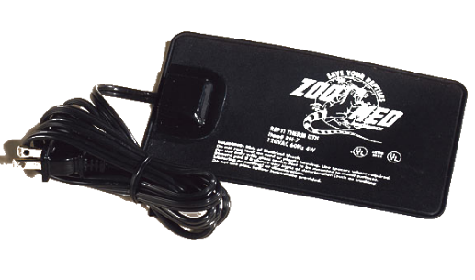
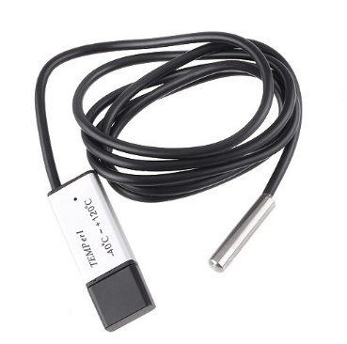
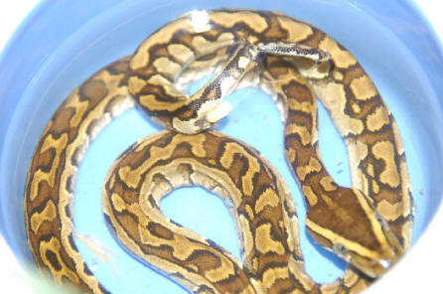
Motivation
Monitoring of pets is more complicated and time consuming than initially seems
  Pets often become neglected if not monitored
This project demonstrates monitoring a pet snake’s behavior
  Heater gets set high (around 110 degrees) – certain times of year it needs high eat and also after eating or if sick it wants high heat
    Also some heat gets lost because heater is under the tank
  If the snake doesn’t want the high heat it will sit in the water bowl or drink frequently from the water bowl
  If this is observed the heat should be adjusted, but if the heat is under 87 degrees and observed, no adjustment should be made

Slide 3
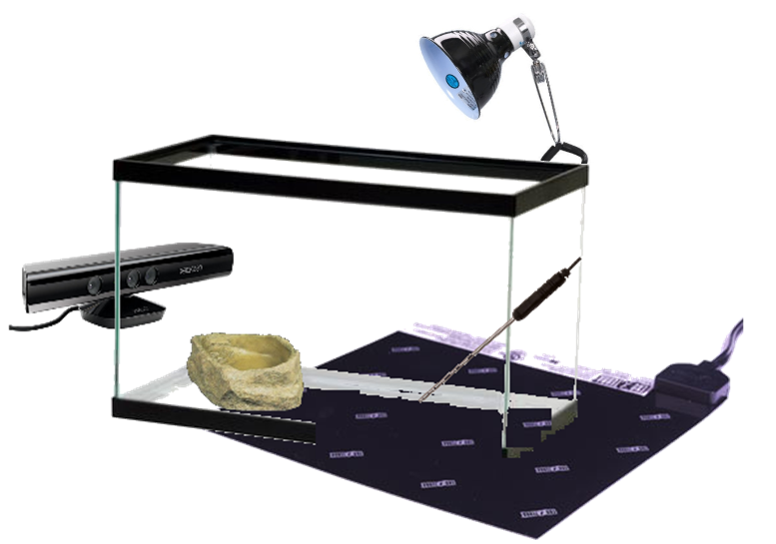
Physical System Design

Slide 4
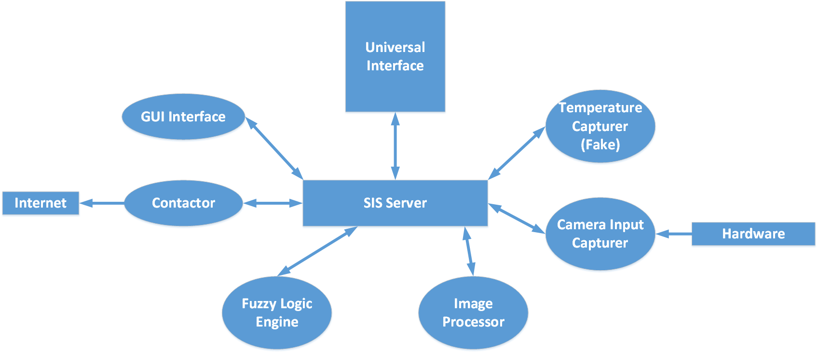
Software Design

Slide 5
Component Descriptions
Universal Interface - Any message sent from one component to another component will be displayed on the right panel. (It is for testing the system and observing all messages in SIS system).
SIS Server – Routes all messages and processes them. Uses messages Create, Kill, and Activate to create, kill, or activate components.
GUI Interface – Just an interface for specifying thresholds and rule parameters which are used by the Fuzzy Logic Engine. The GUI just stores the parameters; no logic is in the GUI component.
Contactor – Accepts a MSG 38 message and sends an ALERT e-mail to owner.
Fuzzy Logic Engine – Implements the fuzzy logic rules for determining whether a problem exists based on image and temperature data.
Temperature Capturer (Fake) – PRJREMOTE.exe will generate temperature readings or it will just read them from a file and broadcast them. We will not actually use the thermostat here. Message 31 is defined as containing temperature readings which get broadcast.
Camera Input Capturer – Captures Frames from Webcam or Kinnect and stores them for use by Image Processor. Sends MSG 33 to notify SIS of new image.
Image Processor – Receives MSG 33 and loads image of timestamp in MSG. Perform SURF Object detection to detect whether snake head is present or snake body is also present in the water bowl. Outputs message 34 with the SURF values for the snake head (drinking) and body (in bowl)
Fuzzy Logic Engine – Implements the fuzzy decision rule algorithm described in the paper I chose. If the conditions seem anomalous, MSG 38 is generated to alert user of the anomaly and that temperature is hot. Receives message 34 and message 31.

Slide 6
SIS Messages
Message 20: Used to Create Components
Message 23: Used to Connect Component to SIS server
Message 31: Temperature Reading
Message 33: Image Capture Notification
Message 34: Image Computation Values
Message 38: Alert Fired

Slide 7
Scenarios
The perceived usage scenario is the following:
  The owner adjusts the thermostat higher because the snake has just eaten. The owner uses the GUI to set the parameters to check every 10 seconds for the camera and the thermostat and threshold probabilities for the fuzzy learner. TempCap sends msg 31 every 10 seconds and CamCap sends message 33 every 10 seconds.
  CamProc accepts message 33 and performs analysis, sending message 34.
  The Fuzzy Learner accepts message 34 (probabilities) and message 31 (temperatures).
  The fuzzy learner checks the values against the fuzzy learning model specified by the user in the GUI (which is saved to the configuration file).
  The fuzzy model may suggest unusual behavior by the snake. If it does, it broadcasts message 38 to the SIS system.
  The contactor receives message 38 and triggers an alert e-mail message with statistics included provided by the fuzzy learner in message 38.

