Slide 1
Time Automation
a visual mechanism for temporal
querying

Slide 2
Introduction
Limitations of current tool
Time Automation algorithm
Practical use of Time Automation
Examples of complex query
Conclusion

Slide 3
Introduction
What is temporal query?
  Query data according to time condition.
Example
  What is the weather look like on every Saturday of Jan, 2013?
  How many people go shopping on black Friday?
  What is the traffic condition on every afternoon from 4pm-7pm except Saturday and Sunday of 2013?
Practical use
  urban mobility analysis, social network mining…

Slide 4
Limitation of current tool
What if we use SQL to do temporal query?
  It is hard to directly formulate temporal query. For example:
  Select all facts occurred in every day between February
  24, 2010 and the second Monday afterwards (inclusive)
Other visual tools
  DynamicQuery
  TimeWheel

Slide 5
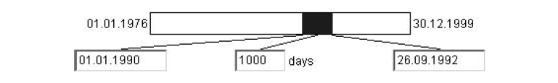
Visual Tools of temporal query
Dynamic Query
It represents the timeline as a segment in which the user selects a temporal portion.
Not designed for query involving recurrence such as “every Saturday”.

Slide 6
Visual Tools of temporal query
Time Wheel
  Designed for cyclic temporal querying It responds to the need of selecting recurring temporal events like ’every Saturday’.

Slide 7
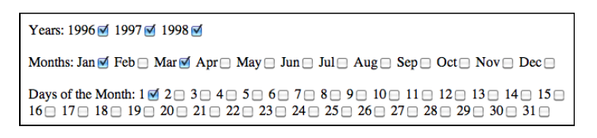
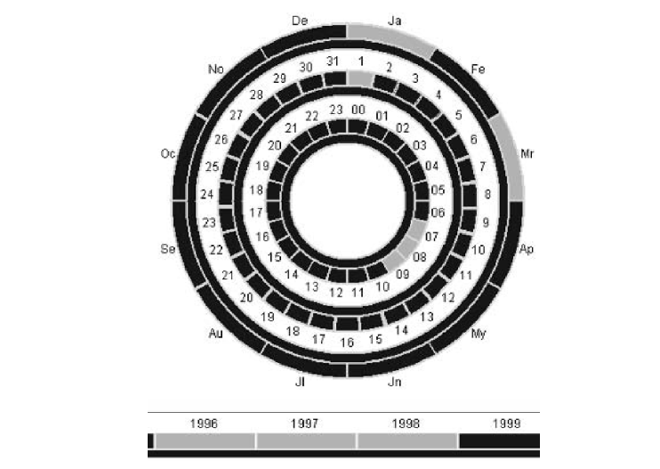
Time Wheel example

Slide 8
Time Automation
Time Automaton is a two tier mechanism formed by the temporal string and the query model.
Temporal string is the structure of how data is stored.
Query model is based on finite state machine and directed graph.

Slide 9
Temporal String
The temporal string (TS) is a sequence of words with temporal meaning.
Some words in TS represent the time when the fact happens(Anchors)
Some words represent the facts themselves.(Facts)

Slide 10
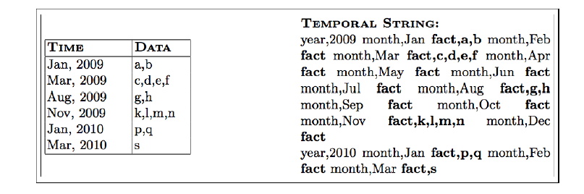
Temporal String Example
The transfer of database columns into a TS

Slide 11
Query Model
In Time Automaton, given a TS, a query is defined as a Connected Digraph.
vertices are words or expressions of the TS
arcs define which word is the next to be read
A query starts from the root and complete if reaches the last vertex or reach the end of the TS.

Slide 12
Rules of the query graph
There is one root vertex, which only has outgoing arcs.
Every vertex other than the root is labeled with an expression, which corresponds to the definition of the syntax of a word in TS.
Every arc (v,u) may have a weight value that defines the maximum number of traversals from v to u.

Slide 13
Algorithm of the query model
Start from the beginning of the TS and the root of the graph, match every word in TS with the label of the current node, if a match is found go to next node
If a fact node is reached, save it to the result set.
Query is complete when the end of TS is reached or every vertex is visited.

Slide 14
Algorithm of query model
Regular Expressions(RE)
  The word search is implemented by using regular expressions.
  Literal():match the word literally with RE. e.g. find “year 2010”
  Any():match any sequence of letters. E.g. find “every month”
  Not(exp):match any sequence except exp. E.g. find “every day except Monday”
  Fact():match any sequence prefix with fact. This is used to store the data. Any data after the word “fact” will be stored.

Slide 15
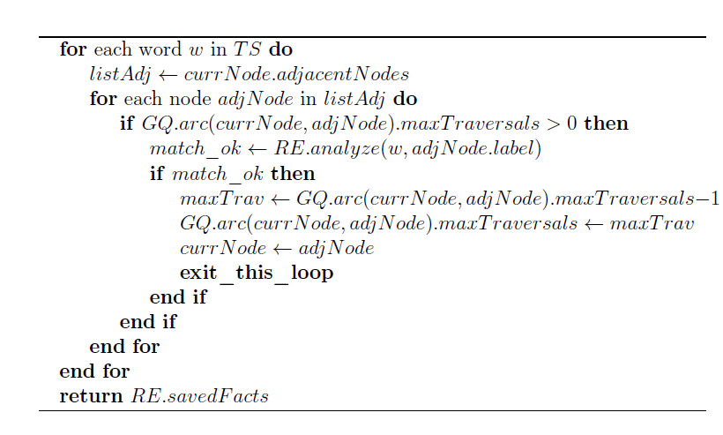
Algorithm of query model

Slide 16

Algorithm of query model
Query: find the fact happened in Jan/2010
Result: p,q

Slide 17
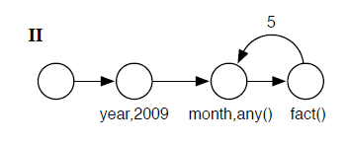
Algorithm of query model
Query: find the fact happened in the first six month in 2009
Result: a,b,c,d,e,f

Slide 18
Practical Applicaiton
Urban Mobility Analysis(a Portugal project)
  Urban planners wants to know the urban mobility affected by some economic factor.
  Question: Where will people go after they get their salary?
  Query: Select mobility data of the weekend immediately after the 23th day of every month( pay day in Portual)

Slide 19
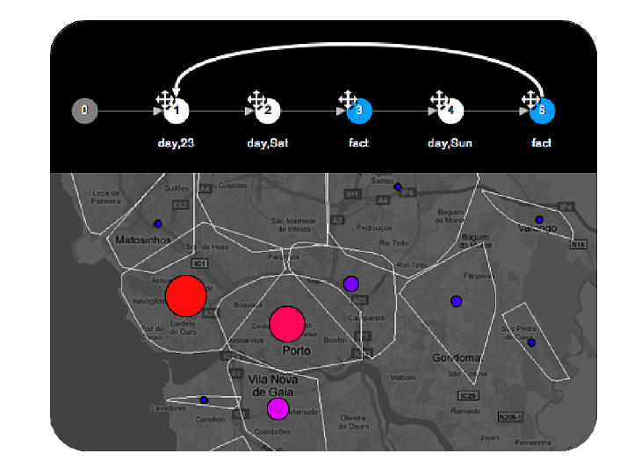
Practical Application

Slide 20
References
Time Automaton: a visual mechanism for temporal querying by Luís Certoa,, Teresa Galvãoa, José Borgesa
R. Edsall, D. Peuquet, A graphical user interface for the integration of time into GIS, in: Proceedings of the 1997 American Congress of Surveying and Mapping Annual Convention and Exhibition, Seattle,WA, 1997, pp. 182–189.

